Slide 1
Lab 1: Introduction to QtSpim
Course: CIS 216 Lab- Computer Organization

Slide 2
MIPS Assembly Language Programming Using QtSpim
Learning Objectives
By the end of this lab, students will be able to:
  Load and run a MIPS program in QtSpim
  Identify registers, memory, and instructions
  Explain how data moves: memory -> registers-> ALU->memory

Slide 3
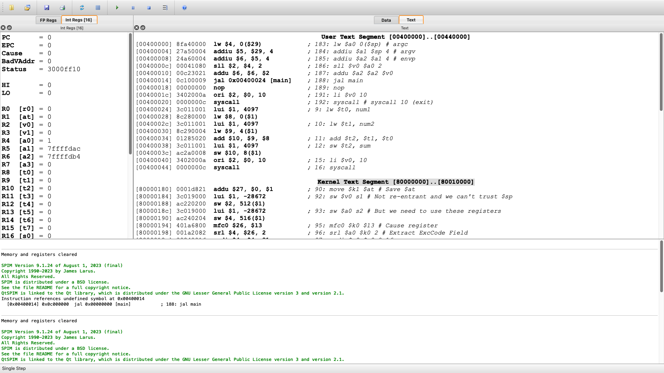
MIPS Assembly Language Programming Using QtSpim
Int Regs holds the integers, addresses (your program)
FP Regs holds the Floating-point values (FP programs)
Data holds variables (your program)
Text holds instructions (your program)
Portion of the text segment for user programs
Contains:
Startup code and your main function
Reserved for OS (kernel code)
Contains:
syscall handlers, exception handling
Console-> messages and program output

Slide 4
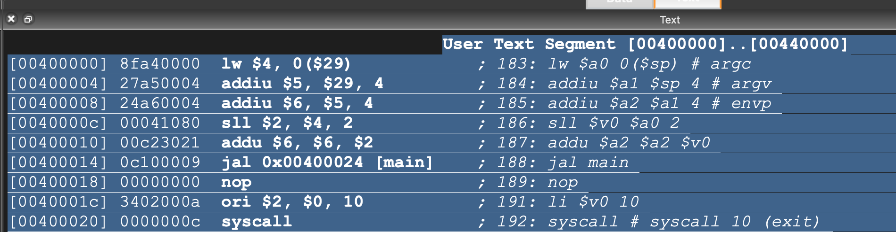
MIPS Assembly Language Programming Using QtSpim
Ignore this: This is the startup code before the main
Startup code
Purpose:
It mimics what a real operating system does:
Load argc, argv,envp
Calls main
Shutdown after main returns

Slide 5
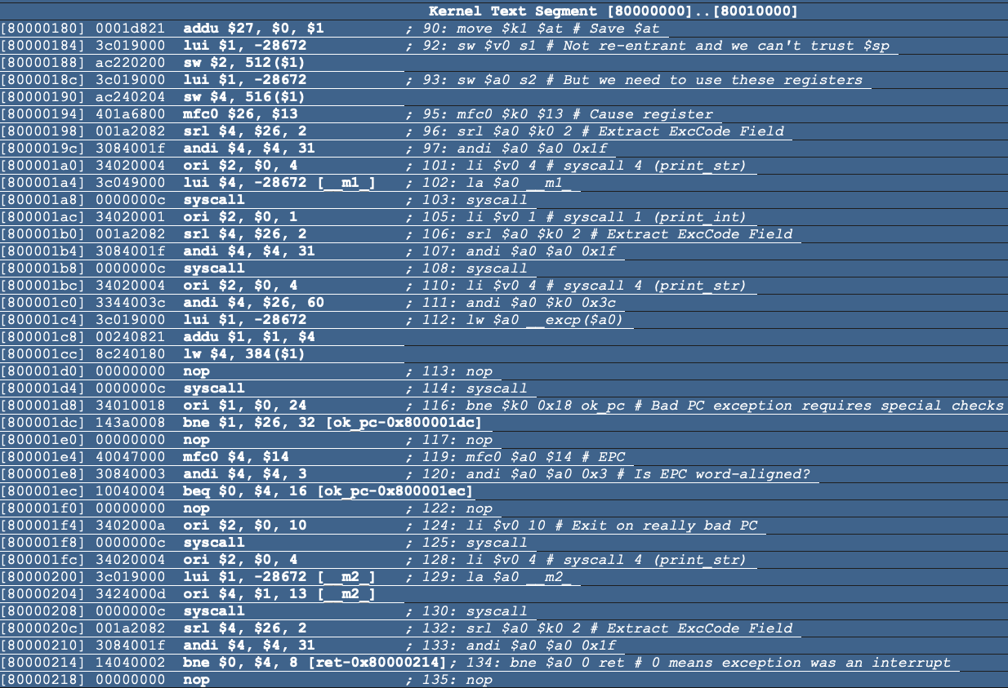
MIPS Assembly Language Programming Using QtSpim
Ignore this: This is the kernel code after the main
Purpose:
Handles syscalls, exceptions, and interrupts
Inserted by QtSpim, not written by you
Runs in kernel mode
Saves registers $k0,$k1,$at,$v0,$a0
Check for syscall, interrupt or bad pc
Perform requested service
Print string, print integer, exit
Restores registers
Returns user code or terminate

Slide 6
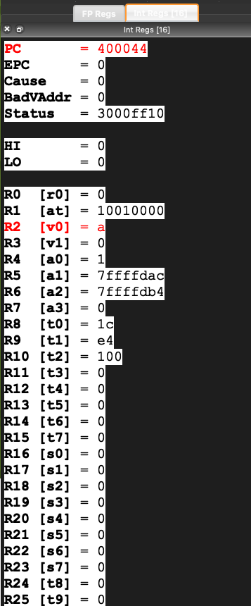
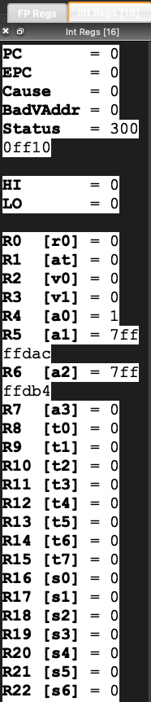
MIPS Assembly Language Programming Using QtSpim
Syscall; exit
0xa (hex) = 10 ; exit syscall

Slide 7
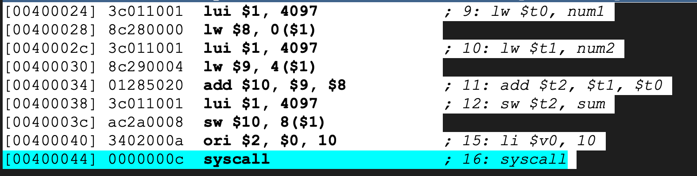
MIPS Assembly Language Programming Using QtSpim
QtSpim executes machine ready code
My Source code
Disassembly view: shows the instruction in memory
The 32 bit machine code (the bits the CPU executes)
[00400044] => the address(PC) of that instruction in memory

Slide 8
Reading QtSpim’s Text Segment (Address vs Instruction)
Address (PC): 0x00400024 → where the instruction lives in memory
Machine code: 0x3c011001 → the 32-bit bits stored at that address
Decoded assembly: lui $1, 4097 → human-readable form of the same bits
Key idea
The CPU fetches and executes machine code.
QtSpim decodes machine code into assembly so humans can read it.
Why 0x3c011001 is 32 bits
  8 hex digits × 4 bits per hex digit = 32 bits
  Binary (grouped):
  0011 1100 0000 0001 0001 0000 0000 0001
Memory is byte-addressed
  1 address = 1 byte
  1 MIPS instruction = 4 bytes ⇒ instruction addresses usually increase by 4:
  …20, …24, …28, …2C

Slide 9
MIPS Assembly Language Programming Using QtSpim
Write a MIPS assembly program that loads two integers from memory, adds them, and stores the result back into memory
Tells the assembler that what follows are
variables/constants stored in memory (RAM).
Example: var_a: .word 40 reserves 4 bytes and
initializes it to 40.
Initial data (in memory)
  Num1 = 28
  Num2 = 228
  Sum = 0
Execution (main)
  Loads num1 into $t0
  Loads num2 into $t1
  Adds them: $t2 = $t1 + $t0
Stores the result into sum
Exits the program
Final result
  Sum = 256
.data
num1: .word 28
num2: .word 228
sum: .word 0
.text
.globl main
main:
lw $t0, num1 # load num1 into $t0
lw $t1, num2 # load num2 into $t1
add $t2, $t1, $t0 # $t2 = num2 + num1
sw $t2, sum # store result into sum
li $v0, 10 # exit
syscall
Tells the assembler that what follows are instructions
(machine code) stored in the program’s code area.
Makes the label main visible outside this file
(exported symbol). QtSpim uses it to find where
your program starts.
This program loads two values from memory, adds them using the ALU, stores the result back in memory, and exits.

Slide 10
QtSpim Syscall Codes
Syscall code ($v0$) | Service
1 | print_int
4 | print_string
5 | read_int
8 | read_string
10 | exit
11 | print_char
12 | read_char
17 | exit2
Printing on console:
  move $a0, $t2 #value to print
  li $v0, 1 #print_int
  syscall
li $a0, 10 #newline character '\n'
li $v0, 11 #print_char
syscall
#print_string (syscall 4): print msg
la $a0, msg
li $v0, 4
syscall

Slide 11
Student Task
Task1: Replace num1: .word 5
num2: .word 7
Load and run the program in QtSpim
Step through instructions until sw executes
Verify result
Task 2: Add 0xFFFFFFFF and 0x80000000

Slide 12
Hexadecimal Representation
Hexa | Decimal | Binary
0 | 0 | 0000
1 | 1 | 0001
2 | 2 | 0010
3 | 3 | 0011
4 | 4 | 0100
5 | 5 | 0101
6 | 6 | 0110
7 | 7 | 0111
8 | 8 | 1000
9 | 9 | 1001
A | 10 | 1010
B | 11 | 1011
C | 12 | 1100
D | 13 | 1101
E | 14 | 1110
F | 15 | 1111
num1: .word 5
num2: .word 7
Verify the result by observing the hexadecimal values in the register
Sum = 12
Register | Hex | Decimal | Mean
$t0 | 0x1c | 28 | num1
$t1 | 0xe4 | 228 | num2
$t2 | 0x100 | 256 | sum
$t0 | 0x5 | 5 | num1
$t1 | 0x7 | 7 | num2
$t2 | 0xc | 12 | sum

Slide 13
How to Identify Registers, Memory & Instructions
Define in the .data section
  .data
  num1: .word 28
  num2: .word 228
  sum: .word 0
Memory -> these values live in the memory not in the CPU
Shown in int Regs ($t0, $t1, $t2, etc)
  lw $t0, num1 # load memory -> register
  lw $t1, num2
Registers -> temporarily holds values for computation
Shown in the Text/User Text Segment
  add $t2, $t1, $t0
Instructions -> tells the CPU what operation to perform

Slide 14
How Data Moves (Step-by-Step)
Data is loaded from memory into registers, processed by the ALU, and stored back into memory
Memory -> register
  lw $t0, num1 # $t0 =28
  lw $t1, num2. #$t1 = 228
Data is loaded from memory into registers
CPU can’t compute directly on memory
Registers -> ALU
add $t2, $t1, $t0
ALU adds register values and stores
results in another register ($t2 = 256)
Registers -> Memory
Sw $t2, sum
Result is written back to memory

Slide 15

PC Path (Fetch → Next Instruction)
PC (Program Counter): Holds the address of the next instruction to fetch.
Normal flow (no branch/jump)
  Fetch instruction at address in PC (e.g., PC = 0x00400020)
  Execute that instruction
  Update PC: PC = PC + 4
    Next instruction address: 0x00400024
If there is a branch/jump
  Instead of PC + 4, PC becomes the target address:
    beq/bne (taken) → PC ← branch_target
    j/jal → PC ← jump_target
PC is like your “current page pointer”: usually goes to the next page (+4), unless you “jump” to a different page (branch/jump).

Slide 16
Int Regs: CPU state (special registers + the 32 general-purpose registers)
Special registers (top block)
  PC: Program Counter: address of the next instruction to fetch/execute (0x00400044 here).
  EPC: Exception Program Counter where the CPU was when an exception occurred (0 if none yet).
  Cause / BadVAddr / Status: exception/interrupt bookkeeping registers (treat as OS/exception machinery for now).
  HI / LO: used by multiply/divide instructions (mult/div) to hold results (0 here because you haven’t used them).

Slide 17
The 32 general-purpose registers (R0–R31)
R0 [$zero] = 0: always 0 (hardware-enforced).
R1 [$at]: “assembler temporary” used internally by the assembler ($at = 0x10010000 often holds a base address for data).
R2–R3 [$v0,$v1]: return values / syscall code.
$v0 = a means 0xA (decimal 10): syscall ->exit.
R4–R7 [$a0–$a3]: function arguments (QtSpim also uses these for program startup args).
R8–R15 [$t0–$t7]: temporaries (caller-saved).
R16–R23 [$s0–$s7]: saved registers (callee-saved).
R28 [$gp]: global pointer (used for some global data conventions).
R29 [$sp]: stack pointer (0x7ffffe00 here).
R31 [$ra]: return address (set by jal; here 0x00400018).

Slide 18
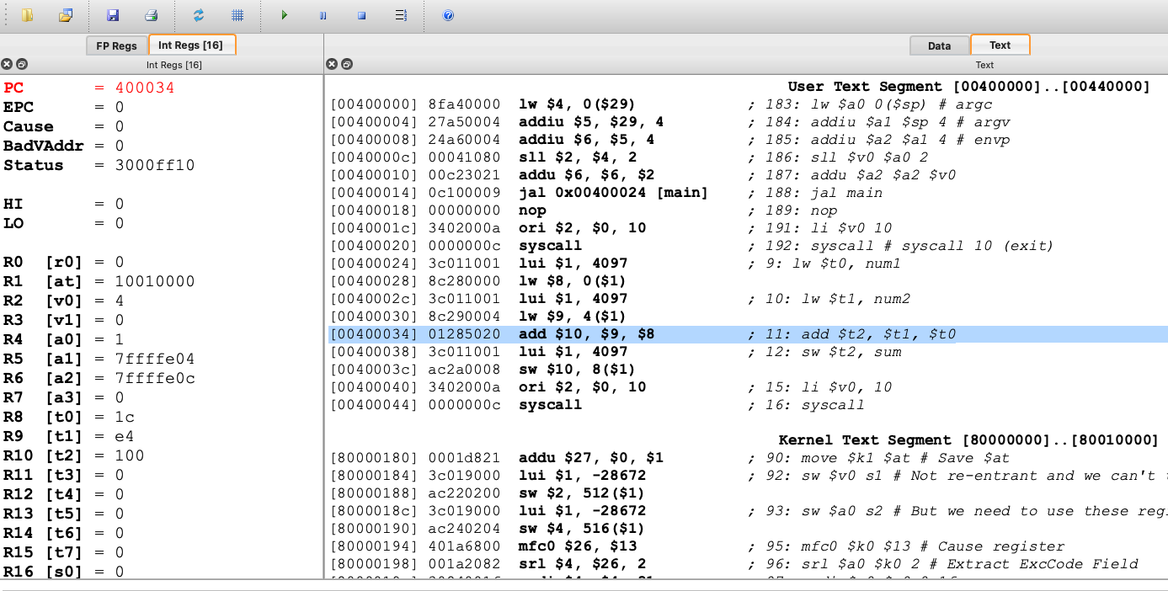
Task: Identify the following
Program
counter
Memory
address
32 bit machine code
Readable assembly code

Slide 19
32-bit machine code
The CPU executes
This is the bits the CPU executes
  Example: 01285020 =>0x01285020
  QtSpim decodes it to => add $t2, $t1, $t0
How does this=> 0x01285020 mean this=> add $t2, $t1, $t0
The Human reads
Split R-function layout
OP | rs | rt | rd | shamt | funct
6 | 5 | 5 | 5 | 5 | 6
op = 000000 = 0 → R-format
rs = 01001 = 9 → $t1
rt = 01000 = 8 → $t0
rd = 01010 = 10 → $t2
shamt = 00000 = 0 (not used for add)
funct = 100000 = 32 = 0x20 → add
0x01285020 =
000000 01001 01000 01010 00000 100000
Is decoded to add $t2, $t1, $t0

Slide 20
Common funct codes(R-format: op=0)
Instruction | funct (bin) | funct (hex) | funct (dec)
add | 100000 | 0x20 | 32
addu | 100001 | 0x21 | 33
sub | 100010 | 0x22 | 34
and | 100100 | 0x24 | 36
or | 100101 | 0x25 | 37
slt | 101010 | 0x2A | 42
jr | 001000 | 0x08 | 8
syscall | 001100 | 0x0C | 12
Register (R) format is used for register – register operations (rs, rt, rd)
Example: add $t2, $t1, $t0

Slide 21
Common opcodes (I/J-format)
Instruction | opcode (bin) | opcode (hex) | opcode (dec)
lw | 100011 | 0x23 | 35
sw | 101011 | 0x2B | 43
beq | 000100 | 0x04 | 4
bne | 000101 | 0x05 | 5
addi | 001000 | 0x08 | 8
andi | 001100 | 0x0C | 12
ori | 001101 | 0x0D | 13
lui | 001111 | 0x0F | 15
j | 000010 | 0x02 | 2
jal | 000011 | 0x03 | 3
Immediate (I) format is used when you need a constant, branch, etc Example addi $t0, $t0, 5
Jump (J) format is used for far jumps to a target label. Example: j label, jal func

Slide 22
QtSpim
Arithmetic: add, sub, addi
Logical: and, or, xor, nor, andi, ori
Memory: lw, sw
Control flow: beq, bne, j, jal, jr
Shift: sll, srl

