Slide 1

Africa Doesn't Need More Traders.
Africa Needs Builders.
Building Real Crypto & Fintech Infrastructure in Africa
Onyeuba Ebuka GodwinCEO & Founder, AcedX
Delta State University, Abraka • 27 February 2026

Slide 2
The Reality of Web3 in Africa
Most people in Africa are playing the wrong game. They're chasing token prices whilst ignoring the real opportunity: building infrastructure that outlasts the hype.
Speculation vs Infrastructure
Why Most People Lose
Buying low, selling high is not building. Infrastructure creates value regardless of market conditions.
No revenue model, no real problem being solved, no operational discipline. Just hope and volatility.
Hype Cycles
The Real Opportunity
Every bull run creates a generation of paper millionaires. Then reality hits. The pattern repeats.
Building payment rails, identity systems, and financial infrastructure that serves real users every single day.

Slide 3
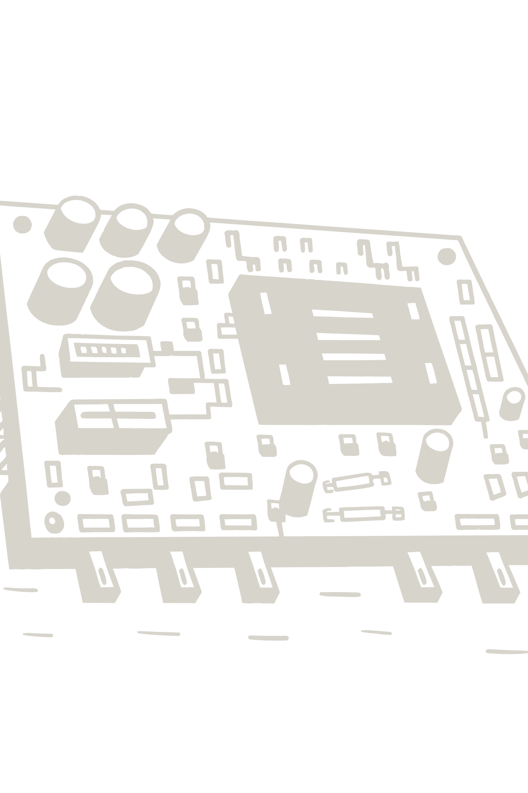
"If crypto disappeared tomorrow, what problem are you still solving?"
This is the question that separates builders from traders. Most Web3 projects collapse under this scrutiny. Infrastructure companies survive because they solve problems that exist regardless of market conditions.

Slide 4
My Journey Building AcedX
I didn't start with a grand vision. I started with a problem: Nigerian fintechs couldn't move money reliably. I saw an opportunity to fix that. What followed was five years of brutal lessons.
Why I Started
1
Watched too many Nigerian businesses fail because they couldn't settle payments. Saw the gap between promise and reality in fintech.
2
Early Mistakes
Assumed technology was the problem. Learned that trust and operations matter more. Burned through capital fixing avoidable errors.
Trust Challenges
3
Convincing users to trust a new Nigerian fintech in 2021 felt impossible. Every hack and scam made our job harder.
4
Liquidity Struggles
Months where we barely had enough capital to process withdrawals. Learned cashflow discipline the hard way.
The Pivot
5
Transitioned from survival mode to structured company. Hired properly. Built compliance. Created repeatable processes.

Slide 5
What It Really Takes to Build in Africa
Forget motivational fluff. These are the five non-negotiables that separate infrastructure builders from hype chasers. Each one nearly broke us before we got it right.
01
02
03
Trust Infrastructure
Distribution > Idea
Compliance & Regulation
Build reputation through reliability, not marketing. Every successful transaction compounds trust. One failure destroys years of work.
The best product means nothing if users can't access it. Invest in distribution channels early. Relationships matter more than technology.
Start compliance conversations before you need them. Nigerian regulators move slowly but enforcement is brutal when you're unprepared.
04
05
Cashflow Discipline
Community Before Product
Revenue today beats projected revenue next quarter. Build revenue-generating features first. Survival beats ambition every single time.
Listen to users before building features. Early adopters will tell you what they need. Iterate based on real feedback, not what you think is cool.

Slide 6
Why Most Web3 Startups Fail
The pattern is predictable. Watch enough launches and you'll see the same mistakes repeated with different branding. Here's what actually kills companies.
No Real Problem
No Revenue Model
Building for the market, not for users. Chasing trends instead of solving pain points that people will pay to fix.
Assuming future revenue will materialise. Tokenomics discussions instead of monetisation strategies. Hype replaces business fundamentals.
Poor Operations
Hype-Driven Decisions
Great on stage, terrible at execution. No processes, no documentation, no repeatable systems. Everything breaks when founders aren't personally involved.
Launching features because they sound impressive, not because users need them. Prioritising media coverage over revenue. Mistaking attention for product-market fit.

Slide 7

How Students Can Start Today
Even with no money. Even with no connections. The infrastructure gap in African Web3 is massive, and you don't need capital to start contributing. Here are practical paths to real skills.
Learn Technical Skills
Product Design
Start with Solidity for smart contracts or move to backend development. Free resources exist. Build one project, deploy it, show people what you can do.
UI/UX for fintech matters. Learn Figma, study existing products, redesign them better. Portfolio beats degree when companies are hiring.
Smart Contracts
Community Management
Write, audit, deploy. Start with simple tokens, move to complex DeFi primitives. The best way to learn is to break things and fix them.
Every Web3 project needs community managers. Learn moderation, content creation, and engagement strategies. Start with small communities.
Writing & Research
Join Early Startups
Technical writing pays well. Research reports, blog posts, documentation. Clear communication is undervalued in Web3.
Equity beats salary when you're starting. Find three-person teams solving real problems. Be the first hire who outworks everyone.

Slide 8


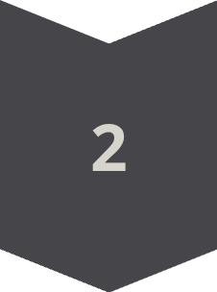
Long-Term Thinking
Most people optimise for the next six months. Builders optimise for the next six years. This changes everything about how you make decisions.
6 Months
Token launches, quick revenue, media coverage, immediate returns, hype cycles, short-term partnerships
6 Years
Revenue-generating products, user-owned infrastructure, repeatable processes, trusted brand, regulatory compliance, sustainable growth
User
Consumes services, pays fees, follows trends, limited influence, transactional relationship
Owner
Builds infrastructure, creates value, sets direction, compounds returns, owns the upside

Slide 9
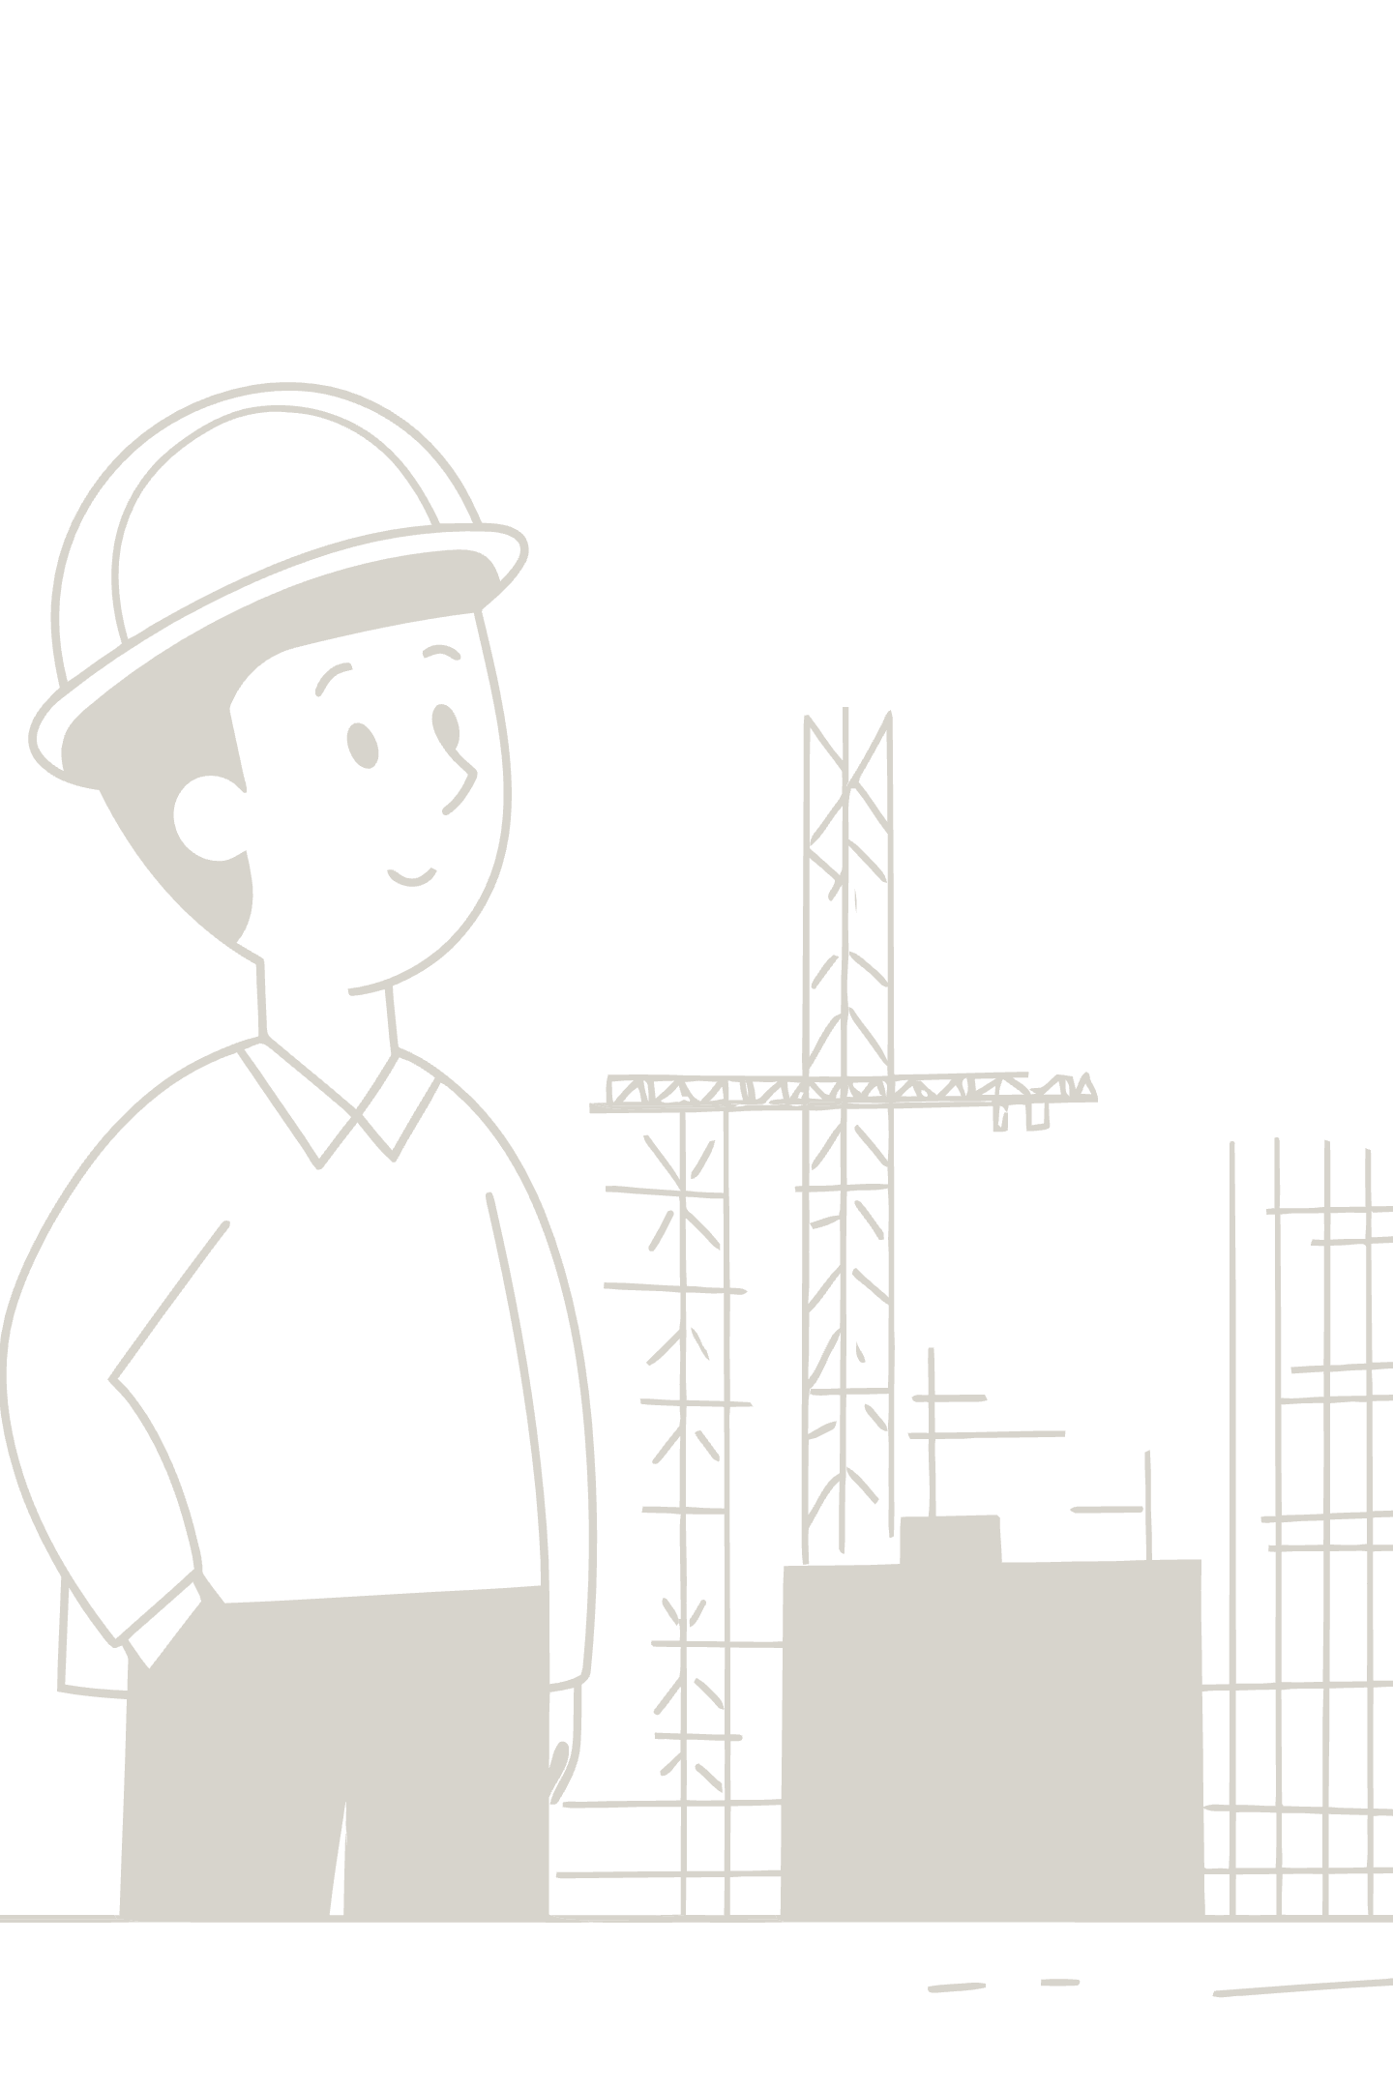
The Next Wave of Wealth
The next wave of wealth in Africa will not come from buying coins early.
It will come from owning infrastructure early.
Token speculation creates paper millionaires who lose everything when markets turn. Infrastructure ownership creates real wealth that compounds regardless of market conditions. Build exchanges that process millions of transactions. Build payment rails that move billions. Build identity systems that verify millions of users. These assets outlast bull runs and survive bear markets.
Speculators get rich and poor based on market timing. Infrastructure builders compound value through usage. The difference is whether you own the platform or just rent access to it.

Slide 10
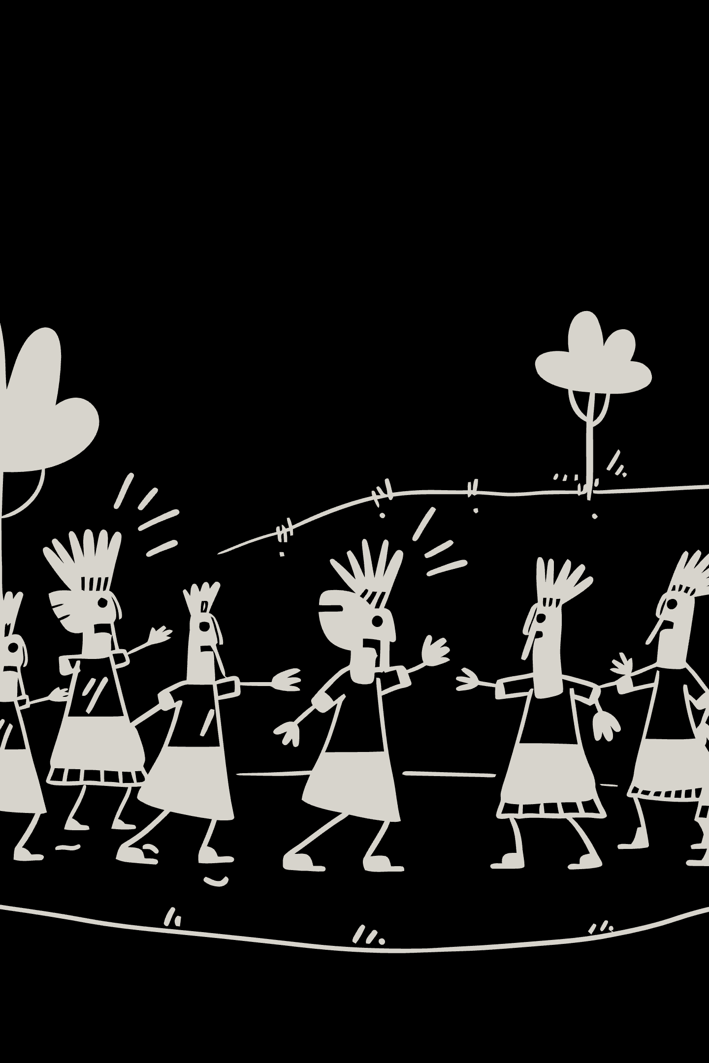
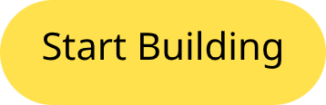
Build What Outlives the Hype.
Onyeuba Ebuka Godwin
CEO & Founder, ACEDXTRADES LTD.

