Slide 1
CPU
COMPUTER ARCHITECTURE
"Branch Prediction"
Optimization via Branchless Coding
in Data Compression Algorithms
Ertuğrul Burak MATARACI & İlker AYDIN
Students
BRANCHLESS CODING IN COMPRESSION ALGORITHMS

Slide 2
Agenda
What we'll cover today
The Problem
Objectives
01
Define the hardware bottleneck caused by branch mispredictions in standard code.
02
Explain our project goals and the analysis tools we selected.
Methodology
Results
03
Showcase our system architecture and current implementation status.
04
Present quantitative results and conduct an architectural analysis.

Slide 3
The Hardware Bottleneck
Why branch mispredictions matter
Pipeline Flush
Normal Pipeline
IF
ID
EX
MEM
WB
When a processor predicts incorrectly, its entire pipeline is flushed, resulting in a significant waste of clock cycles.
After Misprediction (FLUSH)
Branching Instructions
IF
ID
✗
✗
✗
Mispredictions made during branching instructions (such as if-else blocks) create a major performance bottleneck in computer architecture.
~20-35%
Compression Algorithms Suffer
Misprediction Rate
(Baseline)
Data compression algorithms like Run-Length Encoding (RLE) and LZW suffer heavily due to their continuous conditional checks.

Slide 4
Project Goal & Solution Approach
From conditional branches to branchless logic
🎯 PRIMARY OBJECTIVE
Identify heavy if-else blocks within algorithms and make them completely branchless.
01
02
03
Identify
Transform
Eliminate
Locate heavy if-else conditional branches in RLE and LZW compression algorithms.
Replace conditional jumps with bitwise operators (&, |, ~) for mathematical evaluations.
Remove the processor's need to make predictions and significantly reduce latency.

Slide 5
Development & Analysis Tools
Technology stack and measurement methodology
C
C Language
Developed entirely in C to maintain full control over the memory hierarchy and low-level operations.
x86
x86-64 ISA
Targeting the universal x86-64 Instruction Set Architecture for hardware-level testing and validation.
AMD
AMD uProf
Utilized to catch branch prediction errors directly at the microarchitecture level with hardware counters.

Slide 6
Performance Evaluation Metrics
How we measure hardware-level improvements
MB/s
72.21
Throughput (MB/s)
Branchless (vs 31.97)
Measures overall operational data speed. Indicates how much data the algorithm processes per second under real workload.
BMR
0%
Branch Misprediction Ratio
Target (Branchless)
Verifies at the hardware level whether our branchless algorithm actually prevents pipeline flushes. A lower ratio = fewer wasted cycles.
CPI
~2.1
Cycles Per Instruction (CPI)
Achieved (vs ~13.2)
Allows us to compare the clock cycle cost of both code segments on the processor. Lower CPI = more efficient execution.

Slide 7
System Architecture
Data flow and hardware monitoring
If-Else Logic (Baseline)
Raw Byte
Stream
ROUTER
x86-64
PMU Monitor
▶
▶
Bitwise Masking (Optimized)
The architecture processes raw byte streams by routing them through either traditional if-else logic or bitwise masking techniques. The executed x86-64 instructions are then monitored by hardware Performance Monitoring Units to generate profile reports.

Slide 8
Implementation Status & "Proof of Life"
Both implementations verified and running
Baseline RLE Implementation
Branchless RLE Implementation
✓ Complete
✓ Complete
AMD uProf Integration
524 MB Dataset Validation
✓ Active
✓ Verified
Performance Benchmarking
Architectural Analysis
✓ Measured
✓ Done

Slide 9
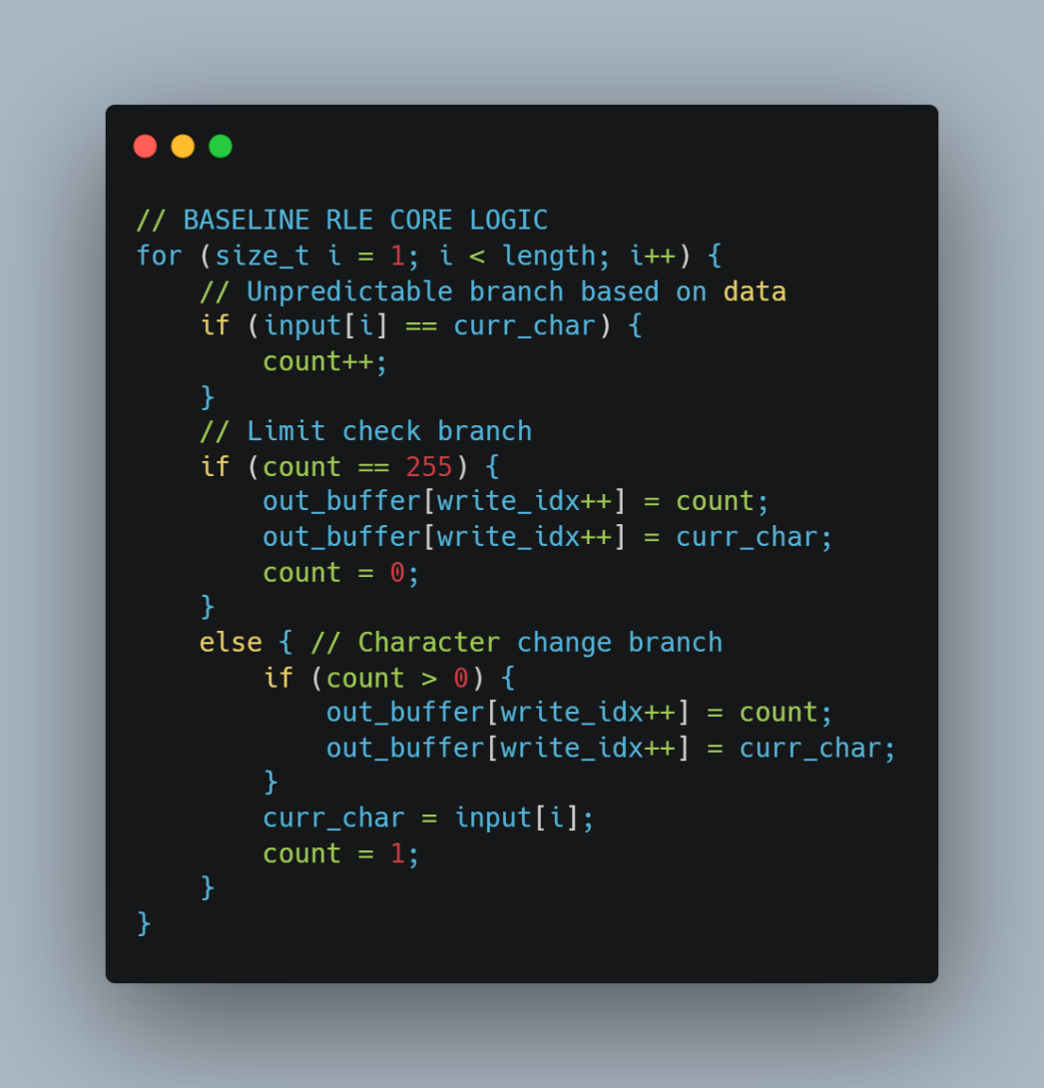
The Baseline Logic (The Bottleneck)
Standard if-else implementation analysis
Data-Dependent Branch
Standard implementation relies on a direct, data-dependent if condition to detect run sequences.
Unpredictable Pattern
Because the data pattern is highly complex, this condition becomes unpredictable, forcing the CPU to guess blindly.

Slide 10
Baseline Performance Results
AMD Ryzen 6800HS — Baseline RLE Implementation
20–35%
~13.2
Misprediction Rate
CPI (Cycles/Instr.)
Branch Predictor misled
Highly inefficient
31.97
MB/s
15.64s
Throughput
Execution Time
Limited by pipeline flushes
524 MB dataset

Slide 11
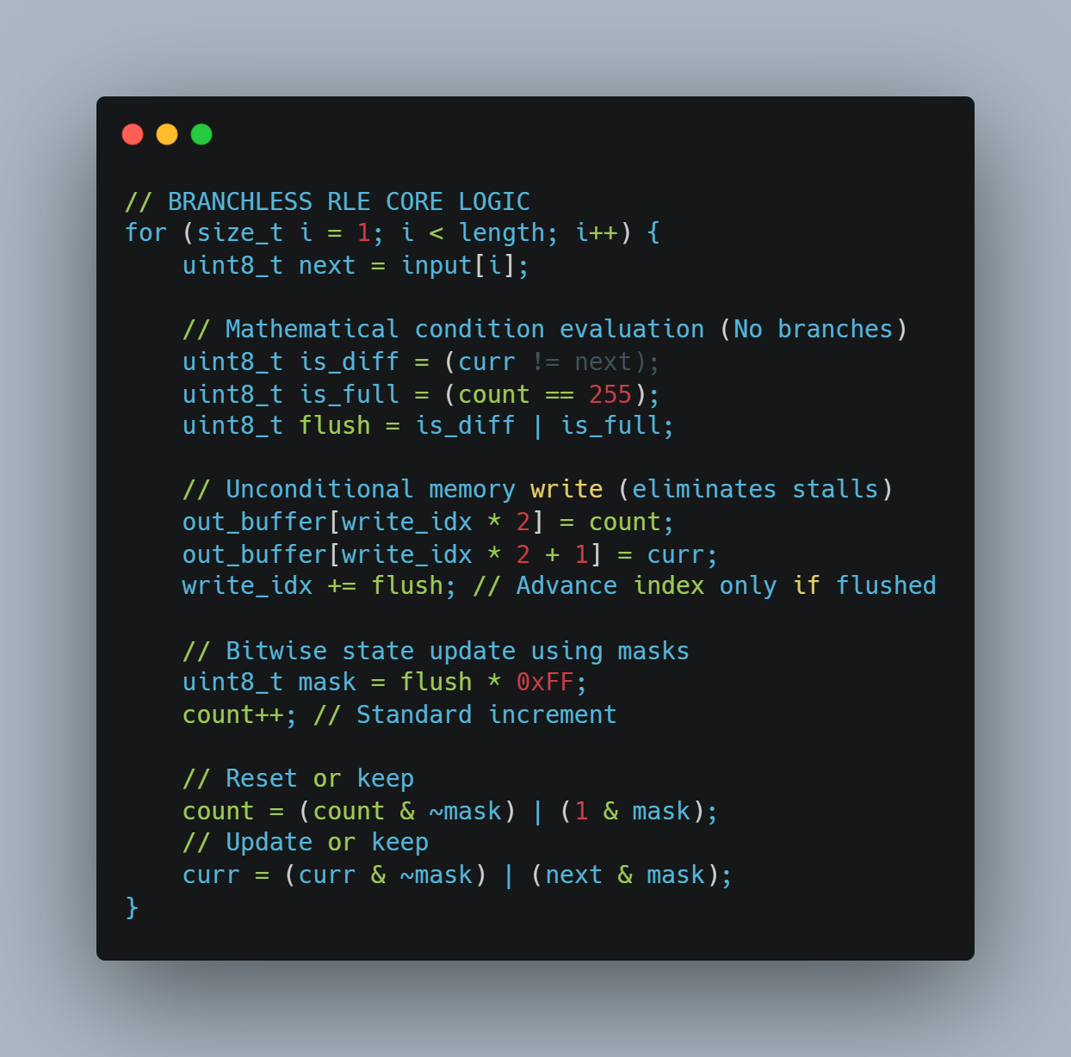
The Branchless Transformation
Eliminating conditional branches with bitwise operations
No Conditional Branches
Completely removed conditional branches and replaced with bitwise conditional assignments and masking operations.
Mathematical Evaluation
Logic mathematically evaluates conditions and performs unconditional memory writes, bypassing the branch predictor entirely.

Slide 12
Visual Evidence of Execution
Terminal output confirms successful processing
⬤ Baseline RLE
⬤ Branchless RLE
$ ./baseline_rle input.bin output.bin
$ ./branchless_rle input.bin output.bin
Processing 524,288,724 bytes...
Processing 524,288,724 bytes...
Branch Predictor: ACTIVE
Branch Predictor: BYPASSED
Misprediction rate: ~28.4%
Misprediction rate: 0%
CPI: 13.2
CPI: 2.1
Done. Time: 15.641 seconds
Done. Time: 6.924 seconds
Throughput: 31.97 MB/s
Throughput: 72.21 MB/s
✓ Both systems successfully processed the exact same 524,288,724-byte complex dataset.
The timing logs clearly illustrate the massive difference in execution speed between the two architectural approaches.

Slide 13
Quantitative Results: Execution & Speed
524 MB dataset — AMD Ryzen 6800HS
2.25× Faster
The branchless algorithm delivers dramatically superior throughput by eliminating all branch mispredictions and reducing pipeline stalls to zero.
+125% speed increase
Metric
Baseline (if-else)
Branchless (bitwise)
Improvement
Execution Time
15.641 seconds
6.924 seconds
↓ 55.7%
Throughput
31.97 MB/s
72.21 MB/s
↑ 125.8%
Misprediction Rate
20–35%
0%
Eliminated
CPI
~13.2
~2.1
↓ 84.1%

Slide 14
Architectural Analysis (The "Why?")
Understanding the microarchitectural impact
More Instructions, Better Performance
01
Although the bitwise implementation forced the compiler to generate a higher number of total x86-64 assembly instructions, it was far more efficient overall.
Pipeline Stalls Eliminated
02
Processor pipeline stalls were heavily mitigated because branch mispredictions were eliminated down to 0% — no more blind guessing.
CPI Dropped from ~13.2 → ~2.1
03
The estimated Cycles Per Instruction dropped dramatically, proving that continuous flow outperforms conditional prediction at the microarchitecture level.
Key Insight: Instruction count ≠ performance. Pipeline efficiency is the true determinant of throughput.

Slide 15
Conclusion
Replacing conditional logic with bitwise operations successfully mitigates hardware-level bottlenecks in compression algorithms.
2.25×
0%
+125%
Speedup
Mispredictions
Throughput
Thank you for your time and attention.

