Slide 1
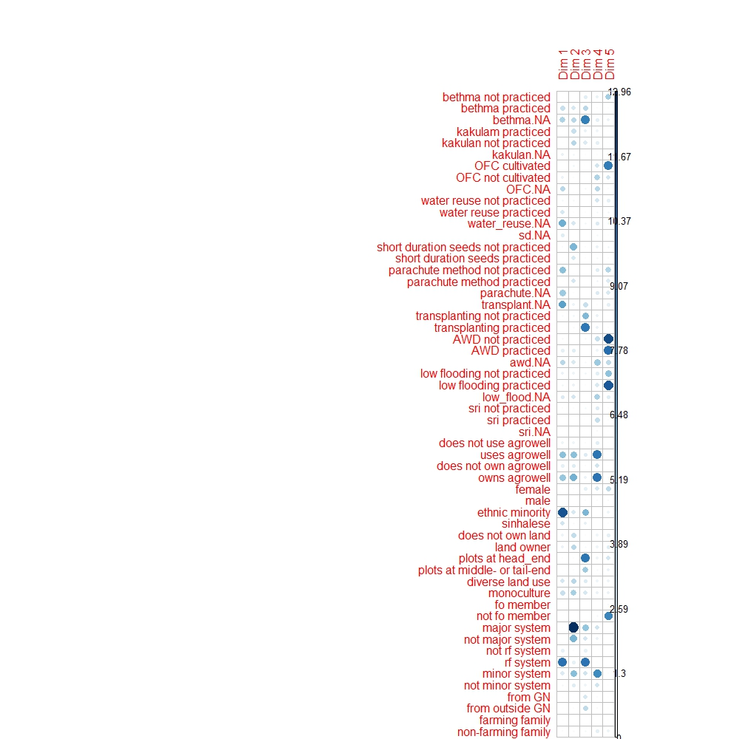

Slide 2
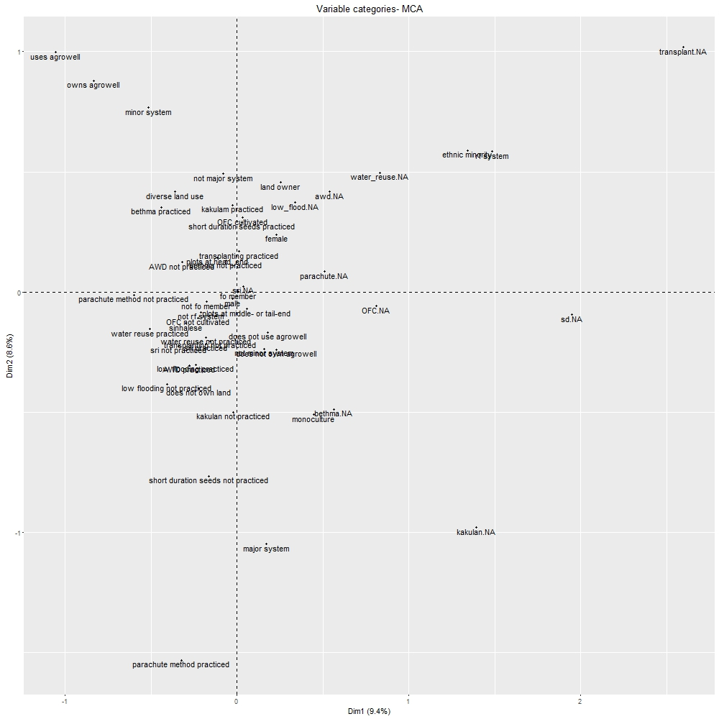
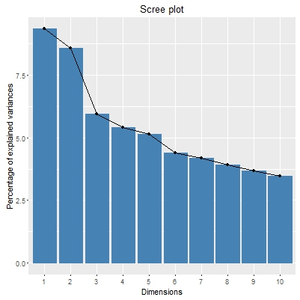

Slide 3
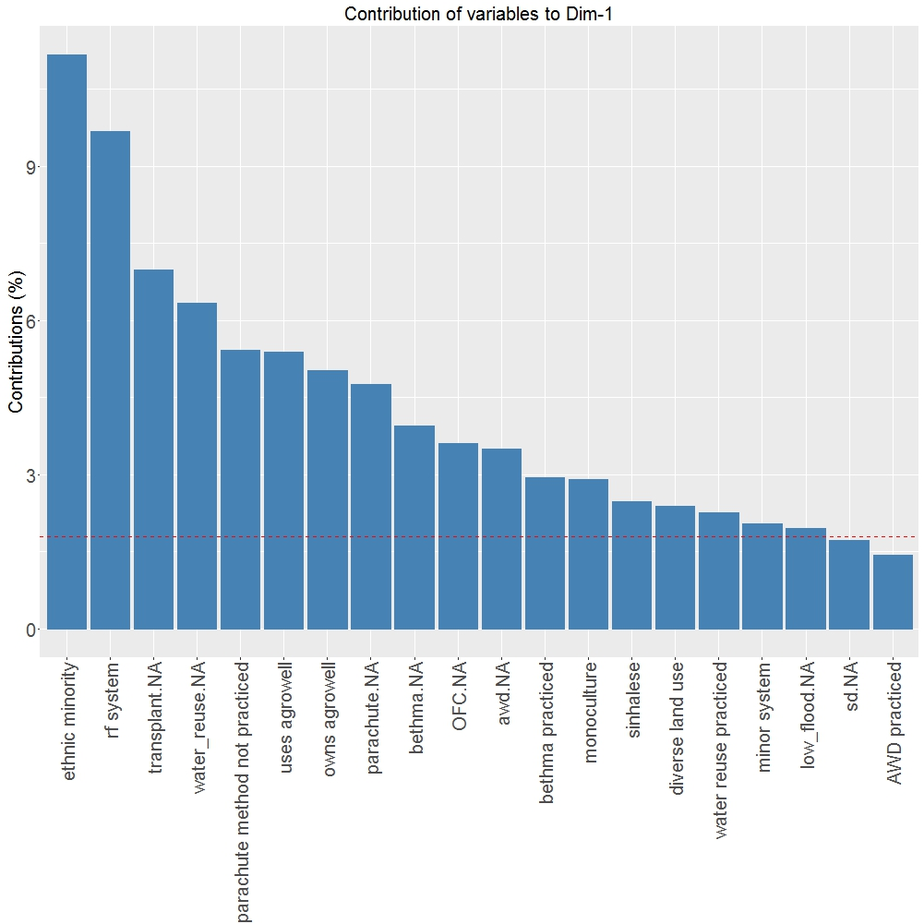
Rain-fed minority farmers who
haven’t heard of many of the adaptive behaviors and tend to use agrowells.
(vulnerable population)

Slide 4
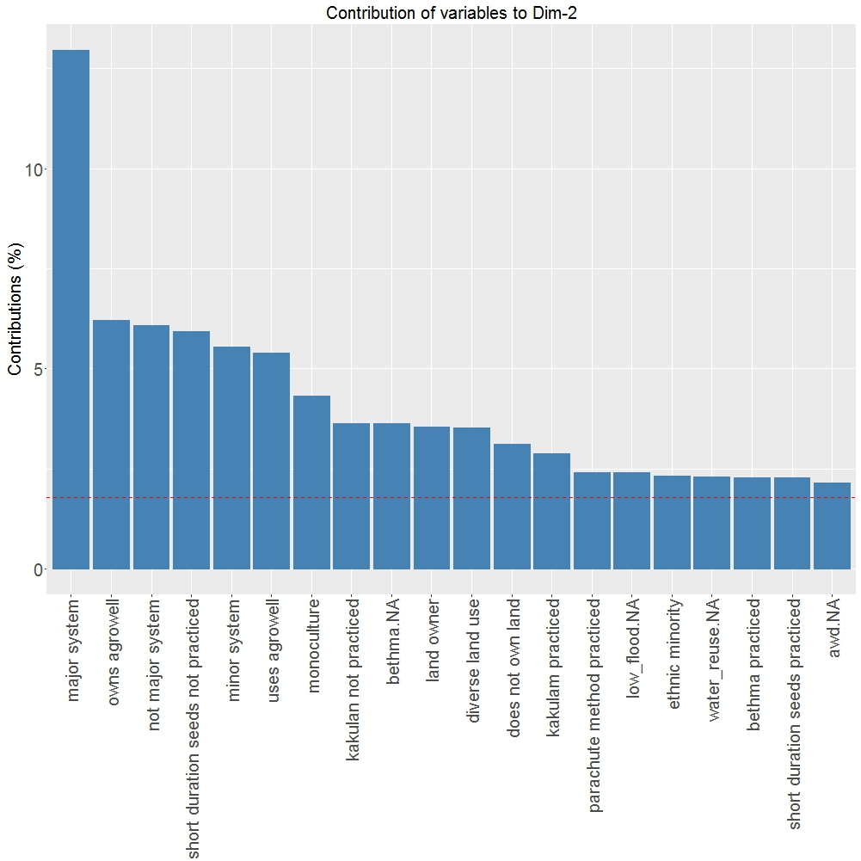
Major/minor system farmers engaged in monoculture who have heard of many practices but do not practice them.

Slide 5
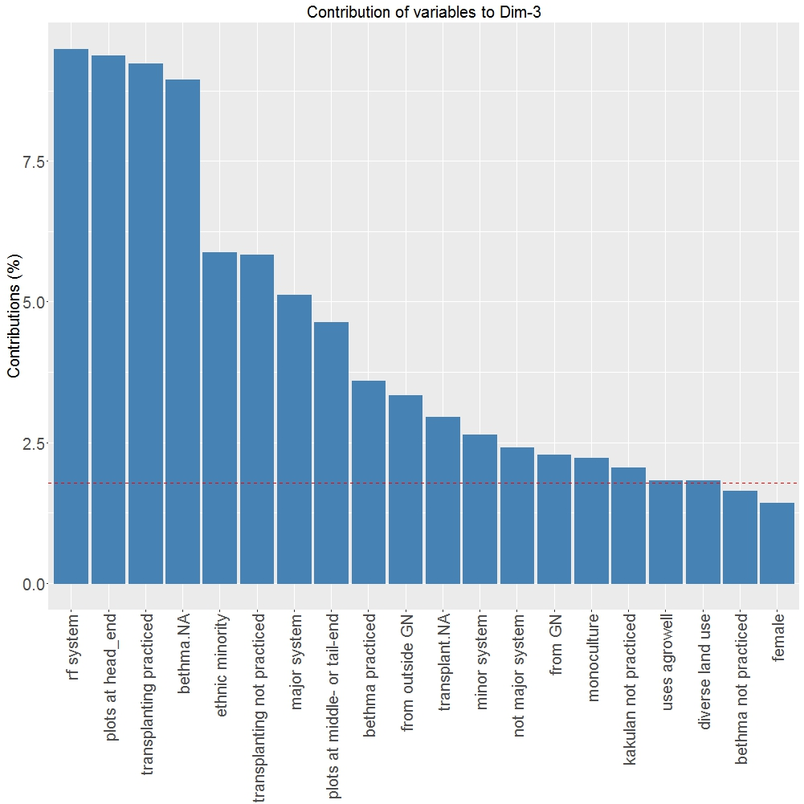

Slide 6
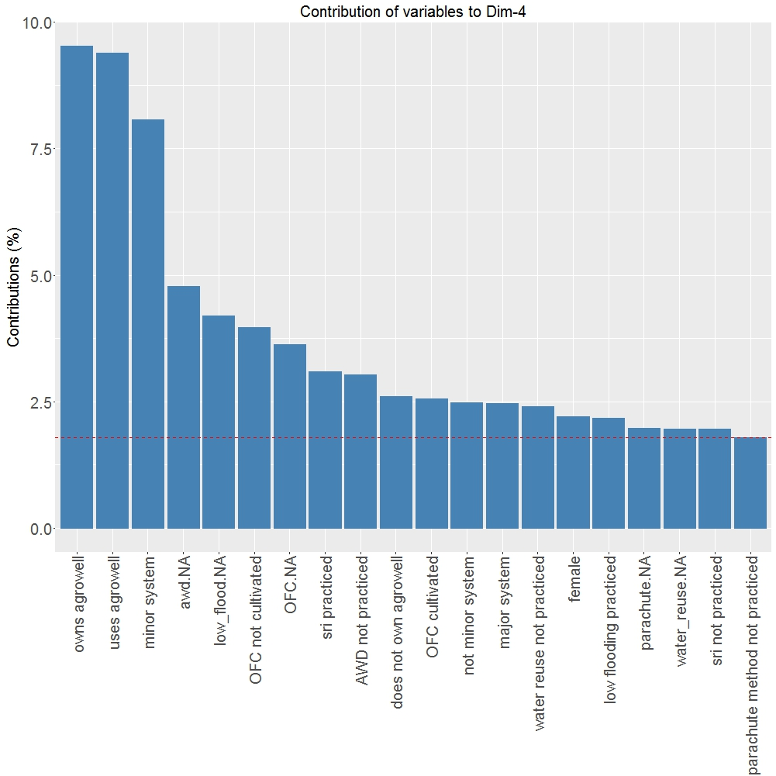

Slide 7
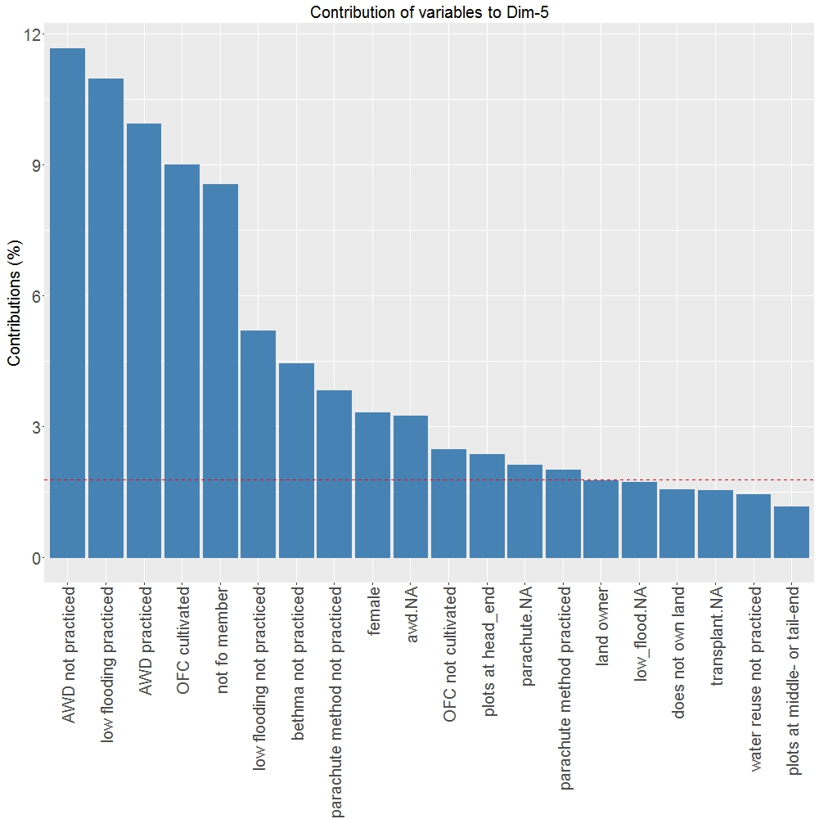

Slide 8
