Slide 1


The evolution of python
Erika burdon * February 2015

Slide 2
Question
How has Python become stronger?
Notes:
Python conceived of in 1980 by Guido Van Rossum who wanted a better way to do system administration – currently had to write Bourne shells, c scripts …
I wanted to find out how Python shifted from industry to general domain, and how it became so popular.
In-depth research project; it’s not an automated tool I can apply to a bunch of different languages (research methodology)

Slide 3
Three things:
The useable source code – Python Version(s) and Open-source community
Projects supported by Python
Community / Users of Python
Implementation: Research more than automated tool
Notes:
Three things contribute to a language’s strength – source code, projects built using it, and of course the user base

Slide 4
Methodology 1 – SOURCE AND PACKAGES
1.0 VISUALIZATION
Watch GOURCE Video
Laws applied?
2.0 STATISTICS
Write Script to parse Python Download page(s)
Get: name, date, size
Graph results
What/Number of features added per release?

Slide 5
Methodology 2 – SUPPORTED PROJECTS
Why would Python be chosen over another language?
Read success stories – what projects have worked?
Increased demand?
Notes:
Why chosen – Looked at metrics like LINES OF CODE, NUMBER OF SPECIAL CHARACTERS, DEVELOPMENT TIME, etc.

Slide 6
Methodology 3 – USER BASE
Register for and explore official Python community
Read Blogs – where is Python used?
Notes:
Where – industry: Pyconferences ; academics/general public: Hour of Code campaign(s)

Slide 7
RESULTS M1 – PART A
M1 – PART A - proved 3 laws (continuous change, maintaining complexity, and continuous growth)
Notes:
M1 had a TON of data! Lots of numbers and facts, but I’m not sure how I could have reduced it further.

Slide 8
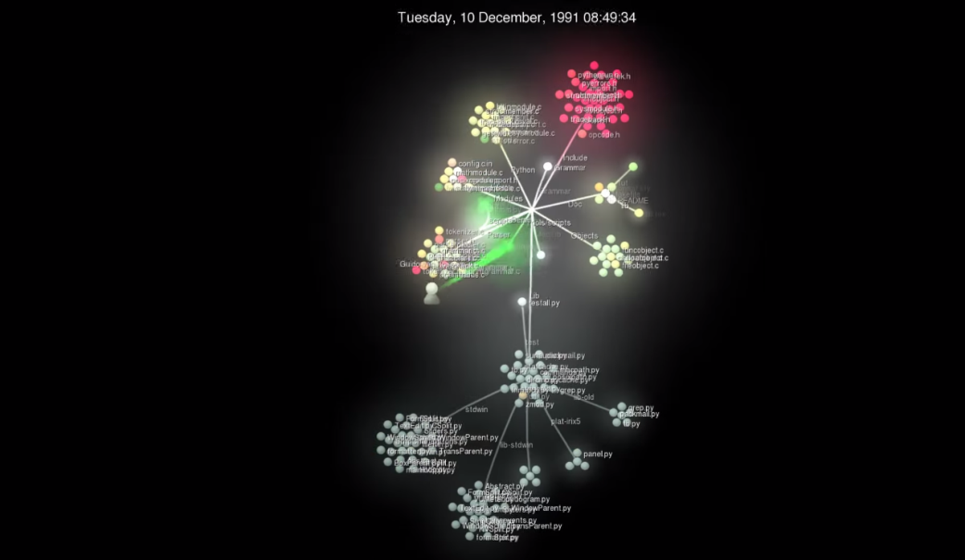
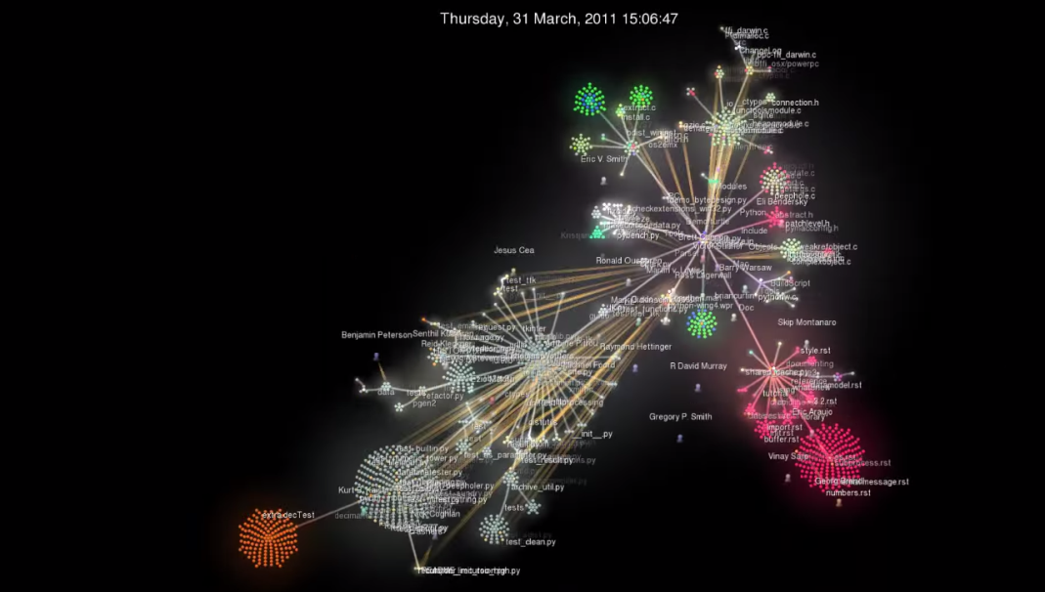
GOURCE SCREENSHOTS / COMPLEXITY VISUAL
Check out my M1 README for all screenshots

Slide 9
RESULTS – m1 part b
Also asserted same laws
law of familiarity – forced to update in order to keep same functionality
Problem: Data not available (current vs history of package)

Slide 10
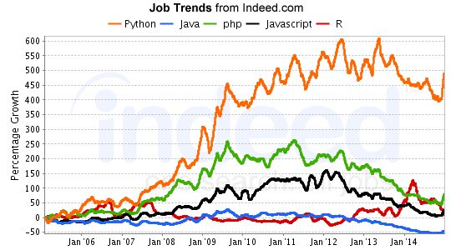
RESULTS – M2
Not show that Python itself had evolved
Python has just been chosen for use
Indirectly asserted Law VIII (feedback)

Slide 11
RESULTS – M3
Effects have not yet been seen (Recent Data)
Clear shift from industry to general domain

Slide 12
Lessons learned
New tools: Import.io, Scrapy
I hate parsing
Python’s really cool – found complex/fully supported projects, not just basic parsing/scripting/automation
Notes:
This was a very meta-project – I studied Python using Python

