Slide 1


The plight of python
Erika burdon * February 2015

Slide 2
Question
How has Python become stronger?
Notes:
Python conceived of in 1980 by Guido Van Rossum who wanted a better way to do system administration
Had to write Bourne shells, c scripts …
I wanted to find out how Python shifted from scientific industry to general domain, and how it became so popular.
This is purely out of interest, there’s no real hypothesis. I assumed it has over time.
Not sure how “useful” it will be… Benchmarks?

Slide 3
Solution: Research, not an automated tool
Three parts of a language:
Source code – Python Version(s) and Open-source packages
Projects supported by Python
Community / Users of Python
Notes:
I spent a lot of time defining the scope – I knew it was going to be a big project. Looking at the final repo, I went a bit overboard.

Slide 4
Methodology 1
PART A – SOURCE
1.0 – Visual inspection
Watch GOURCE Video
2.0 – Statistics
Write Script; get name, date, size
Graph results
Visit docs: What features added per release?
PART B – PACKAGES
Visit PyPi package index
Write script; get name, upload date(s), size(s)
Graph results
Notes:
A.1 – Wanted to see a visualization of the Python structure changes
A.2 - Script: Parsed the official Python website for version release downloads
B -

Slide 5
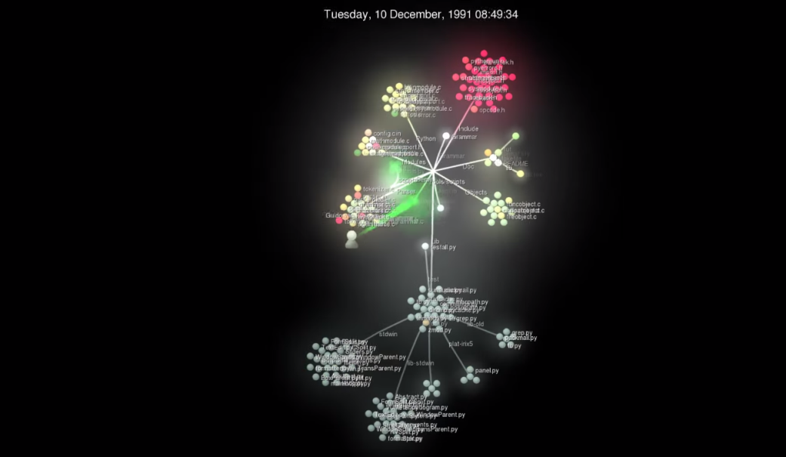
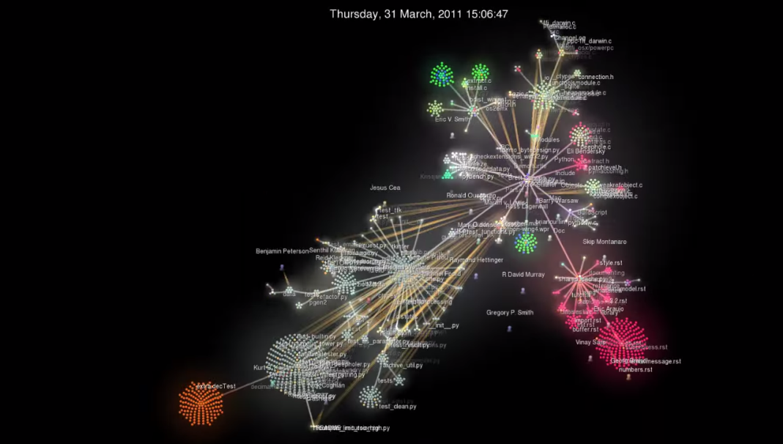
RESULTS M1 – PART A
Gource Visualization asserted:
Continuous change
Increasing complexity (+ maintenance)
Continuous growth
Check out my M1 README for all screenshots

Slide 6
RESULTS – m1 part b
Also: continuous change, increasing complexity, continuous growth
New: law of familiarity forced to update in order to keep same functionality
Side note: Failing with Python 3?!
Problem: Data not available!
Notes:
Problem: I wanted to see and chart the history of Python packages. The Python version source page download table has the name, date, and download file size of each version as its released. Packages only had most recent
My resulting graphs are somewhat misrepresentative – show the dates and number of files updated on that date (number of active; number that update WITH Python?); threat to validity

Slide 7
Methodology 2 SUPPORTED PROJECTS
Why would Python be chosen over another language?
Read success stories – what projects have worked?
Increased demand?
Notes:
Why chosen – Looked at metrics like LINES OF CODE, NUMBER OF SPECIAL CHARACTERS, DEVELOPMENT TIME, etc.

Slide 8
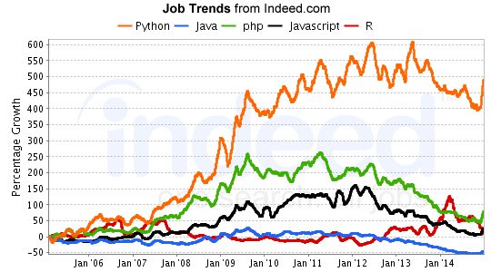
RESULTS – M2
Not show that Python itself had evolved
Python has just been chosen for use
Indirectly asserted Law VIII (feedback)
Notes:
SUPPORTED PROJECTS RESULTS

Slide 9
Methodology 3 USER BASE
Register for and explore official Python community
Read Blogs – where is Python used?

Slide 10
RESULTS – M3
Effects have not yet been seen (Recent Data)
No pretty pictures, sorry.
Clear shift from industry to general domain
Notes:
USER BASE / COMMUNITY

Slide 11
Lessons learned
New tools: Import.io, Scrapy
Parsing is such a pain
Python’s really cool – found complex/fully supported projects, not just basic parsing/scripting/automation
There’s more to do! Python 2 vs 3
Notes:
This was a very meta-project – I studied Python using Python

Slide 12

Any Questions?
<APPLAUSE>

