Slide 1
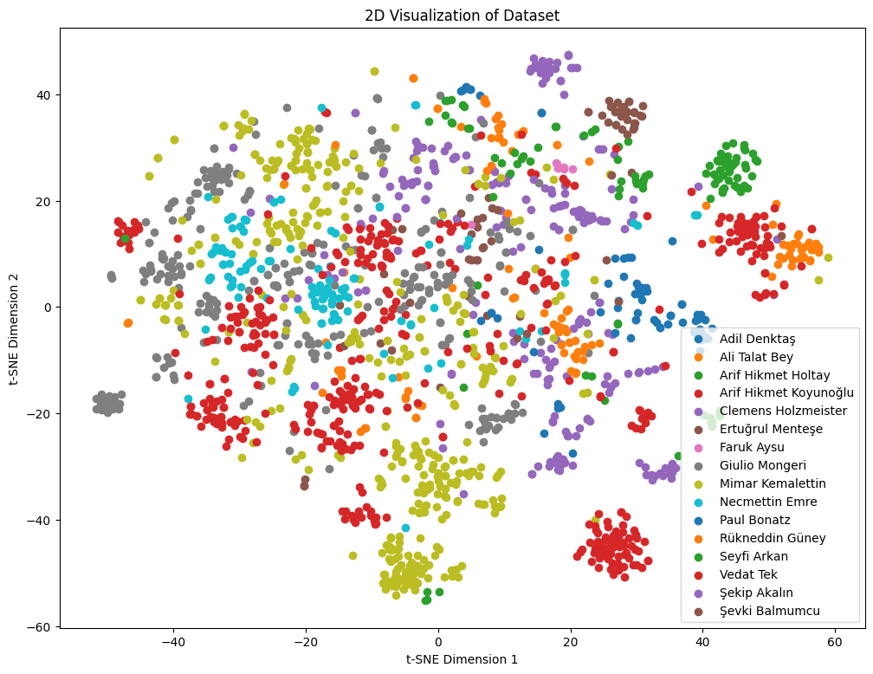
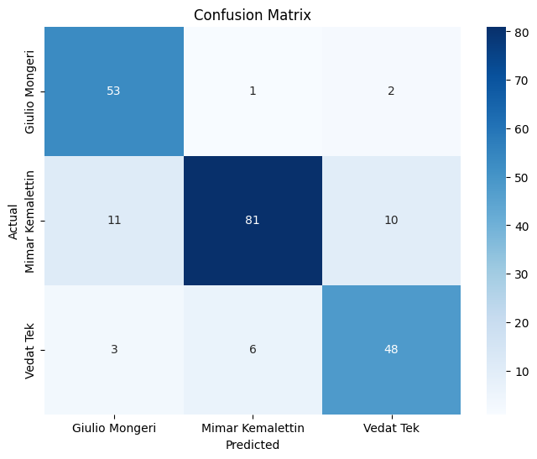
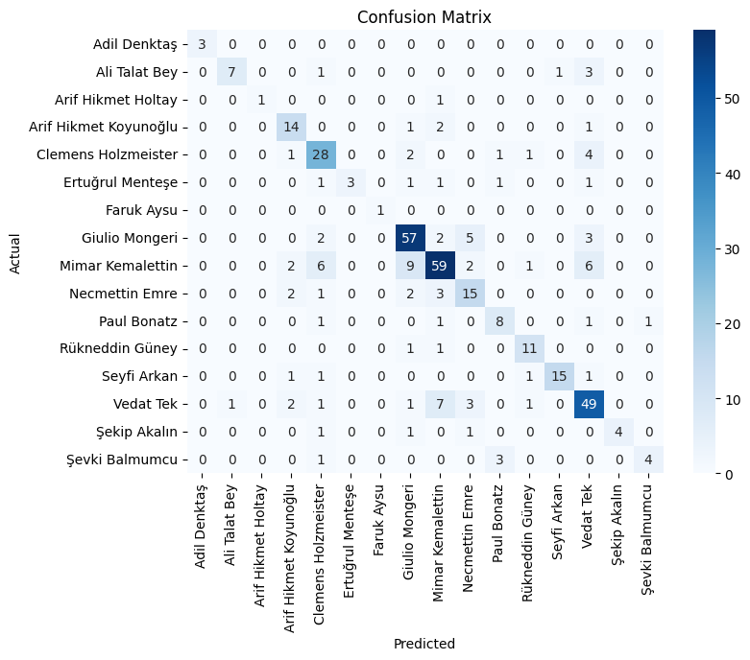
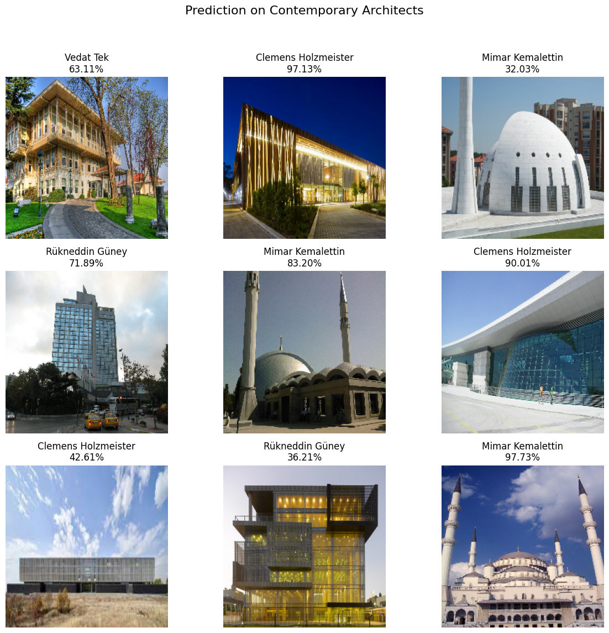
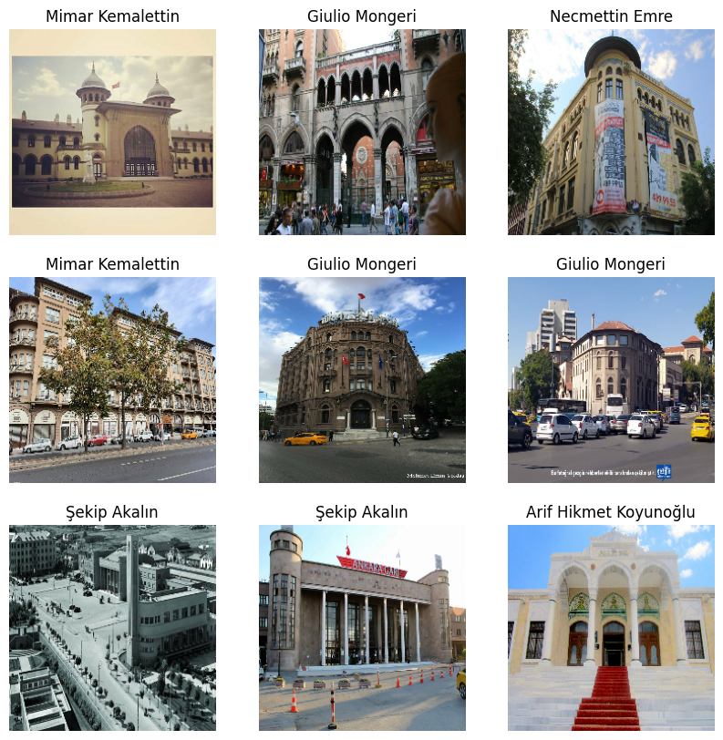
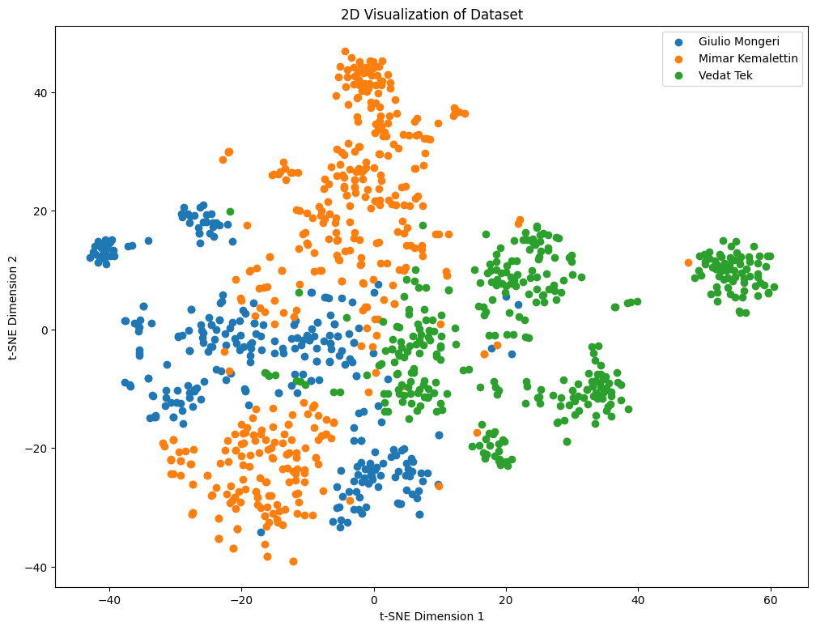
Classification of Architectural Styles
Emirkan Burak Yılmaz Supervisor: Prof. Dr. Yusuf Sinan Akgül
Abstract
This research delves into the rich tapestry of architectural styles from the late Ottoman and early Republican periods. Leveraging advanced neural network architectures, we explore the evolution of styles, aiming to classify architects and visualize their relationships. The study introduces a curated dataset, customized for architectural intricacies, and rigorously analyzes four key convolutional neural network (CNN) models—baseline, VGG, ResNet, and EfficientNet. EfficientNet emerges as the most effective model, boasting high accuracy on both Architects-Top and Architects-All datasets. Beyond classification, our research employs t-SNE dimension reduction to unveil the hidden connections between architects, providing a deeper understanding of their distinctive styles.
Methodology
Comparative analysis of CNN architectures: Baseline, VGG, ResNet, EfficientNet.
Hyperparameter tuning and training strategies for model optimization.
t-SNE dimension reduction showcasing relationships between architects based on styles
Results
Architects-Top Dataset Accuracy: 84.65%
Architects-All Dataset Accuracy: 74.08%
0.43 silhouette score for the clustering
Research Objectives
Understanding architectural styles during the late Ottoman and early Republican periods.
Identifying architects pivotal in shaping the First and Second National Architectural Movements.
Prediction on Contemporary Architects
Dataset
Architects-All: A curated dataset containing 1,910 images from 16 architects of the late Ottoman and early Republican periods.
Architects-Top: A subset focusing on Giulio Mongeri, Mimar Kemalettin, and Vedat Tek.
Visualizing Architectural Relationships
Using t-SNE dimension reduction on the features extracted by our final two models, we generate 2D visualizations that provide insights into the similarities and differences among architects based on their styles.
Future Directions
Enhance the Dataset: Integrate more architectural datasets to improve generalization.
Explore Advanced Architectures: Investigate models with Transformer and attention mechanisms for further innovation.
Generative AI and Practical Application: Apply the trained model to support architects in design processes while exploring connections with generative AI.

