Slide 1
Classifying and Finding Similarities in Architectural Styles
CSE 495 - First Presentation
Emirkan Burak Yılmaz
Project Supervisors:
Prof. Dr. Yusuf Sinan Akgül, Dr. Funda Tan
08/11/2023

Slide 2
Contents
Project Description
Motivation
Project Requirements
Project Timeline
Success Criteria
References

Slide 3
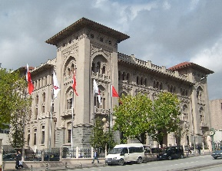
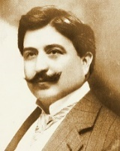
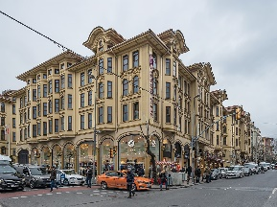
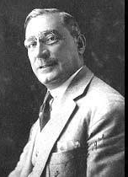

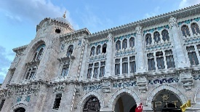
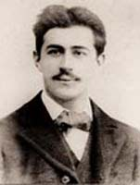
Project Description
We investigate the potential of leveraging advanced technologies like deep learning and computer vision to detect architectural structure similarities and categorize architects according to their unique styles.
Mimar Kemaleddin
First Ziraat Bank Headquarters
Giulio Monger
Tayyare Apartments
Grand Post Office
Vedat Tek

Slide 4
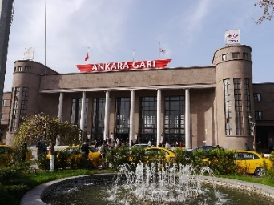
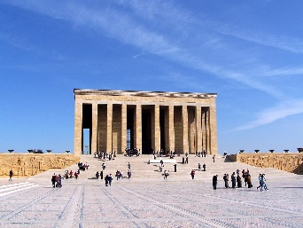
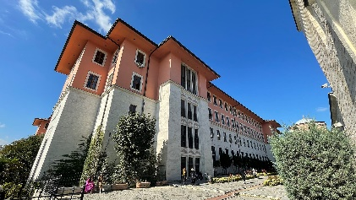
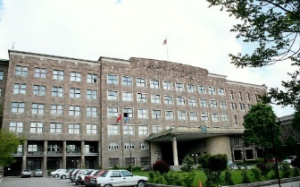
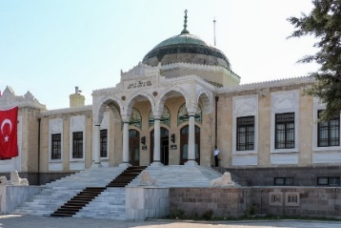
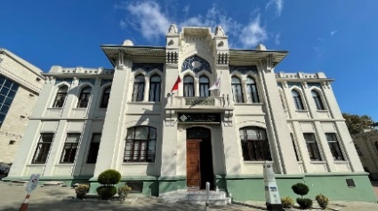
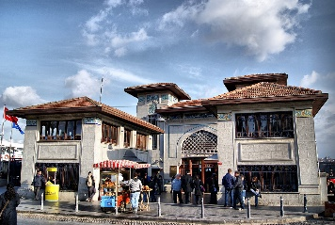
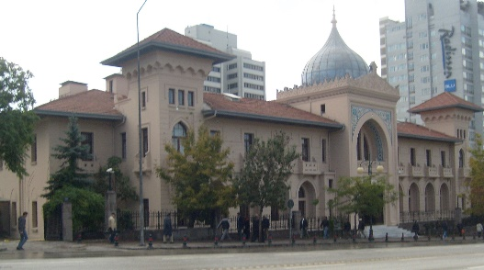
Project Description
Turkish Architecture in the Republican Period
First National Architectural Movement
(Neoclassical Architecture) 1920s to early 1930s
1930s to 1950s
Second National Architectural Movement
(Modernism and foreign influence)

Slide 5
Motivation
Can machine vision accurately identify architects from their architectural works and classify them based on their distinct design styles?
Can we generate novel structures in specific architects' styles through style learning?

Slide 6
Project Requirements- 1
Architect Identification and Definition
Identify and define the architects and their significant works to be studied as part of the project.
Data Collection
Successfully compile a diverse dataset comprising a minimum of 100 high-quality images per architect, ensuring a representative collection of their works.
Splitting the Data
Divide data into %70 training, %20 validation and %10 testing sets.
Implement techniques to handle class imbalance if present.
Building the Model
Define the architecture and specify hyperparameters for the Convolutional Neural Network (CNN) model.
Model Training
Train the CNN model using the designated training dataset.

Slide 7
Project Requirements- 1
Evaluate Performance
Monitor and evaluate the model's performance using appropriate evaluation metrics.
Hyperparameter Tuning and Model Adjustment
Conduct hyperparameter tuning to optimize the model's performance.
Make necessary adjustments to the model's architecture based on the tuning results.
Architectural Style Clustering
Implement a clustering algorithm to group architects based on architectural style similarities, utilizing the model's results.
Compare the clustering results generated by the model to the conventional classifications made by architectural historians and theorists.

Slide 8
Project Requirements- 2
Programming Language
Python
Libraries
TensorFlow
NumPy
PyTorch (if necessary)
Development Environment
Google Colab
Data Collection
Google Images
Google Street View API
Public Social Media Posts (e.g., Instagram)

Slide 9



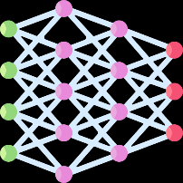

Project Timeline
Data Collection 06/11/23 - 20/11/23
20/11/23 - 27/11/23 Preprocessing
&
Splitting the Data
Architectural Style Clustering
08/01/24 - 15/01/24
11/12/23 - 25/12/23
Performance Evaluation
&
Hyperparameter Tuning
Model
Building & Training
27/11/23 - 11/12/23

Slide 10
Success Criteria
Model Performance
Train a baseline CNN model to achieve at least 75% accuracy in classifying artworks by architect.
Architectural Style Clustering
Implement architectural style-based clustering to reveal meaningful patterns within the architects' works, achieving a clustering accuracy of 75%.

Slide 11
References
Yoshimura, Y., Cai, B., Wang, Z. and Ratti, C., 2019. Deep learning architect: Classification for architectural design through the eye of artificial intelligence. Computational Urban Planning and Management for Smart Cities 16, pp.249-265.
Zhang, M., Cui, Z., Neumann, M. and Chen, Y., 2018, April. An end-to-end deep learning architecture for graph classification. In Proceedings of the AAAI conference on artificial intelligence (Vol. 32, No. 1).
Pesto, C., 2017. Classifying US Houses by Architectural Style Using Convolutional Neural Networks.
Wang, B., Zhang, S., Zhang, J. and Cai, Z., 2023. Architectural style classification based on CNN and channel–spatial attention. Signal, Image and Video Processing, 17(1), pp.99-107.
Architecture of Turkey: https://en.wikipedia.org/wiki/Architecture_of_Turkey
İcons: Flaticon.com

