Slide 1
Architectural Style Classification using Semantic Segmentation
CSE 496 - First Presentation
Emirkan Burak Yılmaz
Project Supervisors:
Prof. Dr. Yusuf Sinan Akgül
27/03/2024

Slide 2
Contents
Project Description
Motivation
Previous Work
Project Diagram
Project Requirements
Project Timeline
Success Criteria
References

Slide 3
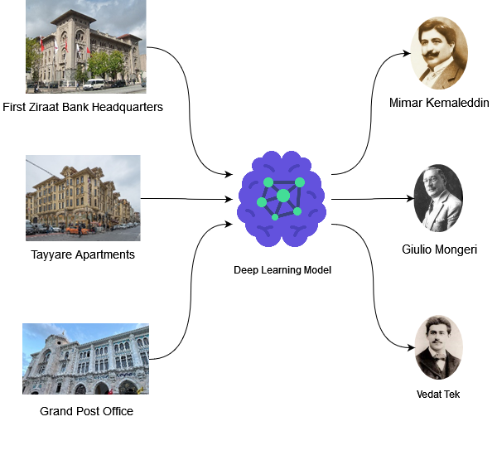
Project Description
We investigate the potential of leveraging deep learning and computer vision to detect architectural structure similarities and categorize architects according to their certain styles.
Notes:
If you can recall. We were working on a multiclass classification problem. Our goal is to build a model capable of detecting the similarities and differences between architectural styles and classify architects.

Slide 4
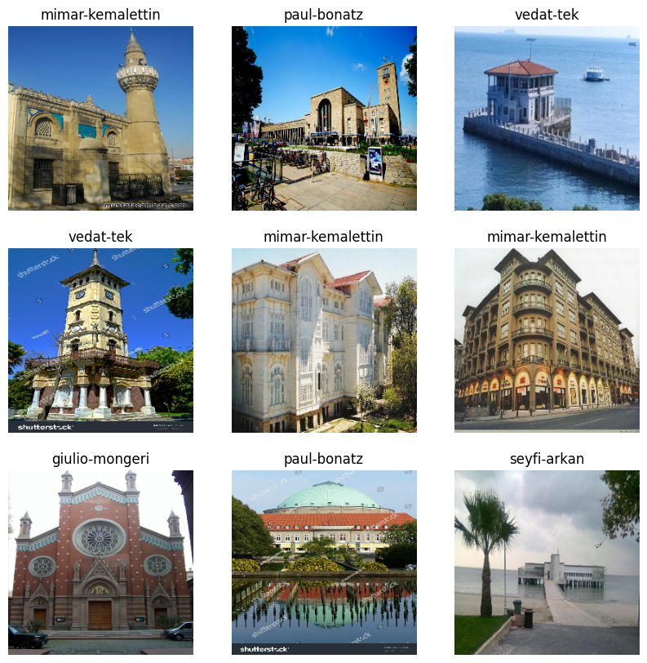
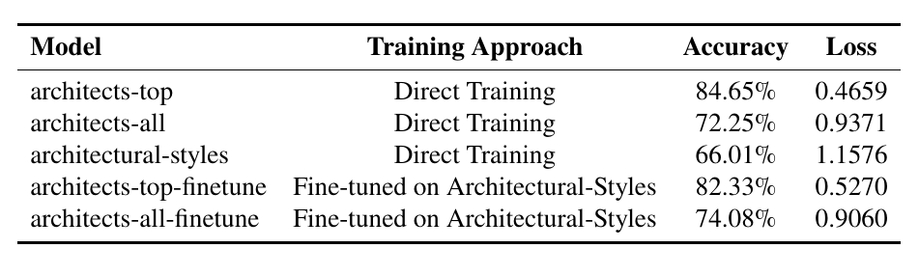
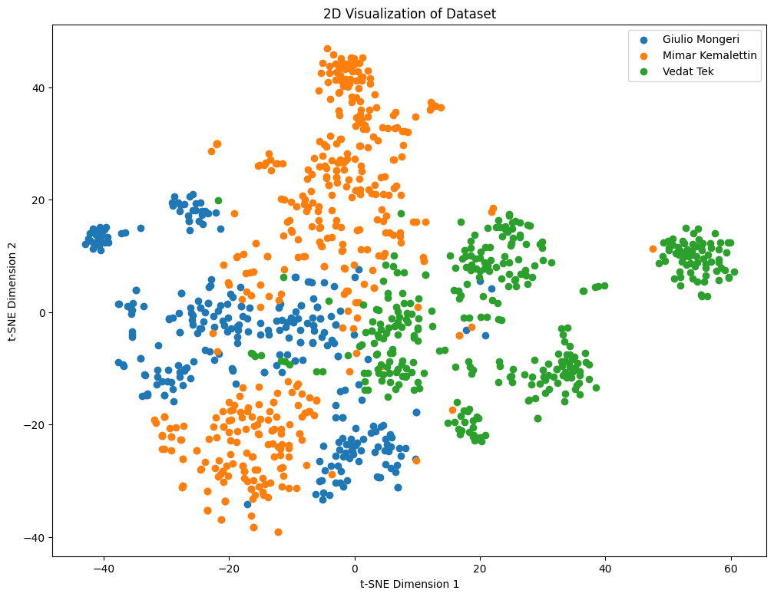
Previous Work
84% acc. for 3 architects
74% acc. for 16 architect
1,910 images belonging to 16 classes
silhouette score of 0.43
Notes:
What was wrong? The DL model extracts features which are irrelevant with the style of architects (e.g. background).

Slide 5

Motivation
Can machine vision accurately identify architects from their architectural works and classify them based on their distinct design styles?
Can we further improve the performance by giving the model some clues to where to look for classification?
Can we generate novel structures in specific architects' styles through neural style transfer (NST)?

Slide 6
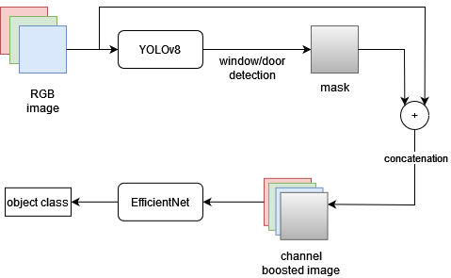
Project Diagram

Slide 7
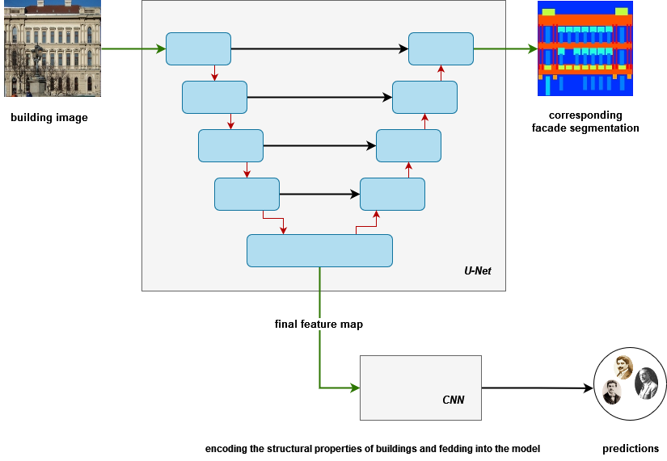
Project Diagram
Notes:
per-pixel semantic labeling of the image without considering higher-level object instance or boundary information.
The skip connection are included to combine low-level features with high-level features

Slide 8
Project Requirements- 1
Pre-processing the Data
Loading facades dataset
Extracting the classes from RGB mask images
Model Building and Training
Construct the U-Net Architecture
Semantic segmentation of building facade (windows, doors, roofs etc)
Classification of Architects
Performance Evaluation & Hyperparameter Tuning
K-Fold Cross Validation
Grid Search and/or Random Search
Architectural Style Clustering
Principal Component Analysis (PCA)
K-Means clustering
Model Deployment

Slide 9
Project Requirements- 2
Programming Language
Python
Libraries
TensorFlow
NumPy
PyTorch
Development Environment
Google Colab
Data Collection
Kaggle
Google Images
Google Street View API
Public Social Media Posts (e.g., Instagram)

Slide 10

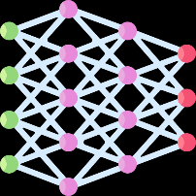




Project Timeline
Data Loading & Preprocessing 01/04/24 - 15/04/24
15/04/24 - 29/04/24 Model Architecture and Building
Architectural Style Clustering
27/05/24 - 05/06/24
13/05/24 - 27/05/24
Hyperparameter Tuning
Model Training and Evaluation
29/04/24 13/05/24
05/06/24 - 12/06/24
Model Deployment

Slide 11

Success Criteria
Semantic segmentation: 80% accuracy
Classify 3 architects: 90% accuracy (prev. 83%)
Classify 16 architects: 80% accuracy (prev. %73)
Clusters' silhouette score: 0.5-0.7 (prev. 0.43)

Slide 12
References
Yoshimura, Y., Cai, B., Wang, Z. and Ratti, C., 2019. Deep learning architect: Classification for architectural design through the eye of artificial intelligence. Computational Urban Planning and Management for Smart Cities 16, pp.249-265.
Zhang, M., Cui, Z., Neumann, M. and Chen, Y., 2018, April. An end-to-end deep learning architecture for graph classification. In Proceedings of the AAAI conference on artificial intelligence (Vol. 32, No. 1).
Pesto, C., 2017. Classifying US Houses by Architectural Style Using Convolutional Neural Networks.
Wang, B., Zhang, S., Zhang, J. and Cai, Z., 2023. Architectural style classification based on CNN and channel–spatial attention. Signal, Image and Video Processing, 17(1), pp.99-107.
Architecture of Turkey: https://en.wikipedia.org/wiki/Architecture_of_Turkey
İcons: Flaticon.com

