Slide 1
Architectural Style Classification using Semantic Segmentation
CSE 496 - Second Presentation
Emirkan Burak Yılmaz
Project Supervisors:
Prof. Dr. Yusuf Sinan Akgül
18/05/2024

Slide 2
Contents
Facades Dataset
Preprocessing
Combined Model Architecture
U-Net Train & Evaluate
Hybrid Model Performance
Combined Model: Train & Evaluate
Optimization Experiments
Success Criteria
References

Slide 3
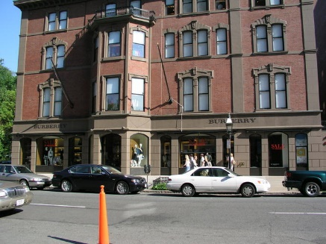
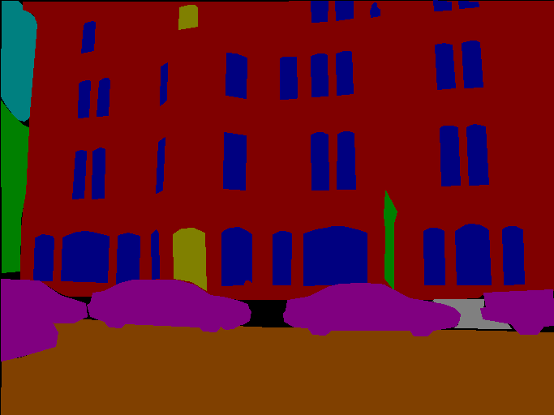
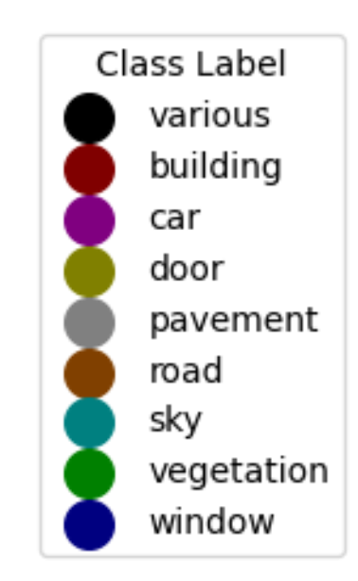
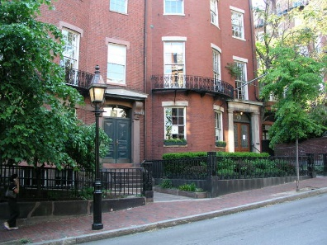
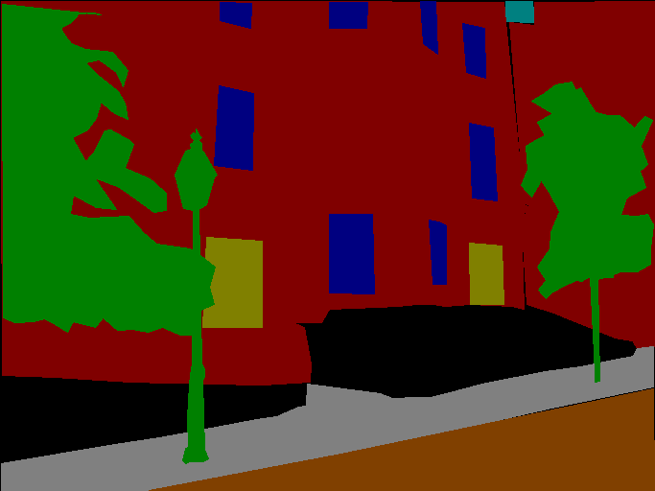
Facades Dataset
Total of 945 images with 9 classes
https://github.com/cvjena/labelmefacade

Slide 4
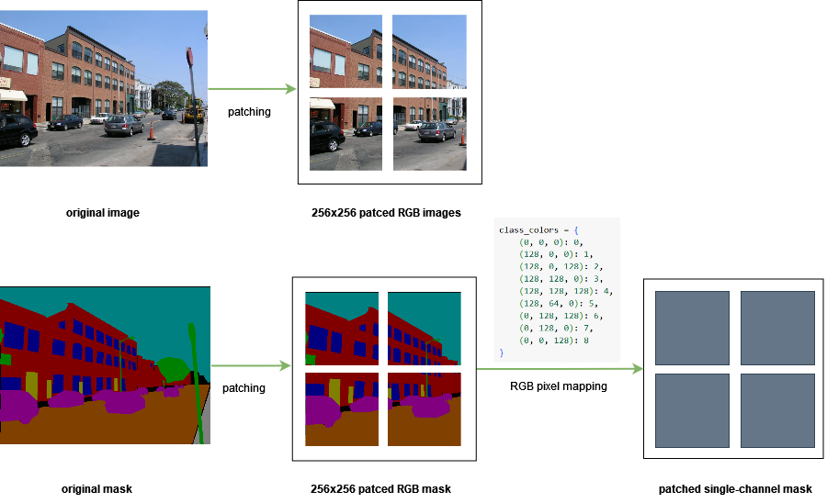
Preprocessing
Notes:
Dataset contains images with various sizes. For semantic segmentation, resizing is not

Slide 5
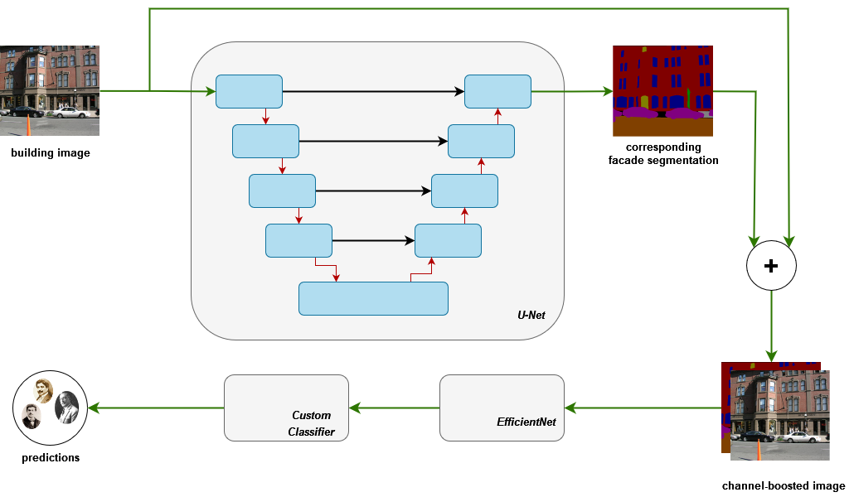
Combined Model Architecture
Notes:
per-pixel semantic labeling of the image without considering higher-level object instance or boundary information.
The skip connection are included to combine low-level features with high-level features

Slide 6
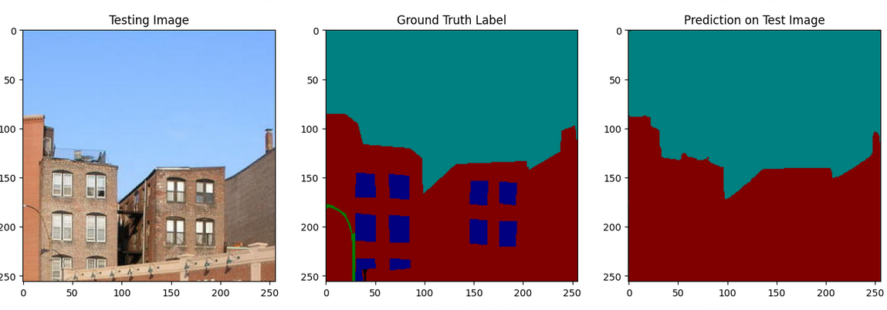
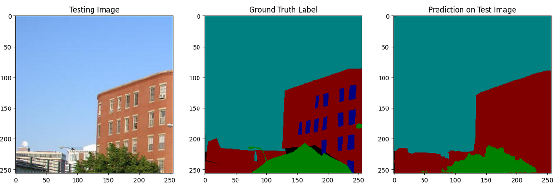
U-Net Train & Evaluate
80% accuracy. Could be better. But wait! Where is the windows?
Notes:
Where is the windows

Slide 7
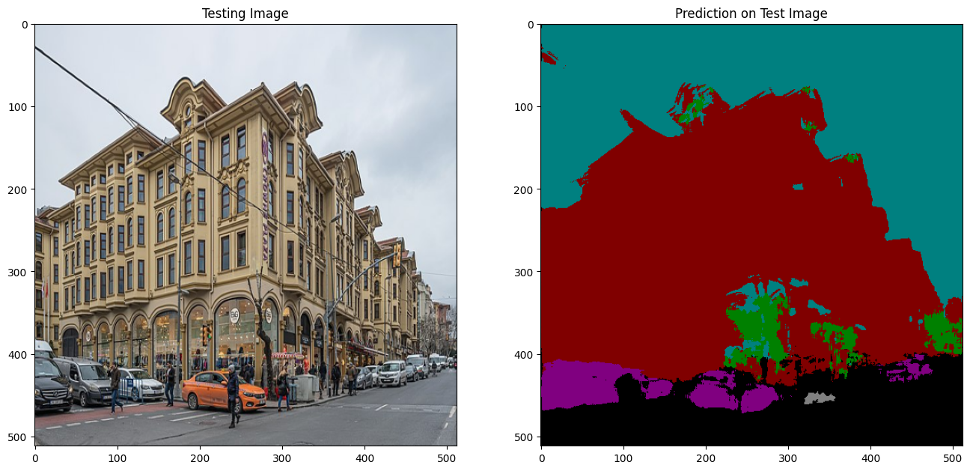
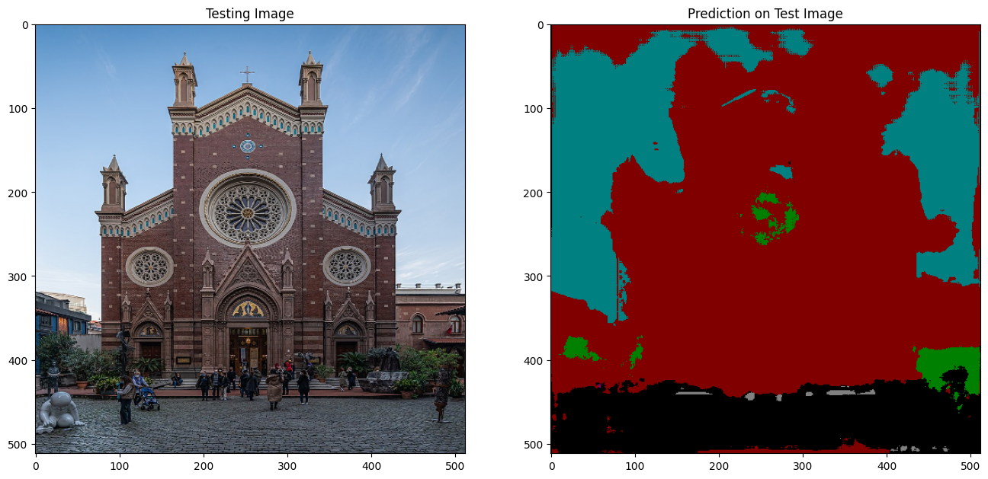
U-Net Predictions on Architects-All

Slide 8
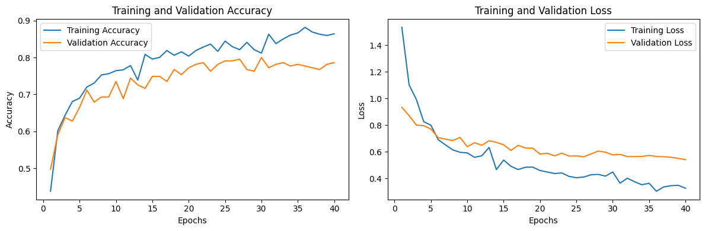
Combined Model: Train & Evaluate
Precision: 0.7915, Recall: 0.7767, Accuracy: 0.8574

Slide 9
Optimization Experiments
Preprocessing
Merging segmentation classes (building, door, window, background)
Resizing images using nearest neighbor interpolation
Model architecture
Extracting features from the deepest layer in the contraction path and fed into to another CNN with the image
Heatmap to observe the attention map

Slide 10

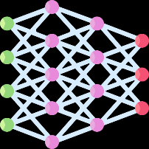




Project Timeline
Data Loading & Preprocessing 01/04/24 - 15/04/24
15/04/24 - 29/04/24 Model Architecture and Building
Architectural Style Clustering
27/05/24 - 05/06/24
13/05/24 - 27/05/24
Hyperparameter Tuning
Model Training and Evaluation
29/04/24 13/05/24
05/06/24 - 12/06/24
Model Deployment

Slide 11

Success Criteria
Semantic segmentation: 80% accuracy
Classify 3 architects: 90% accuracy (current 85%)
Classify 16 architects: 80% accuracy (prev. %73)
Clusters' silhouette score: 0.5-0.7 (prev. 0.43)

Slide 12
References
Yoshimura, Y., Cai, B., Wang, Z. and Ratti, C., 2019. Deep learning architect: Classification for architectural design through the eye of artificial intelligence. Computational Urban Planning and Management for Smart Cities 16, pp.249-265.
Zhang, M., Cui, Z., Neumann, M. and Chen, Y., 2018, April. An end-to-end deep learning architecture for graph classification. In Proceedings of the AAAI conference on artificial intelligence (Vol. 32, No. 1).
Pesto, C., 2017. Classifying US Houses by Architectural Style Using Convolutional Neural Networks.
Wang, B., Zhang, S., Zhang, J. and Cai, Z., 2023. Architectural style classification based on CNN and channel–spatial attention. Signal, Image and Video Processing, 17(1), pp.99-107.
Architecture of Turkey: https://en.wikipedia.org/wiki/Architecture_of_Turkey
İcons: Flaticon.com

