Slide 1

Session #?
Notes:
Version adapted during Summer 2021. Original ppt presented during session 5 in 2019

Slide 2
The Data Pump Utility
© Jean-Jacques Porrovecchio

Slide 3
Agenda
Context
Database architecture
Data model
The packages
Files organisation
Sysper example
Requirements
Enhancements
Demo and conclusion

Slide 4
Context: Sysper project (2008):
plenty of databases: dev, test, acceptance, training, loadtest, production
many parallel streams => plenty of schemas
bi-directional dataflows with other systems: ComRef, NAP, ….

Slide 5
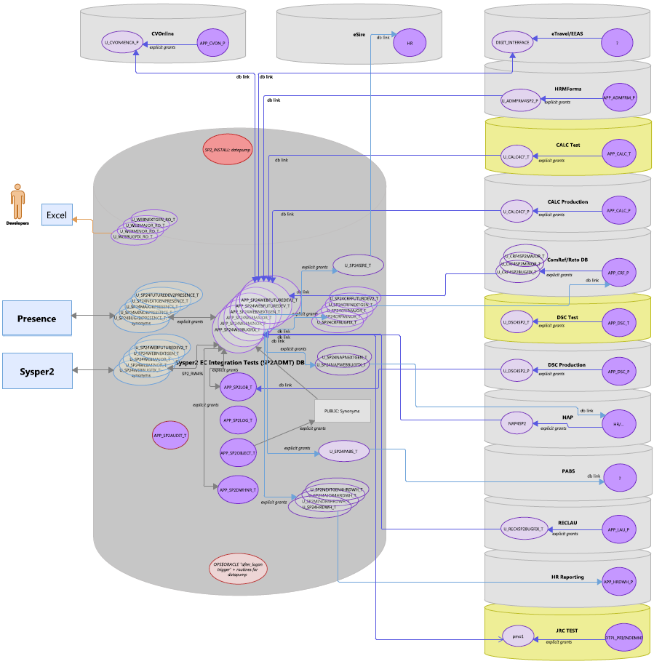
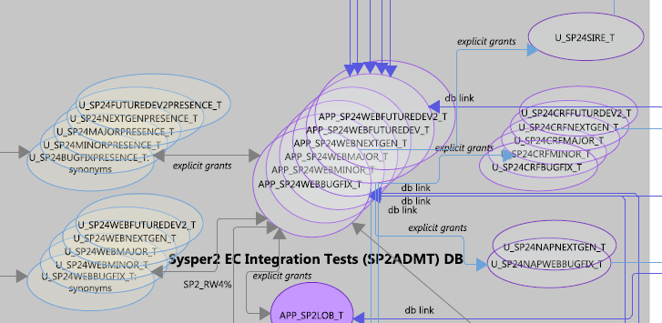
Context: Sysper project (2008):

Slide 6
A solution fully contained within Oracle to replicate schemas between database instances
Export
Transfer the files (optional)
Import from files or
directly via Network_Link (autumn 2019)
Pre and Post actions
Adapted for AWS Oracle RDS (spring 2020)
Adapted for Oracle 12c/19c (september 2020)
Distribution package (summer 2021)
Adapted for CoP (Cloud on Premise) (November 2022)
Used in Sysper (2009), Folio (2016), SerMed (2022).

Slide 7
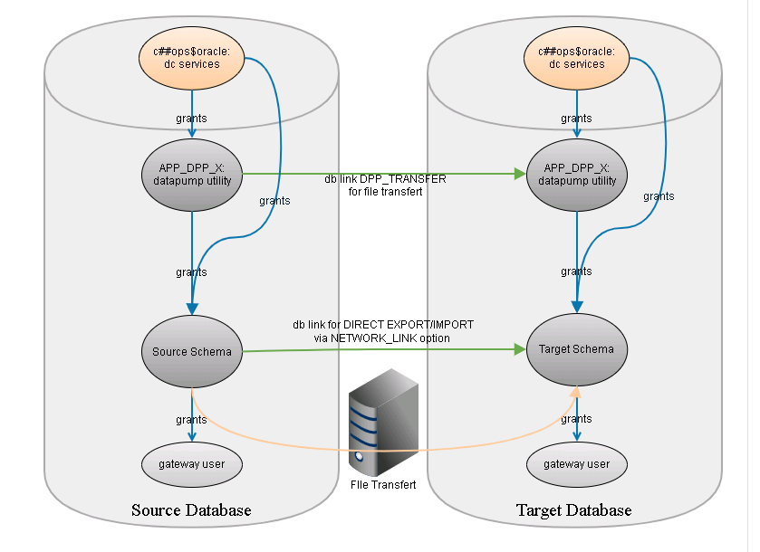
Database architecture
On DC traditional premises
Notes:
Two schemas:
One for the tool itself: app_dpp_x
C##OPS$ORACLE: where the DC puts the services you need

Slide 8
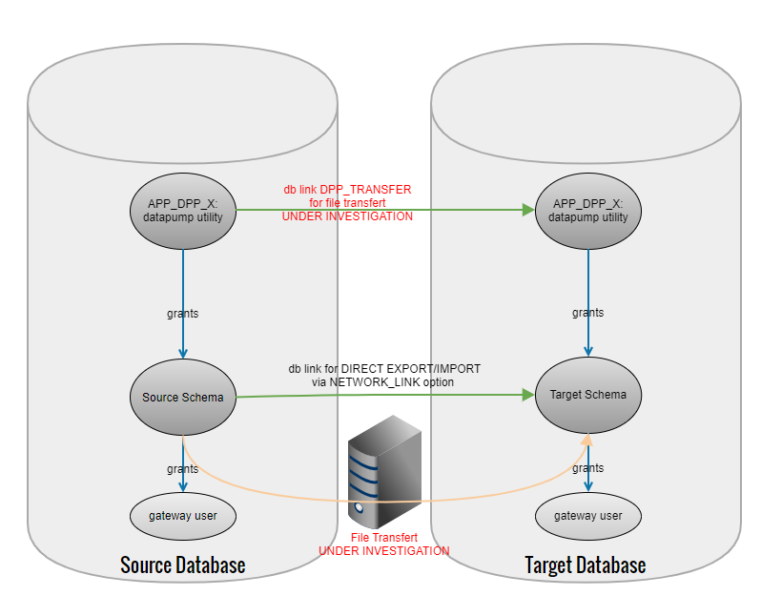
Database architecture
In AWS Oracle RDS

Slide 9
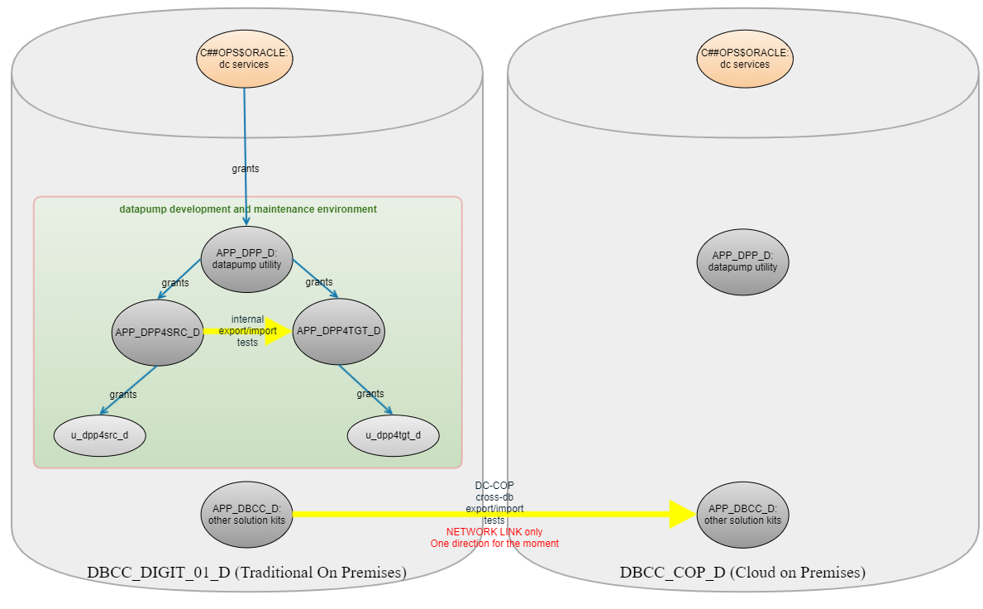
Database architecture
CoP (Cloud on premise)

Slide 10
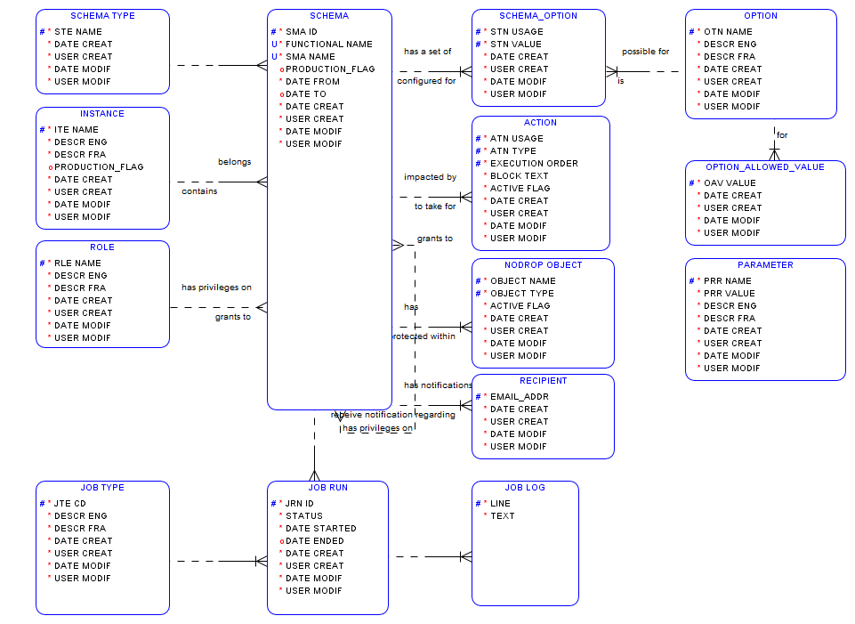
APP_DPP_x Data model

Slide 11
APP_DPP_x Data model
Instance
Development
Test
Acceptance
Production
……
Notes:
Define all the databases in which the tool will be installed for a subject application

Slide 12
APP_DPP_x Data model
Schema Type
Main
Lob
Web
Gateway for client (ComRef, ….)
….
Notes:
This typology can then be used to automate some post import actions such as restore of grants and synonyms

Slide 13
APP_DPP_x Data model
Role
ReadWrite
ReadOnly
….

Slide 14
APP_DPP_x Data model
Option
List of all available options for export and import
Notes:
Put in a single row the settings chosen for a given schema and datapump action type (export, import)

Slide 15
APP_DPP_x Data model
Option Allowed Value
List of allowed values for the options when pertinent
Notes:
Put in a single row the settings chosen for a given schema and datapump action type (export, import)

Slide 16
APP_DPP_x Data model
Schema Option
List of chosen value pairs "option/value" for export or import such as:
RECYCLEBIN=>PURGE
TABLES=>DROP
VIEWS=>DROP
EMAIL_RESULT=>YES
EXEC_POSTFIX=>YES
LOCK_SCHEMA=>YES
METADATA_FILTER=> NOT LIKE 'TMP%'
NETWORK_LINK
….
Notes:
Put in a single row the settings chosen for a given schema and datapump action type (export, import)

Slide 17
APP_DPP_x Data model
Action
Piece of pl/sql code that can be invoked before or after an export or an import.
Sysper examples:
Before import: BEGIN sp2_dpp_utl.prefix_rls; END;
After import: BEGIN sp2_dpp_utl.postfix_rls; END;

Slide 18
APP_DPP_x Data model
No Drop Object
Excludes objects from being dropped if otherwise specified by the (example)
TABLE=>DROP value.
It can be a table, an index, a sequence, a materialized view, a package…

Slide 19
APP_DPP_x Data model
Job Type
Export
Import
File Transfer

Slide 20
APP_DPP_x Data model
Job Run
Contains status, start and ending date of all job runs

Slide 21
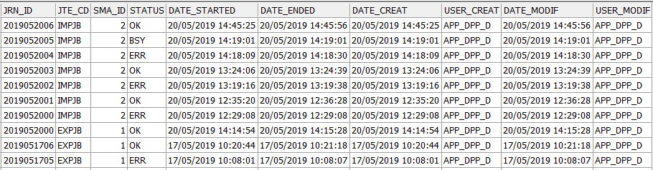
APP_DPP_x Data model
Job Run example

Slide 22
APP_DPP_x Data model
Job Log
Contains detailed job run information

Slide 23
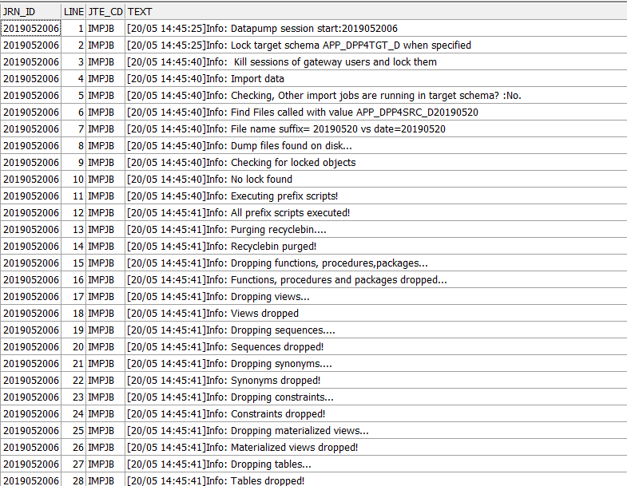
APP_DPP_x Data model
Job Log example (pre import)

Slide 24
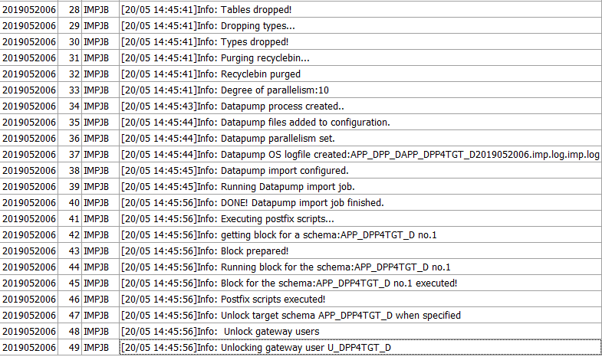
APP_DPP_x Data model
Job Log example (pre import, part 2)

Slide 25
APP_DPP_x Data model
Recipient
List of email addresses that should receive a notification when an export/import/file transfer process is performed for the related schema

Slide 26
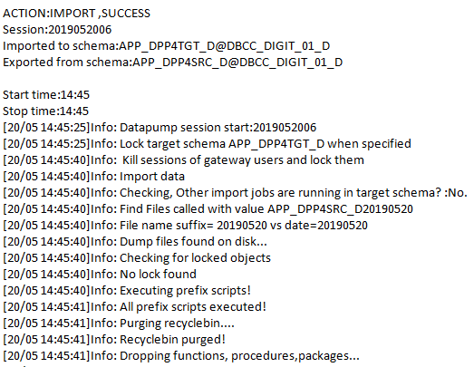
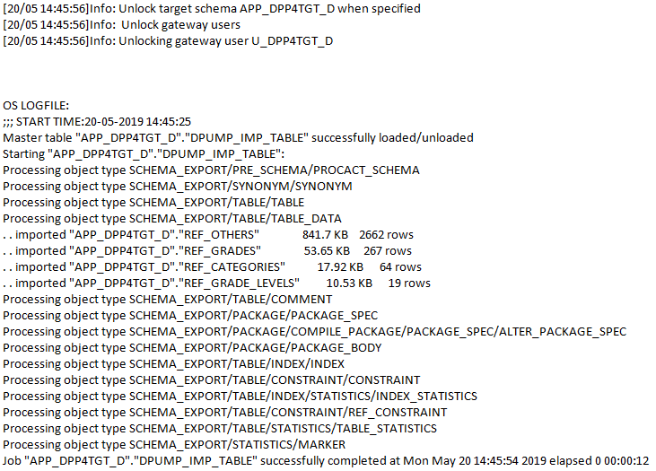
APP_DPP_x Data model
Recipient: notification example

Slide 27
APP_DPP_x Data model
Schema
Configuration of the schemas of your databases:
Instance
Type
Associated roles (eg RW for a gateway applicative user)
Linked schemas (n:n)
….

Slide 28
APP_DPP_x Data model
Parameter
Configuration of the utility itself. So far, only a couple of global Oracle directory names

Slide 29
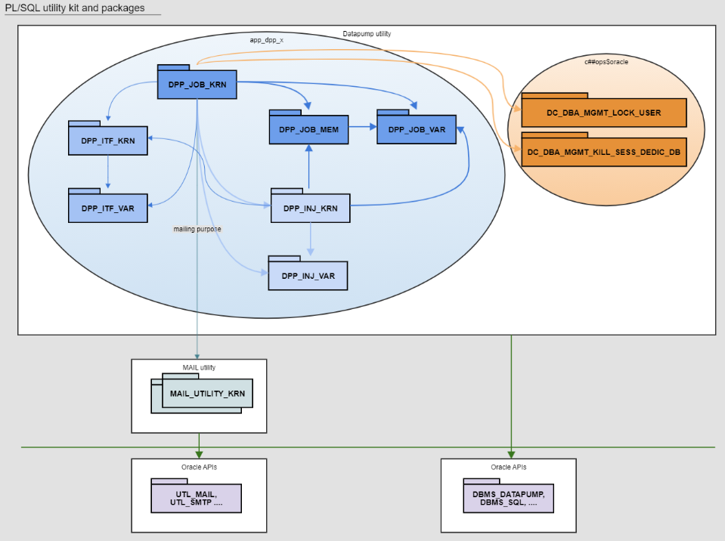
APP_DPP_x packages
On DC premises

Slide 30
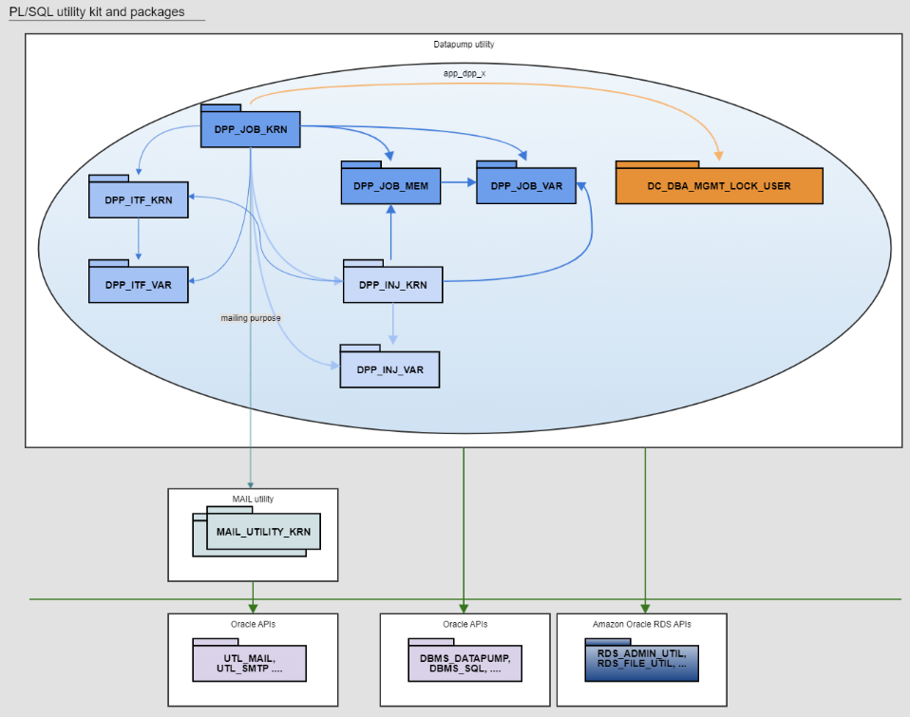
APP_DPP_x packages
In AWS Oracle RDS

Slide 31
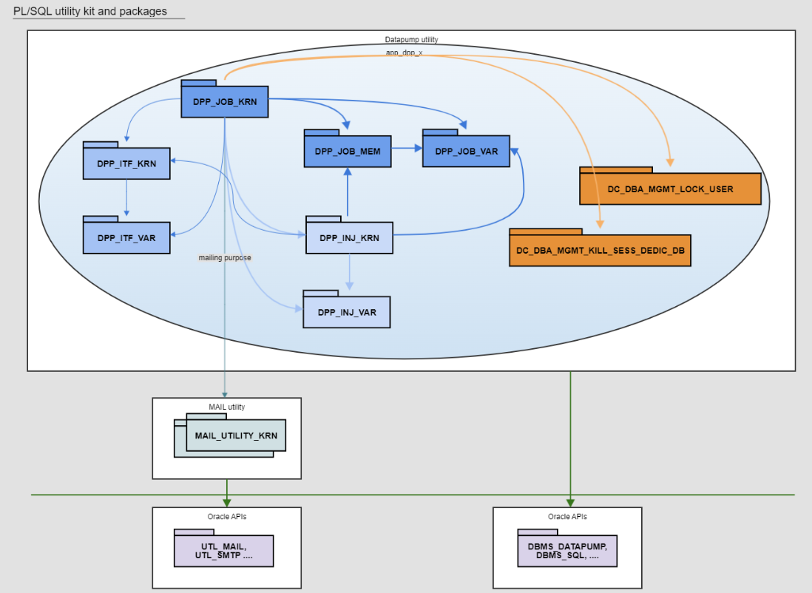
APP_DPP_x packages
CoP (Cloud on premise)

Slide 32
APP_DPP_x packages
Core engine:
DPP_JOB_KRN
DPP_JOB_MEM
DPP_JOB_VAR
Injection:
DPP_INJ_KRN
DPP_INJ_VAR
Logging:
DPP_ITF_KRN
DPP_ITF_VAR
Mailing:
MAIL_UTILITY kit

Slide 33
APP_DPP_x packages
DPP_JOB_KRN Export:
Injects, runs and drops in the source schema:
Pre-export actions
export job
Sends results via email

Slide 34
APP_DPP_x packages
DPP_JOB_KRN Import:
Locks target schema + gateway schemas
Kills sessions
Injects, runs ands drops in target schema:
pre-import actions
object drop routines
import job
post-import actions
Unlocks target schema + gateway schemas
Sends results via email

Slide 35
APP_DPP_x packages
DPP_UTL_KRN Transfer:
Provides a service to transfer dump files between servers (DC version)
Sends results via email

Slide 36
APP_DPP_x packages
DPP_INJ_KRN:
Provides all services to inject routines in a target schema and to drop them afterwards

Slide 37
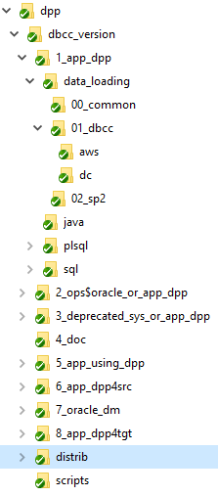
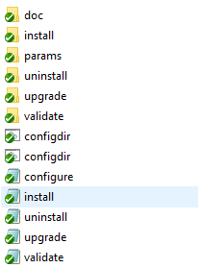
Files organisation
Internal kitchen

Slide 38
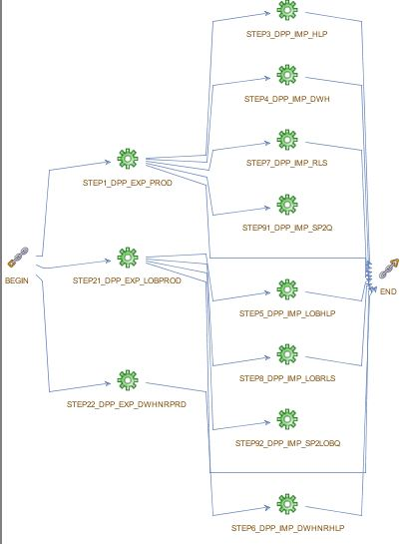
Sysper example

Slide 39
Sysper example
Step1_dpp_exp_prod
BEGIN
dpp_job_krn.remove_files_old_logical('PROD',SYSDATE-1);
dpp_job_krn.remove_files_old_logical@dpp_transfer(
'PROD',SYSDATE-1);
dpp_job_krn.export_logical_name('PROD');
dpp_job_krn.transfer_dumpfiles('PROD','dpp_transfer');
END;
/

Slide 40
Sysper example
Step7_dpp_imp_rls
DECLARE
l_systimestamp VARCHAR2(20) := TO_CHAR(SYSDATE, 'YYYYMMDDHH24MISS');
BEGIN
dbms_scheduler.create_job@dpp_transfer
(job_name=>'SP2_DPP_RLSPROD_'||l_systimestamp
,job_type=>'PLSQL_BLOCK'
,job_action=> '
DECLARE
BEGIN
dpp_job_krn.import_logical_name(''PROD'',''RELEASE'');
END;
'
,start_date=> SYSTIMESTAMP
,enabled=> TRUE
,auto_drop=>FALSE
,comments=>'COM: refresh Release schema immediately'
);
END;

Slide 41
Sysper example
Post import action:
BEGIN sp2_dpp_utl.postfix_rls; END;
PROCEDURE postfix_rls
IS
BEGIN
postfix_common_start; -- check_prod, restore synonyms, compile and disable audit triggers, context, flags….
restore_all_grants;
sec_activation;
postfix_common_near_end(p_exists_gateway_user=>TRUE); -- enable audit triggers, web synonyms, …
-- EXTRA
create_functional_users;
END;

Slide 42
Requirements
On traditional DC premises
In AWS Oracle RDS
C##OPS$ORACLE
Objects to be installed => contact DIGIT ISHS ORACLE via EC HELPDESK IT
APP_DPP_x
System privileges
Object privileges
Roles
Application schema
Object privileges (app_dpp_x, dictionary)
Read/Write on Oracle Directories
NAS storage
There is a standard infrastructure=> contact DC.
APP_DPP_x
System privileges
Object privileges
Roles
Application schema
Object privileges (app_dpp_x, dictionary)
Read/Write on Oracle Directories
CoP (Cloud on premise)
APP_DPP_x
System privileges
Object privileges
Roles
Application schema
Object privileges (app_dpp_x, dictionary)
Read/Write on Oracle Directories

Slide 43
Enhancements
Success/Failure weak interpretation (server logs not analysed)
More flexibility regarding the METADATA_FILTER (so far only Exclude_path implemented)
Support transfert between AWS Oracle RDS
Support transfert between DC and AWS has been refused => use AWS CLI + S3. Possible automation: Bamboo + SQL agent + AWS CLI + S3 + lambda

Slide 44
Final word
Shipping today for free!
Documentation available here: PL/SQL Datapump utility
Questions?
Demo
Notes:
Demo:
Show Wiki: PL/SQL Datapump utility - DIGIT B4 Competency Centres - CITnet Confluence (europa.eu)
Live demo
Enhancements

