Slide 1
Clustering Update Meeting
10/8/2025

Slide 2
Features
Slope between avg T24 log2fc and avg T0 log2fc
Slope between avg T48 log2fc and avg T24 log2fc
Slope between avg T72 log2fc and avg T48 log2fc
Average slope: Average slope score between 1, 2, and 3
Total slope: Linear regression across all time points from T0 to T72
Slope between avg T48 log2fc and avg T0 log2fc
Slope between avg T72 log2fc and avg T0 log2fc
"avg T72 log2fc” Score

Slide 3
What We Tried
Dimension
2D / 4D / 7D
Clustering Model
Spectral Clustering
Mean Shift
OPTICS
DBSCAN
Classified into 2 clusters
Label 0
  All are negative slopes
  Steeper than Label 1
Label 1
  Has both negative and positive slopes

Slide 4
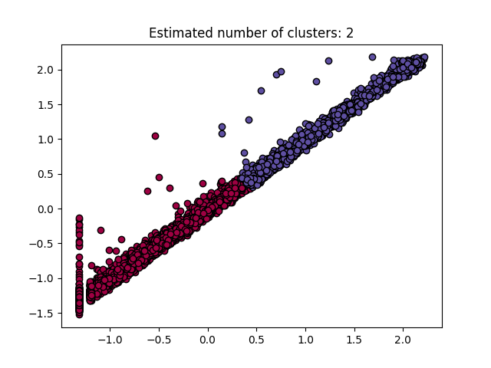
Results (n = 5633)
2D
Features Include:
"avg T72 log2fc” Score
Average slope

Slide 5
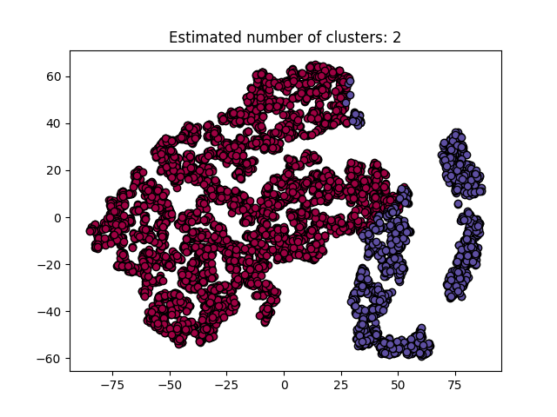
Results
4D
Features include:
Slope between avg T24 log2fc and avg T0 log2fc
Slope between avg T48 log2fc and avg T24 log2fc
Slope between avg T72 log2fc and avg T48 log2fc
Total Slope

Slide 6
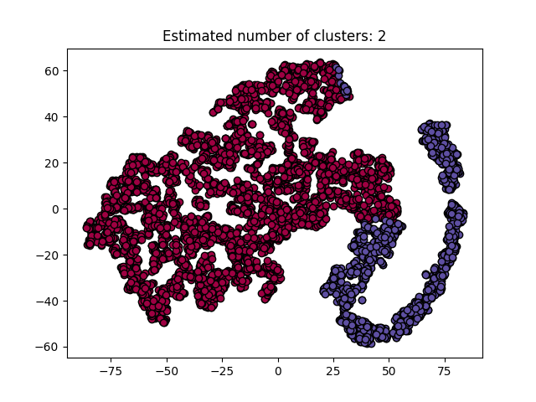
Results
7D
Features include:
Slope between avg T24 log2fc and avg T0 log2fc
Slope between avg T48 log2fc and avg T24 log2fc
Slope between avg T72 log2fc and avg T48 log2fc
Total Slope
Slope between avg T48 log2fc and avg T0 log2fc
Slope between avg T72 log2fc and avg T0 log2fc
"avg T72 log2fc” Score

Slide 7
Results
No bad clustering for all results:
Most data points in Label 0 have a smaller avg T72 log2fc value compared to Label 1
Some overlaps between the two clusters, but they are all within the margin of:
  6 or less for “avg T72 score”
  Less than 0.05 for the average slope score
  0.05 or less for the total slope score

Slide 8
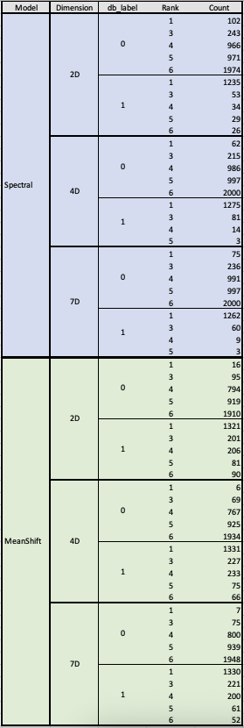
Results Compared to Original Ranks
If compared with the counts of each rank: Spectral Clustering 4D and 7D models have a higher similarity with the original ranking.

Slide 9
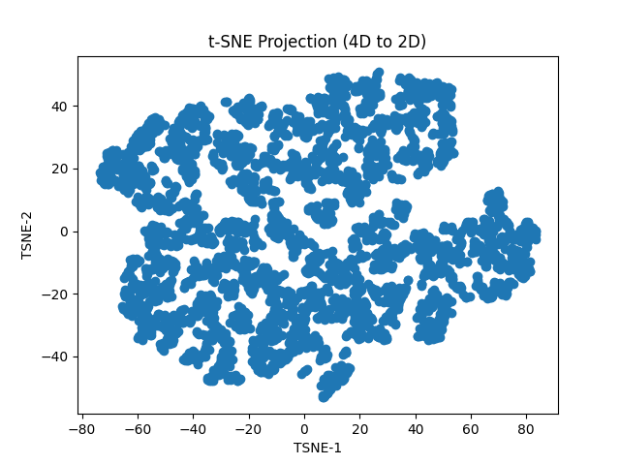
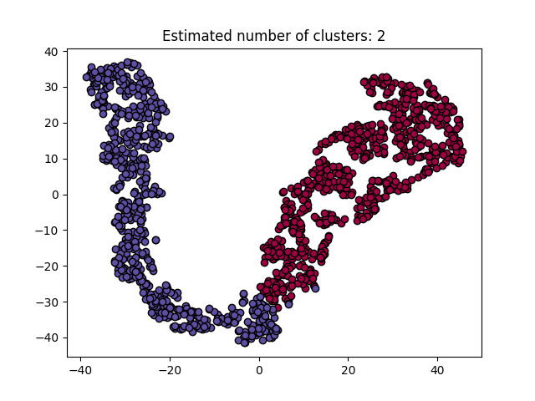
Clustering Again on Each Label
Label 0 – Spectral Clustering 4D
Sample size: 4260
Label 1 – Spectral Clustering 4D
Sample Size: 1373

Slide 10
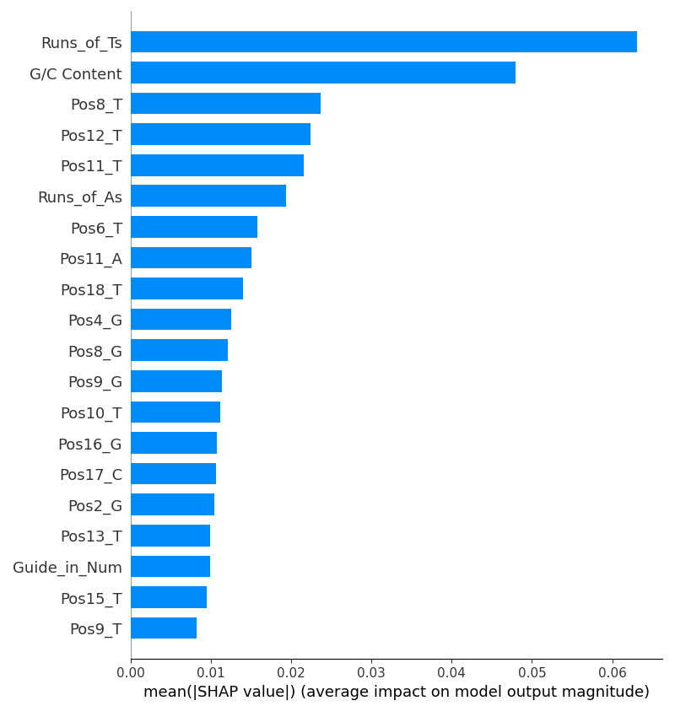
Classification ML Model with new Clusters
Random Forest Classifier – Cluster Label
Accuracy: 81%
F1:80 %
Precision: 80%
Recall: 81%
Null Accuracy: 76%
Random Forest Classifier – Previous Ranking
Accuracy: 81%
F1:79%
Precision: 80%
Recall: 81%
Null Accuracy: 76%

