Slide 1
Update Meeting
7/18/25

Slide 2
Features Included In The Dataset
Guide in numbers
  G = 0; A = 1; C = 2; T = 3
OH encoding guide
  Turns each nucleotides in a guide sequence into true (1) or false (0) format
  To avoid models reading the guide sequences as continuous numbers.
G/C content
Runs of As
Runs of Ts

Slide 3
What We Tried – Predict Ranks
Predictive Machine Learning Models We Tried
Decision Tree Classification
Random Forest Classification
K-Nearest Neighbor (KNN)
Convolutional Neural Network (CNN)
Approaches We Tried
Predict in 5-rank scale: 1, 3, 4, 5, 6
Predict in 4-rank scale: 1, 4, 5, 6
Predict in 3-rank scale: 1, (3, 4 and 5), 6
Predict in binary rank scale: 1, (3, 4, 5, and 6)
Notes:
Rank 1: enriched in library
Rank 2: no data (not cloned or transformed successfully) or had very low counts (generally starting below 130 counts) and were removed from processing
Rank 3: weak depletion, weak enrichment, or no clear trend
Rank 4: Starts out with slow depletion
Rank 5: Slightly steeper depletion
Rank 6: steepest depletion

Slide 4
What We Tried – Predict Ranks
4 Metrics We Used to Scale the Performance of Our Models
(F1, Precision, and Recall are weighted to accommodate uneven class distribution)
Accuracy
F1
Precision → High precision score indicates avoiding purchasing guides that do not work
Recall → High recall score indicates not missing out of guides that would’ve work
Notes:
Precision: When predicting something is positive, how often am I correct
Recall: Did I find all the positives
Accuracy: How often am I correct overall
F1: A balance score for both precision and recall. (Will be low if one of the score is high and the other is low)

Slide 5
Best Approaches and Results
CNN model yields the best result for 5-rank, 4-rank, 3-rank scales in all 4 metrics and have the same results as Random Forest Classification for binary rank scale.
5-rank scale
Accuracy: 49%
F1: 38%
Precision: 42%
Recall: 49%
4-rank scale
Accuracy: 53%
F1: 44%
Precision: 42%
Recall: 53%
3-rank scale
Accuracy: 55%
F1: 55%
Precision: 56%
Recall: 54%
Binary rank scale
Accuracy: 81%
F1: 79%
Precision: 80%
Recall: 81%

Slide 6
Best Approaches and Results
Scale | Null Accuracy (most common rank) | Weighted Random Guess | CNN Model Accuracy
5-rank | 35% (rank 6) | 25% | 49%
4-rank | 37% (rank 6) | 27% | 53%
3-rank | 41% (rank 1) | 35% | 55%
Binary | 76% (rank 1) | 64% | 81%
*Null Accuracy: Always guess with the most common rank in the testing dataset.
*Weighted Random Guess: Guess randomly, with probability equal to each rank’s frequency.
Notes:
5-rank: 14%
4: 16%
3: 14%
2: 5%

Slide 7
What We Tried – Predict avg T72 log2fc
Predictive Machine Learning Models We Tried
XGBoost Regressor
Convolutional Neural Network (CNN)
Metrics
Root Mean Square Error (RMSE)
R Squared (R² )

Slide 8
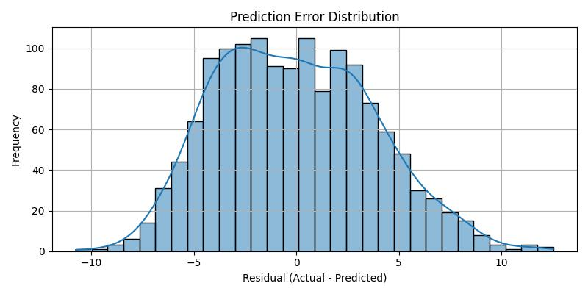
Best Approaches and Results
XGBoost Regressor yields the best RMSE and R² scores.
RMSE: 3.91
R²: 0.35

Slide 9
Explainable AI – LIME
Models Used
Rank prediction models (Predict in 4-rank scale)
  Random Forest Classification
  1D CNN Classification
No single feature shows a dominant influence across both models; however, ‘Runs of Ts’ and ‘Pos_9’ (position 9) consistently exhibit slightly higher influence compared to the other features.

Slide 10
Ideas of Approaches to Try Next
Ideas to Build Upon Already Built Models
Try 2D max pooling for CNN model
Alpha fold + CNN
New Models to Try Next
Support Vector Machine (SVM)
Long Short-Term Memory (LSTM)
Transformers

