Slide 1
Python Unit Testing
What is Automation Testing
Difference between MT & AT
What is Unit Testing
Unit Test Framework
Steps to create a Unit Test
Simple Test
“TestCase” Class
Unit Test Framework-Assertion
Advantages of using Python Unit testing
Case Study

Slide 2
Automation Testing
Using Automation tools to write and execute test
cases is known as automation testing. No manual
intervention is required while executing an
automated test suite.
Testers write test scripts and test cases using the
automation tool and then group into test suites.
Benefits of Automation Testing.
Reduction of repetitive work.
Repeatability
Greater consistency
Ease of access of information about tests or testing

Slide 3
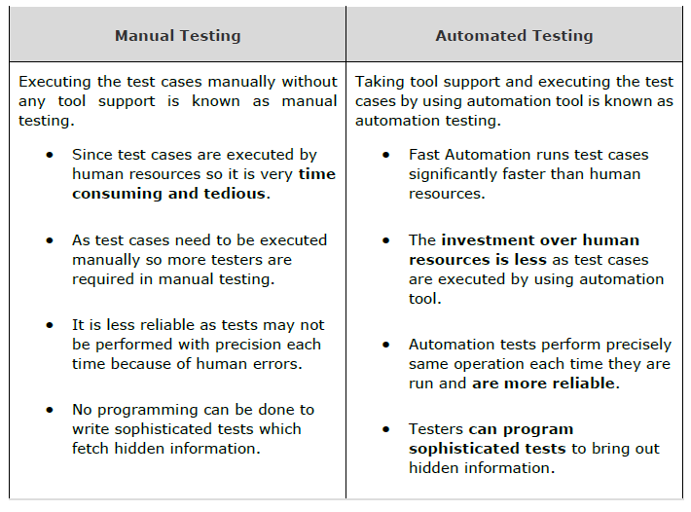
Difference b/n MT & AT

Slide 4
Unit Test
Unit testing is a software testing method by which individual units of source code, such as functions, methods, and class are tested to determine whether they are fit for use.
One can view a unit as the smallest testable part of an application.
Unit tests are short code fragments created by programmers during the development process.
The Python unit testing framework referred as PyUnit and part of Python Standard Library as of Python version 2.1.

Slide 5
UnitTest Framework
‘UnitTest’ supports test automation, sharing of setup and shutdown code for tests, aggregation of tests into collections, and independence of the tests from the reporting framework.
To achieve this, unittest supports the following important concepts:
test fixture: This represents the preparation needed to perform one or more
tests, and any associate cleanup actions.
test case: This is the smallest unit of testing. This checks for a specific
Response to a particular set of inputs.
test suite: This is a collection of test cases, test suites, or both. This is used
to aggregate tests that should be executed together.
test runner: This is a component which orchestrates the execution of tests
and provides the outcome to the user.

Slide 6
Simple Test
import unittest
def add(x,y):
return x+y
class SimpleTest(unittest.TestCase):
def testadd1(self):
self.assertEquals(add(4,5),9)
if __name__ == '__main__':
unittest.main()
Possible outcomes of a test:
OK: The test passes. “.” is displayed on console.
FAIL: The test does not pass, and raises an AssertionError
exception. “F” is displayed on console.
ERROR: The test raises an exception other than AssertionError.
“E” is displayed on console.

Slide 7
Creating a Unit Test
Import the unittest module in your program.
Define a function to be tested. In the following example, add() function is to be subjected to test.
Create a testcase by subclassing unittest.TestCase.
Define a test as a method inside the class. Name of method must start with 'test'.
Each test calls assert function of TestCase class. There are many types of asserts. Following example calls assertEquals() function.
assertEquals() function compares result of add() function with arg2 argument and throws assertionError if comparison fails.
Finally, call main() method from the unittest module.

Slide 8
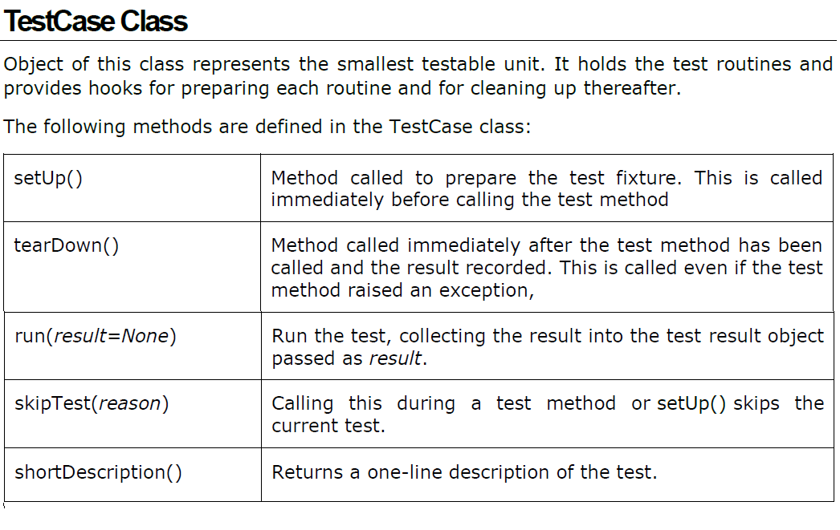

Slide 9
UnitTest Framework — Assertion
Python testing framework uses Python's built-in assert()
function which tests a particular condition.
If the assertion fails, an AssertionError will be raised. The
testing framework will then identify the test as Failure. Other
exceptions are treated as Error.
The following three sets of assertion functions are defined in
unittest module:
Basic Boolean Asserts
Comparative Asserts
Asserts for Collections

Slide 10
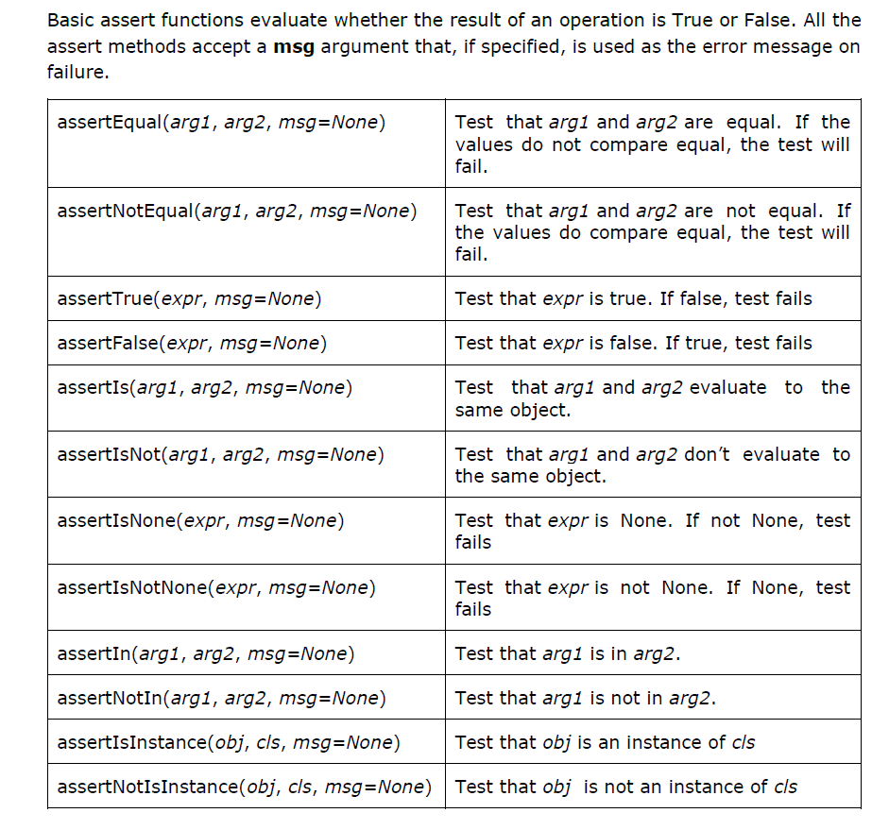

Slide 11
Advantages of using Python Unit testing
It helps you to detect bugs early in the development
cycle
It helps you to write better programs
It syncs easily with other testing methods and tools
It will have many fewer bugs
It is easier to modify in future with very less
consequence

Slide 12
Case Study
https://www.computerworld.com/article/3144985/linux/linux-hardening-a-15-step-checklist-for-a-secure-linux-server.html

