Slide 1

Cassandra
Smart statistics for policy support
Computer ASSisted ANalysis using Dynamic Regression Algorithms
JRC / EUROSTAT
common activities on
Big Data analytics

Slide 2
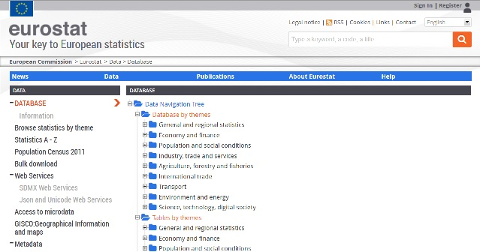
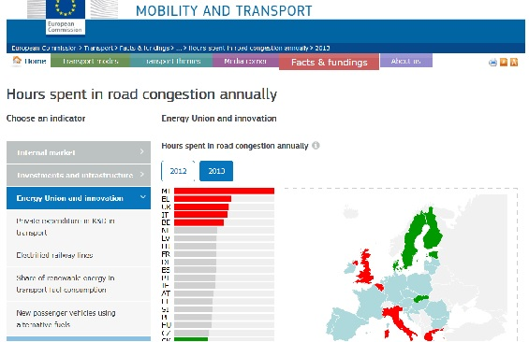

The challenge
VVVs
of data
Evidence based
policy making

Slide 3
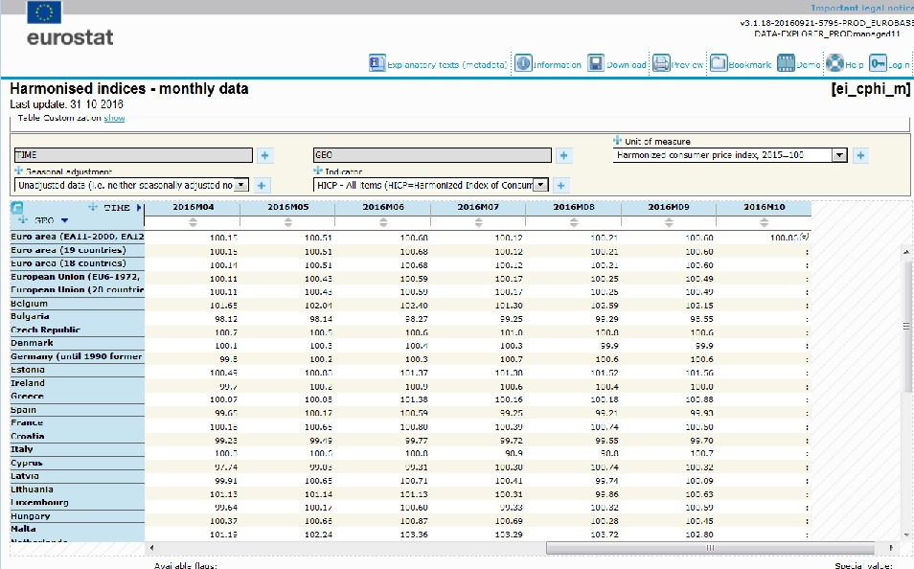
Nowcasting: estimate current value of indicator

Slide 4
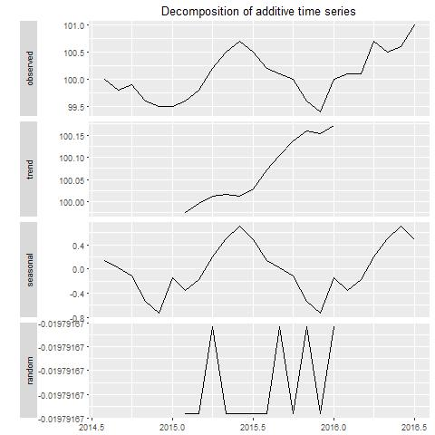
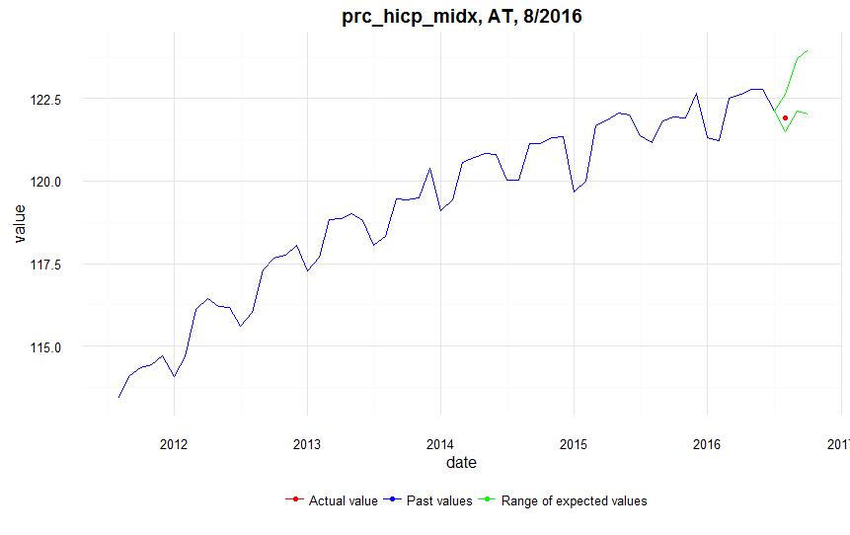
SARIMA approach

Slide 5

Now-casting = forecasting r periods after TS
r=3
Current solution
Machine learning
Limited "new" sources
r between 1 and 6
Confidence interval depends on use
Conf.
interval
r=1
t
Time series

Slide 6



Cassandra: Now-casting
Flexible, modular structure

Slide 7
Finding structural breaks = "forecasting" last TS value
Current solution
Only "simple" model
r is 1
Confidence interval depends on how sensitive
Conf.
interval
r=1
t
Time series (to t-1)

Slide 8
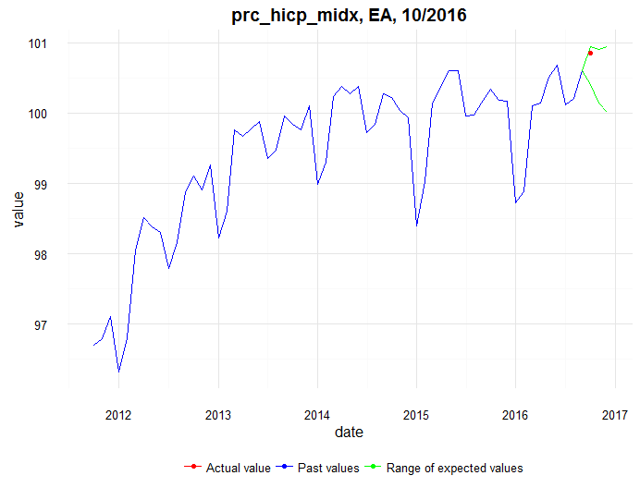
Real life application: structural break in inflation?

Slide 9
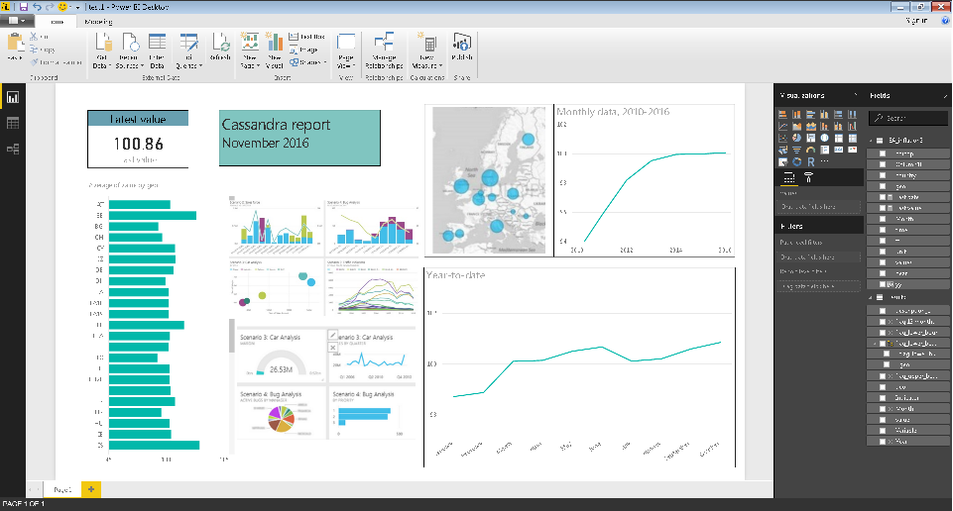

Cassandra: Tailored visualisation tools

Slide 10
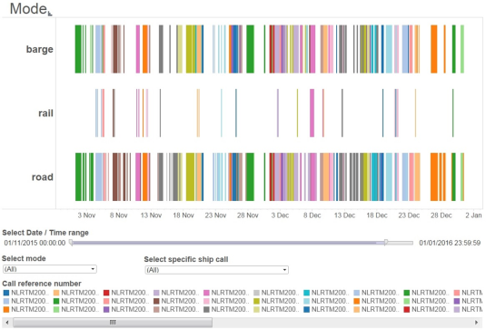
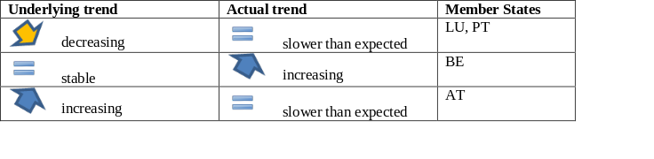
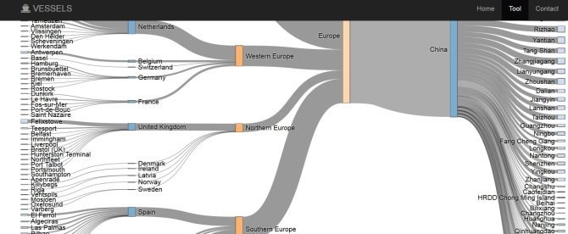
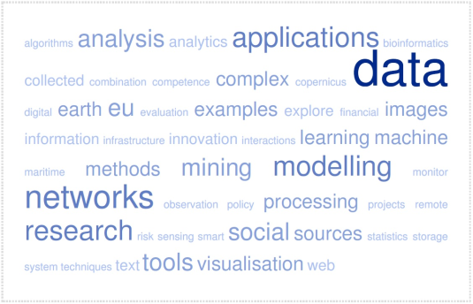

Cassandra: flexibility in input, methods, output
New sources of data
Text mining

Slide 11
Cassandra team
JRC
Panos Christidis
Andris Peize
Alexis Bolivar
EUROSTAT
Dario Buono
Bogomil Kovachev
Loredana Di Consiglio
Fernando Reis
and growing!
Contact: Panayotis.Christidis@ec.europa.eu

