Slide 1

Road congestion / urban transport
Using TomTom data
JRC Big Data analytics
Contacts: N. Ibañez, P. Christidis
Juan-Nicolas.IBANEZ@ec.europa.eu
Panayotis.Christidis@ec.europa.eu

Slide 2

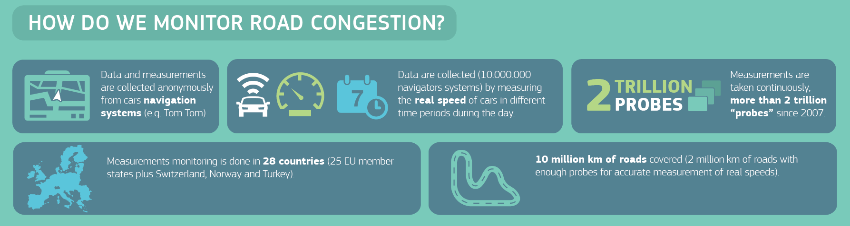

Slide 3
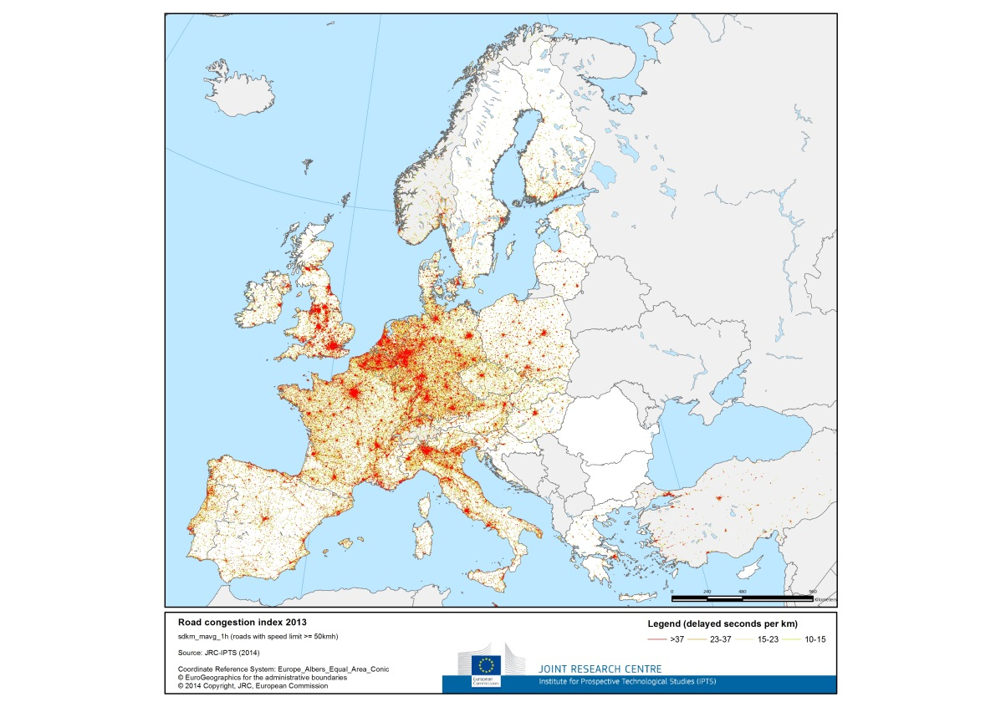
EU – wide map of congestion

Slide 4
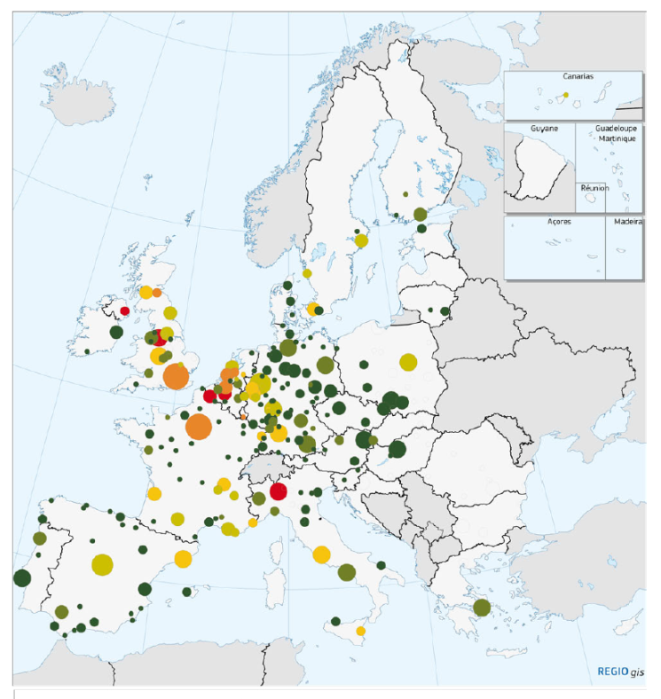
Zoom to urban level…

Slide 5
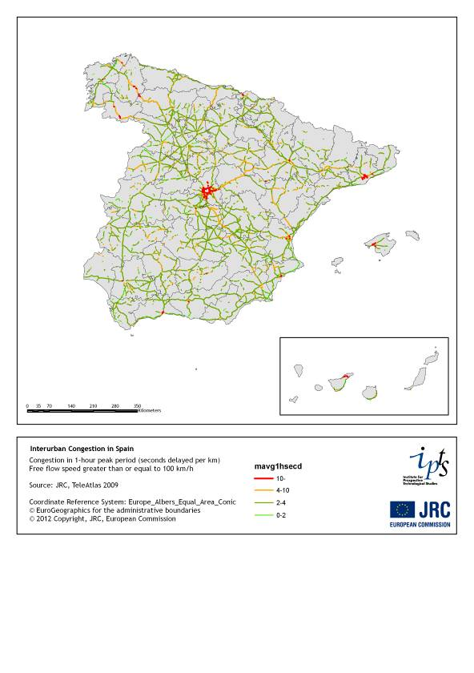
… or network …

Slide 6
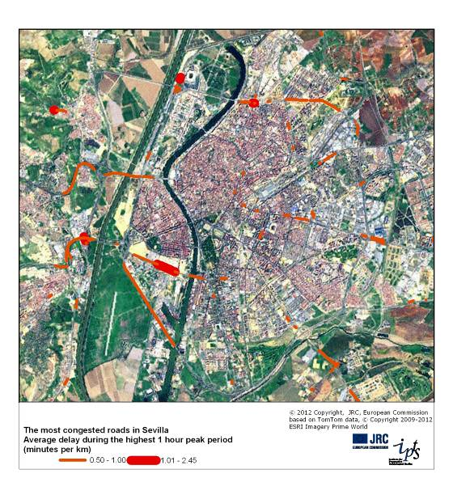
… even specific roads!

Slide 7
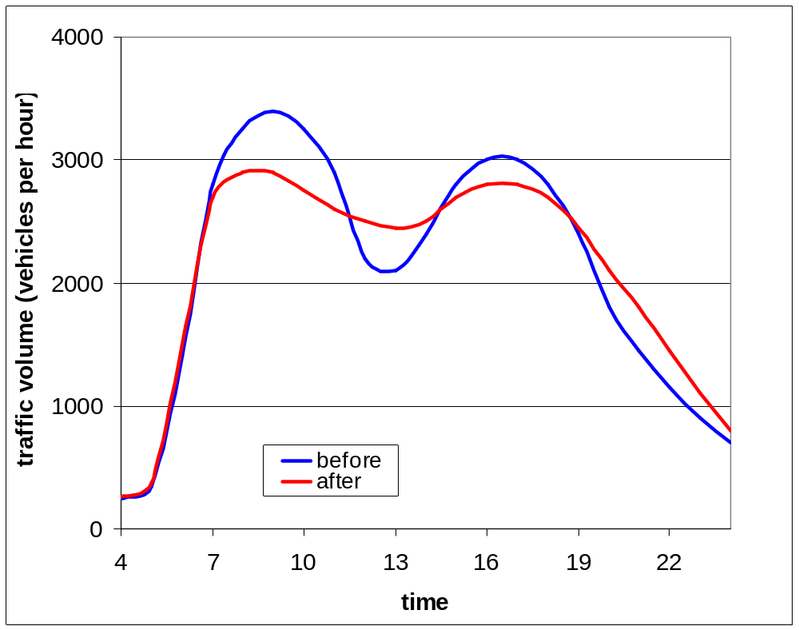
Analysis of time patterns and impact of measures

Slide 8
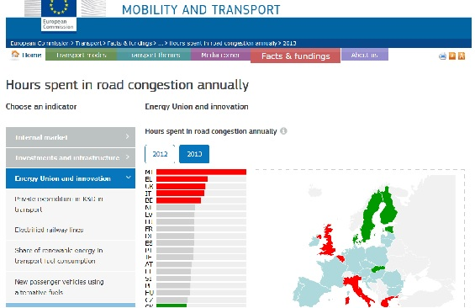
Input to Transport Scoreboard and European Semester reports

Slide 9
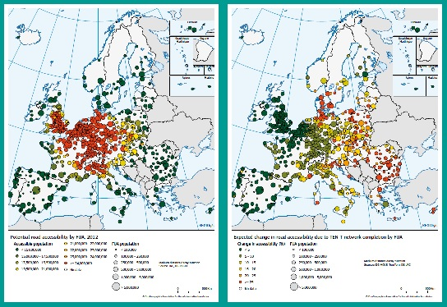
Input to Cities report…

Slide 10
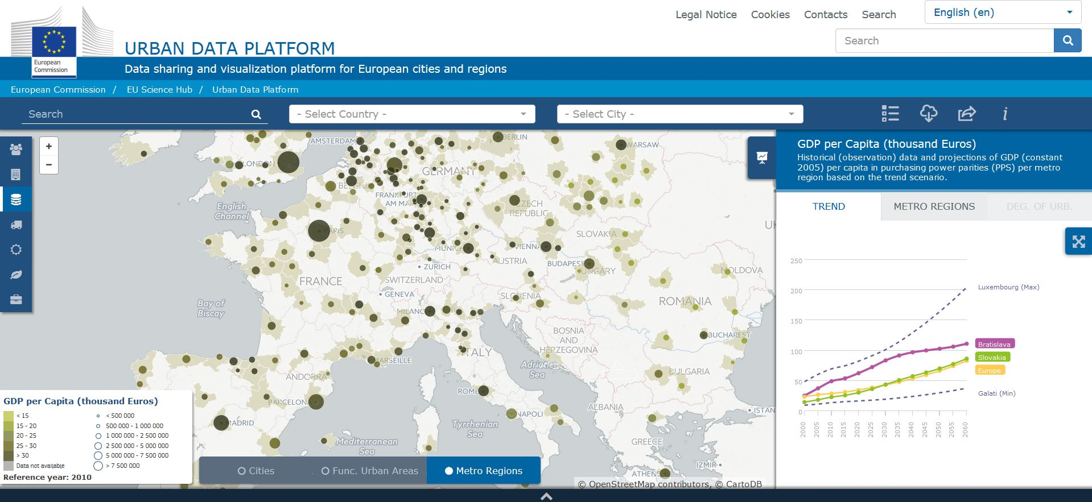
JRC Urban Data Platform

