Slide 1
The role of ICT in the public sector by Prof Diana-Urania Galetta

Slide 2
Digitizing Public Administration?
In what sense exactly?
In the transition towards a digitized public administration two approaches can be followed:
A) digitization on a per-administration basis;
or
B) digitization on a per-procedure basis.
Prof.ssa Diana-Urania GALETTA

Slide 3
A) Digitization of Public Administrations
The digitization process is carried out by defining the technological tools that have to be implemented to support all the activities of each authority
The process would be carried out by digitizing all activities carried out by the specific Authority, without considering interactions with other public administrations
Prof.ssa Diana-Urania GALETTA

Slide 4
B) Digitization of administrative procedures
It involves a cross-cutting approach, which leads to the digitization of a particular process in its entirety, from the first act, until the issuance of the final administrative act.
Prof.ssa Diana-Urania GALETTA

Slide 5
Pros and cons
Both approaches have pros and cons.
A) PROS:
simpler approach
internal per-procedure basis
CONS
fragmentation
coordination needed
inability to achieve full digitization
Prof.ssa Diana-Urania GALETTA

Slide 6
Pros and cons
Both approaches have pros and cons.
B) PROS:
procedural guarantees
legality of action
full digitization
reuse
CONS
more complex
one procedure at a time
Prof.ssa Diana-Urania GALETTA

Slide 7
Methodological issues
Digitization as a tool, not as a goal
A merely reshaping of the internal productive processes: a different way to perform administrative tasks!
The classical concepts of administrative law (administrative procedure, administrative act, etc.) won’t change because of ICT!
Prof.ssa Diana-Urania GALETTA

Slide 8
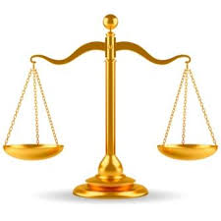
Balancing costs and benefits
The creation, development and maintenance of each technology solution has costs
Just a matter of …
PROPORTIONALITY!!
costs benefits
Prof.ssa Diana-Urania GALETTA

Slide 9
Technology for better service delivery?
The transparency point of view
Right to good administration and administrative transparency in the sense of:
Possibility to allow broader participation
Possibility to enhance the role of the «responsible member of staff»
Easier access to documents concerning specific administrative procedures
Prof.ssa Diana-Urania GALETTA

Slide 10
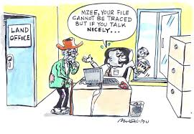

DIGITAL DIVIDE:
Prof.ssa Diana-Urania GALETTA

