Slide 1
NET NEUTRALITY, OPEN DATA AND THE HEALTH OF THE DEMOCRATIC SYSTEM
Mercedes Fuertes
Professor of Administrative Law
University of Leon (Spain)
www.mercedesfuertes.es

Slide 2

Internet access, a simple fact of daily life, has reminded us of the bite of the fruit of the Tree of Knowledge, for it has made it possible for anyone curious to access more and more knowledge and information…

Slide 3
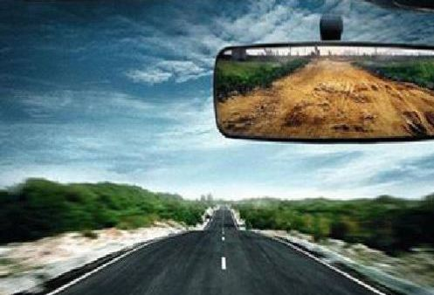
It is forcing us to rethink social relationships and legal institutions, from the most elementary aspects of the political system to the most refined judicial constructions…
… Nevertheless we should not forget the long road of legal conquests that we have already travelled, using the techniques and legal instruments already known to us.

Slide 4
For example, in the twenty-first century, we find that we have to struggle to guarantee a minimum of security on the networks, infrastructures and systems, just as over a thousand years ago, we sought to ensure safety on the highways; and we must protect the freedom of surfing the Internet, just as other jurists defended the freedom of the seas centuries ago; we must guarantee social communication and information but above all the free development of the personality, just as, over two hundred years ago, American and French revolutionaries defended it and saw it mature into the legal status of the “citizen”.

Slide 5
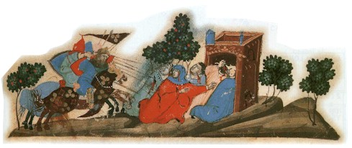
The declaration of “Peace and Truce” was also proclaimed in the diocese of Vich by this abbot when he was Bishop there in 1033, and was repeated in neighbouring territories…
… As opposed to those personal declarations, the “peace of the highway” meant objective protection. The highways and paths themselves, those long and winding roads, now received attention, a singular advance in Medieval legal thinking.

Slide 6
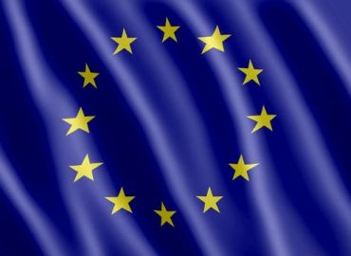
It is above all important to educate citizens in the correct use of the Internet. If in the year 1000, their collaboration and “the king’s love” were insisted on, today, their action must be directed towards respect for and the defence of the democratic and social order, to the recognition of public rights and freedoms. This recognition is the basis of the stars on the flag of the European Union.

Slide 7
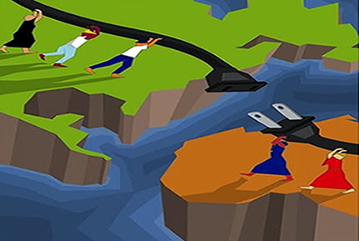
We must increase a solid connection throughout Europe, an extensive connection to benefit all European citizens regardless of where they are, a Network sewing together all the parts of Europe to avoid the split seams of the Eurosceptics and any others wanting to break up Europe.

Slide 8

Net neutrality - Regulation (EU) 2015/2120, 25 November 2015
There is recognition of free choice for surfing the Internet, just as centuries ago there was a defence of the freedom to sail the seas.

Slide 9

It is absolutely necessary to do away with fragmented telecommunications markets, to encourage investments in telecommunications and to be firm in ensuring an open development of the Internet and Net neutrality. The freedom and equality of citizens and companies is at stake.

Slide 10
One praiseworthy aim is the provision of a body of information by the public institutions to improve citizens’ knowledge and aid both their participation in channelling public policy and in monitoring administrative management and in demanding accountability.

Slide 11

The other risk I foresee is that the processing of so much information that encourages automation in the choice of guidelines for public policy, and shortcuts in decision making, might lead to a single path for citizens to channel their wants and demands. Life has to be open.

Slide 12
It must be recognized that thanks to innovation, much has been achieved, but we must keep fighting to raise the flags of freedom and equality over the vast sea of the Internet, to make it open and neutral.

