Slide 1
Knowledge Assistants

Slide 4
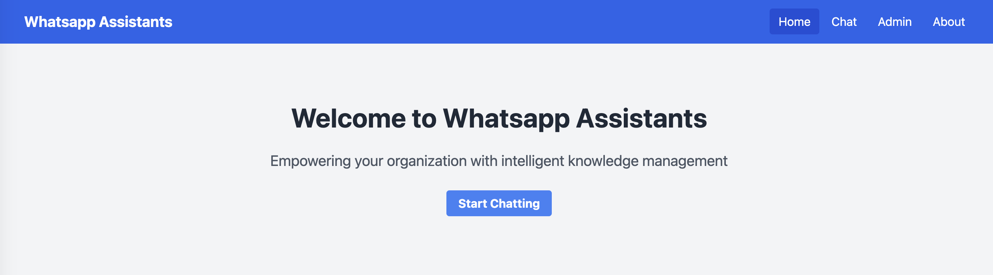

Slide 5
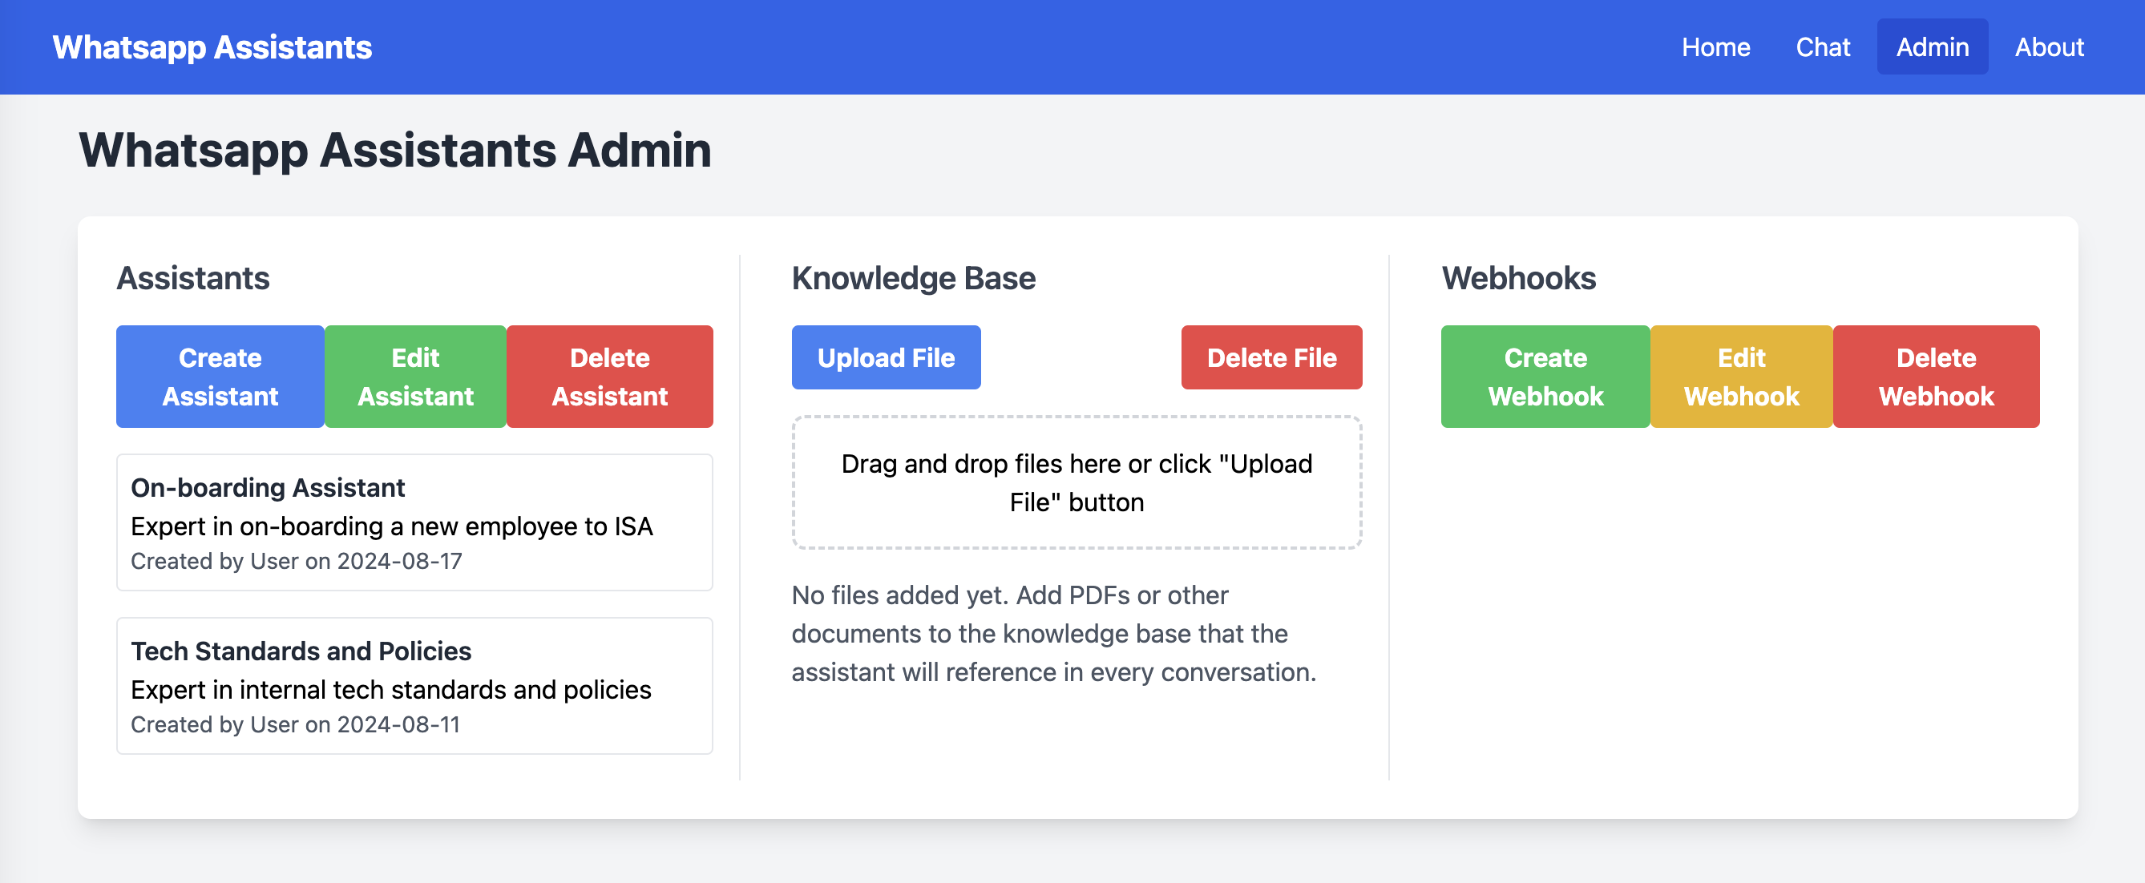
Webhook 1
Webhook 2
List of existing assistants
List of webhooks for the assistant
List of files uploaded

Slide 6
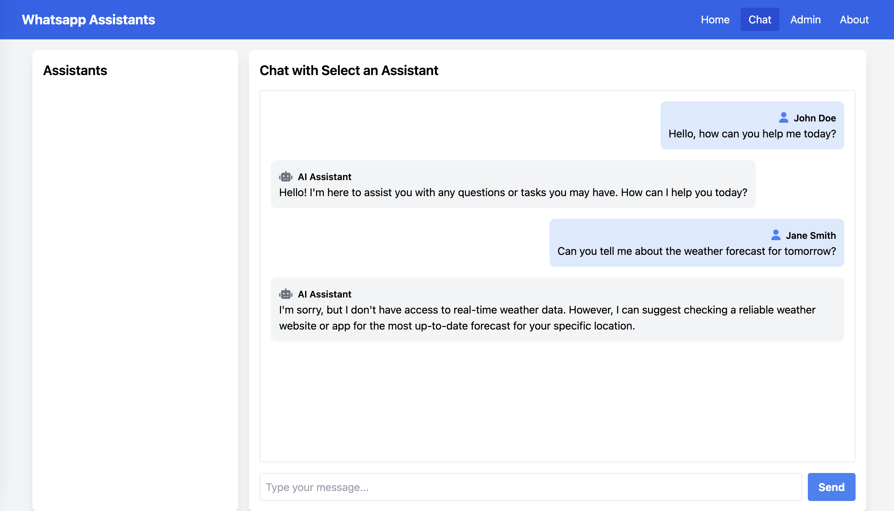

Slide 7
