Slide 1
IPS Assistants
A simple frontend to create AI Assistants
with your own knowledge base

Slide 2
Objectives
Problem Statement
There are 65 technology standards and policies in Westpac IT, total over 1,000 pages. It is time consuming to go through the standards and policies for relevant information.
The Approach
Our approach is to create AI Assistant for our technology standards and policies to cover the following features:
To provide chat interface over our technology standards and policies;
To be able to provide summary of the above documents;
To be able to provide mindmaps of the above documents.
Guiding Principles
1) Fact based reasoning
The Assistant should use the uploaded documents only.
In there is not enough information to answer a question, the Assistant should not provide an answer.
2) Tracebility – Source should be quoted as part of the response for further investigation and validation.
3) Accuracy first
Limitations
It is not possible to guarantee that response from LLM does not contain hallucination or incorrect conclusion. If in doubt, please consult the original documents

Slide 3

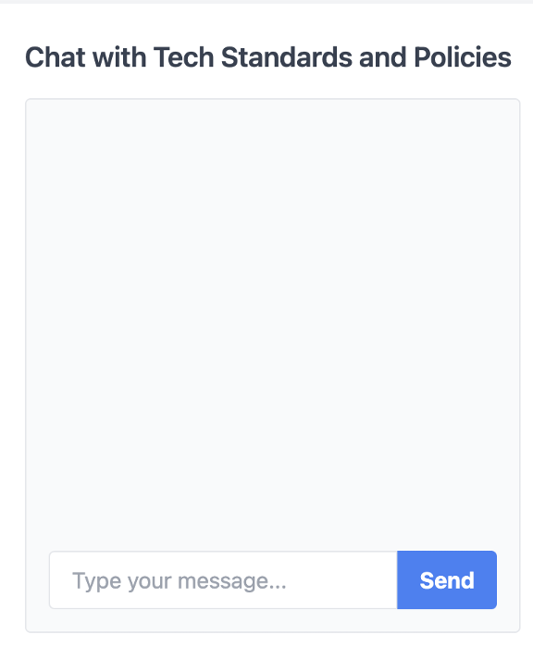
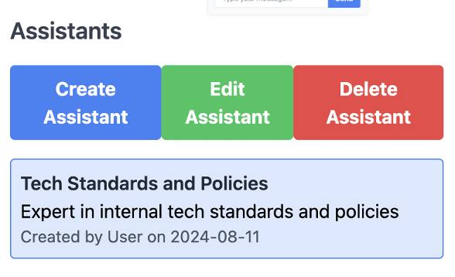

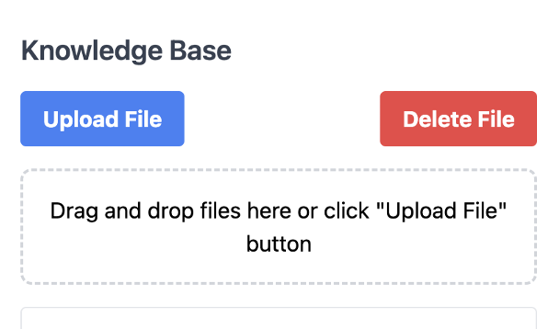
Proposed Application Architecture
AI Services
OpenAI Assistant API
Azure ELZ
3. Consume
2. Publish
1. Define and Upload
System Prompt
Our own documents
Assistant
Python/Flask/Jinja
Local DB
OBMR VM

