Slide 1
Test plots
Trajectory: 1st run of MD (498 frames)

Slide 2
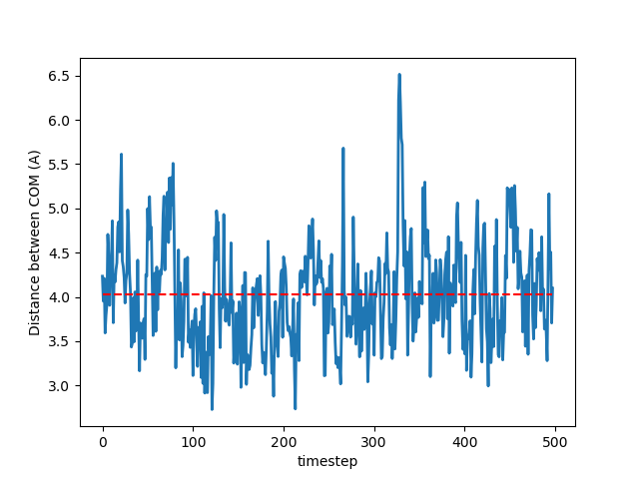
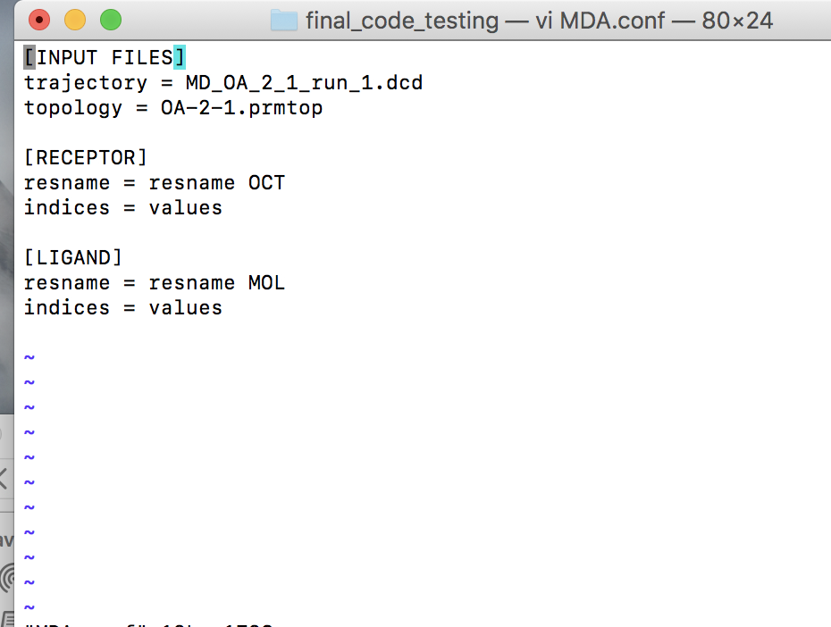
Receptor Selection = ‘resname OCT’
Ligand Selection: ‘resname MOL’
Plot 1

Slide 3
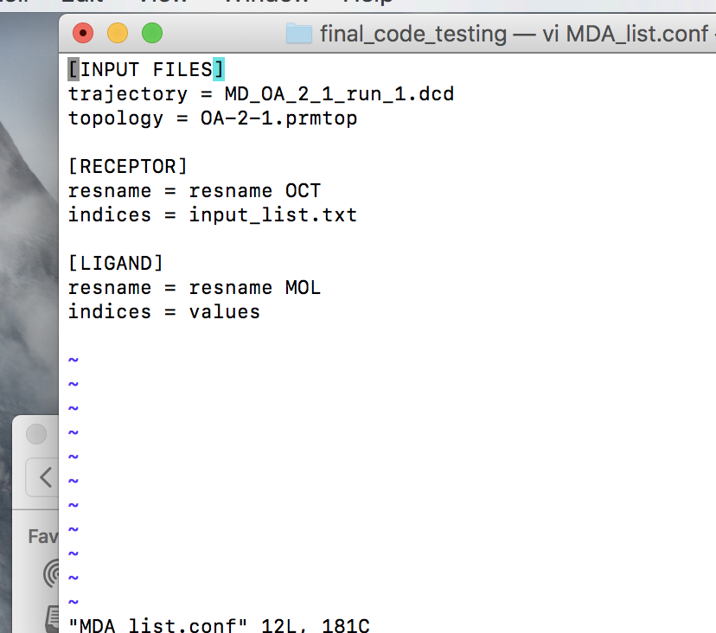
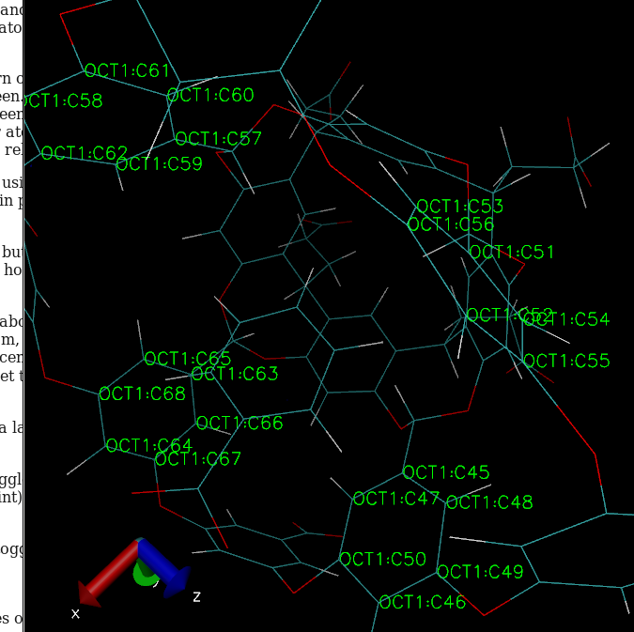
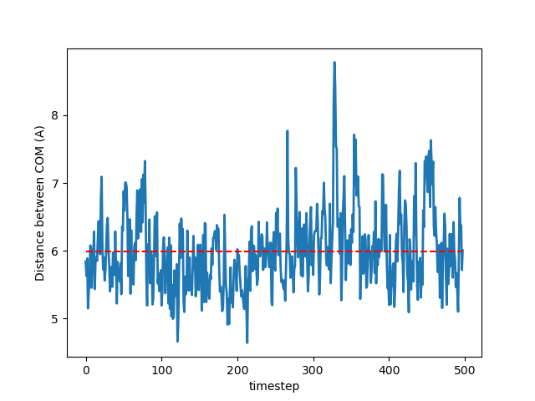
Receptor Selection = atom indices [60,57,61,58,56,59,79,75,78,77,74,76,73,70,71,68,72,69,64,62,65,66,63,67]
Ligand Selection: ‘resname MOL’
Plot 2
Receptor selection

Slide 4
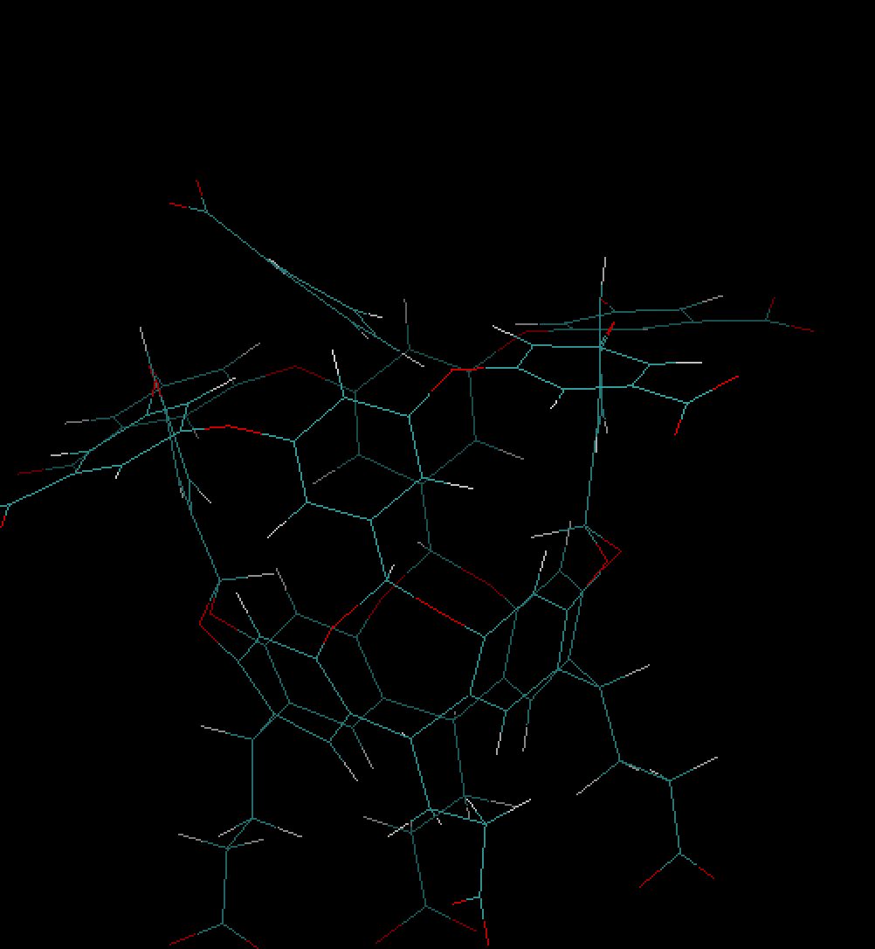
O
Frame 328
O

