Slide 1
Code Review
Group 15: Food-Sharing-App
By Group 3: Haotian & Sunitha

Slide 2
Food-Sharing-App
Project framework (GitHub, sprints, continuous integration)
User stories
Architecture and Design
Tests

Slide 3
Project Framework
Detailed ReadMe
Intro, User Story, Architecture, Technologies to be used and Current and past Sprints Progress.
Suggestions
Could have all four Sprints listed
Could add test script to test the program function

Slide 4
User Stories
As a restaurant owner - if I have excess food available for donation, I would log in to the web app and add the available food.
As Charities/households - we will go onto the application, see restaurants on a map in our area with excess food available. And contact with the restaurants and get the food.

Slide 5
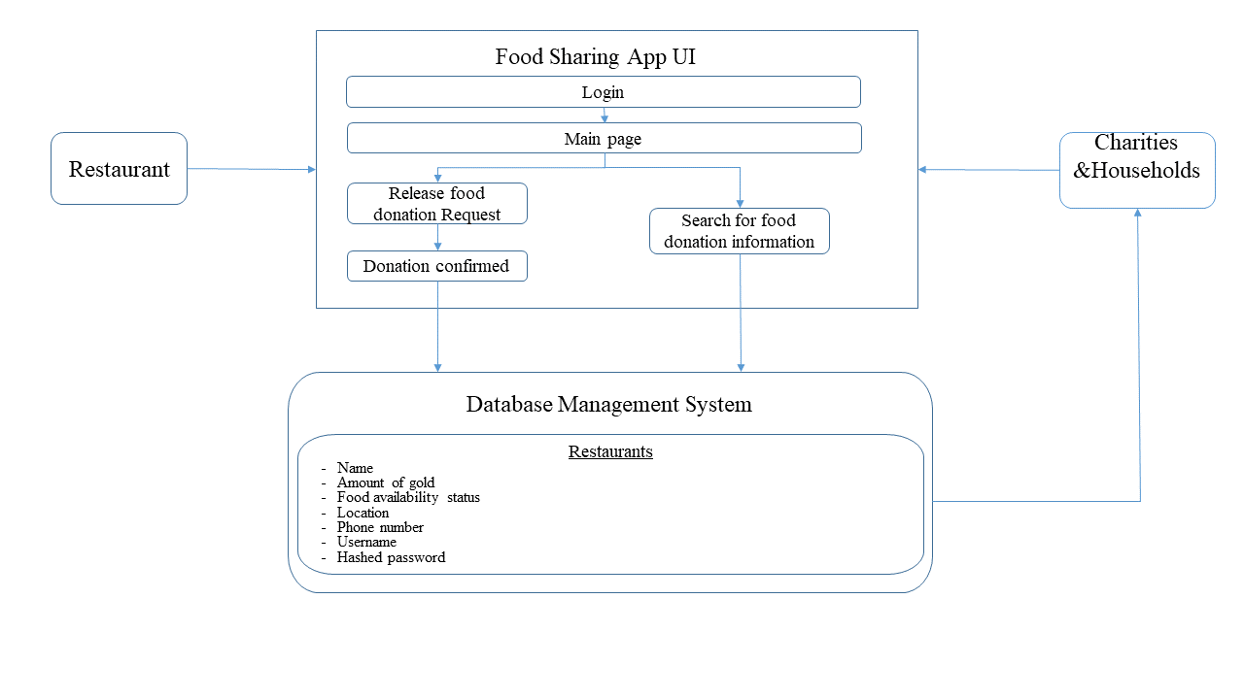
Architecture
Could be more specific

Slide 6
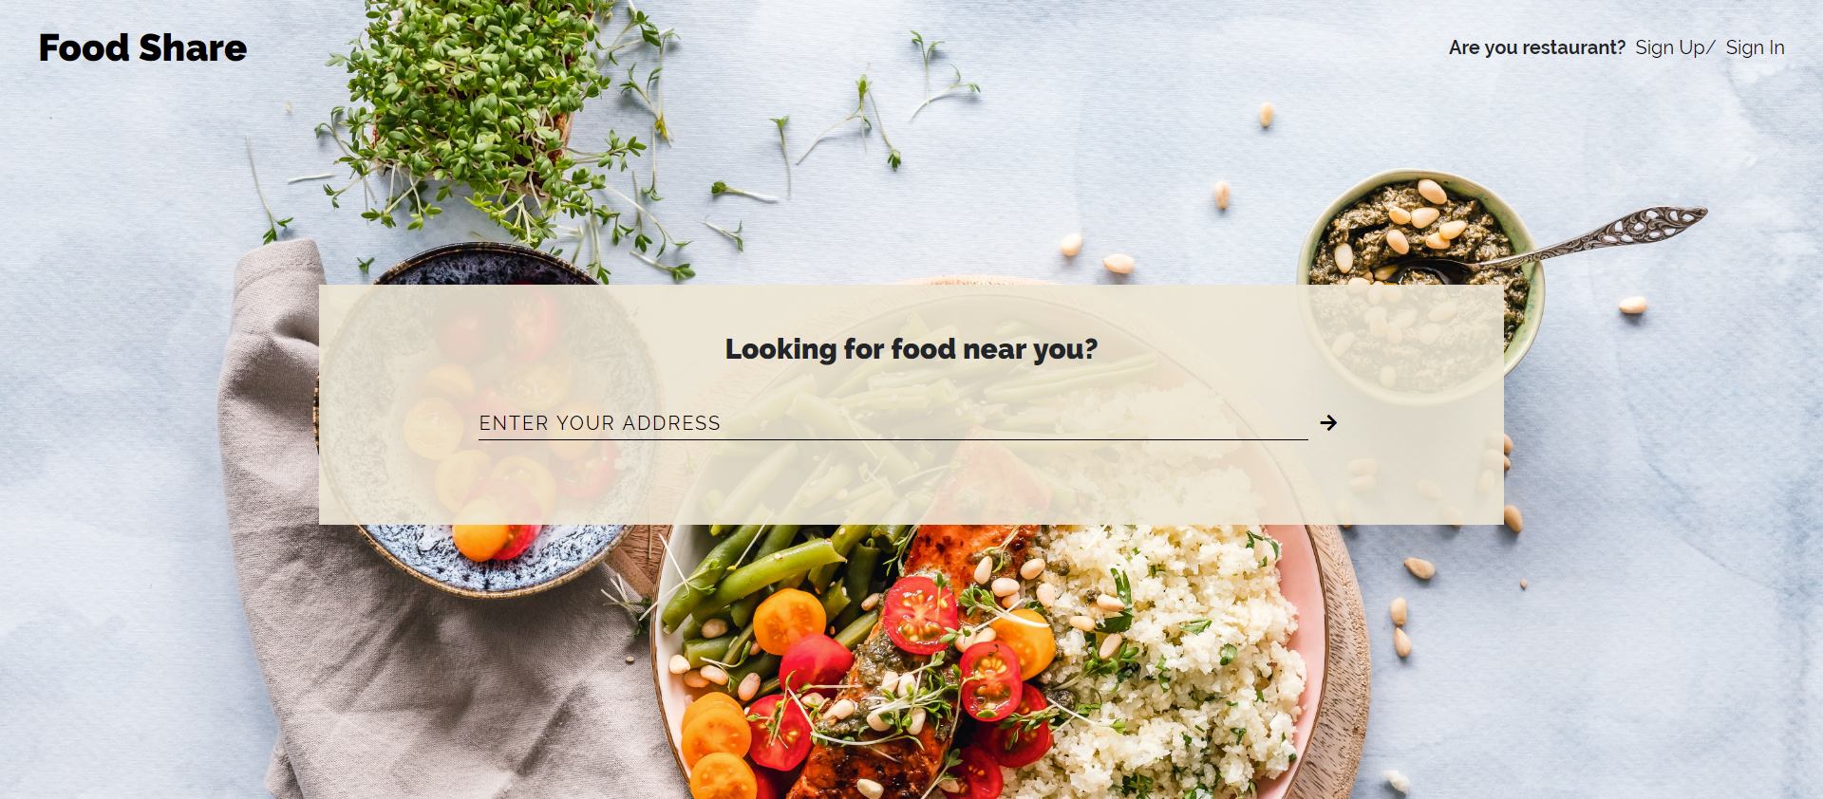
Tests
Great Looking Layout

Slide 7
Concerns
Food Safety & User rights
Food status (hot/cold, expiration time, eaten by others)
Agreements
Deliberately Malicious User
Account Credits & Limits
Social Security Numbers

