Slide 1
Build-Bench Challenge
Boston University · EC528 Cloud Computing · Fall 2026
A working agent that repairs packages that fail to build on a new CPU architecture.
Demo 2 · Working prototype · October 21, 2026
Presenters: Anthony Capraru and Juliette Jacques
Team: Anthony Capraru, Austin Li, Joonseo Moon, Juliette Jacques, Owen Zhang
Mentor: Minghua Ma, Microsoft
Notes:
[Presenter A] · about 20 seconds Hi everyone. We’re the Build-Bench team: [names], with our mentor Minghua Ma from Microsoft. At Demo 1 we showed you a design on paper. Today we’ll show you the agent actually running: what it repairs, what it doesn’t repair yet, and the evidence for both.

Slide 2
A package that builds on x86 can fail on ARM. We repair it, and only the organizers’ clean build can say it worked
Why it matters
REAL CASE · r-cran-digest · amd64 → arm64
Porting Debian packages to ARM and RISC-V is manual: read the log, guess a fix, rebuild, repeat.
Builds on x86_64
then
Fails on ARM64
Our target
crc32c/crc32c_prefetch.h:18:10: fatal error: xmmintrin.h: No such file or directory
ICSE 2027 Build-Bench Challenge: 200 public cases, 100 each way between x86_64 and ARM64.
The cause: a config header, generated on an x86 machine and shipped with the source, turns on an x86-only feature.
What counts as success
The validator reports succeeded and the build artifacts pass validation. Nothing we report about ourselves counts.
Example: Build-Bench public case r-cran-digest (Ubuntu mantic, amd64 → arm64)
2
Notes:
[Presenter A] · about 40 seconds
Quick reminder of the problem.
The same source package can build fine on x86 and then fail on ARM.
Here is a real case from the benchmark: r-cran-digest. On ARM64 the compiler stops because it cannot find xmmintrin.h, an x86-only header.
The log points at that include, but the real fault is one level up: a config file that was generated on an x86 machine and shipped with the source. It switches on an x86 feature unconditionally.
Fixing this by hand means reading logs, guessing, and rebuilding. Our agent does that loop automatically for the Build-Bench Challenge at ICSE 2027. And success is not something we get to decide. A repair only counts when the organizers’ validator reports the build succeeded and the artifacts check out.

Slide 3
Since Demo 1, we built and evaluated the local repair pipeline
Sep 23 · Demo 1
Design proposal only
Changes to the plan
Token cap 30k → 100k per case → 1M
Oct 3
One-shot baseline frozen as one-shot-v1
1M tokens, 80 turns and 10 loop builds; larger budgets did not ensure repairs.
Oct 11–13
Evidence manager (A), read-only tools (B), prompts and reply parser (E)
Replies are JSON in plain text
Explicit actions work with our tested endpoint; malformed replies require correction.
Oct 14
Repair loop (C) and real builds (D) wired in: first full-agent repairs
Keep the best attempt
Rank candidate builds and restore snapshots when replacing changes; retain the selected candidate.
Oct 19
Both agents evaluated on all ten bundle cases and rcran; evidence and diagnostics committed
Team timeline, September 23 – October 20
3
Notes:
[Presenter A] · about 45–50 seconds
Since Demo 1, we’ve built the local repair pipeline: the one-shot baseline, structured evidence, inspection tools, reply parsing, and the full-agent loop with real build feedback.
We froze the one-shot baseline on October 3. The evidence, tools and parser followed, and by October 14 the integrated full agent had produced its first repairs.
By October 19, both agents had processed all ten development cases plus rcran. We preserved the source versions, settings and results, including failures.
We also explored larger budgets—up to one million tokens, eighty turns and ten loop builds—but more allowance alone did not ensure repairs.
Our controller uses explicit JSON actions and retains candidates using build evidence and snapshots. These are implemented local capabilities; adapting to the newly documented hosted model interface remains

Slide 4
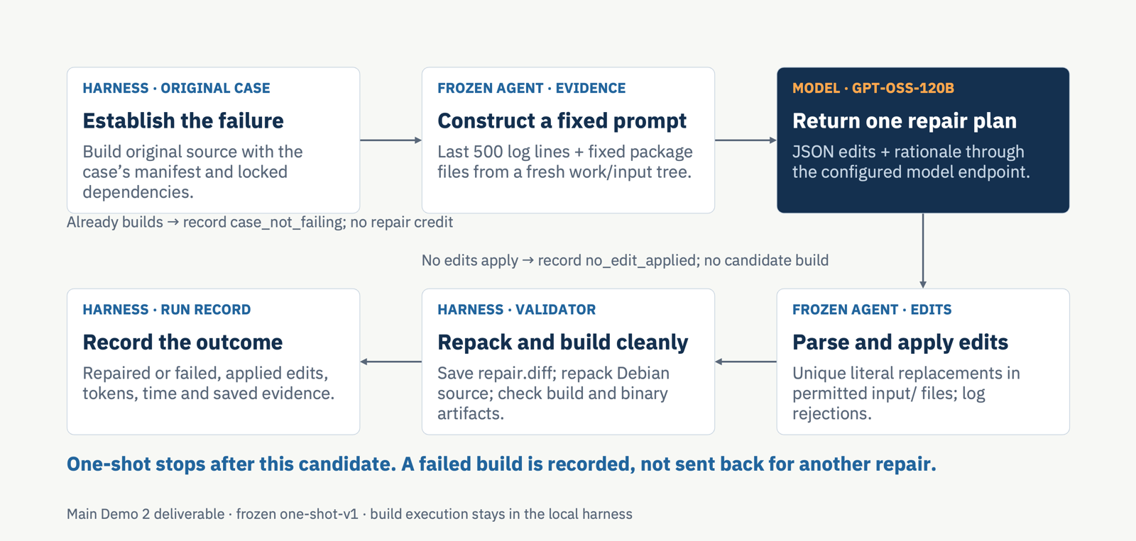
One-shot architecture
2
Notes:
[Presenter A] · about 45 seconds
This is our main Demo 2 deliverable: the frozen one-shot pipeline.
The harness first builds the original package. If it already succeeds, we record that and give no repair credit.
For a failing case, the agent receives the last five hundred log lines and a fixed set of package files. The model returns one proposal containing edits and a rationale.
The edit applier checks permitted paths and requires exact, unique text matches. If no edits apply, the run stops. Otherwise, the harness saves the diff, repacks the Debian source and runs a clean build.
A repair counts only when the build succeeds and the expected artifacts pass validation. Every outcome is recorded.
The defining limitation is that one-shot cannot revise its proposal after seeing the candidate build fail.
Backup details:
The harness first runs the unmodified case. If it already builds, it records case_not_failing and gives no repair credit. For a failing case, it extracts a fresh work/input tree. The agent constructs a fixed prompt containing the last 500 log lines and a predetermined package-file list. Each file is capped at 8 KiB and total file evidence at 32 KiB; 500 log lines is not a token cap. There is no interactive source-retrieval loop.
The configured model returns one JSON object with edits and rationale. Each edit has path, old_text and new_text. The frozen edit applier checks permitted paths under input/ and requires a unique literal match. Some edits may be rejected; evaluation concerns the edits actually applied. If none apply, the run stops with no_edit_applied.
The harness saves the actual diff and repacks the Debian source, preserving the original case configuration and dependencies. The unchanged local validator performs a clean target build. A repair requires both successful build status and the expected binary artifacts. All outcomes, including failures, are recorded.
One-shot means one repair proposal with no revision from the failed candidate build. HTTP transport retries do not constitute repair iterations. The next full-agent diagram adds inspection tools and feedback-driven repair iterations.
Source: docs/design-document.md, section 1.1, Main Demo 2 architecture: the frozen one-shot pipeline, including What the frozen agent sees and does and One-shot modules and boundaries. Baseline tag: one-shot-v1. Modules: agents/one-shot/src/main.py, log_tail.py, model_client.py, edit_applier.py; harness/run_case.py and harness/record.py.

Slide 5
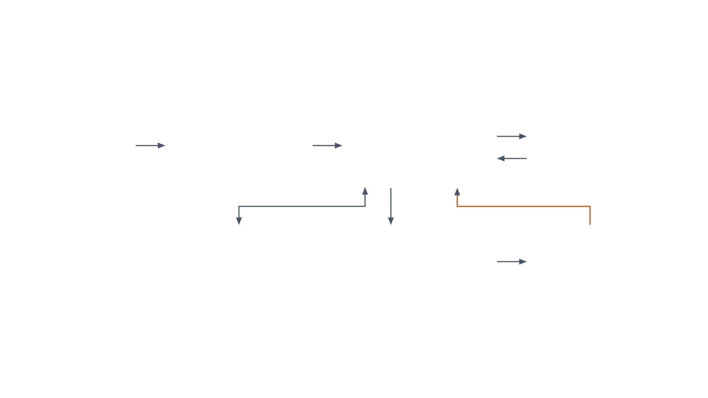
Full-agent architecture
INPUT
A · Anthony
C · Juliette, E · Owen
MODEL
Failure log + task.json
Evidence manager
Repair loop + prompts
gpt-oss-120b
Errors with file, line and stage; paths checked against real files
One model turn at a time: tool request, edit or stop; enforces budgets
OpenAI-compatible API; competition model undisclosed; Bedrock model used in testing
from the case
tool requests, results
edit
build failed: new errors
B · Austin
From the baseline
D · Joonseo · harness
Read-only tools
Edit applier
Build feedback
list, find, search, read, diff, patch series
Validate exact edits before writing, return correction feedback
Repack a copy, build on the real validator
Stops on a passing build, exhausted limits, model stop or repeated diagnostics without sufficient progress. Retains a selected candidate for separate final validation. Build feedback runs only in our local harness; official builds cannot be requested during a hosted agent run.
The full agent as of October 20
6
Notes:
[Presenter A] · about 60 seconds
This is the full-agent extension we built after the one-shot baseline. The labeled components show how we divided the implementation across the team.
The evidence manager extracts diagnostic locations and checks compiler paths against actual package files. The repair controller combines that evidence with prompts and calls the model.
The model can request read-only inspection tools, propose edits, or stop. Proposed edits go through validation before writing. Invalid batches receive correction feedback, so a rejected edit does not immediately consume a build.
After valid edits, our local harness repacks a copy of the source and runs the validator. New diagnostics return to the loop, allowing another repair attempt. The controller tracks budgets and progress, retains a selected candidate, and sends it through separate final validation.
The dashed build component is an important boundary: it belongs to our local research harness. The official platform does not allow agents to request builds during a run; organizers control any later repair rounds.

Slide 6
One-shot failures shaped the full-agent design
One-shot limitation | Design response | Evidence and limits
Compiler paths may differ from valid edit paths | Resolve diagnostic paths against actual files; validate edit paths | Checked on rcran; path and edit failures still occurred on harder cases
Fixed prompt files can omit relevant source | B lets the model list, search and read permitted package files | 4 of 4 live rcran runs found the file and edited the source directly
Never saw its own fix fail | D builds each attempt and sends the new errors back | A deliberately wrong edit was caught on a real build and revised; ~95 s per build
Produced a different fix on each of 3 runs, even at temperature 0 | Preserve run records: every hypothesis, edit and result; 4 switches turn parts off | Matched repeats and history on/off comparison are planned for Demo 3
Baseline runs on rcran, October 3; full-agent runs, October 14
7
Notes:
[Presenter A] · about 45 seconds
The full-agent design grew directly out of failures in our one-shot baseline.
First, the baseline copied a compiler path that did not match the source location. That motivated diagnostic path resolution and edit-path validation.
Second, its fixed prompt could omit relevant source. We added inspection tools so the model could explore permitted package files. Historical rcran runs demonstrated that capability, although harder cases remain unresolved.
Third, one-shot could not learn from a failed candidate build. We added local build feedback, and a scripted wrong-edit test demonstrated failure detection and revision.
Finally, different runs produced different fixes. We preserved detailed records and added component switches so we can run matched comparisons.
These observations explain the design. Measuring how much each component contributes is planned for Demo 3.

Slide 7
One recorded run: ARM64 repair and build in 44 seconds
1
Read the failure: the original error
crc32c/crc32c_prefetch.h:18:10: fatal error: xmmintrin.h: No such file or directory
THE AGENT’S EDIT
input/src/crc32c/crc32c_prefetch.h
2
Model turn 1: malformed
#else // !defined(_MSC_VER)
No JSON action, so the loop explains and asks again (counted against the budget)
+ #if defined(__x86_64__) || defined(__i386__) || defined(_M_X64) || defined(_M_IX86)
3
Model turn 2: tool request
#include <xmmintrin.h>
Inspects the package’s files before proposing anything
+ #endif
#endif // defined(_MSC_VER)
4
Model turn 3: hypothesis and one edit
“crc32c_prefetch.h unconditionally includes <xmmintrin.h>, which is only available on x86”
5
Real build on the local validator: passed
3 model calls · 1 build · 43.5 s total
30 s build · status succeeded · artifacts validated · arm64 .deb produced
24.8k input + 1.8k output tokens
Live run, October 14, gpt-oss-120b; Part C checkpoint with a 30k-token cap
8
Notes:
[Presenter A] · about 50 seconds
Here is one real run, start to finish, from its log.
Step one: the agent reads the original failure, the same xmmintrin error.
Step two: the model’s first reply had no valid action. The loop told it what was wrong and asked again, and that retry counts against the budget.
Step three: it asked to look at the package’s files before guessing.
Step four: it stated a hypothesis in its own words, that this header pulls in an x86-only file, and proposed one edit, on the right: guard the include so it only applies on x86. Its wording isn’t perfectly precise, since that include already sits inside another guard, but the edit is sound.
Step five: a real build on the organizers’ validator, running on our machine. It passed in about 30 seconds, the artifacts validated, and out came the ARM64 Debian package that the unrepaired source never produces.
Whole run: three model calls, one build, 44 seconds.
One thing worth noting: this is a different fix from the one we found by hand.
We changed the config flag; the agent guarded the include. Both pass. That’s exactly why we always let the validator decide, rather than comparing against our own answer.
To be precise: this was the Part C checkpoint run on October 14th, before the evidence manager and final prompts were wired in, with a 30 thousand token cap. It is the run with the most complete log. The runs on the next slide use the fully integrated agent. We had a more recent run that succeeded still to repair the whole package in 288 seconds and final build 94s.

Slide 8
Early rcran experiments: 4/4 full-agent repairs and 1/3 one-shot repairs
Verified repairs, one square per run
Model tokens per run (input + output)
Baseline
1 of 3
Baseline, one call
12.3k
Full agent, history on
11.2k
Full agent
4 of 4
History off, before the reply fix
29.3k
Filled = repaired: the organizers’ validator, run locally, reports succeeded and artifacts validated.
10.6k
History off
Excerpt mode
10.7k
Baseline’s repair: a sed command in debian/rules, flagged for human review
0
10k
20k
30k
Full agent’s repairs: a direct edit to the source, which Debian records as a patch
tokens per run
One case, small samples, different configurations: evidence of a working pipeline, not general repair effectiveness.
Baseline runs October 3 (tokens logged for one run); full agent October 14
9
Notes:
These are our earlier rcran experiments: the baseline runs from October 3 and the full-agent runs from October 14.
The baseline repaired one of three runs. The full agent repaired all four recorded runs across different settings, with success checked by the local validator and expected build artifacts.
The repairs took different forms. The baseline changed a Debian build rule to rewrite the header during the build. The full agent edited the source directly.
On the right are token counts from individual runs. Most full-agent examples used around ten to eleven thousand tokens; one used about twenty-nine thousand before a reply-format fix. We recorded baseline tokens for one run, so this is descriptive evidence, not a controlled efficiency comparison.
These experiments showed that the pipeline could repair rcran. The broader October 19 evaluation, which we discuss next, tests how far that success extends.

Slide 9
Harder cases: neither agent has a repair yet: 0 of 4 for both
Case | Observed failure | One-shot | Full agent | Loop stop
1. ectrans | CMake paths; missing Fortran module | Failed build | 8 candidates; unrepaired | Repeated diagnostic
2. libmceliece | BFD linker assertion | Failed build | PIC changes; unrepaired | Repeated diagnostic
3. libunwind | Hidden-symbol link failure | Edit path rejected | Link changes; unrepaired | Repeated diagnostic
4. rust-subversion | C char pointer type mismatch | 9 edits rejected | No valid batch applied | Correction budget
html-xml-utils: excluded
5 x86_64-target cases: setup blocked
What limits the agent now
Builds unchanged in our local environment, so there is nothing to repair.
Both agents encountered environment failures under QEMU before package compilation.
repeated diagnostics, rejected edits, and ineffective fixes persisted despite enlarged full-agent budgets.
Organizers’ development bundle, x86_64 → aarch64 cases, run on October 19
10
Notes:
On October 19, we evaluated both agents on all ten development cases, plus rcran separately.
This table shows the four development cases where we could evaluate source repair. Neither agent repaired any of them. The full agent explored multiple candidates, but repeated diagnostics, rejected edits and ineffective fixes prevented success.
The other six cases need different interpretations. Html-xml-utils already built unchanged, so it receives no repair credit. All five reverse-direction cases encountered environment setup failures under QEMU before package compilation. Their package-repair capability remains untested.
Separately, the full agent repaired rcran in this repeat; the one-shot did not.
We had enlarged the full-agent budget to one million tokens and eighty turns. More room alone did not solve these cases. Our next work is to fix the environment blockers and improve diagnosis and edit correction before running matched repeats.

Slide 10
Milestone check:
Committed for Demo 2 in our proposal
Status
Evidence and gaps
Runnable packaged agent with an exact command, end-to-end local repair prototype.
Met
Model-generated rcran edit passes final clean build and artifact validation.
Trace on a real Debian case: diagnostic, model call, inspection, edit, validation
Met
Latest rcran record includes turns, edit, loop build and final verdict.
Frozen one-shot comparator
Met
One-shot v1 retained; evaluated separately from the iterative extension
Record ./bb ready honestly, including failures
Recorded
Static submission validation passed. Local readiness failed with no model credentials available to agent. Hosted Smoke remains pending.
Freeze 10 public cases, about 5 per direction
Met
Organizers’ development-v1 bundle, ten cases identified, five per migration direction
Per case: verified status, time, tokens, attempts, tool calls
Met*
22 records including rcran; outcomes, usage and time retained. *Five setup-blocked cases per arm.
Milestones as committed in our Demo 1 design proposal
12
Notes:
Here is our progress against the Demo 2 commitments.
The local prototype runs end to end. The full agent produced a model-generated rcran repair that passed a final clean build and artifact validation. The latest trace includes model turns, edits, build feedback and the final verdict.
We retained the frozen one-shot comparator and evaluated both agents on the ten-case development bundle plus rcran. That produced twenty-two run records.
We also recorded the local readiness check. Static submission validation passed, but the agent received no model credentials and produced no edit. That check did not pass; hosted model integration and Hosted Smoke remain pending.

Slide 11
Next: better fixes and fewer tokens, before the competition version is frozen on November 13
Now to November 6
Nov 13 (UTC+8)
Nov 16 · Demo 3
Freeze today’s agent as the Demo 2 reference
Resolve setup blockers for the five x86_64-target cases under QEMU
Trim tokens: stop resending unchanged evidence
Baseline, Demo 2 agent, history on/off: 3 runs × 10 cases
Adapt to injected model settings; check/package and pass Hosted Smoke Test.
Spot-check our verdicts with official Development Validation
Select the qualified competition version, three days before Demo 3
Target: +1 verified repair per 10 cases on average over the Demo 2 agent, or 20% fewer tokens with no repair lost
Risk: Full evaluation budgets pending
Risk: Official builds cannot be requested during an agent run. Organizers control repair rounds
Risk: Hosted model integration unverified
Hosted Smoke limits are published, official evaluation limits remain to be announced
Use the injected endpoint, model alias and token file, verify through Hosted Smoke
Targets from our Demo 1 design proposal; dates from the competition timeline
14
Notes:
Next, we’ll preserve the Demo 2 agent and its settings as our reference.
Our first task is to resolve the environment blockers affecting the five x86-target cases. The supplied validator runtime is ARM64, and those cases failed during setup under QEMU. Changing the host alone does not establish a native build environment. We need to verify a functioning setup and reproduce the intended package failures before rerunning the agents.
We’ll also improve diagnostic focus and edit correction, reduce repeated evidence in prompts, and run matched comparisons with history on and off.
For competition readiness, we need to support the injected model endpoint, model alias and token file, then check, package and pass Hosted Smoke before confirming our version by November 13, Beijing time.
Official builds cannot be requested during an agent run; organizers control repair rounds.
Our Demo 3 target remains one additional verified repair per ten cases on average, or twenty percent fewer tokens without losing a repair.

Slide 12
Three things to take away
1
The prototype works end to end. Evidence, investigation, edit, real build, repair passing the local validator: 4 of 4 runs on one easy case, against 1 of 3 for the baseline. The full agent repaired rcran autonomously and produced the expected ARM64 package in final validation.
2
Evaluation coverage is complete. Both agents processed ten development cases plus rcran. Four development cases remain unrepaired; five reverse cases were setup-blocked and one built unchanged.
3
The next work is specific. Improve diagnosis and edit correction, repair the emulated environment, then measure history with controlled repeats.
Questions welcome · github.com/ec528-fall26/build-bench
15
Notes:
Three things to take away.
First, the local prototype works end to end: the full agent repaired rcran and produced a validated ARM64 package.
Second, both agents completed all scheduled evaluations. The development bundle exposed four unrepaired cases, five environment blockers and one case that already built unchanged.
Third, we have concrete next steps: test native x86 execution, improve diagnosis and edit correction, and run matched repeats to measure whether history helps.
Thank you—we’re happy to take questions.
Questions:
What is Hosted SMoke?
“Hosted Smoke checks whether our submitted agent works under the organizers’ runtime and can make an official model call and a validated repair. We haven’t run it yet. Our local prototype works, but we still need to adapt model access and ensure it operates without our local build-feedback callback.”
How did you do the local build feedback callback?
In our system:
The agent applies an edit.
The repair controller calls the build-feedback function.
Our harness prepares a copy of the modified package and runs the real validator build.
It returns the build outcome and diagnostic information.
The agent uses that feedback to decide whether to revise its repair.
3. can you summarize your system and how the full-agent worked?
Answer:

Slide 13



Modular implementation, tests and auditable evidence
79
0
4
1
Harness tests passed at the recorded milestone
third-party python dependencies in the agent
switches turn evidence, tools, builds or history off
frozen baseline that automated checks keep unchanged
Shared contracts first
Run evidence is retained
Restricted agent tools
We agreed the data passed between parts on October 7, so each part was built and tested against stand-ins before the others existed.
Each run records every hypothesis, edit, build result and token count, so we analyze failures instead of guessing.
File access and edits are constrained. The model has no general shell-execution tool; builds run through the harness
Recorded milestone: 320 agent + 79 harness tests; current TA wrappers: 15 tests. Docker/system tools required.
13
Notes:
[Presenter B] · about 35 seconds
The implementation is modular, with shared contracts between the evidence manager, tools, repair controller and build harness.
At the recorded code milestone, three hundred and twenty full-agent tests and seventy-nine harness tests passed. Fifteen TA-wrapper tests passed later; those are separate checks, rather than one combined CI result.
The agent uses Python’s standard library, although the build environment still requires Docker and system tools.
Capability switches support future controlled comparisons, and the frozen baseline provides a stable reference.
We retain model responses, edits, build outcomes and token usage so failures can be inspected. The agent’s tools constrain file access and edits and provide no general shell execution; the harness performs the real builds.

Slide 14
Why the model answers in JSON text instead of native tool calling
APPENDIX A
“OpenAI-compatible” fixes the request format, not which features a server supports.
{"action": "edit",
"hypothesis": "the config header enables HAVE_MM_PREFETCH on ARM",
Tool calling varies by server and model, and the competition’s endpoint and model are undisclosed.
"evidence": ["input/src/crc32c/crc32c_config.h:15"],
"edits": [{"path": …, "old_text": …, "new_text": …}]}
Plain text works everywhere, and the baseline uses the same format, so Demo 3 compares like with like.
If the organizers confirm tool calling, only the reply parser changes.
The parser drops any reasoning block and takes the last JSON object with an “action” key: tool, edit or stop.
Team design decision, October 7
A
Notes:
Backup for the question “why not use the model’s built-in tool calling?”
OpenAI-compatible describes the request format, not what a given server supports. Tool calling varies by server and model, and we don’t know the competition’s. Plain text is the one thing every endpoint guarantees.
The baseline uses the same format, so the Demo 3 comparison isn’t mixing two formats. If the organizers confirm tool calling, only the layer that turns a reply into an action changes.

Slide 15
What the agent can rely on in our harness and in the competition
APPENDIX B
 | Our research harness | The competition
Model | gpt-oss-120b through Bedrock’s OpenAI-compatible API | One organizer endpoint; model undisclosed
Build feedback | A real validator build per attempt, about 95 s on rcran | Promised, protocol not published: the agent submits untested
Budget per case | Research settings: 100k tokens, 5 attempts, 3 builds, 30 min | Organizers’ budget, not published yet
Build logs | Full logs, or excerpts only with --excerpt | Diagnostic excerpts
Verdict | The organizers’ validator, run locally | The organizers’ clean build
Organizer guidance to the team; our research budget settings
B
Notes:
Backup for “does your local setup match the competition?”
Not fully, and we design for the gap. Locally we use gpt-oss-120b and real validator builds after every attempt.
In the competition the model is undisclosed and the build service’s protocol isn’t published, so the agent must still investigate and submit without testing.
Excerpt mode exists so we don’t tune the agent to full logs it won’t get. Our budgets are research settings until the organizers publish theirs.

