Slide 1
Computational Storage
Aakash, Harshada, Ivan, Jeehan, Mason

Slide 2
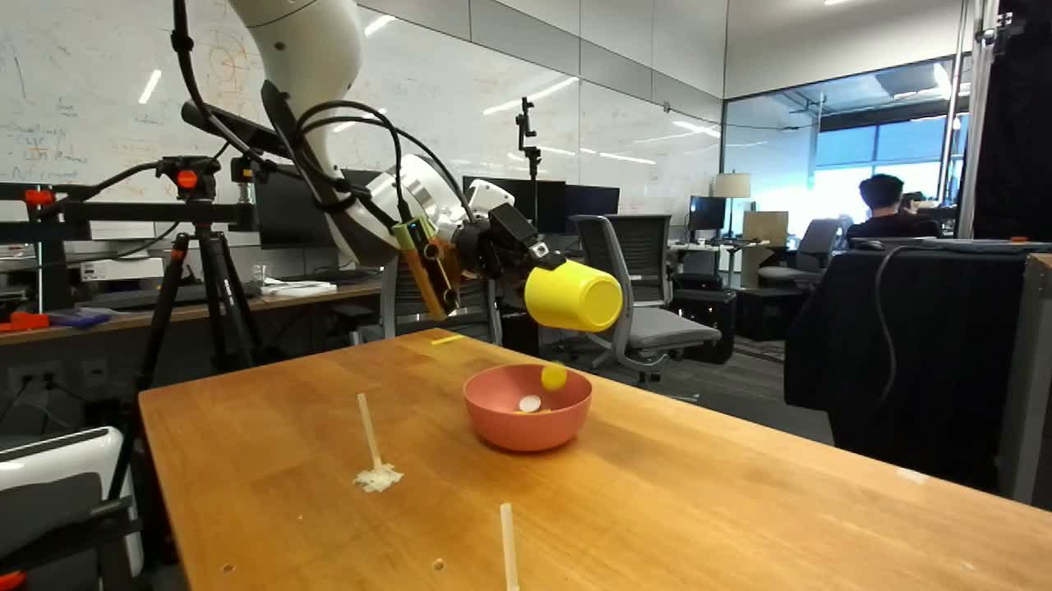
Why computational storage?
DROID and robot learning
DROID
76,000
demonstrations
8.7 TB raw
USED IN
π0.5-DROID
GR00T N1.6

Slide 3
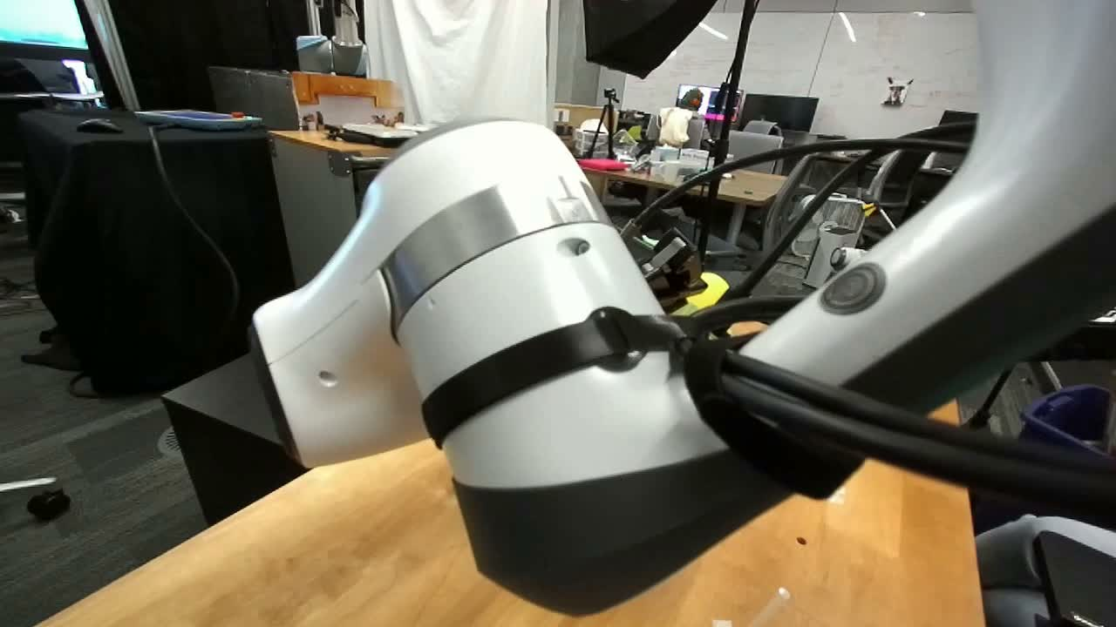
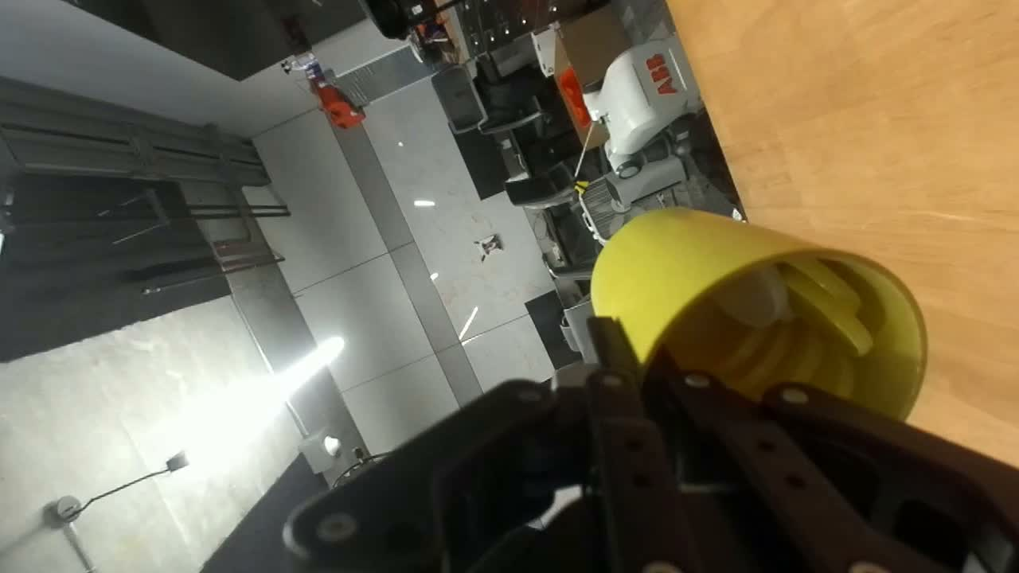
Why computational storage?
Inside one demonstration
EXTERIOR 1
EXTERIOR 2
WRIST
GRIPPER
Action
Robot state
LANGUAGE
1
Use a cup to pour.
0
0
10
20
30
Time (s)

Slide 4

Why computational storage?
Unnecessary transfers in preprocessing
1280 × 720
16×
fewer pixels
320 × 180

Slide 5
Why computational storage?
Separate
Combined
Storage
Compute
Storage + compute
input
ƒ
ƒ
output
local read → process

Slide 6
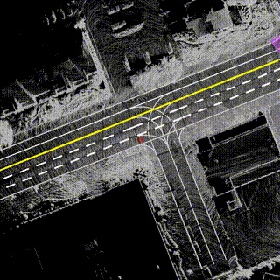
Why computational storage?
Common Crawl
Argoverse 2 Lidar
web data → link edges
Point clouds → training windows

Slide 7
Computational Storage Design
Interface
APPLICATION
function
data transformations
Worker
ƒ
inputs
domain specific dependencies
output
format + destination

Slide 8
Computational Storage Design
Storage node
video
dependency map
video
trajectory
trajectory.h5
language
language + metadata
one episode

Slide 9
Computational Storage Design
Node A
Node B
fetch missing
input
ƒ
metadata
video

Slide 10
Computational Storage Design
The proposed system
Storage node A
Stored inputs
Preprocessing
worker
all dependencies
present
runs fully local
Placement and
execution coordinator
Application
Processed
outputs
function, inputs,
and dependencies
1. Colocate related inputs
2. Otherwise, pick node with
fewest missing bytes
missing dependency
Storage node B
Stored inputs
Preprocessing
worker
one dependency
missing
fetches what is missing
results or output locations

Slide 11
Benchmarks
Separate
Combined
Raw DROID → RLDS
ƒ
ƒ
RLDS → LeRobot
ƒ
ƒ

Slide 12
Benchmarks
NETWORK BYTES
WALL TIME
1.7 TB → 400 GB
≤ baseline
≈ −70%
OUTPUT
Equivalent
reduction goal

Slide 13
Benchmarks
10 / 21
11 / 16
12 / 09
Demo 2
Demo 3
Final
Working conversion
Locality-aware execution
Both workloads

Slide 14
Possible Challenges
PHYSICAL LOCALITY
ARITHMETIC INTENSITY
STRAGGLER NODES
A
ƒ
A
B
B
C
Place dependent
data together
Keep operations
lightweight
Balance work
across nodes

