Slide 1
Lecture 1: Course Introduction Fall 2026
CE 528 Cloud Computing
Prof. Yigong Hu

Slide 2
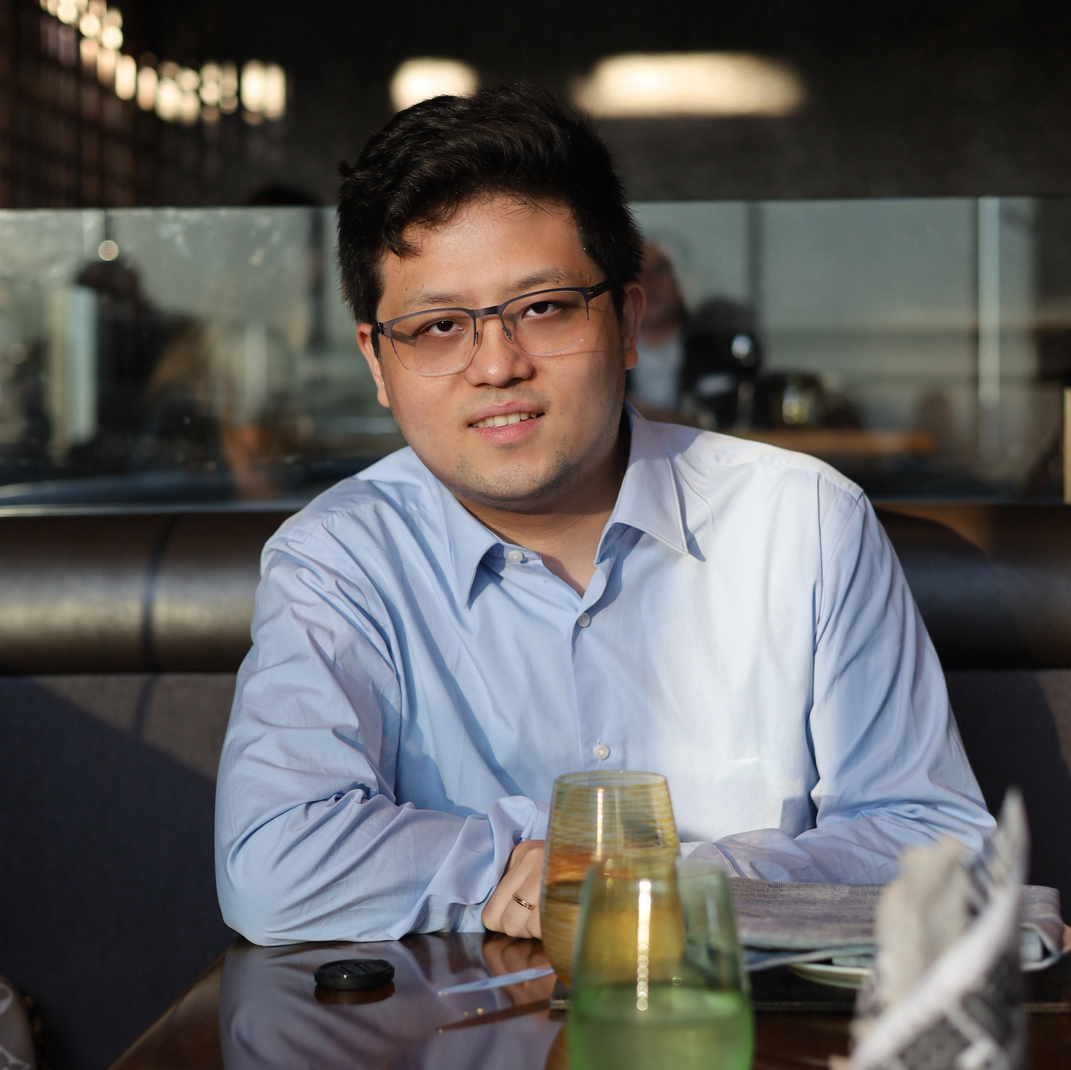
About Me
Prof. Yigong Hu
Building reliable and fast systems
From cloud platforms to ML systems
https://yigonghu.github.io/
Office Hours
Office: PHO335
Mon/Wed: 4:00-5:00PM (or by appointment)

Slide 3
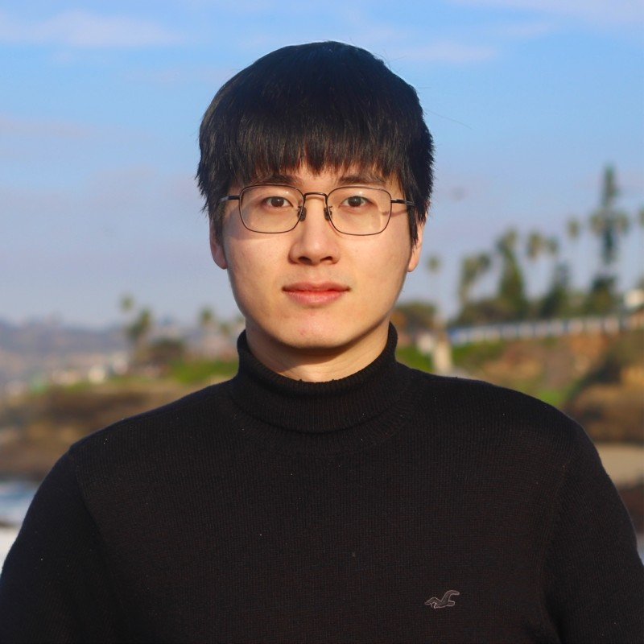
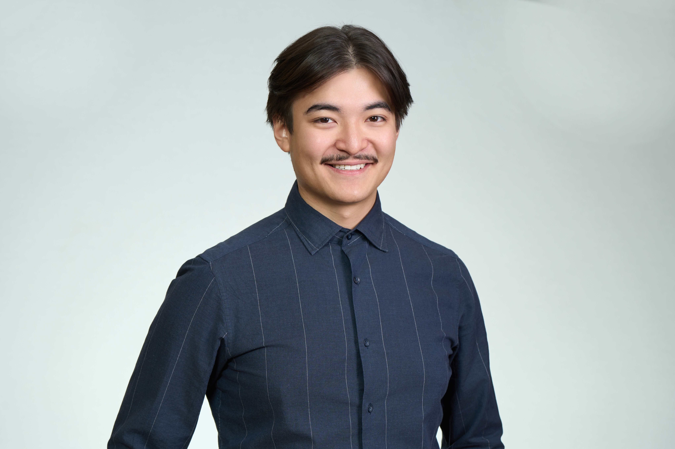
Course Staff
Wenbo Qian (TA)
Office Hours: Tue 3:00-4:30 · Thu 4:30-6:00 · Fri 3:00-4:30
Location: PHO 305/307
Zhakhangir Mamayev (grader)
Office Hours: Mon 10:30-12:00 · Tue 1:00-2:30 · Wed 10:30-12:00
Location: PHO 305/307
Course Website: https://ec528.github.io/ec528/fall26/
Notes:
Of course, I won’t be running this course alone. We have a great set of staff to help you with projects, grading, and questions.

Slide 4
What is Cloud Computing?
What do you think?
“Cloud computing is the delivery of computing services – servers, storage, databases, networking, software, analytics and more – over the Internet (“the cloud”). Companies offering these computing services are called cloud providers and typically charge for cloud computing services based on usage, similar to how you’re billed for gas or electricity at home.”
https://azure.microsoft.com/en-gb/overview/what-is-cloud-computing/

Slide 5
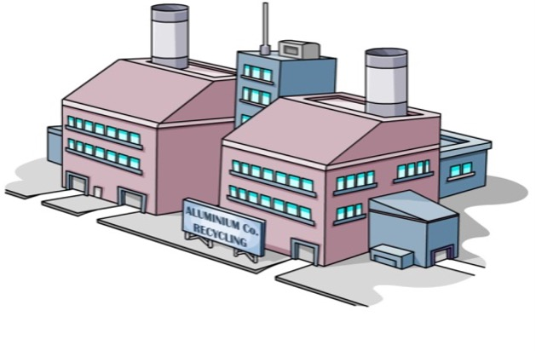
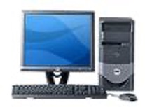



Cloud Computing: A Case
IT dept.
Joe’s Widget Co.
Notes:
Let’s start with Joe’s Widget Company.
Initially, Joe runs everything himself. He has his own IT department, his own servers, and his own computing infrastructure. All of these machines are physically located next to his factory.
But owning all of this infrastructure is expensive. Joe has to buy the servers upfront, maintain them, replace them when they fail, and hire people to operate them.

Slide 6
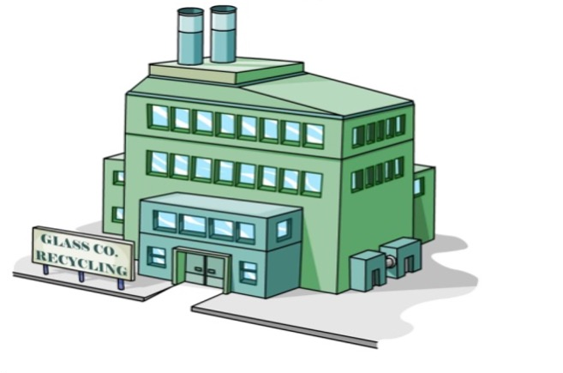
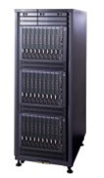
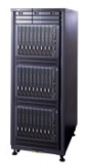





Cloud Computing: A Case
Host it R us.
Joe’s Widget Co.
Notes:
Now suppose a company called Host it R us tells Joe: “You don’t actually need to own these machines. Just move your applications and workloads to our servers. We’ll run them for you, and you pay us for the computing resources you use.” So Joe moves his workload to Host it R us.

Slide 7
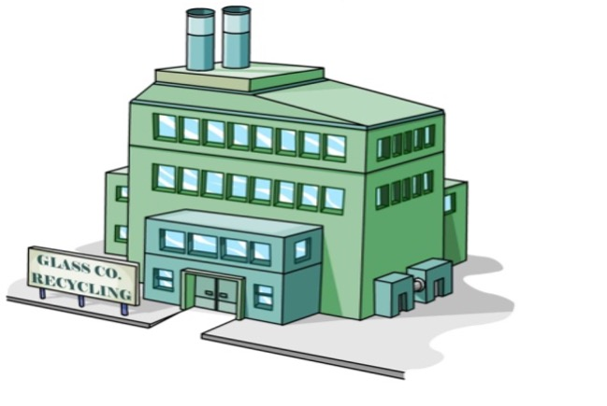
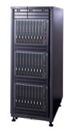





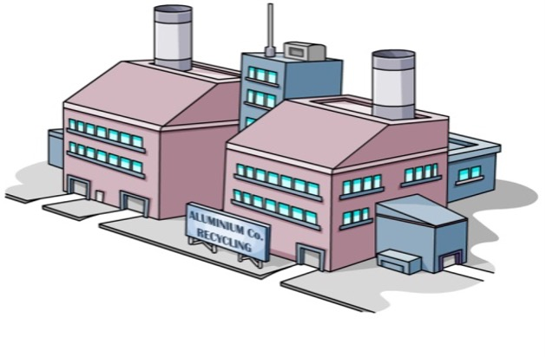

Cloud Computing: A Case
Host it R us.
Joe’s Widget Co.
Notes:
Notice what has changed. Joe’s applications are still running, but the physical machines are no longer in Joe’s building. From Joe’s perspective, he just needs a terminal to access his applications.
This is the first important transition: Joe no longer owns the computing infrastructure. He consumes computing as a service.

Slide 8
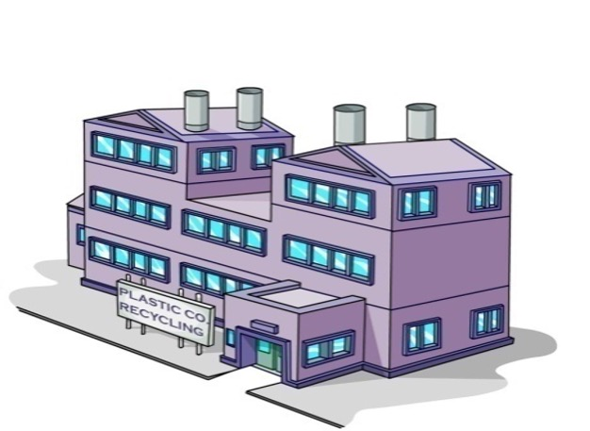


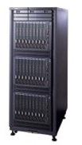



Cloud Computing: A Case
$5/day
$3/day
Host it R us.
Host 4 Less
Joe’s Widget Co.
Notes:
Now something more interesting happens.
A second provider, Host 4 Less, enters the market. Host it R us charges five dollars per day, while Host 4 Less charges only three dollars per day.
If Joe’s workload can run at either provider, what should Joe do?

Slide 9




Cloud Computing: A Case
Host it R us.
Host 4 Less
Joe’s Widget Co.
Notes:
He can simply move his workload from Host it R us to Host 4 Less.
Nothing fundamental about Joe’s application has changed. He still needs the same computing resources. The only thing that changed is who provides those resources and how much they cost.

Slide 10



Cloud Computing: A Case
Host it R us.
Host 4 Less
Joe’s Widget Co.
Notes:
This is a very important idea behind cloud computing: computing starts to look like a commodity.
Joe doesn’t necessarily care which physical server runs his application or who owns that server. He cares that he gets the computing resources he needs at the right price.
And if workloads can easily move between providers, providers have to compete. If one provider charges five dollars and another charges three dollars for essentially the same service, Joe can move to the cheaper provider.
So computing changes from an asset that Joe owns into a service that Joe rents.

Slide 11




Cloud Computing: A Case
Host it R us.
Host 4 Less
Snoopy’s Startup
Notes:
Now let’s look at another company: Snoopy’s Startup.
Snoopy has a lot of ideas. He launches Dogspace, then DogTube, then DogFlix, and finally dBay.
The problem is that Snoopy has no idea which of these products will actually succeed.
If Snoopy had to build his own infrastructure, launching four products would be very expensive. He would have to buy enough servers for each product before knowing whether anyone would even use it.

Slide 12



Cloud Computing: A Case
Host it R us.
Host 4 Less
Dogspace
Snoopy’s Startup
Notes:
but with rented computing resources, he doesn’t have to make that commitment.

Slide 13



Cloud Computing: A Case
Host it R us.
Host 4 Less
Dogspace
DogTube
Snoopy’s Startup

Slide 14



Cloud Computing: A Case
Host it R us.
Host 4 Less
Dogspace
DogTube
DogFlix
Snoopy’s Startup

Slide 15



Cloud Computing: A Case
Host it R us.
Host 4 Less
Dogspace
DogTube
DogFlix
dBay
Snoopy’s Startup
Notes:
He can start all four products with relatively small amounts of resources and see what happens.
So the first benefit of elasticity is: you can experiment cheaply without making a large upfront infrastructure investment.

Slide 16


Cloud Computing: A Case
Host it R us.
Host 4 Less
Dogspace
DogTube
DogFlix
dBay
Snoopy’s Startup
Notes:
And, as often happens with startups, most of these ideas don’t work.
One product fails. Then another one fails. Then another one fails.

Slide 17


Cloud Computing: A Case
Host it R us.
Host 4 Less
DogTube
DogFlix
dBay
Snoopy’s Startup

Slide 18


Cloud Computing: A Case
Host it R us.
Host 4 Less
DogTube
dBay
Snoopy’s Startup
Notes:
But notice what happens to the computing resources when a product disappears. They immediately become available again.
If Snoopy had bought physical servers for each product, those servers would still be sitting there. The product may be dead, but Snoopy has already paid for the hardware.
With cloud computing, when an experiment fails, Snoopy can simply release those resources and stop paying for them.
So failure becomes much cheaper. You acquire resources when you need them, and release them when you don’t.

Slide 19

Cloud Computing: A Case
Host it R us.
Host 4 Less
dBay
Snoopy’s Startup
Notes:
Eventually, only one product survives: dBay.
And then something very different happens: dBay becomes extremely popular.

Slide 20
Cloud Computing: A Case
Host it R us.
Host 4 Less
dBay
Snoopy’s Startup

Slide 21












Cloud Computing: A Case
Host it R us.
Host 4 Less
dBay
Snoopy’s Startup
Notes:
Suddenly, Snoopy doesn’t need fewer resources. He needs dramatically more resources.
If Snoopy owned his infrastructure, this would create the opposite problem. He might have a lot of unused servers from the three failed products, but still not have enough capacity to handle the rapid growth of dBay. Buying, installing, and configuring new servers takes time.

Slide 22


















Cloud Computing: A Case
Host it R us.
Host 4 Less
dBay
Snoopy’s Startup
Notes:
With rented infrastructure, Snoopy can simply acquire more computing resources as demand grows.
The infrastructure can grow with the application. This is what we mean by elasticity: computing resources can expand when demand increases and shrink when demand decreases.

Slide 23

Cloud Computing: A Case
Host it R us.
Host 4 Less
Notes:
So Snoopy gets both sides of elasticity:
When an idea fails, scale down and stop paying. When an idea succeeds, scale up quickly.
By the end of the story, Snoopy doesn’t need to own a data center or manage all of those physical machines himself. He can focus on building the product while the cloud providers supply the computing infrastructure.
Joe’s story: Why own computing if you can rent it? Snoopy’s story: Why decide today how much computing you will need tomorrow?

Slide 24
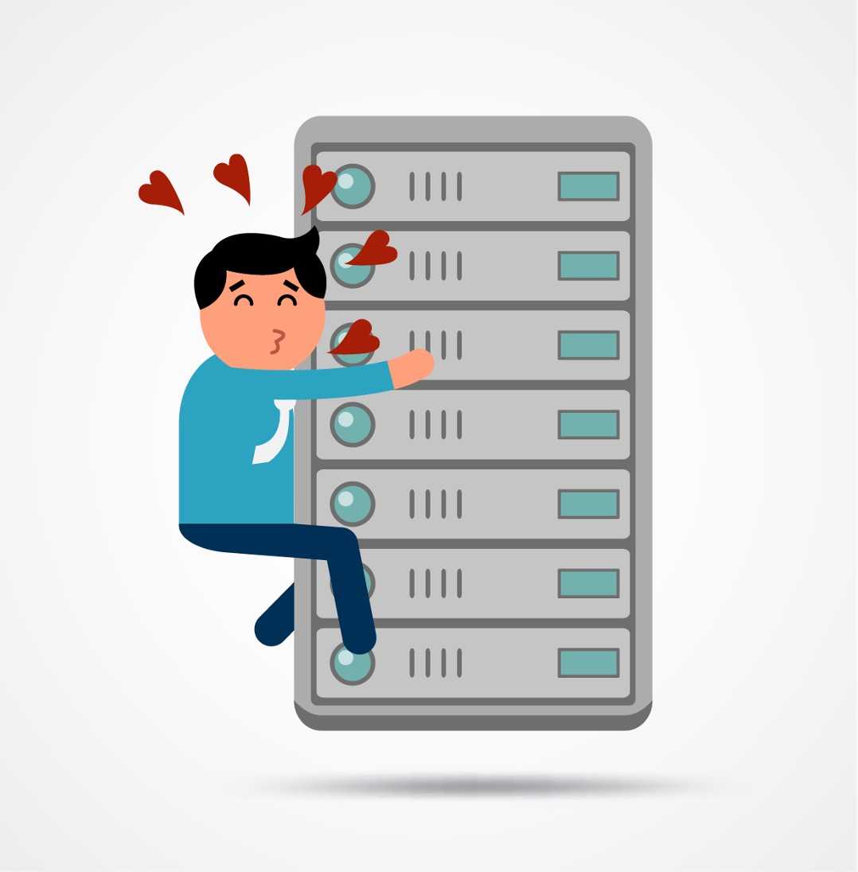
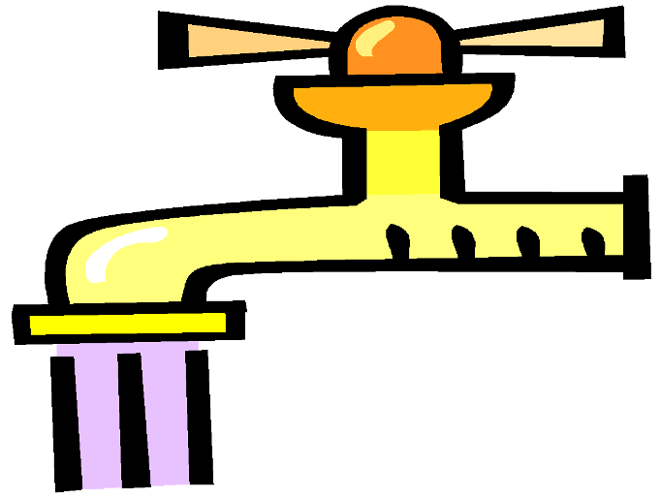
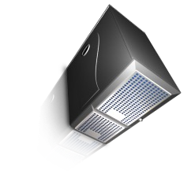
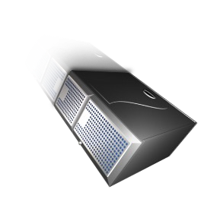
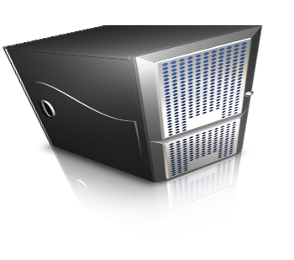
What We Want?
Notes:
So what do these two stories tell us?
Traditionally, we treated computers almost like physical assets that we owned and took care of. We bought servers, installed them, maintained them, and kept them even when we no longer needed them.
But that’s not what we really want.
Ideally, we want computing to work more like a utility — like water or electricity.
When I need more computing, I turn it on. When I don’t need it anymore, I turn it off. And I only pay for what I actually use.
Pay only for what you use, and get as much or as little computing as you need, when you need it.

Slide 25
Cloud Computing Models, Resource, Attributes
Delivery models
Software as a Service (SaaS)
Deployment models
Platform as a Service (PaaS)
Public cloud
Private cloud
Community cloud
Hybrid cloud
Infrastructure as a Service (IaaS)
Cloud computing
Infrastructure
Distributed infrastructure
Defining attributes
Resource virtualization
Massive infrastructure
Autonomous systems
Resources
Utility computing. Pay-per-usage
Compute & storage servers
Accessible via the Internet
Networks
Services
Elasticity
Applications
Notes:
So far, we’ve used two stories to build some intuition about cloud computing. Now let’s put some formal terminology around those ideas. There are several different ways to describe a cloud computing system, and this figure organizes them into five dimensions.
First, delivery models describe what level of the computing stack you are consuming as a service. We usually divide them into Infrastructure as a Service, Platform as a Service, and Software as a Service — IaaS, PaaS, and SaaS.
Second, deployment models describe how the cloud is deployed and who has access to it. This gives us public clouds, private clouds, community clouds, and hybrid clouds.
Third, infrastructure describes how the cloud itself is built. Here we have distributed infrastructure, resource virtualization, and autonomous systems.
Fourth, resources describe what the cloud actually provides: networks, compute and storage servers, services, and applications.
And finally, we have the defining attributes of cloud computing.

Slide 26
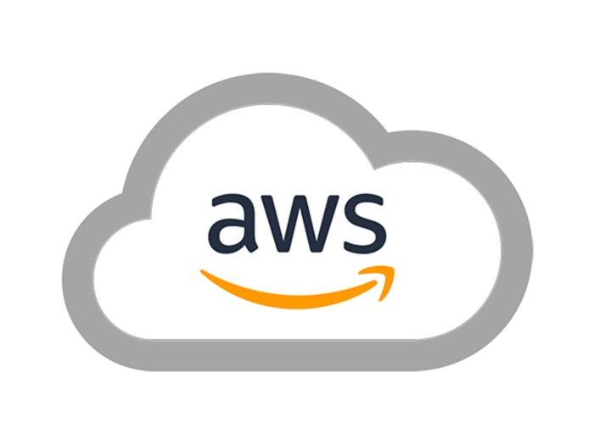
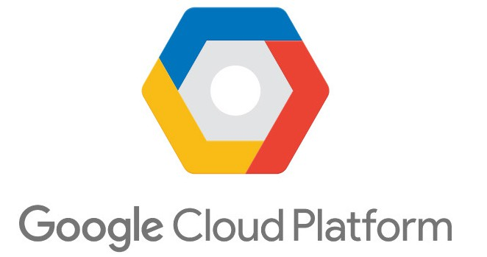


Types of Clouds
Public Cloud - the infrastructure is made available to the general public or a large industry group and is owned by the organization selling cloud services.
Private Cloud – the infrastructure is operated solely for an organization.
Hybrid Cloud - composition of two or more Clouds (public, private, or community) as unique entities but bound by a standardized technology that enables data and application portability.
Other types: e.g., Community/Federated Cloud - the infrastructure is shared by several organizations and supports a community that has shared concerns.
Notes:
Let’s take one of these dimensions — deployment models — and make it more concrete.
The first and most familiar one is the public cloud. When people talk about “the cloud,” this is usually what they have in mind. Examples include AWS, Microsoft Azure, and Google Cloud. The cloud provider owns and operates the infrastructure, and many different customers rent resources from it.
The second model is a private cloud. Here, the cloud infrastructure is dedicated to a single organization. You can still have cloud technologies such as virtualization and on-demand resource provisioning, but the infrastructure is not open to the general public.
The third is a hybrid cloud, which combines public and private cloud infrastructure. An organization might keep some workloads in its own private cloud while using a public cloud for others.
And finally, we have community or federated clouds, where infrastructure is shared across multiple organizations or institutions. One example that you will see again in this course is the Mass Open Cloud, or MOC.

Slide 27
Course Structure
Distributed Systems Foundation
Cloud Computing Foundation
Advance topic on Cloud Computing
Projects mentored by the industry
You can get to course website. This will be kept up to date, has all deadlines, demos…
Piazza is the source of truth.
Useful Link: http://nil.csail.mit.edu/6.824/2020/schedule.html
https://web.eecs.umich.edu/~manosk/eecs591-f21.html
Notes:
Now that we have a basic idea of what cloud computing is, let me briefly explain how this course is organized.
We will start with some distributed systems foundations. Cloud systems are fundamentally distributed systems, so we need this foundation before we can understand how large-scale cloud services work.
Then we will move into the foundations of cloud computing, including topics such as virtualization, data centers, storage, networking, and resource management.
After that, we will discuss a number of advanced topics in cloud computing, including more recent systems and research problems.
And throughout the semester, you will also work on a course project mentored by someone from industry. The goal is not just to learn cloud concepts in lectures, but also to build and work with real systems.
For logistics, there are two places you should pay attention to.
The course website will always have the latest schedule, deadlines, and course materials. And Piazza is our source for course communication. If there is an announcement or an update, make sure you check Piazza.

Slide 28
Course Logistics
Good News: no exam in this class
Paper readings
1–2 papers per week.
You do not need to write reviews, but you are expected to read them.
Notes:
First, some good news: there is no exam in this class.
But that doesn’t mean there is no work. This is a systems course, and an important part of the course is learning from real systems research. So we will typically read one or two papers each week.
You do not need to write formal paper reviews. But I do expect you to actually read the papers before class.
We will use these papers to understand not only how existing cloud systems work, but also how researchers identify important systems problems, design solutions, and evaluate them.
So think of the readings as an important part of the course, rather than something separate from the lectures.

Slide 29
How You Are Evaluated
Project: 50% (team)
Demo 1 - design proposal: 5%
Demo 2 - working prototype: 10%
Demo 3 - optimized system: 10%
Final project result and report: 20%
Presentation quizzes: 5%
Presentation: 10% (per presenter)
Individual contribution: 10% (peer + mentor)
Paper quizzes: 30%
There are 18 quizzes in class:
MS/Ph.D. students: your highest 14 scores count.
Undergraduate students: your highest 12 scores count.
Notes:
Now, how will you be evaluated?
There are three major components in this course.
The biggest one is the course project, which is 50% of your grade. Cloud computing is a systems course, and I want you to actually build something rather than only learn the concepts from lectures and papers.
The project will progress through several milestones. You will first present your design proposal, then demonstrate a working prototype, then show an optimized system, and finally present your results and submit a final report.
Another part is your presentation and individual contribution.
Because the project is team-based, I also want to make sure that everyone actually contributes. So part of your grade will reflect your individual contribution, based on feedback from your teammates and your mentor.
I’ll explain exactly how that works on the next couple of slides.
The second major component is paper quizzes, which are 30%.
We will have 18 quizzes during the semester, but not all of them count. For Master’s and Ph.D. students, I will take your highest 14 scores. For undergraduate students, I will take your highest 12 scores.
So if you miss a quiz or have a bad day, it is not necessarily a big problem.

Slide 30
How You Are Evaluated
In-class Questions: Bonus
A correct answer receives 0.5 bonus point, and an insightful answer receives 1 bonus point.
A wrong answer does not incur any penalty
Each student may receive at most one bonus per class
Bonus points are capped at 3 points toward your final grade.
If no one volunteers to answer, a student will be selected at random.
Notes:
One more thing about grading: you can earn some bonus points by participating in class. Throughout the semester, I will ask questions during lectures. If you give a correct answer, you receive 0.5 bonus points. If you give a particularly insightful answer, you can receive 1 bonus point. And importantly, there is no penalty for a wrong answer.
So please don’t be afraid to raise your hand and try. I would much rather have you think about the question and give an imperfect answer than have everyone sit quietly. To keep this fair, each student can receive at most one bonus per class, and the total bonus is capped at three points toward your final grade. And if nobody volunteers… I may randomly pick someone. So participation is encouraged.

Slide 31
Course Project
There is a capstone project in the course.
Each team will be assigned a mentor from industry or a senior graduate student.
Project teams will consist of 4–5 students.
Projects are proposed by mentors, and you may indicate your preferences among them.
Notes:
Now let’s talk about the course project, which is a major part of this class.
This is a semester-long capstone project. You will work in teams of four to five students, and each team will have a mentor from industry or a senior graduate student.
These are not projects where I simply give everyone the same assignment and ask you to implement it.
Instead, the projects are proposed by the mentors and are based on real systems problems. In many cases, your mentor is someone who actually works on or researches the system you will be studying.
You will be able to indicate which projects you are most interested in, and we will use those preferences to form the teams.
Throughout the semester, your team will work with your mentor, build a real system, and present your progress through several milestones.
So this project is really your opportunity to take the ideas we discuss in class and apply them to a real cloud systems problem.

Slide 32
Lets look at the projects
Notes:
For a few of the projects, I’m still waiting for additional details from the mentors. I’ll update the project descriptions as soon as I receive them.
We currently have seven project options. You will submit your project preferences this week, and the final project assignments will be based on student preferences. We expect each team to have around 4–5 students, so not every project is guaranteed to have a team.

Slide 33
Peer Scoring
There will be an anonymous peer scoring process
Individual contribution: 10% = 5% peer + 5% mentor
Each team member rates every teammate on a scale of 1 to 10.
How it is scored
10 = carried their full share; 1 = contributed nothing
Your score is the average of what teammates give you
Peer points = 5 x min(average, 9) / 9
An average of 9 or above earns full marks
Your mentor also rates engagement and reliability
Ratings are anonymous - nobody sees who gave what
Notes:
Since this is a team project, one question naturally comes up: what if different team members contribute very different amounts of work?
That’s why we have an individual contribution component.
Your individual contribution is worth 10% of your final grade. Half of that comes from your teammates, and the other half comes from your mentor.
For the peer evaluation, each team member will anonymously rate every other teammate on a scale from 1 to 10.
A 10 means that the person fully carried their share of the project. A 1 means that they essentially contributed nothing.
We will take the average score you receive from your teammates. An average of 9 or above gives you the full five peer-evaluation points.
Your mentor will separately evaluate your engagement and reliability for the other five points.
The important thing is that the peer ratings are anonymous. Your teammates will not know who gave them which score.

Slide 34
Project Presentation
3 in-class demos plus a final presentation; all groups present.
Before the demo
Push slides and code to the demo branch by 12:00 noon
Email me two multiple-choice questions by 5:30 PM
You are teaching us - minimize acronyms
Review your slides with your mentor first
Presenting
10 minutes to present, 5 minutes for questions
At most two members per demo; everyone presents once
Notes:
Throughout the semester, we will have three in-class project demos and one final presentation. For every demo, all groups will present their progress to the class.
There are a few things you need to do before each demo.
First, push your slides and code to the demo branch by 12 noon.
Second, send me two multiple-choice questions based on your presentation by 5:30 PM. Your classmates will answer questions about the project presentations, so this is also part of how we make sure everyone is paying attention to what the other teams are doing.
And importantly, please review your slides before presenting them in class.
For the presentation itself, each group will have 10 minutes to present and 5 minutes for questions.
At most two team members should present during each demo, and everyone on the team needs to present at least once during the semester.
And when you present, remember that you are teaching the rest of the class.
Your classmates may not know your particular system or research area, so don’t fill your slides with unexplained acronyms. Explain the problem and the key ideas in a way that everyone in the room can follow.

Slide 35
Paper Quizzes
18 quizzes, one per lecture
One in every lecture except the first two
10 multiple-choice questions in 10 minutes
Open book and open internet
Only your best scores count
MS/Ph.D. students: your highest 14
Undergraduates: your highest 12
There are no make-ups
The extra quizzes are your absence buffer
Notes:
Now let me explain how the paper quizzes work.
There will be 18 quizzes during the semester, roughly one in every lecture except the first two. Each quiz has 10 multiple-choice questions, and you have 10 minutes to complete it.
The quizzes are open book and open Internet. I’m not trying to test whether you can memorize small details from a paper. The goal is to make sure that you actually read and understand the main ideas before coming to class.
Also, not every quiz counts toward your final grade. For Master’s and Ph.D. students, I take your highest 14 scores. For undergraduate students, I take your highest 12 scores. Because of that, there are no make-up quizzes.
If you are sick, traveling, have an interview, or simply have one bad quiz, that’s what the extra quizzes are for. They are already built into the grading policy as your absence buffer.
So you don’t need to contact me every time you miss one quiz. Just make sure that, over the semester, you complete enough of them to have the required number of scores.

Slide 36
Grading Scale
Grade thresholds
≥93 A, ≥88 A-, ≥83 B+, ≥78 B, ≥68 B-, ≥60 C
I may lower these. I will never raise them
Based on course difficulty and the class distribution
Do not spend the semester worrying
In past offerings about half the class finished A or A-
Notes:
Finally, let me briefly explain the grading scale.
These are the default grade thresholds for the course. For example, if you get a 93 or above, that’s an A. An 88 or above is an A-, and so on. At the end of the semester, depending on the overall difficulty of the course and the grade distribution, I may lower these thresholds.
But I will never raise them.
So these cutoffs can only move in your favor, not against you. And don’t spend too much time worrying about the exact cutoff. In past offerings, roughly half of the class finished with an A or A-. So focus on doing good work rather than optimizing for a particular cutoff.

Slide 37
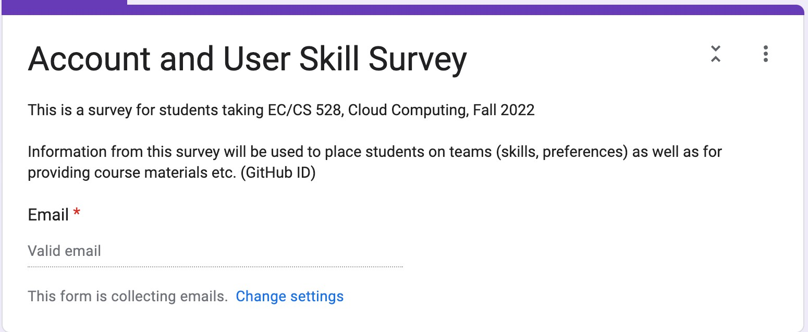
Immediate Next Steps
Project matching
We will post a project preference form on the course website.
Fill out the form by 11:59 PM on 09/06.
We will assign project teams and please reach out to your team member asap
Notes:
So what do you need to do immediately after today’s class?
The first thing is project matching. We post a project preference form on the course website. You should look through the projects we introduced today and tell us which ones you are most interested in. Please submit the form by 11:59 PM on September 6th.
We will use your preferences to assign project teams. Of course, we may not be able to give everyone their first choice, but we will try to match your interests as much as possible. Once the teams are announced, please reach out to your teammates as soon as possible.
Introduce yourselves, set up a communication channel, and start coordinating with your mentor. Don’t wait until the first project deadline to start talking to each other. The earlier your team gets organized, the easier the rest of the semester will be.

Slide 38
Some Suggestions
Working as a team
Come to office hours for help with design problems
Be in touch with your mentors.
Focus on the high-level questions
Let the instructors know early if there are problems
Notes:
Before we move on, let me give you a few suggestions about the course project.
First, remember that this is a team project. Communicate with your teammates early, divide the work clearly, and make sure everyone understands what the team is trying to accomplish.
Second, stay in touch with your mentor. Your mentor is there to help you with the high-level questions: Is this the right problem? Does our design make sense? Are we evaluating the right thing?
For more detailed design and implementation problems, please come to our office hours. The course staff is here to help.
And most importantly, if something is not working — either within your team or with your mentor — let us know early.
Most problems are easy to fix early in the semester and much harder to fix right before a deadline.
“Okay, that’s enough logistics. Now let’s talk about why you should actually be excited about this class.”

Slide 39
But, Why Should You Stay in This Class, and This Field?
Notes:
So far, I’ve spent a lot of time talking about logistics — projects, quizzes, grading, and deadlines.
But there is a more important question:
Why should you stay in this class? And why should you care about cloud computing?
Let me give you a few reasons.

Slide 40
We Will Discuss
This is the future of all computing
It has profound impact on:
how hardware is developed
how software is developed
the computer industry
society as a whole
Notes:
The first reason is that cloud computing is shaping the future of computing as a whole.
And I don’t simply mean that everything is going to run on AWS.
Cloud computing is changing how we think about the entire computing stack.
It affects how hardware is developed, because increasingly we design hardware for large-scale data centers rather than just individual machines.
It affects how software is developed, because modern applications are increasingly distributed and need to operate at very large scale.
It has also transformed the computer industry. Many companies today build their products and services directly on top of cloud infrastructure.
And of course, it has a broader impact on society, because so many services that people use every day now depend on this infrastructure.
So even if you don’t become a cloud engineer, many of the ideas we discuss in this class will probably show up somewhere in your career.

Slide 41
Course Contents: A Variety of Topics
Overview of Cloud Computing
Virtualization
Distributed systems
Datacenter architectures
Storage systems
Resource management
Big data processing
Datacenter networking
Serverless Computing
Performance Issue
Reliability and AIOps
LLM Infrastructure
Notes:
And that’s also why this course covers such a wide range of topics.
Cloud computing is not one single technology. It brings together many different areas of computer systems.
We will talk about virtualization, which allows us to share physical machines.
We will study distributed systems, because cloud applications run across many machines.
We will look at data-center architectures, storage, networking, and resource management, because all of these components have to work together at very large scale.
And we will also discuss Serverless Computing, performance tunning, and LLM infrastructures.
So this course is not just about learning how to use AWS or how to launch a virtual machine.
It is really a course about the systems principles behind modern cloud infrastructure.
And when we talk about “the cloud,” remember that there is nothing magical about it. Behind the cloud are real physical machines, networks, power systems, cooling systems, and enormous data centers.
Sometimes these data centers can even be in unusual places — including under the water.
As a cloud user, you usually don’t know and don’t care where the physical machine is.
You simply ask for computing resources, and the cloud gives them to you.
But as systems people, we care about what is happening underneath that abstraction.
And that’s a big part of what we are going to study in this course.

Slide 42
So, Why is Cloud Computing Cool?
Shared Resources and Resource Management
Cloud uses a shared pool of resources
Uses Internet to offer scalable and elastic services.
The term “elastic computing” refers to the ability of dynamically and on-demand acquiring computing resources and supporting a variable workload.
Resources are metered and users are charged accordingly.
It is more cost-effective due to resource-multiplexing. Lower costs for the cloud service provider are past to the cloud users.
Notes:
So what makes cloud computing interesting?
At the center of cloud computing is a very simple idea: a large pool of computing resources is shared by many users and applications.
From the user’s perspective, this creates several important properties.
You can access computing resources over the Internet.
You can dynamically acquire more resources when your workload grows and release them when your workload shrinks. That’s what we call elasticity.
And because resource usage can be measured, you can pay based on what you actually use.
So from the user’s perspective, the cloud looks almost unlimited and available on demand.
But underneath, these resources are still physical machines.
So here’s an interesting systems question:
How can a cloud provider give millions of users this illusion of elastic, on-demand computing while still using the physical infrastructure efficiently?
A big part of the answer is resource sharing and resource management.

Slide 43
Cloud Computing Benefits?
Resources, such as CPU cycles, storage, network bandwidth, are shared.
When multiple applications share a system, their peak demands for resources are not synchronized thus, multiplexing leads to a higher resource utilization.
Resources can be aggregated to support data-intensive applications.
Data sharing facilitates collaborative activities. Many applications require multiple types of analysis of shared data sets and multiple decisions carried out by groups scattered around the globe.
Notes:
So why is sharing resources so useful?
Imagine that every application has its own dedicated servers.
Most applications do not use their maximum amount of CPU, storage, or network bandwidth all the time. Their resource demand goes up and down.
More importantly, different applications usually don’t reach their peak demand at exactly the same time.
Maybe one application is busy in the morning, while another one is busy at night.
If they have separate servers, we have to provision each application for its own peak, and much of that capacity will sit idle most of the time.
But if they share a common pool of resources, one application can use resources that another application doesn’t currently need.
This is resource multiplexing, and it allows the cloud provider to achieve much higher overall utilization.
At the same time, because the cloud aggregates resources from many machines, it can provide enormous amounts of computing and storage when an application actually needs them.
So resource sharing gives us two important things: better efficiency and larger scale.

Slide 44
Cloud Computing Benefits(cont’d)
Eliminates the initial investment costs for a private computing infrastructure and the maintenance and operation costs.
Cost reduction: concentration of resources creates the opportunity to pay as you go for computing.
Elasticity: the ability to accommodate workloads with very large peak-to-average ratios.
User convenience: virtualization allows users to operate in familiar environments rather than in idiosyncratic ones.
Notes:
So resource sharing makes the infrastructure more efficient. But what does that mean for cloud users?
First, it eliminates a large upfront investment. Traditionally, if you wanted to launch a new service, you might have to buy servers, build infrastructure, and maintain all of it yourself.
With the cloud, you can start with a small amount of computing and pay as you go.
Second, we get elasticity. If your workload suddenly grows, you can acquire more resources. When the workload decreases, you can release them.
This is especially useful when there is a very large difference between your average demand and your peak demand.
And finally, virtualization makes the infrastructure much easier to use. You can work with a familiar computing environment without worrying too much about the particular physical machine underneath.
So the cloud gives users lower upfront cost, pay-as-you-go computing, elasticity, and a much simpler way to access infrastructure.

Slide 45
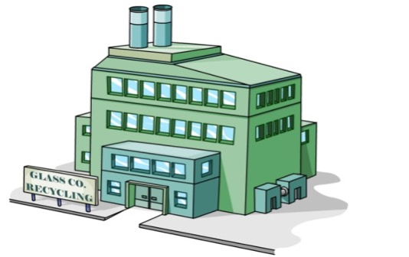
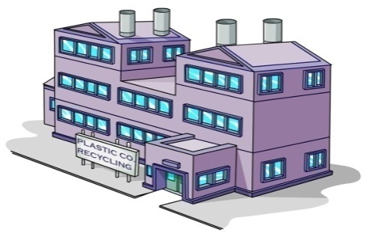












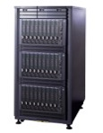
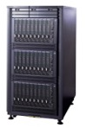
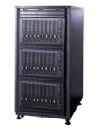
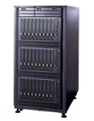



























Remember this?
Host it R us.
Host 4 Less
Notes:
Remember this example from the beginning of the lecture?
Snoopy didn’t know which application would succeed, and he also didn’t know how much computing the successful application would eventually need.
That’s exactly why elasticity matters.
When an application fails, he can release the resources.
When an application suddenly becomes popular, he can acquire more resources.
The important point is that he doesn’t have to predict the future when he buys the infrastructure.
And this isn’t just a cartoon example.
Real companies have grown in almost exactly this way.

Slide 46
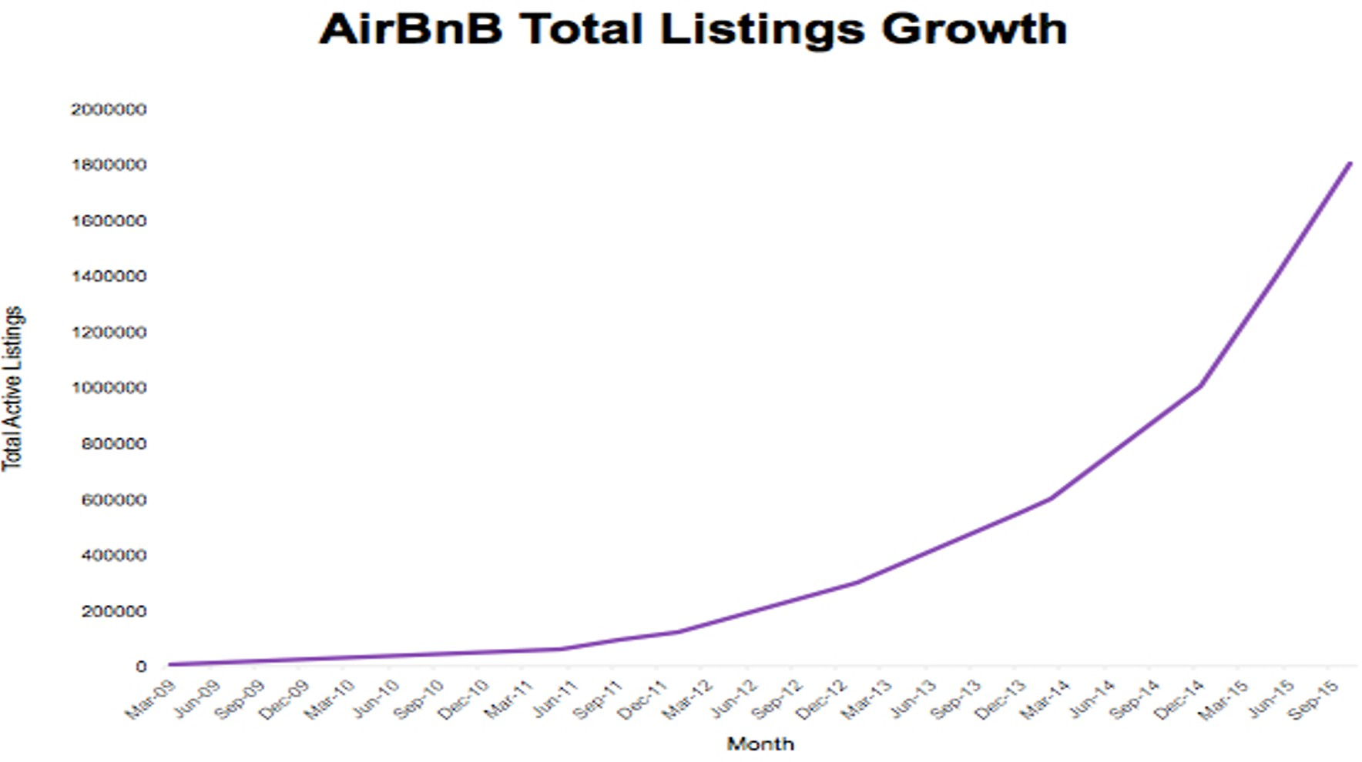
AirBnB Example
Success of market depends on network of renters and landlords
starts really small
Notes:
One classic example is Airbnb.
Think about the business model of Airbnb. Its success depends on building a network of both renters and landlords. And like many startups, it started very small.
At the beginning, nobody knows whether this kind of business is going to succeed.
So imagine that you are Airbnb at that point.
How much computing infrastructure should you buy?
Do you buy enough servers for a thousand users? A million users? Ten million users?
You simply don’t know.
This is very similar to the problem Snoopy had.

Slide 47
AirBnB
2010 – 24 EC2 instances, 300 GB of data
2015 – 1000 EC2 instances, 50 TBytes data
Grew up entirely on AWS, no data center, no capital purchases, no racking/stacking, no acquisition networking…
5-person operations team
Piggyback on AWS for external network, availability zones
Rapid growth easily accommodated
Notes:
So what actually happened?
In 2010, Airbnb was running on only about 24 EC2 instances, with roughly 300 gigabytes of data.
Five years later, it had grown to around 1,000 EC2 instances and 50 terabytes of data.
That’s an enormous increase in infrastructure. But Airbnb didn’t have to build its own data center to support that growth. It grew entirely on AWS.
There was no need to make a huge capital investment in servers, build a data center, rack and stack machines, or build the external network infrastructure themselves.
Instead, as the company grew, its cloud infrastructure could grow with it.
And according to this example, they were able to operate this infrastructure with a relatively small operations team.
So this is a real-world version of the Snoopy story.
Start small. If the business grows, let the infrastructure grow with it.

Slide 48
Coursera
Massive on-line courses from Stanford, Duke…
Went from 0 to 3.2 million users in first year
Accessed from around the world
Spikes common, e.g., 75% increase in load in 5 minutes
Notes:
Airbnb shows one kind of growth: a company can become much larger over several years.
But cloud systems also have to deal with a different kind of change: very sudden spikes in demand.
Coursera is a good example.
It grew from zero to 3.2 million users in its first year, with users accessing the service from around the world.
But even more interesting is that its workload can change extremely quickly.
According to this example, Coursera could see a 75 percent increase in load in only five minutes.
You cannot respond to that kind of workload by ordering new physical servers.
By the time the servers arrive, the spike is already over.
This is where elasticity becomes especially important.
The infrastructure has to respond on roughly the same timescale as the workload.
“If your workload changes in minutes, your infrastructure cannot take weeks to change.”

Slide 49
Many Cloud Providers
Make computing resources available on demand
through a growing set of simple APIs
leverages economies of scale of large datacenters
… for anyone with a credit card
… at a large scale, if desired
Notes:
And today, there are many cloud providers that make this kind of computing possible.
The important change is that computing resources are now available on demand through APIs.
Think about how different this is from traditional computing infrastructure.
Traditionally, if you needed one hundred new servers, someone had to purchase them, ship them, install them, connect them to the network, and configure them.
In the cloud, acquiring computing resources can become an API call.
And because cloud providers operate enormous data centers, they can take advantage of economies of scale.
The result is that very large amounts of computing become available to organizations that could never afford to build this infrastructure themselves.
In principle, anyone with an account and a credit card can start with a few machines and, if necessary, scale to a very large number of machines.
That’s a fundamental change in how we access computing.

Slide 50
Cloud Services Providers
Amazon: Queue API in 2004, EC2 launched in 2006 Google: AppEngine in 2005, other services starting in 2008 Microsoft: Azure launched in 2008.
Millions of customers using these services Shift towards these services is accelerating Comprehensiveness of APIs increasing over time
Notes:
So this idea of providing computing through APIs started to become practical in the mid-2000s.
Amazon was one of the early major players. It first introduced services such as its queue API, and later launched EC2, which made virtual machines available on demand.
Google and Microsoft soon developed their own cloud platforms as well.
But the important point is not really the exact year when each service was launched.
The important point is how much the cloud has changed since then.
Cloud providers started with a relatively small set of services. Today, they provide APIs for almost every part of the computing stack — compute, storage, databases, networking, machine learning, and many other services.
And millions of customers now build their systems on top of this infrastructure.
So over the last twenty years, cloud computing has gone from a new way of renting a few computing resources to a major platform for building modern software systems.

Slide 51
Top-Down View of the Course
DC Building
Racks
Servers
Internal Network
A computer
Tasks/processes
VMs, Containers, etc
VM/Container schedulers
Distributed File System
Scheduling Systems
File systems
High level computation frameworks
Distributed Computation
(Semi) Structured Data
Distributed Data Base & Streaming
Cloud Reliability
Software Failure
Notes:
This figure gives you a top-down view of the course.
A cloud system is a very complicated system. There are many different layers, from physical machines and networks all the way up to distributed applications and data-processing systems.
So rather than studying all of these pieces independently, we are going to build up a picture of the cloud layer by layer.
At the bottom, we have the basic computing resources: machines, servers, racks, networks, and ultimately entire data centers.
On top of that, we need mechanisms to share and manage those resources.
And then, on top of those mechanisms, we build distributed storage, computation, databases, streaming systems, and other cloud services.
Throughout the semester, we will move through these different layers and understand how they fit together.
So you can think of this figure as a map of the course.

Slide 52
Top-Down View of the Course
Berkely view of cloud computing
DC Building
Racks
Servers
Internal Network
A computer
Datacenter as a computer
Tasks/processes
VMs, Containers, etc
VM/Container schedulers
Distributed File System
Scheduling Systems
File systems
High level computation frameworks
Distributed Computation
(Semi) Structured Data
Distributed Data Base & Streaming
Cloud Reliability
Software Failure
Notes:
The first important perspective I want you to develop is this:
In cloud computing, we often stop thinking about a single machine as the computer.
Instead, we start thinking about the entire data center as one giant computer.
A traditional computer has processors, memory, storage, and an interconnect connecting those components.
A data center has thousands of servers, enormous amounts of storage, and a network connecting all of those machines.
So conceptually, many of the same questions appear again, but at a completely different scale.
How do we allocate resources?
How do we schedule computation?
How do we store data?
How do different components communicate?
And what happens when something fails?
This “data center as a computer” perspective is one of the fundamental ways to think about cloud computing.
And it will guide much of what we discuss in this course.

Slide 53
Top-Down View of the Course
Berkely view of cloud computing
DC Building
Racks
Servers
Internal Network
A computer
Datacenter as a computer
Tasks/processes
VMs, Containers, etc
VM/Container schedulers
Distributed File System
Xen Container-OS
Scheduling Systems
File systems
Google File Sys
High level computation frameworks
Distributed Computation
MapReduce
(Semi) Structured Data
Distributed Data Base & Streaming
Cloud Reliability
Software Failure
Notes:
Once we adopt this data-center-as-a-computer view, we can start asking what systems we need to build on top of the physical infrastructure.
For example, if many users are sharing the same physical machines, we need virtualization. Systems such as Xen, and later container-based systems, allow us to isolate workloads and share physical resources.
Then we need storage systems that can store data across many machines. One classic example is the Google File System.
And once we have many machines available, we need programming models that allow applications to actually use all of that computing power.
One classic example is MapReduce.
Don’t worry if you don’t know these systems yet.
The point of this slide is simply to show you that cloud computing is built as a collection of layers, and each layer solves a different systems problem.
We will study many of these systems in much more detail later in the semester.

Slide 54
Top-Down View of the Course
Berkely view of cloud computing
DC Building
Racks
Servers
Internal Network
A computer
Datacenter as a computer
Tasks/processes
VMs, Containers, etc
VM/Container schedulers
Distributed File System
Xen Container-OS
Scheduling Systems
Borg
Mesos
File systems
Google File Sys
High level computation frameworks
Distributed Computation
MapReduce
(Semi) Structured Data
Distributed Data Base & Streaming
Kafka
Dynamo
Cloud Reliability
Software Failure
Raft
Cloud Failure
Notes:
But that’s still only part of the cloud stack.
Once you have thousands of machines, you also need to decide where computation should run.That gives us scheduling and cluster-management systems such as Borg and Mesos.
You need systems for moving and processing streams of data, such as Kafka.
You need distributed databases and storage systems, such as Dynamo.
And because these systems run across many machines, those machines need to coordinate with each other. That brings us to fundamental distributed-systems problems such as consensus, which we will discuss through systems and protocols such as Raft.
And finally, at this scale, failure is unavoidable.
Machines fail. Networks fail. Software fails.
So reliability is not something we can add after building the system. It has to be part of the system design from the beginning.
These are all different pieces of the same cloud-computing stack.

Slide 55
Top-Down View of the Course
Berkely view of cloud computing
DC Building
Racks
Servers
Internal Network
A computer
Datacenter as a computer
Tasks/processes
VMs, Containers, etc
VM/Container schedulers
Distributed File System
Xen Container-OS
Scheduling Systems
Borg
Mesos
File systems
Google File Sys
Flat Datacenter
CEPH
High level computation frameworks
Distributed Computation
MapReduce
Spark
Hive
(Semi) Structured Data
Distributed Data Base & Streaming
Kafka
Dynamo
Cloud Reliability
Software Failure
Raft
Cloud Failure
Notes:
And if we keep filling in this picture, we get something like this.
There are systems for virtualization and containers.
There are distributed file systems and storage systems.
There are cluster schedulers and resource-management systems.
There are frameworks such as MapReduce and Spark for distributed computation.
There are databases, streaming systems, networking systems, and systems for reliability and failure handling.
You do not need to understand all of these names today.
In fact, that’s the point of the course.
By the end of the semester, when you look at a picture like this, I want you to understand what these different systems are trying to accomplish, why they are necessary, and how they fit together.
More importantly, I want you to be able to look at a new cloud system that you’ve never seen before and ask the right questions:
What problem is this system solving? Where does it fit in the stack? What design choices does it make? And what are the trade-offs?
That’s the systems way of thinking that I want you to develop in this course.

Slide 56
How to Read
You May Think You Already Know How To READ, But…

Slide 57
Why Do We Need to Read Paper?
Reading for classes
Reach the edge of human knowledge
Keeping up with your field
Transitioning into a new areas
Learning how to write better papers

Slide 58
Keshav’s Three-Pass Approach: Step 1
A ten-minute scan to get the general idea
Title, abstract, and introduction
Section and subsection titles
Conclusion and bibliography
What to learn: the five C’s
Category: What type of paper is it?
Context: What body of work does it relate to?
Correctness: Do the assumptions seem valid?
Contributions: What are the main research contributions?
Clarity: Is the paper well-written?

Slide 59
Keshav’s Three-Pass Approach: Step 2
A more careful, one-hour reading
Read with greater care, but ignore details like proofs
Figures, diagrams, and illustrations
Mark relevant references for later reading
Grasp the content of the paper
Be able to summarize the main idea
Identify whether you can (or should) fully understand

Slide 60
Keshav’s Three-Pass Approach: Step 3
A several-hour virtual re-implementation
Making the same assumptions, recreate the work
Identify the paper’s innovations and its failings
Identify and challenge every assumption
Think how you would present the ideas yourself
Jot down ideas for future work

Slide 61
Other Tips for Reading Papers
Read at the right level for what you need
“Work smarter, not harder”
Read at the right time of day
When you are fresh, not sleepy
Read in the right place
Where you are not distracted
Read actively
With a purpose (what is your goal?)
With a pen or computer to take notes
Read critically
Think, question, challenge, critique, …

Slide 62
Next Time
The rise of cloud computing systems

