Slide 1
Lecture 6: Consensus II
Fall 2026
CE 528 Cloud Computing
Prof. Yigong Hu
Slides courtesy of Chang Lou and Robert Morrios
Notes:
Last time we saw how Raft elects one leader and uses that leader to choose the order of client commands. In the common case, the leader appends a command, replicates it to a majority, marks it committed, and tells the state machines to apply it.
Today we focus on everything that becomes difficult when leaders change. A leader can crash after sending an entry to only some followers. After several elections, different servers may have different entries at the same log index. Raft must choose a new leader, repair those logs, and still preserve every command that might already be committed.
We will then look below the protocol at stable storage. Which Raft variables must survive a reboot? Why can disk latency become the bottleneck? Finally, we will compact the log with snapshots so recovery time and storage do not grow forever.
SOURCE
MIT 6.824, Spring 2020, Lecture 7 transcript/video, 00:01–09:59 and 32:04–64:07.
Local transcript: fall2026/lectures/references/mit-6824-2020-lecture7-raft2-transcript.txt
https://www.youtube.com/watch?v=4r8Mz3MMivY
Ongaro and Ousterhout, In Search of an Understandable Consensus Algorithm, Sections 5.3–5.5 and 7.
https://pdos.csail.mit.edu/6.824/papers/raft-extended.pdf

Slide 2
Administrivia
Share your AWS ID by Tonight
  https://forms.gle/C9vuYuMkDJcN2xEF7
Notes:
Please share the AWS account ID that your team will use by tonight. Use the form on the slide and submit the one account your team has chosen, so we can assign the course credits correctly.

Slide 3
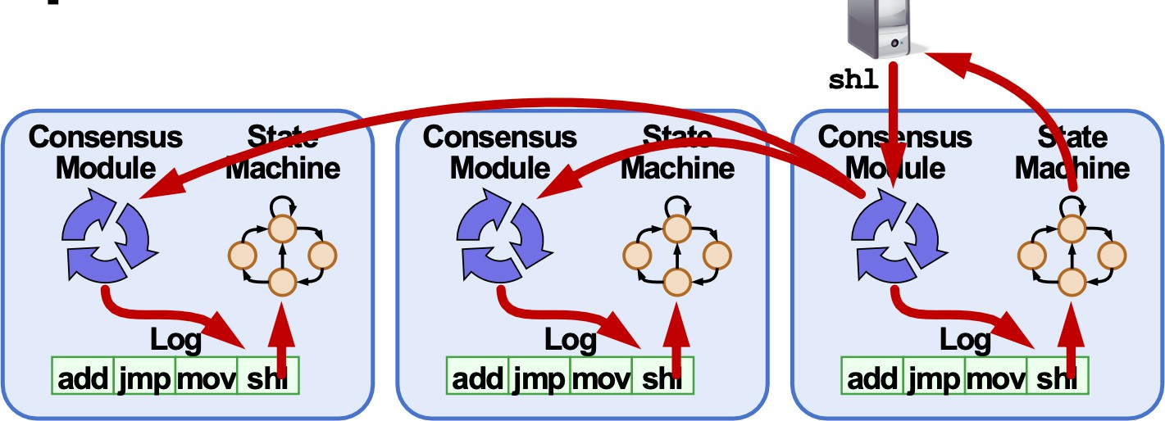
Crash
Crashed / slow followers?
Performance is “optimal” in common case:
  Leader retries RPCs until they succeed
  Followers pass committed commands to their state machines
Notes:
A crashed or slow follower is the easy case. The leader sends AppendEntries RPCs in parallel and keeps retrying until each follower catches up. Duplicate RPCs are harmless because a follower can recognize entries it already has.
The common path stays fast. In a three-server cluster, the leader counts itself and needs one follower to reach a majority. It does not wait for the slowest machine. Once the command is committed, the leader applies it and can answer the client. A lagging follower learns the commit index from a later AppendEntries or heartbeat and applies the same commands in order.
So one failed follower affects redundancy, but it does not immediately affect availability or client latency. A failed leader is harder. The replacement may inherit a cluster in which different servers have accepted different uncommitted suffixes.
SOURCE
Ongaro and Ousterhout, In Search of an Understandable Consensus Algorithm, Sections 5.3 and 5.5.
https://pdos.csail.mit.edu/6.824/papers/raft-extended.pdf

Slide 4
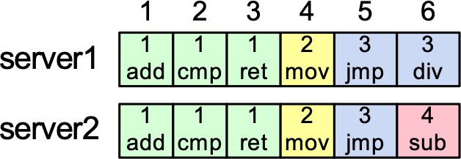
Log Operation
If log entries on different server have same index and term:
  Store the same command => one leader, one entry, one index, one term + log position never change
  Logs are identical in all preceding entries => consistency check
If given entry is committed, all preceding also committed
Notes:
The repair algorithm relies on the Log Matching Property.
First, if two entries have the same index and the same term, they contain the same command. A term has only one leader, and that leader creates at most one entry at a particular index. Leaders also never rewrite their own earlier entries.
Second, if two logs contain the same entry, then every preceding entry is also identical. AppendEntries enforces that statement one step at a time: the follower accepts new entries only if it already contains the exact entry named by the leader as the predecessor.
This gives us a powerful shortcut. When a leader finds one matching index and term on a follower, it has found a common prefix. It can replace everything after that point with its own suffix.
The final statement on the slide connects log matching to commitment. When Raft safely commits an entry from the leader's current term, all earlier entries in that leader's log become committed as well. We will return to why the phrase current term matters on slides 15 and 16.
SOURCE
Ongaro and Ousterhout, In Search of an Understandable Consensus Algorithm, Sections 5.3–5.4.2 and Figure 3.
https://pdos.csail.mit.edu/6.824/papers/raft-extended.pdf

Slide 5
Leader Changes
As long as the leader stays up:
  clients only interact with the leader
  clients can't see follower states or logs
Things get interesting when changing leaders
  e.g. after the old leader fails
  how to change leaders without anomalies?
Notes:
As long as one leader stays in control, clients see a simple system. They send requests to that leader, and they cannot observe whether one follower is a few entries behind or whether another follower has received an entry but not yet learned that it is committed.
A leader change exposes those hidden differences. The old leader may have crashed in the middle of replication, so one server may contain an entry that another server never received. After several crashes, the same index may even contain commands created by different leaders in different terms.
The new leader therefore has two jobs. It must make every follower's log match its own, and it must never erase an entry that a previous leader committed. If it gets either part wrong, clients can observe a missing operation, the same operation twice, or a different command at a log position that was already applied.
Raft splits the solution into two rules. AppendEntries repairs followers after a leader is chosen. The election restriction controls which log is allowed to become the leader's source of truth.
SOURCE
MIT 6.824, Spring 2020, Lecture 7 transcript/video, 00:01–20:36.
Local transcript: fall2026/lectures/references/mit-6824-2020-lecture7-raft2-transcript.txt
https://www.youtube.com/watch?v=4r8Mz3MMivY
Ongaro and Ousterhout, In Search of an Understandable Consensus Algorithm, Sections 5.3–5.4.
https://pdos.csail.mit.edu/6.824/papers/raft-extended.pdf

Slide 6
Crashes can Leave Log Disagree
A leader crashes before sending last AppendEntries to all
Logs might have different commands in same entry! after a series of leader crashes
Notes:
Here is how disagreement appears.
Suppose a leader in term three sends its last entry to S2 and S3, but crashes before S1 receives it. S2 and S3 have one more entry than S1. That situation is normal: accepting an entry is not the same as knowing that it is committed.
Now repeat the process across several leader changes. A term-four leader may append command four on only one server and crash. A term-five leader may then append command five at the same index on a different server. The index is the position in the command sequence; the term tells us which leader created that version of the position.
Raft permits these conflicting suffixes because they have not yet become part of the committed history. The protocol does not try to merge them. One future leader will be selected, and its log will become authoritative. The safety question is how to ensure that the chosen log contains everything that was already committed before it starts deleting the other suffixes.
SOURCE
MIT 6.824, Spring 2020, Lecture 7 transcript/video, 00:01–09:59.
Local transcript: fall2026/lectures/references/mit-6824-2020-lecture7-raft2-transcript.txt
https://www.youtube.com/watch?v=4r8Mz3MMivY
Ongaro and Ousterhout, In Search of an Understandable Consensus Algorithm, Sections 5.3–5.4.
https://pdos.csail.mit.edu/6.824/papers/raft-extended.pdf

Slide 7
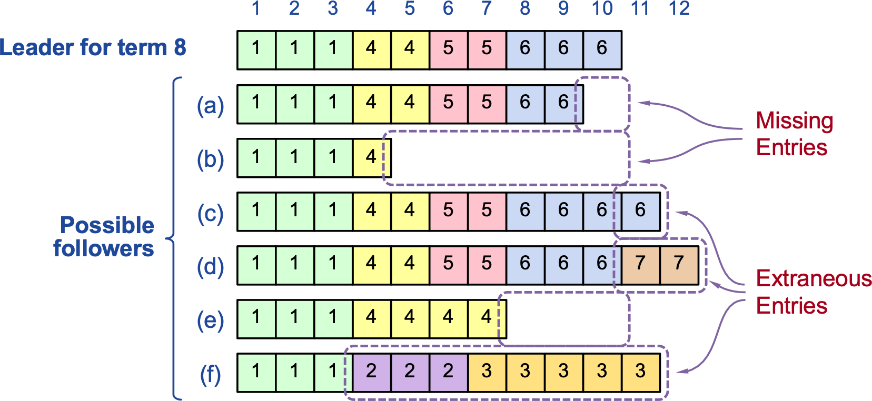
Challenge: Log Inconsistencies
Leader changes can result in log in consistencies
Notes:
The figure shows the set of logs a new leader might encounter. Some followers are missing entries. Some contain extra entries from older leaders. Others contain a suffix whose terms and commands disagree with the new leader.
We need one result from all of these cases: after communication succeeds, every follower must contain the leader's log. Missing entries must be copied, and conflicting entries must be removed.
That repair is safe only if the leader's log is the right history to preserve. The election rule will guarantee that a candidate cannot win unless its log is at least as up to date as the logs of the voters that form its majority. Once that leader is chosen, the consistency check in AppendEntries finds the last common entry and makes the remaining suffix agree.
Keep those two pieces together. Election protects committed history before a leader is chosen. Log repair removes uncommitted disagreement after the leader is chosen.
SOURCE
MIT 6.824, Spring 2020, Lecture 7 transcript/video, 00:01–20:36.
Local transcript: fall2026/lectures/references/mit-6824-2020-lecture7-raft2-transcript.txt
https://www.youtube.com/watch?v=4r8Mz3MMivY
Ongaro and Ousterhout, In Search of an Understandable Consensus Algorithm, Sections 5.3–5.4 and Figure 7.
https://pdos.csail.mit.edu/6.824/papers/raft-extended.pdf

Slide 8
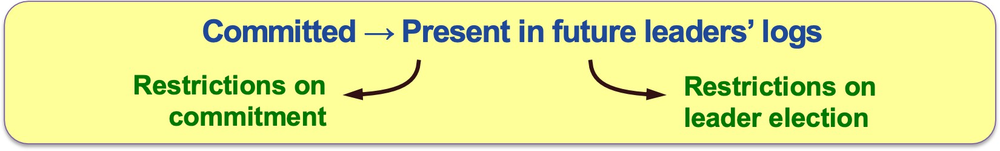
Safety Requirement
Once log entry applied to a state machine, no other state machine must apply a different value for that log entry.
Raft safety property: If leader has decided log entry is committed, entry will be present in logs of all future leaders
Why does this guarantee higher-level goal?
  1. Leaders never overwrite entries in their logs
  2. Only entries in leader’s log can be committed
  3. Entries must be committed before applying to state machine
Notes:
The client-visible requirement is State Machine Safety: once any server applies a command at a log index, no server may ever apply a different command at that index.
Raft reaches that requirement through Leader Completeness. If a leader has decided that an entry is committed, every leader elected in a later term must contain that entry.
The rest of the argument follows from the rules on the slide. A leader never overwrites entries in its own log. Only entries from the leader's history can become committed. A server applies an entry only after learning that it is committed, and it applies entries in order.
Therefore, if every future leader contains the committed entry, no future leader can create a different committed history at that index. Followers may temporarily contain other uncommitted suffixes, but those suffixes cannot reach the state machine. They will be removed when the new leader repairs the logs.
This is why election and commitment cannot be designed independently. The election restriction is what makes it safe to treat the new leader's log as the truth.
SOURCE
Ongaro and Ousterhout, In Search of an Understandable Consensus Algorithm, Sections 5.4–5.4.3 and Figure 3.
https://pdos.csail.mit.edu/6.824/papers/raft-extended.pdf

Slide 9
Repairing Follower Logs
New leader’s log is truth
New leader must make follower logs consistent with its own
  Delete extraneous entries
  Fill in missing entries
Notes:
Use the example from the MIT lecture. S3 has become leader in term six, and its first new entry is at index thirteen. To send that entry, it also names the preceding entry: index twelve, term five.
S2 has an entry at index twelve, but that entry came from term four. S1 does not have index twelve at all. Both followers reject the first AppendEntries because the predecessor does not match.
The leader then moves backward. For S2, it tries again with index eleven, term three as the predecessor. That entry matches. S2 now knows that its log agrees with the leader through index eleven. It deletes its conflicting term-four entry at index twelve and appends the leader's term-five and term-six entries.
S1 may have to move backward one step farther before it finds a match. After that, the leader fills every missing entry.
Why is it acceptable to delete S2's term-four command? That command was never stored on a majority, so its leader could not safely commit it, apply it, or reply to the client on its behalf. If the client did not receive a reply, it must retry. The protocol preserves committed commands, not every tentative command that ever appeared in a log.
SOURCE
MIT 6.824, Spring 2020, Lecture 7 transcript/video, 00:01–09:59.
Local transcript: fall2026/lectures/references/mit-6824-2020-lecture7-raft2-transcript.txt
https://www.youtube.com/watch?v=4r8Mz3MMivY
Ongaro and Ousterhout, In Search of an Understandable Consensus Algorithm, Section 5.3.
https://pdos.csail.mit.edu/6.824/papers/raft-extended.pdf

Slide 10
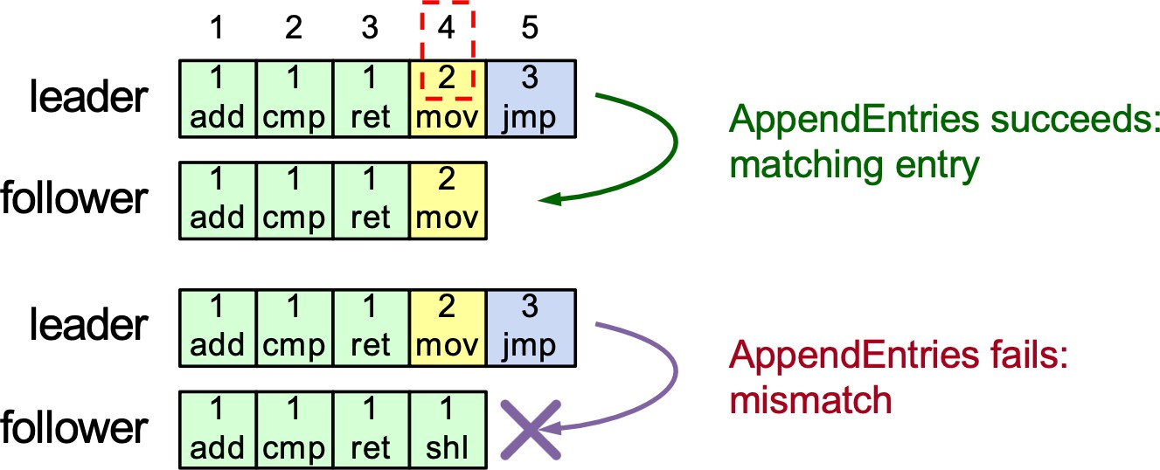
Consistency Check
AppendEntries has of entry preceding new ones
Follower must contain matching entry; otherwise it rejects
Implements an induction step, ensures coherency
Notes:
Every AppendEntries request identifies the entry immediately before the new entries with two fields: prevLogIndex and prevLogTerm.
The follower checks that exact position. If it has the same index and term, the request may proceed. If the entry is missing or has a different term, the follower rejects the request without changing its log.
Why does one matching entry tell us that the entire prefix matches? The argument is inductive. An entry could originally be accepted only after its own predecessor matched. Therefore, two copies of the same entry imply two copies of the same predecessor, and the reasoning continues all the way back to the beginning of the log.
This check prevents the leader from creating holes or attaching a new suffix to the wrong history. Once the leader finds a matching predecessor, it can remove any conflicting entries after that point and append its own entries. The follower's log then matches the leader for the portion that was sent.
SOURCE
Ongaro and Ousterhout, In Search of an Understandable Consensus Algorithm, Section 5.3 and Figure 2.
https://pdos.csail.mit.edu/6.824/papers/raft-extended.pdf

Slide 11

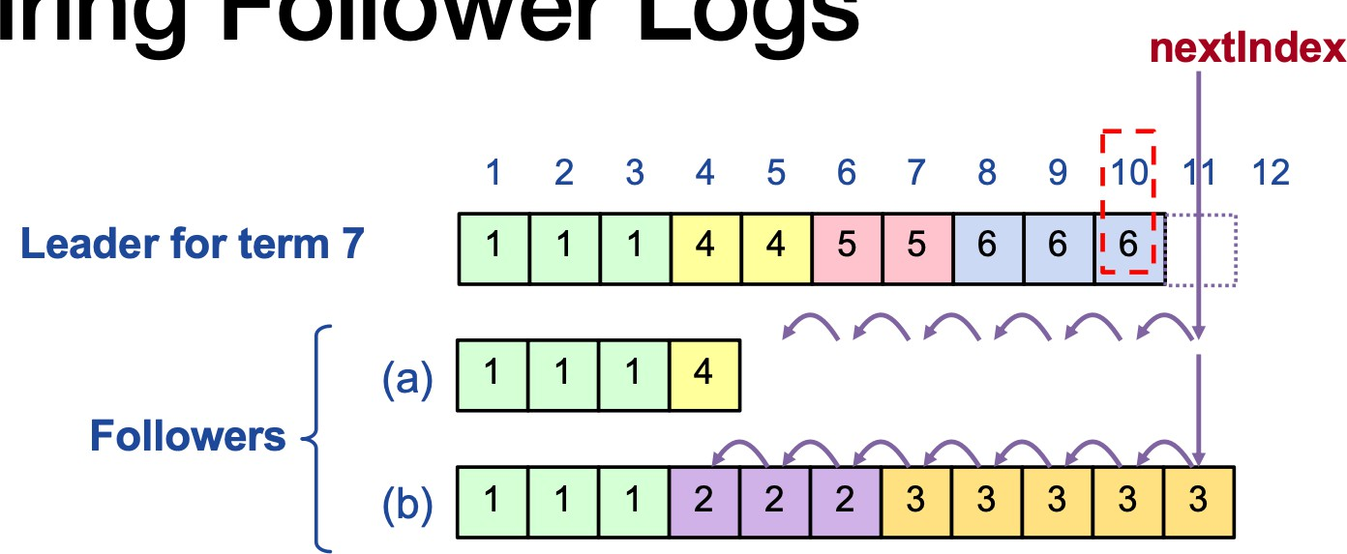
Repairing Follower Logs
New leader’s log is truth
New leader must make follower logs consistent with its own
  Delete extraneous entries
  Fill in missing entries
Leader keeps nextIndex for each follower:
  Index of next log entry to send to that follower
  Initialized to (1 + leader’s last index)
If AppendEntries consistency check fails, decrement nextIndex, try again
Notes:
The leader keeps a separate nextIndex for every follower. nextIndex is the first log index that the leader believes that follower still needs.
When a server becomes leader, it initializes every nextIndex to one position after the end of its own log. It first assumes that the follower is caught up. If the follower rejects AppendEntries, the assumption was too optimistic, so the leader moves nextIndex backward and tries again. Rejections continue until the request names a predecessor that the follower actually has with the same term.
After a successful match, the leader sends the suffix beginning at nextIndex. The follower deletes any conflicting suffix and stores the leader's entries. The leader can then advance nextIndex and matchIndex for that follower.
The simple algorithm decreases one index at a time. It is easy to understand and correct, but a very stale follower may require many round trips. Practical implementations return information about the conflicting term and the first index for that term, allowing the leader to jump backward by an entire term. That optimization changes the search speed, not the safety rule.
nextIndex and matchIndex are volatile. A new leader can reconstruct them by starting at the end of its log and repeating this process.
SOURCE
MIT 6.824, Spring 2020, Lecture 7 transcript/video, 00:01–09:59 and 20:36–32:04.
Local transcript: fall2026/lectures/references/mit-6824-2020-lecture7-raft2-transcript.txt
https://www.youtube.com/watch?v=4r8Mz3MMivY
Ongaro and Ousterhout, In Search of an Understandable Consensus Algorithm, Section 5.3 and Figure 2.
https://pdos.csail.mit.edu/6.824/papers/raft-extended.pdf

Slide 12
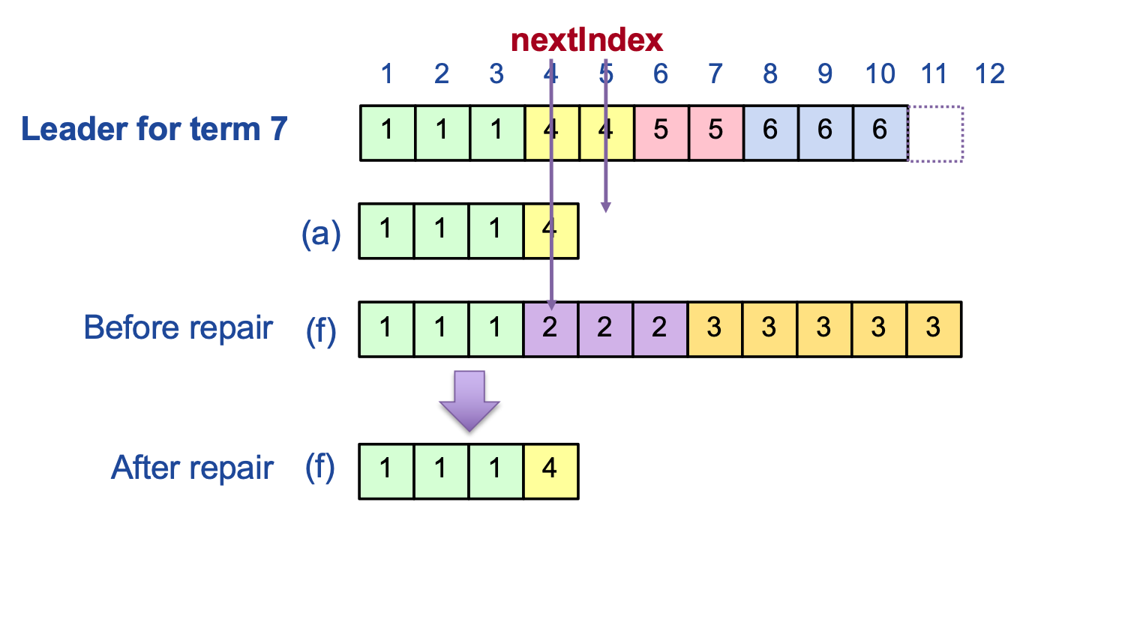
Repairing Follower Logs
Notes:
The lower log is the same follower before and after repair.
Before repair, the follower agrees with the leader through the green prefix and then follows a different history. The leader backs up nextIndex until the consistency check succeeds at the last common entry. The follower then removes the purple and yellow suffix and accepts the leader's entries.
After repair, the follower's log is a prefix of the leader's log, and continued AppendEntries calls make the two identical. Notice that the leader does not modify its own log to merge the follower's commands. Raft chooses one history and overwrites uncommitted alternatives.
That can make a tentative client command disappear. A client that did not receive a successful reply must retry, and the service layer normally uses client IDs and sequence numbers to suppress duplicate execution. A committed command is different: the election restriction ensures that it is already present in every possible future leader.
SOURCE
MIT 6.824, Spring 2020, Lecture 7 transcript/video, 00:01–09:59.
Local transcript: fall2026/lectures/references/mit-6824-2020-lecture7-raft2-transcript.txt
https://www.youtube.com/watch?v=4r8Mz3MMivY
Ongaro and Ousterhout, In Search of an Understandable Consensus Algorithm, Sections 5.3–5.5.
https://pdos.csail.mit.edu/6.824/papers/raft-extended.pdf

Slide 13
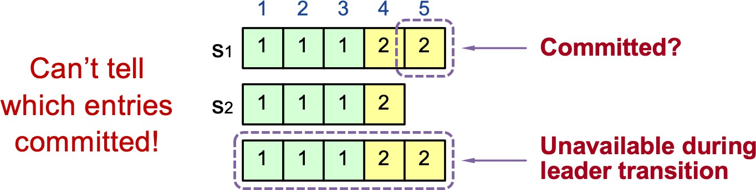
Picking The Best Leader
Why not elect the server with the longest log as leader?
  Example
    S1: 5 6 7
    S2: 5 8
    S3: 5 8
Notes:
Log length alone does not tell us which server has the safest history.
Construct the example across several crashes. S1 is leader in term five and appends an entry only to itself. It crashes. S1 returns, becomes leader in term six, appends another entry only to itself, and crashes again. Its log now has entries from terms five, six, and seven, so it is the longest.
Meanwhile, a different leader in term eight appends an entry to S2 and S3. Because two of the three servers store that entry, the term-eight leader may have committed it and answered a client. S2 and S3 have shorter logs, but their last entry comes from the newer term.
If we elect S1 merely because it has more entries, S1 will overwrite the term-eight entry on S2 and S3. That could erase a committed command. The extra entries on S1 do not help because they were created in earlier terms and never reached a majority.
Raft therefore compares the term of the last entry before comparing length. A last entry from a newer term represents progress by a newer leader and takes priority over any number of older uncommitted entries.
SOURCE
MIT 6.824, Spring 2020, Lecture 7 transcript/video, 09:59–20:36.
Local transcript: fall2026/lectures/references/mit-6824-2020-lecture7-raft2-transcript.txt
https://www.youtube.com/watch?v=4r8Mz3MMivY
Ongaro and Ousterhout, In Search of an Understandable Consensus Algorithm, Section 5.4.1.
https://pdos.csail.mit.edu/6.824/papers/raft-extended.pdf

Slide 14
Restricted Leader Election
Elect candidate most likely to contain all committed entries
  In RequestVote, candidates incl. index + term of last log entry
  Voter V denies vote if its log is “more complete”: (newer term) or (entry in higher index of same term)
  Leader will have “most complete” log among electing majority
Notes:
A RequestVote RPC includes the candidate's lastLogTerm and lastLogIndex. A voter grants its vote only if the candidate's log is at least as up to date as its own.
The comparison is lexicographic. Compare the last terms first. The server with the larger last term is more up to date. Only when the last terms are equal do we compare last indexes; in that case, the longer log is more up to date.
Apply that rule to the previous example. S1's last term is seven. S2 and S3 end in term eight. Even though S1 has more entries, both S2 and S3 reject S1's vote request. One of the term-eight servers can collect the majority and preserve the entry that may already be committed.
The majority intersection gives the safety intuition. A committed entry is stored on a majority. A candidate also needs votes from a majority. Those two sets overlap. At least one voter has the committed history, and the up-to-date check prevents it from voting for a candidate that would lose that history.
This election restriction is what justifies the rule that the new leader's log is authoritative during repair.
SOURCE
MIT 6.824, Spring 2020, Lecture 7 transcript/video, 09:59–20:36.
Local transcript: fall2026/lectures/references/mit-6824-2020-lecture7-raft2-transcript.txt
https://www.youtube.com/watch?v=4r8Mz3MMivY
Ongaro and Ousterhout, In Search of an Understandable Consensus Algorithm, Section 5.4.1 and Figure 2.
https://pdos.csail.mit.edu/6.824/papers/raft-extended.pdf

Slide 15
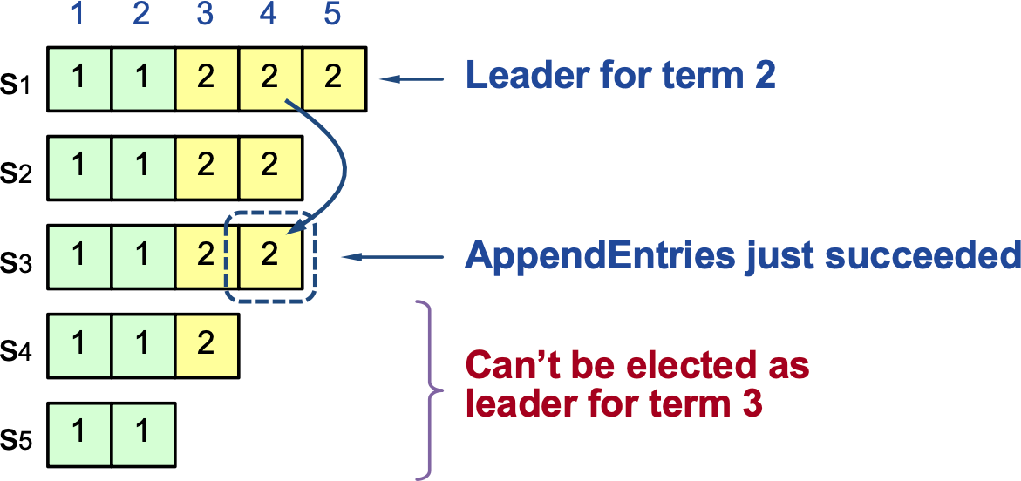
Committing Entry From Current Term
Case #1: Leader decides entry in current term is committed
Safe: leader for term 3 must contain entry 4
Notes:
Now consider when a leader may decide that an entry is committed.
In this picture, S1 is leader in term two. It has replicated the entry at index four to a majority. Because this entry was created in the leader's current term, S1 can mark it committed.
The election restriction makes that decision durable. Any candidate in a later term needs votes from a majority. A majority that stored the term-two entry must overlap the candidate's voting majority. A voter with that entry will not support a candidate whose log is less up to date. Therefore, every future leader must contain the committed entry at index four.
Once index four is committed, all preceding entries in S1's log are committed as well. The Log Matching Property guarantees that a future leader containing index four also contains the same prefix.
This is the ordinary rule in the Raft implementation: count replicas to advance commitIndex only for an entry whose term equals currentTerm.
SOURCE
Ongaro and Ousterhout, In Search of an Understandable Consensus Algorithm, Section 5.4.2, Figure 2, and Figure 8.
https://pdos.csail.mit.edu/6.824/papers/raft-extended.pdf

Slide 16
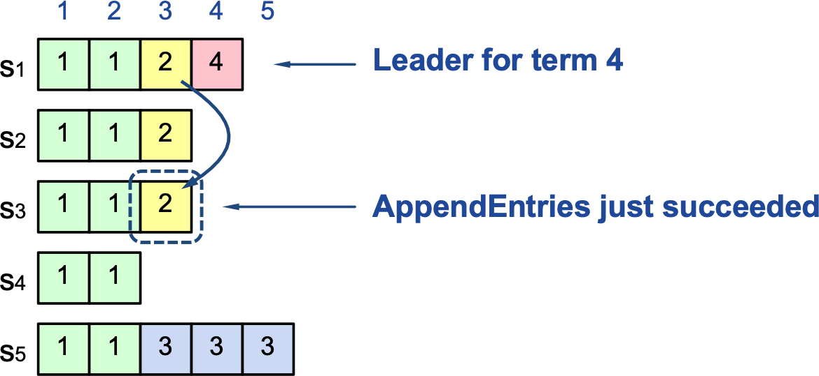
Committing Entry From Earlier Term
Case #2: Leader trying to finish committing entry from earlier
Entry 3 not safely committed:
  s5 can be elected as leader for term 5 (how?)
  If elected, it will overwrite entry 3 on s1, s2, and s3
Notes:
An entry from an earlier term needs more care. Figure 8 in the paper gives the counterexample.
S1 created the entry at index three in term two and later returns as leader in term four. It replicates that old entry to a majority. It is tempting to count three copies and declare the entry committed.
But S1 can crash before creating any term-four entry. S5 may then win term five using votes from S2, S3, and S4. Its last log term is newer than the last term on the other servers, so the election rule can allow it to win. S5 can overwrite index three even though the old term-two entry briefly appeared on a majority.
Raft therefore never commits an old-term entry merely by counting its replicas. The leader first appends an entry in its current term, often a no-op, and replicates that current-term entry to a majority. Once the current-term entry commits, every earlier entry in the leader's prefix becomes committed indirectly.
The rule may delay commitment, but it keeps the proof simple: direct majority counting is used only for entries created by the current leader's term.
SOURCE
Ongaro and Ousterhout, In Search of an Understandable Consensus Algorithm, Section 5.4.2 and Figure 8.
https://pdos.csail.mit.edu/6.824/papers/raft-extended.pdf

Slide 17
Persistence
What would we like to happen after a server crashes?
  Raft can continue with one missing server
Two strategies:
  replace with a fresh (empty) server?
  reboot crashed server, re-join with state intact, catch up requires state that persists across crashes
Notes:
So far, a crash meant that one server disappeared while the remaining majority kept running. In that case, we could replace the failed machine with an empty server and copy the state from a live replica.
That is not enough for every failure. A process may restart on the same machine, or the whole cluster may lose power at once. When the machines return, the protocol cannot assume that some untouched replica still remembers the terms, votes, and log entries from before the crash.
Raft therefore separates persistent state from volatile state. Persistent state is written to stable storage and reloaded before the server sends or answers RPCs after a restart. Volatile state can be reconstructed from the persistent log and new messages from the current leader.
The key discipline is ordering: if a server's reply makes a promise visible to another machine, the state supporting that promise must already be durable. Otherwise a crash could erase the promise while another server continues to rely on it.
SOURCE
MIT 6.824, Spring 2020, Lecture 7 transcript/video, 32:04–49:39.
Local transcript: fall2026/lectures/references/mit-6824-2020-lecture7-raft2-transcript.txt
https://www.youtube.com/watch?v=4r8Mz3MMivY
Ongaro and Ousterhout, In Search of an Understandable Consensus Algorithm, Figure 2 and Section 5.5.
https://pdos.csail.mit.edu/6.824/papers/raft-extended.pdf

Slide 18
Persistent State
Three variables:
  log[], currentTerm, votedFor
Why log[]?
Why votedFor?
Why currentTerm?
Some Raft state is volatile
  commitIndex, lastApplied, next/matchIndex[]
  why is it OK not to save these?
Notes:
Three pieces of Raft state must survive a crash: the log, currentTerm, and votedFor.
The log contains the commands that may already be committed and the tentative commands that a future leader may need. A leader persists a new entry before sending AppendEntries. A follower persists the entry before replying success. An acknowledgment must mean that the entry will still exist after a reboot.
currentTerm prevents a restarted server from accepting authority from an older term or reusing an earlier term as if the later election never happened. votedFor prevents a server from granting two votes in the same term, with a crash between the votes. Both values must be persisted before the server sends the corresponding reply.
commitIndex, lastApplied, nextIndex, and matchIndex can be volatile in the basic design. A new leader reconstructs nextIndex and matchIndex through AppendEntries. A restarting server can learn commitIndex from the leader. It can rebuild the application by loading a snapshot and replaying committed log entries, which also reconstructs lastApplied.
The general question is whether losing a variable could make the server contradict an earlier externally visible promise. If yes, that variable or an equivalent record must be durable.
SOURCE
MIT 6.824, Spring 2020, Lecture 7 transcript/video, 32:04–49:39.
Local transcript: fall2026/lectures/references/mit-6824-2020-lecture7-raft2-transcript.txt
https://www.youtube.com/watch?v=4r8Mz3MMivY
Ongaro and Ousterhout, In Search of an Understandable Consensus Algorithm, Figure 2 and Section 5.5.
https://pdos.csail.mit.edu/6.824/papers/raft-extended.pdf

Slide 19
Persistence is often the bottleneck
A hard disk write takes 10 ms, SSD write takes 0.1 ms
  disk, SSD, battery-backed RAM, &c
Lots of tricks to cope with slowness of persistence:
  batch many new log entries per disk write
  persist to battery-backed RAM, not disk
Notes:
Stable storage can become the latency bottleneck.
A disk write is not durable merely because the operating system accepted it. The bytes may still be in a memory cache. Raft needs the equivalent of fsync before it sends a reply that depends on the write.
On a hard drive, one durable write can take roughly ten milliseconds. If every client command waits for a separate sync, one server can perform only about one hundred such operations per second. SSDs reduce the latency substantially, and battery-backed or nonvolatile memory can reduce it further, but the ordering requirement remains.
Systems therefore batch work. A leader can place several new log entries in one durable write and then replicate them together. A follower can persist a batch before acknowledging the batch. The requests share one sync cost.
The performance requirement follows directly from safety: the leader must persist an entry before advertising it to followers, and a follower must persist an entry before its success reply can count toward a majority.
SOURCE
MIT 6.824, Spring 2020, Lecture 7 transcript/video, 40:24–49:39.
Local transcript: fall2026/lectures/references/mit-6824-2020-lecture7-raft2-transcript.txt
https://www.youtube.com/watch?v=4r8Mz3MMivY
Ongaro and Ousterhout, In Search of an Understandable Consensus Algorithm, Figure 2 and Section 5.5.
https://pdos.csail.mit.edu/6.824/papers/raft-extended.pdf

Slide 20
Log Compaction
How does the service recover its state after a crash+reboot?
  easy approach: start with empty state, re-play Raft's entire persisted log
  problem:
    log will get to be huge
    re-play will be too slow for a long-lived system
Insight:
  clients only see the state, not the log
  Service state usually much smaller, so let's keep just that
Solution: ”SnapShot”
  service periodically creates persistent "snapshot”
  service writes snapshot to persistent storage
  service tells Raft it is snapshotted
  Raft discards log before that index
Notes:
Keeping every log entry forever creates two problems. Stable storage grows without bound, and a restarting server must replay the entire history before it can serve requests.
The application usually needs the current state, not every command that produced it. A key-value service may have processed a million writes but contain only the latest value for each key. We can therefore replace an old committed prefix with a snapshot of the application state after that prefix was applied.
The service creates a snapshot at an exact log index. Raft stores the snapshot together with the last included index and the term of that entry. The snapshot must become durable before Raft discards the covered log prefix. Otherwise a crash between deletion and persistence would lose both the history and the state it produced.
Raft cannot discard uncommitted entries or entries the application has not yet included in the snapshot. The snapshot boundary must describe a committed and applied prefix. Entries after the boundary remain in the log so Raft can continue replication and replay.
Raft treats the snapshot contents as opaque bytes. The application knows how to serialize its state; Raft knows which part of the log that state replaces.
SOURCE
MIT 6.824, Spring 2020, Lecture 7 transcript/video, 49:39–59:40.
Local transcript: fall2026/lectures/references/mit-6824-2020-lecture7-raft2-transcript.txt
https://www.youtube.com/watch?v=4r8Mz3MMivY
Ongaro and Ousterhout, In Search of an Understandable Consensus Algorithm, Section 7 and Figure 12.
https://pdos.csail.mit.edu/6.824/papers/raft-extended.pdf

Slide 21
Log Compaction
What happens on crash+restart?
  service reads snapshot from disk
  Raft reads persisted log from disk
  service tells Raft to set lastApplied to last included index to avoid re-applying already-applied log entries
Problem: What if follower's log ends before leader's log starts?
  leader can't repair that follower with AppendEntries RPCs
  InstallSnapshot RPC
Notes:
After a restart, the service first loads its snapshot. Raft then reads the remaining log and replays the committed suffix after lastIncludedIndex. lastApplied begins at the snapshot boundary, so the service does not execute commands that are already reflected in the restored state.
Snapshots also create a replication case that AppendEntries alone cannot solve. A follower may be so far behind that its nextIndex points before the beginning of the leader's retained log. The leader has already compacted the entries that the follower needs, so decrementing nextIndex cannot find a common predecessor.
The leader sends InstallSnapshot instead. The follower replaces the corresponding application state, records the snapshot's last included index and term, and discards obsolete log entries. The leader can then continue with ordinary AppendEntries for the suffix that comes after the snapshot.
An old or duplicate snapshot can be ignored when the follower has already advanced beyond it. As with the other Raft RPCs, retries must be safe.
The log is the command history; the snapshot is the state produced by a committed prefix of that history. Raft uses both representations so normal replication remains incremental while recovery remains bounded.
SOURCE
MIT 6.824, Spring 2020, Lecture 7 transcript/video, 49:39–64:07.
Local transcript: fall2026/lectures/references/mit-6824-2020-lecture7-raft2-transcript.txt
https://www.youtube.com/watch?v=4r8Mz3MMivY
Ongaro and Ousterhout, In Search of an Understandable Consensus Algorithm, Section 7 and Figure 13.
https://pdos.csail.mit.edu/6.824/papers/raft-extended.pdf

Slide 22

Quiz Attendance
https://forms.gle/Ln2N5fwHiAoDCvBT6
Notes:
ATTENDANCE CHECK - do this right before the quiz.
1. In Google Forms, open 'Quiz 04 Attendance - Raft II (Fall 2026)' and turn on Accepting responses. Then show this slide.
2. Tell the class: this attendance check is NOT graded. It only confirms that the number of quiz submissions matches the number of students in the room. Sign in with your BU account and enter your BU ID.
3. While they submit, count the students in the room. Headcount: ____
4. After about 2 minutes, turn OFF Accepting responses on the attendance form and compare its response count with your headcount. If they differ, say so now, before the quiz starts.
5. Only then open the quiz form and go to the next slide. After class, compare the quiz responses with this attendance list: a quiz submission whose email is not on the list did not check in.
TODO: this form does not exist yet. Create it, then put its link and QR on this slide.

Slide 23

Quiz
https://forms.gle/tnjNUFKsbhY5ekc4A
Notes:
BEFORE THE QUIZ: the form was created closed. In Google Forms, turn on 'Accepting responses' when you start the quiz, and turn it off after 10 minutes.
Form: 'Quiz 04 - Raft II (Fall 2026)' in the Drive folder EC528-Fall26. Students sign in with their BU account and must enter their BU ID.
Covers this lecture only: leader changes, log inconsistency and repair, the election restriction, commitment rules, persistence, and log compaction.
TODO: this form does not exist yet. Create it, then put its link and QR on this slide.

