Slide 1
Lecture 6: Consensus I
Fall 2026
CE 528 Cloud Computing
Prof. Yigong Hu
Notes:
Today we move from systems that replicate work or data but still rely on one coordinator to consensus, which lets us replicate the coordinator's decision itself.
MapReduce has one master that assigns tasks and decides which output counts. GFS has one master that chooses primaries. Those systems tolerate many worker or chunkserver failures, but one machine still makes the decision that must be unique.
Raft shows how a group of machines can make that decision while machines crash, messages are delayed, and the network may split. In this lecture we will first see why two replicas are not enough, then introduce majority voting, the replicated state machine, terms, and leader election. The next Raft lecture will focus on the harder log-repair problem after leaders change.
SOURCE
MIT 6.824, Spring 2020, Lecture 6: no counterpart.
Title page. For orientation: MIT 6.824 Lecture 6 runs 00:00 to 79:46. This deck covers its first two thirds; the log material that MIT reaches around 65:00 is in 6-raft-2 instead.
Local transcript: fall2026/lectures/references/mit-6824-2020-lecture6-raft1-transcript.txt

Slide 2

Quiz Attendance: GFS
https://forms.gle/jwbSKDuKGsZVEs3U9
Notes:
ATTENDANCE CHECK - do this right before the quiz.
1. In Google Forms, open 'Quiz 02 Attendance - GFS (Fall 2026)' and turn on Accepting responses. Then show this slide.
2. Tell the class: this attendance check is NOT graded. It only confirms that the number of quiz submissions matches the number of students in the room. Sign in with your BU account and enter your BU ID.
3. While they submit, count the students in the room. Headcount: ____
4. After about 2 minutes, turn OFF Accepting responses on the attendance form and compare its response count with your headcount. If they differ, say so now, before the quiz starts.
5. Only then open the quiz form and go to the next slide. After class, compare the quiz responses with this attendance list: a quiz submission whose email is not on the list did not check in.
SOURCE
MIT 6.824, Spring 2020, Lecture 6: no counterpart.
Course admin - no MIT counterpart.
Local transcript: fall2026/lectures/references/mit-6824-2020-lecture6-raft1-transcript.txt

Slide 3

Quiz: GFS
https://forms.gle/KX6h17o1A2hE7HMa8
Notes:
BEFORE THE QUIZ: the form was created closed. In Google Forms, turn on 'Accepting responses' when you start the quiz, and turn it off after 10 minutes.
Form: 'Quiz 02 - GFS (Fall 2026)' in the Drive folder EC528-Fall26. Students sign in with their BU account and must enter their BU ID.
This is the GFS quiz carried over: it was not taken at the end of the GFS lecture, so it runs here at the start of this one. 10 multiple-choice questions, 10 minutes, open book and open internet.
SOURCE
MIT 6.824, Spring 2020, Lecture 6: no counterpart.
Course admin - no MIT counterpart.
Local transcript: fall2026/lectures/references/mit-6824-2020-lecture6-raft1-transcript.txt

Slide 4
Motivation
A pattern in the fault-tolerant systems:
  MR replicates computation but relies on a single master to organize
  GFS replicates data but relies on the master to pick primaries
A single entity to make decision
  Avoid split brain
  But the single machine can have failure
Notes:
There is a pattern in the fault-tolerant systems we have already studied.
MapReduce can run duplicate tasks and restart failed work, but one master assigns the tasks and decides which result becomes part of the job. GFS stores several copies of every chunk, but one master decides which replica may act as the primary. Replication protects most of each system, while one machine still makes the coordination decision that must be unique.
That single decision maker is useful because one machine cannot disagree with itself. If the question is which replica is primary, one authority naturally prevents two different answers. That is exactly what protects us from split brain.
The weakness is also clear: the decision maker becomes the remaining single point of failure. The workers or replicas may all be healthy and may still contain the data, but if the coordinator disappears, they cannot safely decide who takes over.
Consensus addresses that last centralized decision. Instead of trusting one machine to choose the primary or the next command, a group of machines reaches one decision together. The difficulty is preserving one answer when a silent machine might have crashed or might simply be unreachable.
SOURCE
MIT 6.824, Spring 2020, Lecture 6 video, 00:00–02:16 (about 2.3 min).
The pattern: MapReduce, GFS and VMware FT all lean on one entity. MIT names three examples; this slide keeps two, since VMware FT is not on our syllabus.
https://www.youtube.com/watch?v=64Zp3tzNbpE
MIT 6.824, Spring 2020, Raft lecture notes, lines 7-12.
http://nil.csail.mit.edu/6.824/2020/notes/l-raft.txt
Local transcript: fall2026/lectures/references/mit-6824-2020-lecture6-raft1-transcript.txt

Slide 5
Two Servers Are Not Enough
Replicate a lock: set the flag to 1, return the previous value
  only one client may ever get 0 back — that client holds the lock
C1
S1
S2
C1 holds the lock
0 → 1, returns 0
crashed
If S2 really crashed, C1 must proceed
  otherwise replication bought us no fault tolerance at all
  requiring both servers would be worse than not replicating
Notes:
Start with the smallest possible replicated decision service: two servers implementing test-and-set. Each server stores one flag, initially zero. A request changes the flag to one and returns its previous value. The client that receives zero has acquired the lock, so at most one client may ever receive zero.
Now C1 can reach S1 but gets no response from S2. One possible rule is to require both replicas for every operation. That keeps the replicas together, but it provides no fault tolerance. If S2 has really crashed, the entire service stops even though S1 is healthy. In fact, the replicated service is now less available than one server, because it depends on both machines being alive.
To tolerate one failure, C1 must be allowed to continue with S1. In the world shown here, that is the right decision. S2 has crashed. S1 changes its flag from zero to one, returns zero, and C1 safely holds the lock.
The problem is that C1 did not observe S2 crashing. It observed only that S2 did not answer. Keep the left half of this picture unchanged and replace the crash with a broken network; the same rule will produce a completely different result.
SOURCE
MIT 6.824, Spring 2020, Lecture 6 video, 02:16–05:21 (about 3.1 min).
Setting up the two-server test-and-set, and the branch where S2 really crashed: C1 must go ahead, because requiring both servers is worse than not replicating at all.
https://www.youtube.com/watch?v=64Zp3tzNbpE
MIT 6.824, Spring 2020, Raft lecture notes, lines 14-23.
http://nil.csail.mit.edu/6.824/2020/notes/l-raft.txt
Local transcript: fall2026/lectures/references/mit-6824-2020-lecture6-raft1-transcript.txt

Slide 6
Two Servers Are Not Enough
Now suppose S2 did not crash
C1
S1
S2
C2
C1 holds the lock
0 → 1, returns 0
0 → 1, returns 0
C2 holds the lock
partition
If S2 is alive and only the network broke, C1 must not proceed
  both clients get 0 back, both think they hold the lock
And C1 cannot tell which case it is in
  the left half of this picture is identical to the last slide
  no fault tolerance, or split brain — pick one
Notes:
Now S2 is alive. The network has partitioned the system so C1 can reach only S1 and C2 can reach only S2. From C1's point of view, nothing has changed: S2 still does not answer.
If we follow the fault-tolerant rule from the previous case, C1 proceeds with S1. S1 changes zero to one and returns zero, so C1 believes it holds the lock. On the other side, C2 makes exactly the same decision. It proceeds with S2, receives zero, and also believes it holds the lock.
The replicas now contain the same value, but the service is still incorrect. Two clients were told that each had exclusive ownership. In a primary-backup system, this is split brain: both sides believe they may act as primary.
In the crash case, C1 had to proceed. In the partition case, C1 must not proceed. Yet C1's local observation is identical in both worlds. A missing response cannot distinguish a dead machine from a live machine behind a broken network.
With only two servers, waiting for both preserves one answer but loses fault tolerance. Allowing either server to proceed preserves availability but may create two answers. The system needs a rule that permits progress on at most one side of the partition.
SOURCE
MIT 6.824, Spring 2020, Lecture 6 video, 05:21–08:24 (about 3.1 min).
The other branch - S2 alive behind a broken network - and the dilemma itself. MIT ends this stretch with "this was basically where things stood until the late 80s".
https://www.youtube.com/watch?v=64Zp3tzNbpE
MIT 6.824, Spring 2020, Raft lecture notes, lines 24-29.
http://nil.csail.mit.edu/6.824/2020/notes/l-raft.txt
Local transcript: fall2026/lectures/references/mit-6824-2020-lecture6-raft1-transcript.txt

Slide 7
“Server Crashed” vs “Network Broken”
Same symptom, two worlds — and no replica can tell which
This is a network partition: each side can still talk to itself, neither can reach the other
Solution?
  a perfectly reliable network
  human to decide
  a single perfectly reliable arbiter
But all three are single points of failure — can we do better?
Notes:
For a long time, systems avoided this dilemma by adding an assumption outside the replication protocol.
One approach was to build a network that was treated as perfectly reliable. If communication could not fail, then a missing response really did mean the other machine was down. This can be reasonable inside tightly controlled hardware, but it is expensive and unrealistic for a distributed service.
A second approach was to stop automatically and ask a human operator to decide. The operator could inspect the machines, shut one side down, and then authorize the other side to continue. That can be safe, but recovery is slow and the human becomes the tie breaker.
A third version is a separate arbiter that decides which replica may proceed. That makes failover automatic, but the arbiter is again the single machine whose decision must be correct and available. We have moved the original problem rather than solved it.
All three approaches introduce a component that is assumed not to fail: the network, the operator, or the arbiter. Consensus protocols remove that assumption. The replicas follow a voting rule that lets one side continue through a partition while preventing the other side from making a conflicting decision.
SOURCE
MIT 6.824, Spring 2020, Lecture 6 video, 08:24–11:04 (about 2.7 min).
The three escapes people actually used, and why none is satisfying: each one is itself a single point of failure. MIT moves to majority voting at 11:27.
https://www.youtube.com/watch?v=64Zp3tzNbpE
MIT 6.824, Spring 2020, Raft lecture notes, lines 31-41.
http://nil.csail.mit.edu/6.824/2020/notes/l-raft.txt
Local transcript: fall2026/lectures/references/mit-6824-2020-lecture6-raft1-transcript.txt
MIT spends 00:00-11:27, about 11.5 minutes, on slides 4-7 combined. Our budget for the same four slides is roughly 7.5 minutes, because the GFS deck has already covered split brain, network partitions and the master as a single point of failure.

Slide 8

Consensus Protocols
Require only a majority of nodes to be up at any time in order to make progress.
Two papers, both around 1990:
  Paxos — Leslie Lamport
  Viewstamped Replication — Liskov & Oki
Raft: the same guarantees, designed to be understandable
  Splits into leader election, log replication, and safety
  As capable as multi-Paxos — you can just learn it
Notes:
The key idea is that an important decision requires approval from a majority of all servers. If the network partitions, at most one side can contain more than half of the cluster. The majority side may continue; every minority side must stop. That gives us automatic failover without allowing two independent decision makers.
Two influential protocols developed this idea around 1990: Paxos and Viewstamped Replication. They showed that machines can reach one decision despite crashes, lost messages, delayed messages, and network partitions, as long as a majority can communicate.
Raft provides the same kind of safety and liveness guarantees, organized around the replicated log that a service actually needs. It separates the design into leader election, log replication, and safety rules. The strong leader chooses the order, and majority votes make that order durable.
A majority is a safety boundary, not a promise that the service is always available. When no majority can communicate, the protocol deliberately stops. Waiting is safer than allowing two sides to invent different histories.
SOURCE
MIT 6.824, Spring 2020, Lecture 6 transcript/video, 17:21–18:29 (about 1.1 min).
Local transcript: fall2026/lectures/references/mit-6824-2020-lecture6-raft1-transcript.txt
https://www.youtube.com/watch?v=64Zp3tzNbpE
Ongaro and Ousterhout, In Search of an Understandable Consensus Algorithm, Sections 1–3.
https://pdos.csail.mit.edu/6.824/papers/raft-extended.pdf

Slide 9
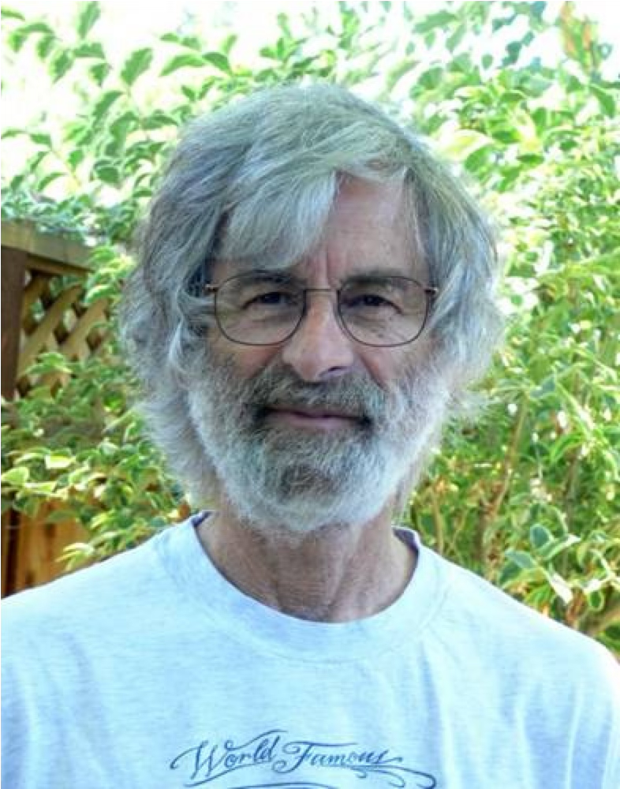
Where Consensus Came From
Two partition-tolerant schemes, both around 1990
Viewstamped Replication - Liskov & Oki
Paxos - Leslie Lamport, “The Part-Time Parliament”
Submitted 1990, published 1998 - the first draft was famously hard to read
Lamport later rewrote it as “Paxos Made Simple”; SIGOPS Hall of Fame 2012, Turing Award 2013
He is also behind LaTeX, Byzantine fault tolerance, and TLA+
The theory sat mostly unused for a decade
Widespread production use only arrived in the last fifteen years or so
Notes:
Paxos and Viewstamped Replication appeared at roughly the same time. Viewstamped Replication was developed by Barbara Liskov and Brian Oki. Leslie Lamport submitted the original Paxos paper in 1990, although it was not published until 1998.
The Paxos paper presents the protocol through a fictional parliament whose members move in and out of the chamber while messages arrive late. The underlying result is fundamental, but the presentation was famously difficult to translate into an implementation. Lamport later wrote Paxos Made Simple to explain the core protocol more directly.
Lamport's broader work also gave distributed systems much of its language for reasoning about time, ordering, and failures. It includes logical clocks, Byzantine agreement, and TLA+, in addition to LaTeX. He received the Turing Award in 2013.
The surprising historical point is the delay between theory and use. These protocols existed around 1990, but widespread production use came much later, when large distributed services needed automatic leader election and replicated metadata. Raft was designed in that environment, with understandability as an explicit goal.
SOURCE
ACM, Leslie Lamport, 2013 A.M. Turing Award recipient.
https://amturing.acm.org/award_winners/lamport_1205376.cfm
Ongaro and Ousterhout, In Search of an Understandable Consensus Algorithm, Sections 1 and 3.
https://pdos.csail.mit.edu/6.824/papers/raft-extended.pdf
MIT 6.824, Spring 2020, Lecture 6 transcript/video, 17:21–18:29 (about 1.1 min) — the same window as slide 8, which now carries this material.

Slide 10


Raft
Notes:
Raft solves the same consensus problem as multi-Paxos. Its main contribution is the structure of the explanation and the resulting implementation model.
The protocol uses one strong leader. Client commands flow to that leader, and log entries flow from the leader to followers. Raft separates the problem into leader election, normal log replication, and the safety rules that connect elections to committed entries. Randomized election timeouts reduce split votes without adding a complicated ranking mechanism.
The result is a protocol we can follow one rule at a time. We will begin with the majority properties that make agreement possible, then build the replicated service and the election mechanism on top of them.
SOURCE
Ongaro and Ousterhout, In Search of an Understandable Consensus Algorithm, Abstract and Sections 1, 4, and 5.
https://pdos.csail.mit.edu/6.824/papers/raft-extended.pdf
MIT 6.824, Spring 2020, Lecture 6 transcript/video, 18:29–18:42.
Local transcript: fall2026/lectures/references/mit-6824-2020-lecture6-raft1-transcript.txt
https://www.youtube.com/watch?v=64Zp3tzNbpE

Slide 11
Majority Vote
An important decision needs approval from a majority of all servers
  use an odd number — two equal halves look alike and would both proceed
S1
S2
S3
S4
S5
3 of 5 — a majority, can act
2 of 5 — never a majority
partition
At most one side can hold a majority
so only one side can ever act — split brain ruled out by counting
The denominator is every server, not the live ones
three servers still need two votes even when you know one is dead
Notes:
The rule is that a decision other machines must trust requires approval from a majority of the entire cluster.
Use an odd number of servers. With five servers, a single partition might produce a group of three and a group of two. Those groups are no longer symmetric. The three-server side has a majority and may act. The two-server side cannot obtain a majority and must stop. Only one side can contain more than half, so counting rules out split brain.
The denominator never changes. A five-server cluster always needs three votes, even if two machines have failed. A three-server cluster still needs two votes when one machine is known to be down. If each partition were allowed to redefine a majority using only the servers it could see, both sides could declare themselves a majority and make conflicting decisions.
This gives the usual fault-tolerance formula. With two-f-plus-one servers, the system can continue after f failures. Three servers tolerate one unavailable server; five tolerate two. These voting groups are also called quorums.
Majority voting preserves safety, but it cannot guarantee progress during every failure. If fewer than a majority are alive and connected, Raft waits until communication is restored.
SOURCE
MIT 6.824, Spring 2020, Lecture 6 transcript/video, 11:04–14:19 (about 3.2 min): odd number and the symmetry argument at 11:20–11:47; majority out of all servers at 13:09; 2f+1 at 13:49; “quorum” at 14:19.
https://www.youtube.com/watch?v=64Zp3tzNbpE
Ongaro and Ousterhout, In Search of an Understandable Consensus Algorithm, Section 2.
Local transcript: fall2026/lectures/references/mit-6824-2020-lecture6-raft1-transcript.txt

Slide 12
Any Two Majorities Overlap
Any two majorities must share at least one server
  3 + 3 > 5 — two majorities cannot be disjoint
majority that elected the term-5 leader
S1
S2
S3
S3
S4
S5
in both majorities
majority that elects the term-6 leader
Terms can never go backwards
the shared server knows the term-5 leader’s term, so the next leader starts higher
Nothing committed can be lost
the shared server holds every entry the term-5 leader committed
Notes:
Majorities have a second property that Raft uses throughout the protocol: any two majorities overlap.
In a five-server cluster, each majority has at least three members. Two groups of three cannot be disjoint because six positions do not fit into five servers. They must share at least one server.
Suppose one majority elected the leader for term five and another majority later elects the leader for term six. At least one server participated in both decisions. That shared server carries information from the earlier decision into the later one. It knows the earlier term, so terms cannot move backward.
The same overlap applies to log entries. A committed entry is stored on a majority. A future leader must also collect votes from a majority, so its voting majority intersects the majority that stored the entry. Overlap alone is not the complete proof: Raft also restricts which candidates the shared server may vote for. Together, the overlap and that voting rule prevent a future leader from losing committed history.
The first majority property prevents two sides from acting simultaneously. The overlap property connects decisions made at different times. That connection is what allows Raft to replace a failed leader without starting from an empty history.
SOURCE
MIT 6.824, Spring 2020, Lecture 6 transcript/video, 14:19–16:08 (about 1.8 min).
https://www.youtube.com/watch?v=64Zp3tzNbpE
Ongaro and Ousterhout, In Search of an Understandable Consensus Algorithm, Section 5.2 and Figure 3.
Local transcript: fall2026/lectures/references/mit-6824-2020-lecture6-raft1-transcript.txt

Slide 13
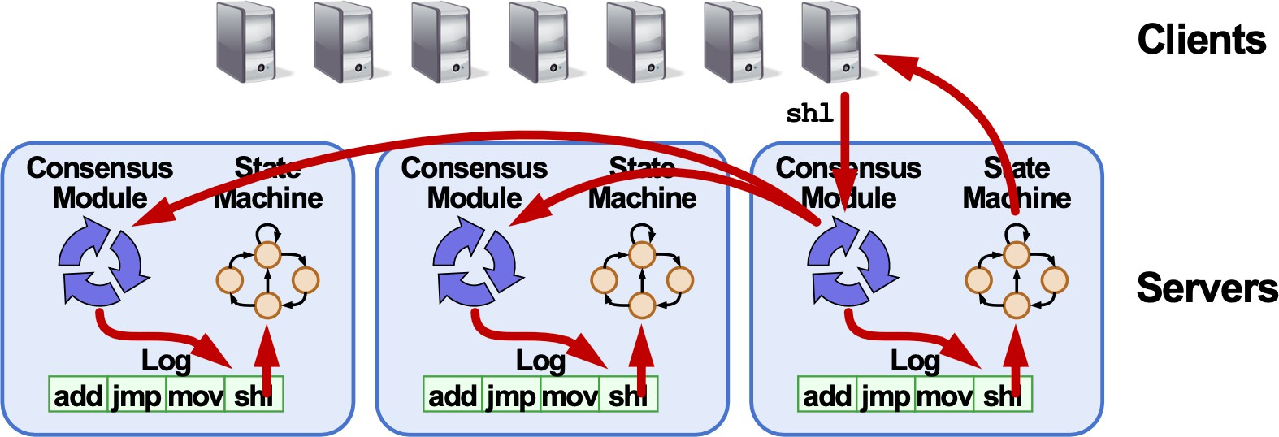
Raft Overview
Replicated log => replicated state machine
  All servers execute same commands in same order
Consensus module ensures proper log replication
Notes:
Raft is used as a library underneath a replicated service. Imagine a key-value server on each machine. The application owns the key-value table, and the Raft module owns a log of commands that change that table.
A client sends a request such as Put or Get to the current leader. The application does not immediately execute the command and reply. It gives the command to Raft so the replicas can agree on its position in the log.
After an entry is committed, Raft delivers the command to the local application. Every server executes the same deterministic commands in the same log order, so the separate state machines produce the same state. We replicate the ordered operations rather than copying the entire table after every request.
The client should experience this cluster as one reliable server. It may need to find the current leader or retry after a failure, but it must never observe two committed histories. The consensus module is responsible for preserving that single history while individual machines crash and recover.
SOURCE
MIT 6.824, Spring 2020, Lecture 6 transcript/video, 18:29–19:54 (about 1.4 min).
Local transcript: fall2026/lectures/references/mit-6824-2020-lecture6-raft1-transcript.txt
https://www.youtube.com/watch?v=64Zp3tzNbpE
Ongaro and Ousterhout, In Search of an Understandable Consensus Algorithm, Section 2 and Figure 1.
https://pdos.csail.mit.edu/6.824/papers/raft-extended.pdf

Slide 14
Normal Operation
Client
S1 leader
S2
S3
Put(x, 3)
append to own log, persist
AppendEntries
ok
slow, or down
committed → apply
result
next AppendEntries, now carrying commitIndex
apply
apply
The leader counts itself — with three servers it waits for one reply
There is no commit message — the commit index rides on the next AppendEntries
Notes:
Follow one client command through the normal case.
The client sends Put x equals three to the leader. The leader first appends the command to its own log and makes the entry persistent. It then sends AppendEntries RPCs to the followers in parallel.
The leader counts its own copy. In a three-server cluster, a majority is two, so it needs one successful follower response. It does not wait for the slowest server. Once the entry is stored on a majority, the leader marks it committed, applies it to its own state machine, and returns the result to the client.
The followers may already store the entry without knowing it is committed. Raft has no separate commit RPC. The leader includes its commitIndex in later AppendEntries messages. The next client operation can carry it, or an empty heartbeat can carry it when the system is idle. When a follower learns that the commit index has advanced, it applies the newly committed commands in order.
Notice the distinction between accepted and committed. An entry can sit in a follower's log while still being tentative. If the leader crashes before the entry becomes committed, a later leader may remove it. The service exposes a command to the client only after Raft has made the command part of the committed history.
SOURCE
MIT 6.824, Spring 2020, Lecture 6 transcript/video, 19:54–24:34 for the layered walk-through, and 24:34–30:21 for the message-level view — the leader waiting on only one other replica at 25:31–26:27, and no explicit commit message at 27:24–28:19.
https://www.youtube.com/watch?v=64Zp3tzNbpE
Ongaro and Ousterhout, In Search of an Understandable Consensus Algorithm, Section 5.3 and Figure 2.
Local transcript: fall2026/lectures/references/mit-6824-2020-lecture6-raft1-transcript.txt

Slide 15
Leader
Why a leader?
  ensures all replicas execute the same commands, in the same order
Notes:
Raft uses a leader to choose one order for concurrent commands. If several clients send requests at the same time, one server assigns the log indexes and sends that ordering to the followers.
A permanent leader is not mathematically required for consensus, but it makes the common case simple and efficient. Clients have one place to send requests, entries flow in one direction, and one round of AppendEntries can replicate a new command to a majority.
Leadership is authority backed by a majority. An old leader may remain alive in a minority partition and may still believe it is leader. It can append a client's request to its own log, but it cannot collect enough acknowledgments to commit the entry. It therefore cannot apply the command or safely tell the client that the operation succeeded.
The leader chooses the proposed order; the majority makes that order durable. Terms tell the cluster which leader's authority is newer.
SOURCE
MIT 6.824, Spring 2020, Lecture 6 transcript/video, 46:27–48:08 (about 1.7 min).
Local transcript: fall2026/lectures/references/mit-6824-2020-lecture6-raft1-transcript.txt
https://www.youtube.com/watch?v=64Zp3tzNbpE
Ongaro and Ousterhout, In Search of an Understandable Consensus Algorithm, Sections 3 and 5.
https://pdos.csail.mit.edu/6.824/papers/raft-extended.pdf

Slide 16
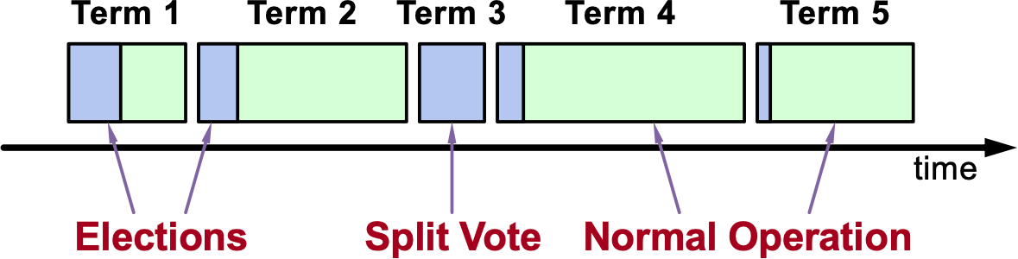
Term (aka Epochs)
Raft divides time into terms:
  In each term, election (new leader -> new term)
  A term has at most one leader; might have no leader
Each server maintains current term value
Key role of terms: identify obsolete information
Notes:
Raft divides logical time into numbered terms. Each term begins with an election. If a candidate wins, it serves as leader for the rest of that term. If the vote splits, the term may end without any leader.
Every server maintains a currentTerm value on stable storage, and that number only increases. RequestVote, AppendEntries, and their replies all carry a term number.
The comparison rule is simple. If a server receives a message with a larger term, it updates its current term and becomes a follower. If it receives a message from an older term, it rejects the request. A leader isolated by a partition therefore loses its authority as soon as it reconnects and sees a newer term.
Terms identify stale information without synchronized clocks. Different servers may learn about a new term at different moments. Safety depends on comparing the logical term numbers, not on agreeing about wall-clock time.
SOURCE
MIT 6.824, Spring 2020, Lecture 6 transcript/video, 48:08–48:34.
Local transcript: fall2026/lectures/references/mit-6824-2020-lecture6-raft1-transcript.txt
https://www.youtube.com/watch?v=64Zp3tzNbpE
Ongaro and Ousterhout, In Search of an Understandable Consensus Algorithm, Section 5.1 and Figure 5.
https://pdos.csail.mit.edu/6.824/papers/raft-extended.pdf

Slide 17
Server States
At any given time, each server is either:
  Leader: handles all client interactions, log replication
  Follower: completely passive
  Candidate: used to elect a new leader
Normal operation: 1 leader, N-1 followers
  Exercise: how do the states transit to one another?
Notes:
At any moment, a Raft server is a follower, candidate, or leader.
Followers are passive during normal operation. They respond to AppendEntries from the leader and RequestVote from candidates, but they do not initiate client command replication.
The leader handles client requests, chooses the log order, and manages replication to the followers. Normal operation has one leader and every other server is a follower.
Candidate is a temporary state used during an election. A follower becomes a candidate when it stops hearing from a valid leader long enough for its election timeout to expire. The candidate asks the cluster for votes. If it wins a majority, it becomes leader. If it discovers that another valid leader exists, it returns to follower.
These three states separate ordinary replication from recovery. Most of the time the cluster stays in the simple leader-and-followers arrangement. Candidate state exists only long enough to replace a leader that is no longer usable.
SOURCE
Ongaro and Ousterhout, In Search of an Understandable Consensus Algorithm, Section 5.1 and Figure 4.
https://pdos.csail.mit.edu/6.824/papers/raft-extended.pdf
MIT 6.824, Spring 2020, Lecture 6: no dedicated segment — MIT introduces the three states inline while describing an election, 48:34–49:28. This deck gives them a page of their own, immediately before the transition diagram on the next slide.
Local transcript: fall2026/lectures/references/mit-6824-2020-lecture6-raft1-transcript.txt
https://www.youtube.com/watch?v=64Zp3tzNbpE

Slide 18
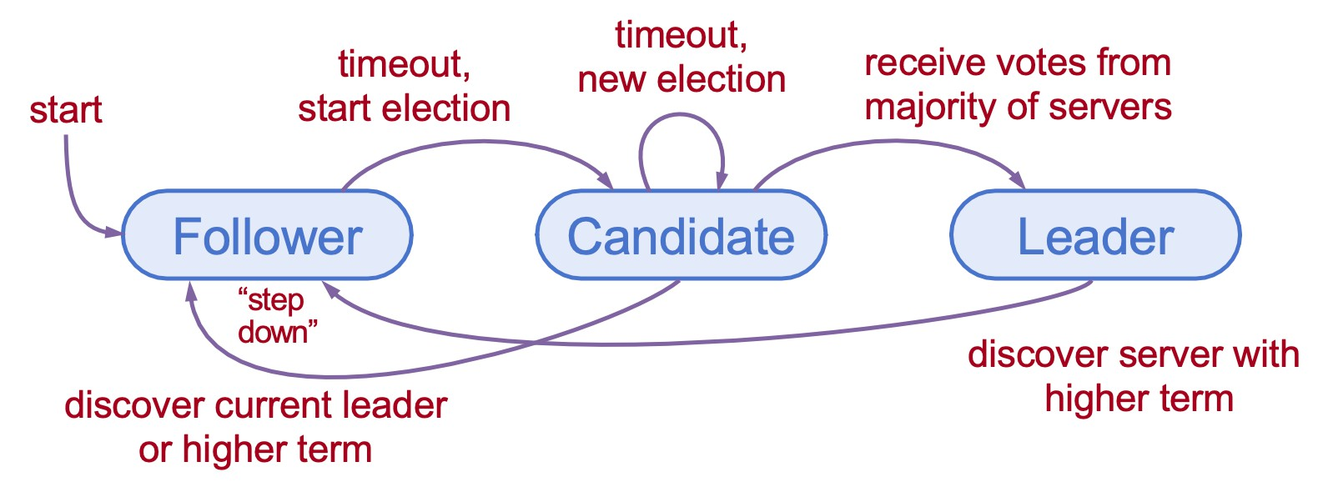
Leader State Transition
Servers start as followers
Leaders send heartbeats (empty AppendEntries RPCs) to maintain authority over followers
If election Timeout elapses with no RPCs (100-500ms), follower assumes leader has crashed and starts new election
Notes:
All servers start as followers. A leader maintains its authority by sending regular heartbeats, which are AppendEntries RPCs with no new log entries. Every valid heartbeat resets the follower's election timer.
If that timer expires, the follower cannot tell whether the leader crashed or the network lost several messages. It does not need a perfect diagnosis. It increments its term, becomes a candidate, votes for itself, and begins an election.
A candidate that receives votes from a majority becomes leader and immediately sends heartbeats. A candidate that receives AppendEntries from a leader in the same or a newer term returns to follower. If nobody wins before the next timeout, the candidate starts another election in a still higher term.
Any leader or candidate also steps down when it discovers a higher term. That rule is how an old leader learns it has been replaced.
The timeout may occasionally trigger an election even when the leader is alive but messages are delayed. That can pause progress, but the voting rules must keep the result safe. Timing controls how quickly Raft makes progress; it does not determine whether two leaders can win the same term.
SOURCE
MIT 6.824, Spring 2020, Lecture 6 transcript/video, 48:34–49:28.
Local transcript: fall2026/lectures/references/mit-6824-2020-lecture6-raft1-transcript.txt
https://www.youtube.com/watch?v=64Zp3tzNbpE
Ongaro and Ousterhout, In Search of an Understandable Consensus Algorithm, Sections 5.1–5.2 and Figure 4.
https://pdos.csail.mit.edu/6.824/papers/raft-extended.pdf

Slide 19
A Preview of Raft with Visualization
https://raft.github.io/
Notes:
The visualization puts the vocabulary together. The servers are shown on the left and their logs on the right. Slow the animation down so the term numbers, states, and messages remain visible.
At the beginning, one server wins an election and becomes leader. The others remain followers, and the leader sends repeated heartbeats that reset their election timers.
Pause the leader. Once the heartbeats stop, the followers' randomized timers begin to expire. Usually one follower times out first, becomes a candidate, increments the term, and sends RequestVote messages. With votes from a majority, it becomes the new leader and starts its own heartbeats.
Bring the old leader back. It may still remember that it was leader of an earlier term, but the first newer-term message forces it to update its term and rejoin as a follower. No failure detector tells it that it was replaced; the term comparison does.
The election can occasionally split if candidates start close together. When that happens, no candidate obtains a majority, the term ends without a leader, and randomized timeouts trigger another attempt.
SOURCE
RaftScope visualization, embedded at https://raft.github.io/ (Ongaro's own demo). No MIT counterpart — this slide is ours, placed after the vocabulary and before the election mechanics.
Ongaro and Ousterhout, In Search of an Understandable Consensus Algorithm, Figure 4 for the state transitions being shown.

Slide 20
Elections
Start election:
  Increment current term, change to candidate state, vote for self
Send RequestVote to all other servers, retry until either:
  1. Receive votes from a majority of servers:
    Become leader
    Send AppendEntries heartbeats to all other servers
  2. Receive RPC from a valid leader:
    Return to follower state
  3. No one wins (election timeout elapses):
    Increment term, start new election
A dead leader is not required — a few dropped heartbeats are enough
  so the old leader may still be running, and does not know it was replaced
Notes:
A follower starts an election after one complete election timeout with no valid message from a leader. It increments currentTerm, changes to candidate, votes for itself, and sends RequestVote RPCs to every other server.
Three outcomes are possible. First, the candidate receives yes votes from a majority of the full cluster. It becomes leader and immediately sends AppendEntries heartbeats to establish its authority.
Second, it receives AppendEntries from a leader whose term is at least as new as its own. Another server has won, so the candidate returns to follower.
Third, no candidate obtains a majority before the election timer expires. The candidate increments the term again and begins a new election with a fresh round of vote requests.
A dead leader is not required. Delayed or dropped heartbeats are enough to start an election. The old leader may still be running in another partition and may not know that the majority has elected a replacement. Raft must remain safe while both machines temporarily believe they are leader. The majority rule prevents the isolated old leader from committing new commands.
SOURCE
MIT 6.824, Spring 2020, Lecture 6 transcript/video, 48:59–53:28 (about 4.5 min). Starting an election at 49:28; “we might still unfortunately get an election” at 50:19; the stranded old leader at 50:43. A student question on one-way network failures runs 51:42–53:01 — MIT concedes Raft is not proof against every network pathology.
https://www.youtube.com/watch?v=64Zp3tzNbpE
Ongaro and Ousterhout, In Search of an Understandable Consensus Algorithm, Section 5.2 and Figure 2.
Local transcript: fall2026/lectures/references/mit-6824-2020-lecture6-raft1-transcript.txt

Slide 21
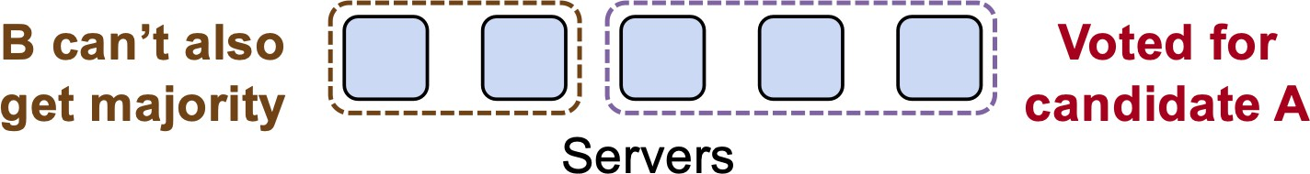
At Most One Leader Per Term
At most one winner per term
  each server votes only once per term, and records it on disk before replying
  two candidates cannot both collect a majority
A minority being down does not stop an election
  but with fewer than a majority reachable, Raft keeps trying and never elects
How does everyone else find out who won?
  the winner knows directly — it saw yes votes from a majority
  nobody else does, so the winner immediately sends AppendEntries
  only a leader may send AppendEntries for a term, so one for term 19 proves somebody won term 19
  and it resets every election timer, suppressing further elections
Notes:
Raft must ensure that at most one candidate becomes leader in a term. Each candidate needs votes from a majority, and each server may grant only one vote in that term. The server records the vote on stable storage before replying, so a crash cannot make it forget and vote a second time.
Because any two majorities overlap, two candidates cannot both collect separate sets of one-time votes. Election safety does not depend on message timing: at most one candidate can win the term even when messages are delayed or reordered.
A minority of unavailable servers does not prevent an election. A majority can still choose a leader. If fewer than a majority are reachable, Raft keeps trying but elects nobody.
The winner knows it won because it directly received the votes. The other servers do not receive a separate election-result message. The new leader immediately sends AppendEntries. Only a leader may send AppendEntries for a term, so receiving one stamped with the new term proves that the election produced a leader. Followers do not need a separate announcement or even a globally agreed leader name; they need the current term and the valid RPC sender.
Those immediate heartbeats also reset every election timer and suppress further elections while the new leader remains reachable.
SOURCE
MIT 6.824, Spring 2020, Lecture 6 transcript/video, 53:28–56:55 (about 3.5 min). One vote per term at 53:28–53:55; electing with a minority down at 54:24; how everyone learns at 54:49–56:05; heartbeats resetting timers at 56:05–56:30.
https://www.youtube.com/watch?v=64Zp3tzNbpE
Ongaro and Ousterhout, In Search of an Understandable Consensus Algorithm, Section 5.2.
Local transcript: fall2026/lectures/references/mit-6824-2020-lecture6-raft1-transcript.txt

Slide 22
When Elections Fail
An election may fail in two ways:
  fewer than a majority reachable — nothing happens, and that is safe
  simultaneous candidates split the vote, nobody gets a majority
Three servers, all timers fire together:
  each votes for itself and refuses the other two — one vote each, nobody wins
  the timers fire again, and may collide again, forever
Solution: randomize the election timeout
  all reset on the same heartbeat, but to different random deadlines
  the earliest candidate collects its votes before the next timer fires
Notes:
An election can fail to choose a leader in two ways.
The first is unavoidable: fewer than a majority can communicate. No candidate can collect enough votes, so the system waits. It is temporarily unavailable, but it does not create two leaders.
The second occurs even when every server is healthy. In a three-server cluster, suppose all three election timers expire together. Each server becomes a candidate and votes for itself. When the vote requests arrive, every server has already used its one vote. Each candidate receives one vote, nobody has a majority, and the term ends with no leader.
If every server uses the same fixed timeout, the timers may expire together again in the next term and repeat the split forever.
Raft breaks the symmetry by randomizing election timeouts. The followers may reset their timers after the same heartbeat, but they choose different future deadlines. Usually one server times out first. If it can send RequestVote RPCs and receive replies before the next timer expires, it wins the majority and sends heartbeats that cancel the remaining elections.
Randomization makes repeated collisions unlikely rather than impossible. Safety still comes from one vote per term and majority voting; random timing supplies liveness.
SOURCE
MIT 6.824, Spring 2020, Lecture 6 transcript/video, 56:55–60:16 (about 3.4 min). Two failure modes at 56:55–57:45; the three-server split-vote walkthrough at 57:45–58:35; randomization and the timeline drawing at 58:35–60:16.
https://www.youtube.com/watch?v=64Zp3tzNbpE
Ongaro and Ousterhout, In Search of an Understandable Consensus Algorithm, Section 5.2.
Local transcript: fall2026/lectures/references/mit-6824-2020-lecture6-raft1-transcript.txt

Slide 23
Choosing the Election Timeout
Minimum: a few heartbeat intervals
  one interval at least — but packets drop, so with 100 ms heartbeats use a ~300 ms floor
Maximum: two forces pulling against each other
  longer means clients wait longer with no leader after a failure
  but the gap between the first and second timer must exceed one RPC round trip
  otherwise the first candidate cannot finish collecting votes before the next one starts
Draw a fresh value on every reset
  pick once at startup and two unlucky servers collide in every term, forever
Notes:
There is some judgment in choosing the election-timeout range.
The minimum must be longer than the normal heartbeat interval. If the leader sends a heartbeat every one hundred milliseconds, an election timeout below one hundred milliseconds would expire during healthy operation. Because packets can be lost or delayed, the minimum should be several heartbeat intervals; the MIT example uses a floor around three hundred milliseconds.
The maximum faces two competing pressures. A smaller maximum gives faster recovery. From the leader's failure until the first follower times out, there is no leader and client work cannot commit. A very large timeout turns every leader failure into a long outage.
A wider range, however, spreads the candidates apart. The time between the first and second expiration should usually exceed one RequestVote round trip. Otherwise the second candidate starts before the first one finishes collecting votes, and split votes remain common. Larger clusters or slower networks generally need more separation.
The lab adds a practical upper bound because the tests expect the cluster to recover within a few seconds.
Every reset must draw a fresh random timeout. If each server chooses one value at startup and reuses it forever, two unlucky servers with the same value may collide in every term. Fresh randomness lets the next election escape the previous split vote.
SOURCE
MIT 6.824, Spring 2020, Lecture 6 transcript/video, 60:16–64:56 (about 4.7 min). The minimum at 60:43–61:33; the recovery-latency force at 61:57–62:22; the round-trip-gap force at 62:48–63:15; the lab's few-seconds bound at 63:40; a fresh value on every reset at 64:05–64:56.
https://www.youtube.com/watch?v=64Zp3tzNbpE
Ongaro and Ousterhout, In Search of an Understandable Consensus Algorithm, Section 5.2 and Section 9.3.
Local transcript: fall2026/lectures/references/mit-6824-2020-lecture6-raft1-transcript.txt

Slide 24

Quiz Attendance
https://forms.gle/oKYS9zxkogM5N4uq9
Notes:
ATTENDANCE CHECK - do this right before the quiz.
1. In Google Forms, open 'Quiz 03 Attendance - Raft I (Fall 2026)' and turn on Accepting responses. Then show this slide.
2. Tell the class: this attendance check is NOT graded. It only confirms that the number of quiz submissions matches the number of students in the room. Sign in with your BU account and enter your BU ID.
3. While they submit, count the students in the room. Headcount: ____
4. After about 2 minutes, turn OFF Accepting responses on the attendance form and compare its response count with your headcount. If they differ, say so now, before the quiz starts.
5. Only then open the quiz form and go to the next slide. After class, compare the quiz responses with this attendance list: a quiz submission whose email is not on the list did not check in.
TODO: this form does not exist yet. Create it, then put its link and QR on this slide.

Slide 25

Quiz
https://forms.gle/G5GTvLLCUXB4P36q6
Notes:
BEFORE THE QUIZ: the form was created closed. In Google Forms, turn on 'Accepting responses' when you start the quiz, and turn it off after 10 minutes.
Form: 'Quiz 03 - Raft I (Fall 2026)' in the Drive folder EC528-Fall26. Students sign in with their BU account and must enter their BU ID.
Covers this lecture only: consensus motivation, split brain, Paxos background, Raft roles and terms, leader election, and what a log entry is.
TODO: this form does not exist yet. Create it, then put its link and QR on this slide.

