Slide 1
Advanced Encryption Standard with Electronic Codebook and Counter Modes
Milestone 2
04/10/2013
Florian Raudies
Michael Pyrch
Ben Humphries

Slide 2
Overview
04/10/2013
Waveforms
Testing
Synthesis
Post-synthesis testing
Timeline
References

Slide 3
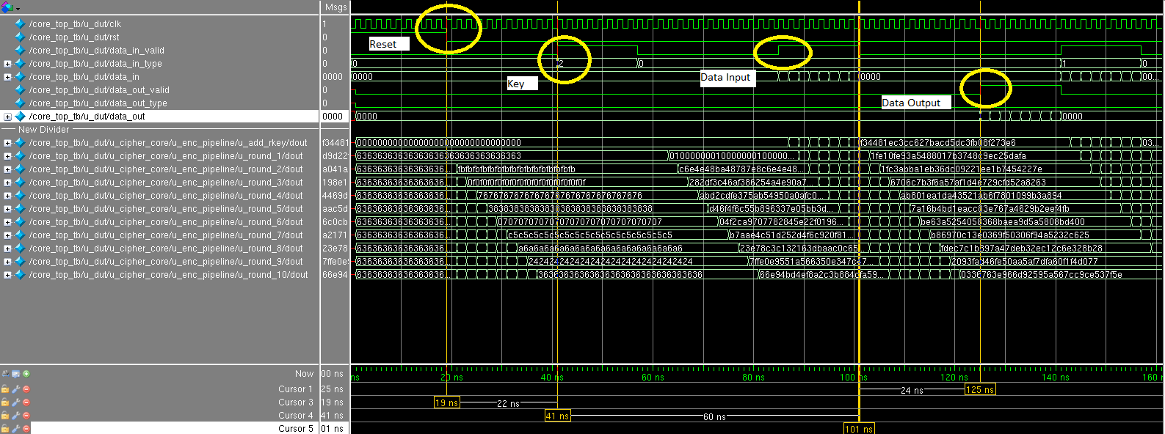
Waveforms of our Encoding Pipeline
04/10/2013

Slide 4
Testing – Electronic Codebook Mode (ECB)
04/10/2013
National Institute of Standards and Technology (NIST)
156 vectors for 128bit key size tests keys, plain texts, and provides the corresponding cipher text.
Key
Key expansion
Plain text
Encoding
Cipher text
Encoding
Plain text
Compare
Known cipher text
Compare

Slide 5
Test Passed
04/10/2013
perl ../runsim.pl -sim -tb ../tb/core_top_tb.sv -stim ../inputs/ecb_loopback.sv
--------------------------
Test Number # 155
--------------------------
@32359 INFO: Letting DUT out of rst...
@32379 INFO: Setting DUT to ECB
@32379 INFO: Sending the KEY...
@32379 INFO: Transmitting type=10, data=0xfffffffffffffffffffffffffffffffe
@32421 INFO: Sending the ENCRYPT DATA...
@32421 INFO: Transmitting type=00, data=0x00000000000000000000000000000000
@32439 INFO: Waiting for ENCRYPTED DATA...
@32476 INFO: Receiving type=0, data=0x9ba4a9143f4e5d4048521c4f8877d88e
@32476 INFO: Sending the DECRYPT DATA...
@32476 INFO: Transmitting type=01, data=0x9ba4a9143f4e5d4048521c4f8877d88e
@32493 INFO: Waiting for DECRYPTED DATA...
@32530 INFO: Receiving type=1, data=0x00000000000000000000000000000000
------------------------------------------------------------
END TEST
# Warnings: 0
# Errors : 0
------------------------------------------------------------
Simulation complete via $finish(1) at time 32549 NS + 0
../tb/core_top_tb.sv:185 $finish;
ncsim> exit
---------------------------------------------------
We use a perl script to organize our design tool flow

Slide 6
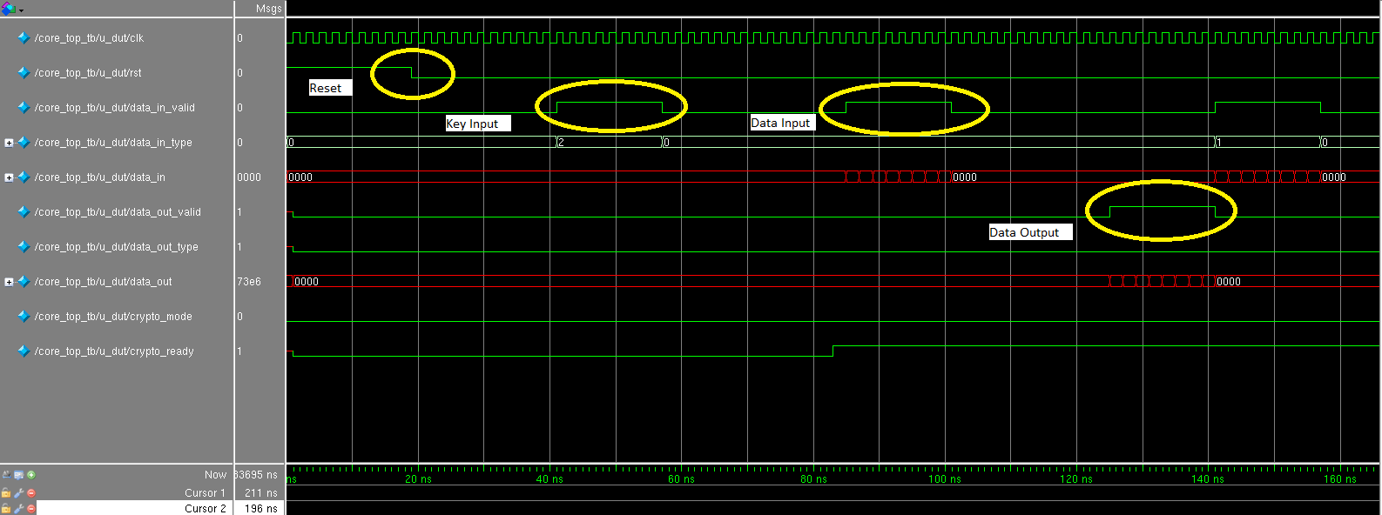
Test Waveform
04/10/2013

Slide 7
Testing – Counter Mode (CTR)
04/10/2013
Used AES CTR NIST Vectors
  Key, Init Vector, Plaintext, & Ciphertext
All output data and types get checked
Data is sent back-to-back (no dead cycles)
2 Tests
  Loopback – 4 Encrypts then 4 Decrypts
  Interlaced – 1 Enc, 1 Dec, 1 Enc, 1 Dec, etc.

Slide 8





Testing – ECB vs CTR
04/10/2013
Wikipedia Version
ECB
CTR
Our
Version

Slide 9
Synthesis – What does not synthesize?
04/10/2013
We use a perl script to organize our design tool flow
perl ../runsim.pl -synth
Warning : Ignoring unsynthesizable construct. [VLOGPT-37]
: Initial in file '../rtl/inv_sbox.v' on line 22, column 10.
: The following constructs will be ignored:
- initial block
- final block
- program block
- property block
- sequence block
- covergroup
- gate drive strength
- system task enable
- reg declaration with initial value
- specify block.
initial $readmemh("inv_sbox.dat", inv_sbox);

Slide 10
Non-Synthesizable vs. Synthesizable
04/10/2013
module rcon (
input clk,
input [3:0] addr,
output reg [31:0] dout);
reg[31:0] rcon [0:15];
initial begin
$readmemh(“rcon.dat”, rcon)
end
always @(posedge clk) dout <= rcon[addr];
endmodule
From rcon.dat
01000000
02000000…
module rcon(
input clk,
input rst,
input [3:0] addr,
output reg [31:0] dout);
reg [3:0] addr_r;
always @(posedge clk)
if (rst) addr_r <= 0;
else addr_r <= addr;
always @(*) // switch
case (addr_r)
4'h0: dout = 32'h01000000;
4'h1: dout = 32'h02000000;
…
endcase
endmodule

Slide 11
Cadence Encounter -- Script
04/10/2013
set the nangate library
set hdl_search_path ../rtl
set_attribute library ../../NangateOpenCellLibrary_typical_ccs.lib
read_hdl {../rtl/add_rkey.v ../rtl/cipher_core.v ../rtl/convert_aes_block.v ../rtl/core_top.v ../rtl/ctrl_pipeline.v ../rtl/dec_pipeline.v ../rtl/dec_round.v ../rtl/dec_round_last.v ../rtl/enc_pipeline.v ../rtl/enc_round.v ../rtl/enc_round_last.v ../rtl/gf_mul2.v ../rtl/inv_mix_bytes.v ../rtl/inv_mix_cols.v ../rtl/inv_sbox.v ../rtl/inv_shift_rows.v ../rtl/inv_sub_bytes.v ../rtl/key_expansion.v ../rtl/key_expansion_logic.v ../rtl/mix_bytes.v ../rtl/mix_cols.v ../rtl/rcon.v ../rtl/sbox.v ../rtl/shift_rows.v ../rtl/stream_in.v ../rtl/stream_out.v ../rtl/sub_bytes.v} -top ../rtl/core_top.v -sv
elaborate
check_design > synth_check_design.rpt
set clk_input [define_clock -period 2000 -name clk_input clk]
external_delay -input 0 -clock $clk_input -name in_con [find /des* -port ports_in/*]
external_delay -output 0 -clock $clk_input -name out_con [find /des* -port ports_out/*]
synthesize -to_mapped -effort medium
write -mapped > core_top_netlist.v
report timing > timing.rpt
report area > cell_area.rpt
report gates > gate_area.rpt
report design_rules core_top > design_rule_violations.rpt
exit
-sv --- use structural verilog
-top – sets top module
2000ps clock
Output file for netlist

Slide 12
Cadence Encounter – End of Log file
04/10/2013
Incremental optimization status
===============================
Worst - - DRC Totals - -
Total Neg Max Max
Operation Area Slack Trans Cap
----------------------------------------------------------
init_delay 1504408 0 0 0
init_drc 1504408 0 0 0
init_area 1504408 0 0 0
Done mapping core_top
Synthesis succeeded.

Slide 13
Synthesis Reports – Timing clk @ 500MHz
04/10/2013
Pin Type Fanout Load Slew Delay Arrival
(fF) (ps) (ps) (ps)
------------------------------------------------------------------------
(clock clk_input) launch 0 R
u_cipher_core
u_dec_pipeline
u_round_8
u_inv_sub_bytes
u_inv_sbox_5
din_r_reg[3]/CK 0 0 R
…
u_round_9/din[108]
u_inv_sub_bytes/din[108]
u_inv_sbox_d/din[4]
g14113/A1 +8 1573
g14113/ZN AND2_X1 1 1.4 8 +30 1602 R
din_r_reg[4]/D DFF_X1 +9 1611
din_r_reg[4]/CK setup 0 +31 1642 R
- - - - - - - - - - - - - - - - - - - - - - - - - - - - - - - - - - - -
(clock clk_input) capture 2000 R
------------------------------------------------------------------------
Timing slack : 358ps
Start-point : u_cipher_core/u_dec_pipeline/u_round_8/u_inv_sub_bytes/u_inv_sbox_5/din_r_reg[3]/CK
End-point : u_cipher_core/u_dec_pipeline/u_round_9/u_inv_sub_bytes/u_inv_sbox_d/din_r_reg[4]/D
We could go faster…, we also know the critical path for timing

Slide 14
Synthesis Reports – Area
04/10/2013
Type Instances Area Area %
---------------------------------------
sequential 5971 27353.844 11.4
inverter 34765 18495.246 7.7
buffer 8 6.384 0.0
logic 157272 195000.344 81.0
---------------------------------------
total 198016 240855.818 100.0
Most of the design (81%) is logic
Area is in um².
Assuming a squared size the design takes 0.48mm x 0.48mm

Slide 15
Test of Synthesized Design with “ncverilog”
04/10/2013
ncverilog simulation!
ncverilog(64): 08.10-p002: (c) Copyright 1995-2008 Cadence Design Systems, Inc.
Loading snapshot worklib.core_top_tb:sv .................... Done
ncsim> source /opt/cadence/IUS81/tools/inca/files/ncsimrc
ncsim> run
------------------------------------------------------------
INITIALIZE TEST: ECB Loopback
------------------------------------------------------------
--------------------------
Test Number # 1
--------------------------
@19 INFO: Letting DUT out of rst...
@39 INFO: Setting DUT to ECB
@39 INFO: Sending the KEY...
@39 INFO: Transmitting type=10, data=0x00000000000000000000000000000000

Slide 16
Timeline
04/10/2013
Studied AES
decided to optimize the 128bit key for speed
support codebook and counter mode
Verilog code for all modules
Initial tests for key expansion
Layout of chip
Clock optimization
Run-time comparison with c Code
Finalize all tests
Synthesize and test synthesized code
Selected AES
Write final project report
Initial proposal
Proposal
Milestone 1
Milestone 2
Milestone 3
Report

Slide 17
References
04/10/2013
Daemen, J. & Rijmen, V. (1999). AES Proposal: Rijndael. http://csrc.nist.gov/archive/aes/rijndael/Rijndael-ammended.pdf (Accessed Feb 2013)
Rijmen, V., Bosselaers, A., & Barreto, P. (2000). C reference code of AES. http://www.efgh.com/software/rijndael.htm (Accessed Feb 2013)
Mali, M., Novak, F., Biasizoo, A. (2005). Hardware implementation of AES algorithm. Journal of Electrical Engineering 56(9-10), 265-269.
Bassham, L.E. (2002). The advanced encryption standard algorithm validation suite (AESAVS). National Institute of Standards and Technology. http://csrc.nist.gov/groups/STM/cavp/ (Accessed March 2013)

Slide 18
Questions?
05/02/2011

