Slide 1
Advanced Encryption Standard with Electronic Codebook and Counter Modes
Milestone 1
05/02/2011
Zhonghan Liu
Florian Raudies
Michael Pyrch
Ben Humphries

Slide 2
Overview
05/02/2011
Secure Communication
Verilog
  Core Top
  Stream In/Out
  Key Expansion
  Cipher Core
  Pipelines
Test Benches
Timeline

Slide 3
Motivation – Secure Communication
05/02/2011
Eve can easily read any message Alice and Bob sends because they are Plaintext!
Eve
Alice
Bob
AES Encrypt/Decrypt
AES Encrypt/Decrypt
Carl
Dave
Key
Key
Eve cannot read messages Carl and Dave send because they are Ciphertext!
Both Encryption and Decryption are necessary for a complete conversation.

Slide 4
External Interfaces
05/02/2011
Inputs:
clock - System Clock
reset - System Reset
crypto_mode - Selects the mode of encryption
0 – Codebook (ECB)
1 – Counter (CTR)
data_in [15:0] - Inbound data to be processed
data_in_valid - Data on inbound bus is good
data_in_type [1:0]- What the inbound data bus is
00 – Plaintext (bound for Encryption)
01 – Ciphertext (bound for Decryption)
10 – Key (bound for Key Expansion)
11 – Initial Counter
Outputs:
crypto_ready - Ready for data to encrypt/decrypt
data_out [15:0] - Outbound data that has been processed
data_out_valid - Data on outbound bus is good
data_out_type - What the outbound data bus is
0 – Ciphertext (from Encryption)
1 – Plaintext (from Decryption)
Core Top
clock
reset
data_in
data_out
data_in_valid
data_out_valid
data_in_type
data_out_type
crypto_mode
crypto_ready

Slide 5
Core Top
05/02/2011
crypto mode (1)
crypto ready (1)
Core Top
Stream In
Cipher Core
Stream Out
data in (16)
data in valid (1)
data in type (2)
data out (16)
data out valid (1)
data out type (1)
data in (128)
data in valid (1)
data in type (2)
data out (128)
data out valid (1)
data out type (1)
key (128)
save (4)
keyed (1)
Key Expand
clock (1)
reset (1)

Slide 6
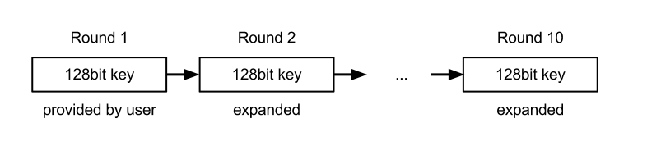
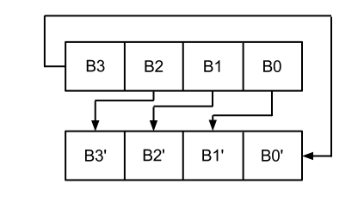
Key Expansion
05/02/2011
Pseudo code for expansion
W[0] = (key[0], key[1], key[2], key[3]);
W[1] = (key[4], key[5], key[6], key[7]);
W[2] = (key[8], key[9], key[10], key[11]);
W[3] = (key[12], key[13], key[14], key[15]);
W[4] = W[0] ^ SubBytes[RotBytes[W[3]]] ^ Rcon[0];
W[5] = W[1] ^ W[4];
W[6] = W[2] ^ W[5];
W[7] = W[3] ^ W[6];
W[8] = W[4] ^ SubBytes[RotBytes[W[7]]] ^ Rcon[1];
…
Initialize (1st round)
2nd round
3rd round

Slide 7
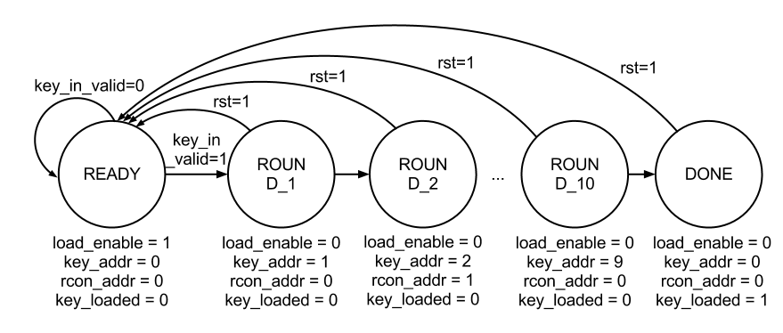
Key Expansion – FSM
05/02/2011

Slide 8
Verilog – Two always block design
05/02/2011
I put the code here after the trouble-shooting.

Slide 9
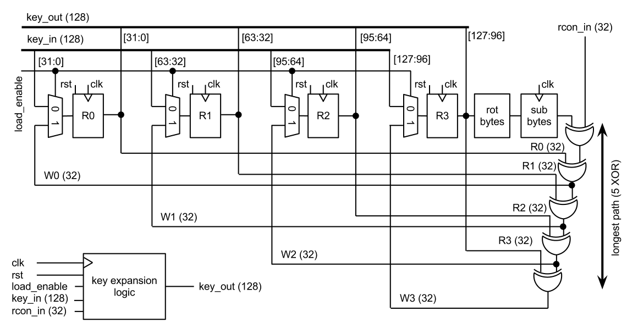
Key Expansion – Logic
05/02/2011

Slide 10
Key Expansion in VERILOG
05/02/2011
I put the code here after the trouble shooting.

Slide 11
Cipher Core
05/02/2011
key (128)
save (4)
Cipher Core
Cipher Data In Controller
crypto data in (128)
Cipher Data Out Controller
AES Encrypt Pipeline
enc data out (128)
-route data based on mode
-ignore key data
-dump pre-keyed data
-save and increment counter data
-demux data based on valid, type, and mode
-final stage processing based on mode
-register the data on valid before driving out
data in (128)
data in valid (1)
data in type (2)
AES Decrypt Pipeline
dec data out (128)
data out (128)
data out valid (1)
data out type (1)
Control Pipeline
Enc Counter
Dec Counter
valid in (1)
type in (1)
control data in (128)
valid out (1)
type out (1)
control data out (128)
Data Out Register
ready (1)
mode (1)
Cipher Controller
Cipher Mode
Keyed
crypto ready (1)
keyed (1)
crypto mode (1)

Slide 12
Encryption & Decryption Pipelines
05/02/2011
AES Encrypt Pipeline
AES Enc Round Last
(No Mix Col)
9
AES Enc Round
0
AES Enc Round
1
AES Enc Round
2
AES Enc Round
3
AES Enc Round
4
AES Enc Round
5
AES Enc Round
6
AES Enc Round
7
AES Enc Round
8
data (128)
data (128)
key (128)
save (4)
AES Decrypt Pipeline
AES Dec Round First
(No Inv Mix Col)
0
AES Dec Round
1
AES Dec Round
2
AES Dec Round
3
AES Dec Round
4
AES Dec Round
5
AES Dec Round
6
AES Dec Round
7
AES Dec Round
8
AES Dec Round
9
data (128)
data (128)
key (128)
save (4)

Slide 13
Verilog – Combinational logic and lookups
05/02/2011
Ben, please add code of, e.g. the enc_pipeline here. It does not have to include exactly all round, maybe first, second, and last.

Slide 14
Test Bench Design
02/25/2013
Data_Controller
Input_Controller
Output_Controller
Checking_unit
DUT

Slide 15
Testing
02/25/2013
Syntax checking (compiled)
First round of bugs
  Small logic bugs
  Verify design can be simulated
Second round of bugs
  Major logic bugs
  Validating design is correct

Slide 16
Timeline
05/02/2011
Studied AES
decided to optimize the 128bit key for speed
support codebook and counter mode
Verilog code for all modules
Initial tests for key expansion
Layout of chip
Clock optimization
Run-time comparison with c Code
Finalize all tests
Synthesize and test synthesized code
Selected AES
Write final project report
Initial proposal
Proposal
Milestone 1
Milestone 2
Milestone 3
Report

Slide 17
Questions?
05/02/2011

