Slide 1
Advanced Encryption Standard with Electronic Codebook and Counter Modes
05/02/2011
Zhonghan Liu
Florian Raudies
Michael Pyrch
Ben Humphries

Slide 2
Overview
05/02/2011
Crypto Modes
  ECB
  CTR
External Interfaces
Internal Block Diagrams
  Core Top
  Stream In/Out
  Key Expansion
  Cipher Core
  Pipelines
Verification
Conclusions

Slide 3
Motivation – Secure Communication
05/02/2011
Eve can easily read any message Alice and Bob sends because they are Plaintext!
Eve
Alice
Bob
AES Encrypt/Decrypt
AES Encrypt/Decrypt
Carl
Dave
Key
Key
Eve cannot read messages Carl and Dave send because they are Ciphertext!
Both Encryption and Decryption are necessary for a complete conversation.

Slide 4
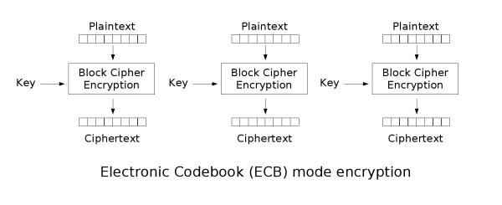

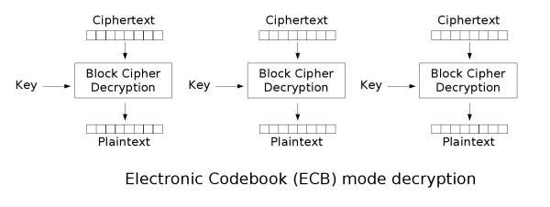

Electronic Codebook Mode (ECB)
05/02/2011
Image and Diagram Credits – Wikipedia – http://en.wikipedia.org/wiki/Block_cipher_modes_of_operation

Slide 5
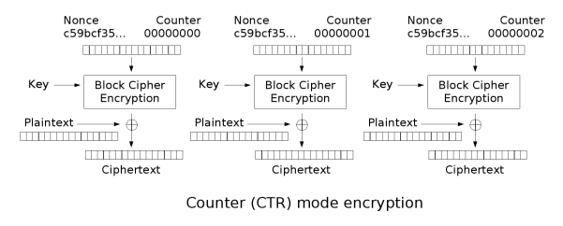
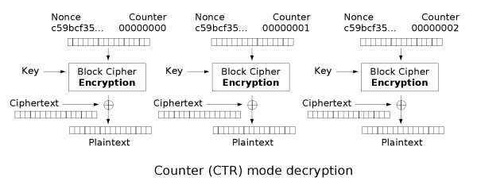

Counter Mode (CTR)
05/02/2011
Image and Diagram Credits – Wikipedia – http://en.wikipedia.org/wiki/Block_cipher_modes_of_operation

Slide 6
External Interfaces
05/02/2011
Inputs:
clock - System Clock
reset - System Reset
crypto_mode - Selects the mode of encryption
0 – Codebook (ECB)
1 – Counter (CTR)
data_in [15:0] - Inbound data to be processed
data_in_valid - Data on inbound bus is good
data_in_type [1:0]- What the inbound data bus is
00 – Plaintext (bound for Encryption)
01 – Ciphertext (bound for Decryption)
10 – Key (bound for Key Expansion)
11 – Initial Counter
Outputs:
crypto_ready - Ready for data to encrypt/decrypt
data_out [15:0] - Outbound data that has been processed
data_out_valid - Data on outbound bus is good
data_out_type - What the outbound data bus is
0 – Ciphertext (from Encryption)
1 – Plaintext (from Decryption)
Core Top
clock
reset
data_in
data_out
data_in_valid
data_out_valid
data_in_type
data_out_type
crypto_mode
crypto_ready

Slide 7
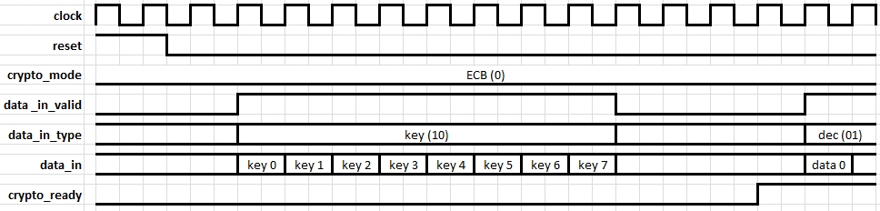





Device Initialization
05/02/2011
Initialization Process:
1. De-assert reset
2. Set crypto_mode
3. Transmit key
4. Transmit initial counter
(only when crypto_mode is CTR)
5. Wait for crypto ready to assert
6. Transmit data for encryption or decryption

Slide 8
Core Top
05/02/2011
crypto mode (1)
crypto ready (1)
Core Top
Stream In
Cipher Core
Stream Out
data in (16)
data in valid (1)
data in type (2)
data out (16)
data out valid (1)
data out type (1)
data in (128)
data in valid (1)
data in type (2)
data out (128)
data out valid (1)
data out type (1)
key (128)
save (4)
keyed (1)
Key Expand
clock (1)
reset (1)

Slide 9
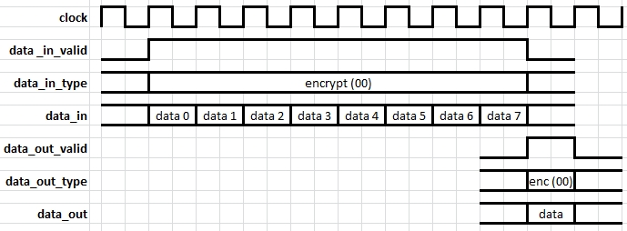
Stream In
05/02/2011
Stream In
data in (16)
data out (128)
16 bits
16 bits
16 bits
16 bits
-assert data out valid when the data counter rolls over
-ensure correct type follows data out
-keep registers to data out lines free of logic
16 bits
-latch data in on valid
-increment data counter and propagate data on valid
-latch type on the first valid data in transfer
16 bits
16 bits
data in valid (1)
16 bits
data out valid (1)
data counter
data in type (2)
data out type (2)
type

Slide 10
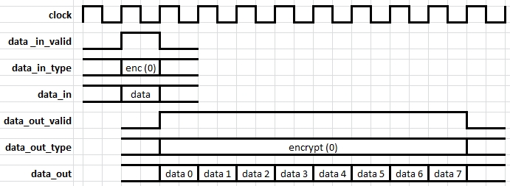
Stream Out
05/02/2011
Stream Out
data in (128)
data out (16)
16 bits
16 bits
-latch data registers from data in on valid
-latch type on valid
-reset counter on valid
16 bits
16 bits
16 bits
-always drive data out from the same data register
-last shift register fills with zeros
-data out valid is asserted until the counter rolls over
-data out type is always driven from the register
16 bits
16 bits
data in valid (1)
16 bits
data out valid (1)
data counter
data in type (1)
data out type (1)
type

Slide 11
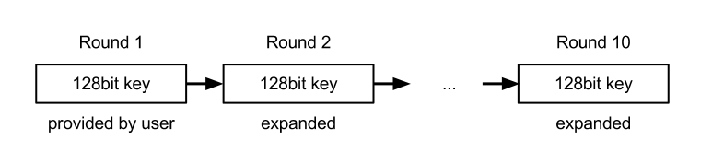
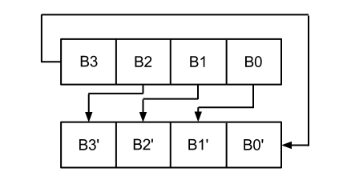
Key Expansion
05/02/2011
Pseudo code for expansion
W[0] = (key[0], key[1], key[2], key[3]);
W[1] = (key[4], key[5], key[6], key[7]);
W[2] = (key[8], key[9], key[10], key[11]);
W[3] = (key[12], key[13], key[14], key[15]);
W[4] = W[0] ^ SubBytes[RotBytes[W[3]]] ^ Rcon[0];
W[5] = W[1] ^ W[4];
W[6] = W[2] ^ W[5];
W[7] = W[3] ^ W[6];
W[8] = W[4] ^ SubBytes[RotBytes[W[7]]] ^ Rcon[1];
…
Initialize (1st round)
2nd round
3rd round

Slide 12
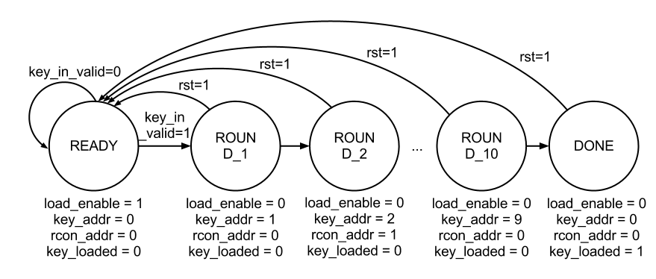
Key Expansion – FSM
05/02/2011

Slide 13
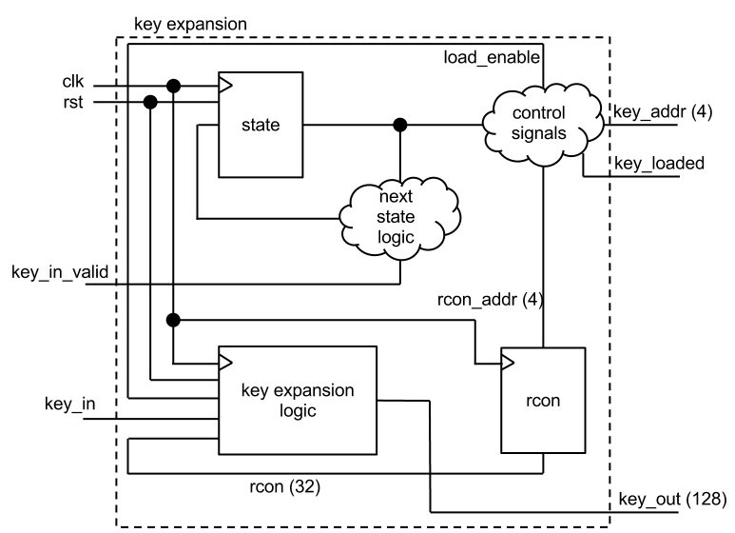
Key Expansion – Block Diagram
05/02/2011

Slide 14
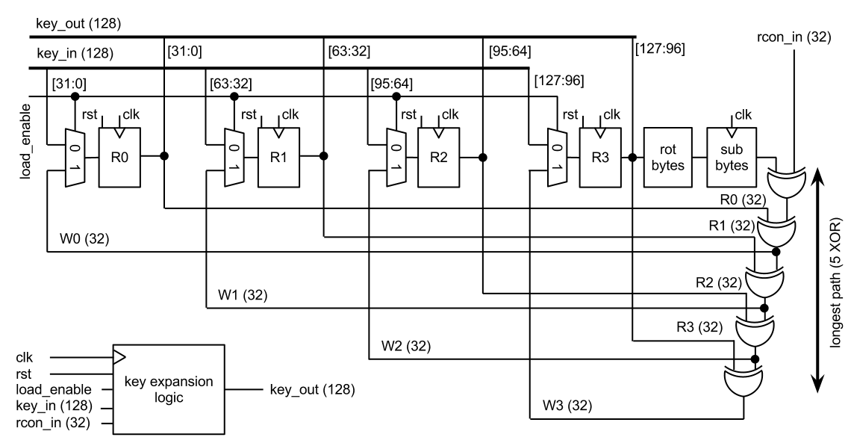
Key Expansion – Logic
05/02/2011

Slide 15
Key Expansion – C Reference Code
05/02/2011
int rijndaelKeySetupEnc(u32 rk[/*4*(Nr + 1)*/], const u8 cipherKey[], int keyBits) {
int i = 0;
u32 temp;
rk[0] = GETU32(cipherKey );
rk[1] = GETU32(cipherKey + 4);
rk[2] = GETU32(cipherKey + 8);
rk[3] = GETU32(cipherKey + 12);
if (keyBits == 128) {
for (;;) {
temp = rk[3];
rk[4] = rk[0] ^
(Te4[(temp >> 16) & 0xff] & 0xff000000) ^
(Te4[(temp >> 8) & 0xff] & 0x00ff0000) ^
(Te4[(temp ) & 0xff] & 0x0000ff00) ^
(Te4[(temp >> 24) ] & 0x000000ff) ^
rcon[i];
rk[5] = rk[1] ^ rk[4];
rk[6] = rk[2] ^ rk[5];
rk[7] = rk[3] ^ rk[6];
if (++i == 10) {
return 10;
}
rk += 4;
}
}

Slide 16
Key Expansion in VERILOG
05/02/2011
module key_expansion_logic(input clk, input rst, input load_enable, input [127:0] key_in, input [31:0] rcon_in, input [127:0] key_out)
reg [31:0] B0, B1, B2, B4;
wire [31:0] W0, W1, W2, W3;
wire [7:0] sbyte0, sbyte1, sbyte2, sbyte3;
always @(posedge clk or posedge rst)
if (rst) begin B0 <= 8'd0; B1 <= 8'd0; B2 <= 8'd0; B3 <= 8'd0;
end else begin
/* Note that this read-in is convoluted. I assume bit 0 is received first and bit 128 last */
B0 <= load_enable ? {key_in[ 7: 0], key_in[ 15: 8], key_in[ 23: 16], key_in[ 31: 24]} : W0;
B1 <= load_enable ? {key_in[ 39:32], key_in[ 47: 40], key_in[ 55: 48], key_in[ 63: 56]} : W1;
B2 <= load_enable ? {key_in[ 71:64], key_in[ 79: 72], key_in[ 87: 80], key_in[ 95: 88]} : W2;
B3 <= load_enable ? {key_in[103:96], key_in[111:104], key_in[119:112], key_in[127:120]} : W3;
end
assign W0 = load_enable ? B0 : B0 ^ {sbyte3, sbyte2, sbyte1, sbyte0} ^ rcon_in;
assign W1 = load_enable ? B1 : B1 ^ W0;
assign W2 = load_enable ? B2 : B2 ^ W1;
assign W3 = load_enable ? B3 : B3 ^ W2; /* longest path 2 memory retrivals (in parallel) and 5 xors. */
assign key_out = {B3, B2, B1, B0};

Slide 17
Cipher Core
05/02/2011
key (128)
save (4)
Cipher Core
Cipher Data In Controller
crypto data in (128)
Cipher Data Out Controller
AES Encrypt Pipeline
enc data out (128)
-route data based on mode
-ignore key data
-dump pre-keyed data
-save and increment counter data
-demux data based on valid, type, and mode
-final stage processing based on mode
-register the data on valid before driving out
data in (128)
data in valid (1)
data in type (2)
AES Decrypt Pipeline
dec data out (128)
data out (128)
data out valid (1)
data out type (1)
Control Pipeline
Enc Counter
Dec Counter
valid in (1)
type in (1)
control data in (128)
valid out (1)
type out (1)
control data out (128)
Data Out Register
ready (1)
mode (1)
Cipher Controller
Cipher Mode
Keyed
crypto ready (1)
keyed (1)
crypto mode (1)

Slide 18
Encryption & Decryption Pipelines
05/02/2011
AES Encrypt Pipeline
AES Enc Round Last
(No Mix Col)
9
AES Enc Round
0
AES Enc Round
1
AES Enc Round
2
AES Enc Round
3
AES Enc Round
4
AES Enc Round
5
AES Enc Round
6
AES Enc Round
7
AES Enc Round
8
data (128)
data (128)
key (128)
save (4)
AES Decrypt Pipeline
AES Dec Round First
(No Inv Mix Col)
0
AES Dec Round
1
AES Dec Round
2
AES Dec Round
3
AES Dec Round
4
AES Dec Round
5
AES Dec Round
6
AES Dec Round
7
AES Dec Round
8
AES Dec Round
9
data (128)
data (128)
key (128)
save (4)

Slide 19
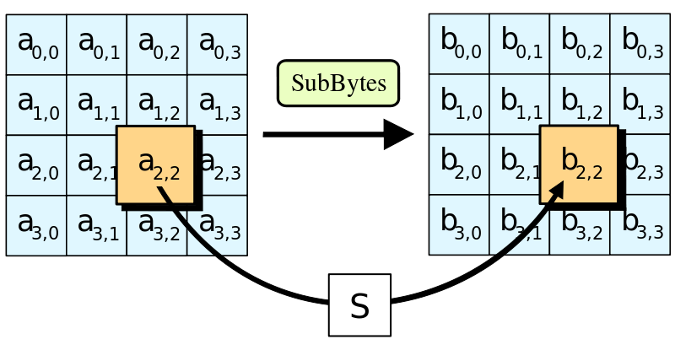
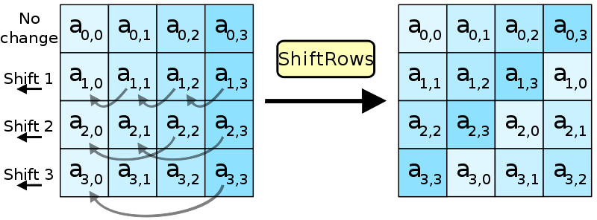
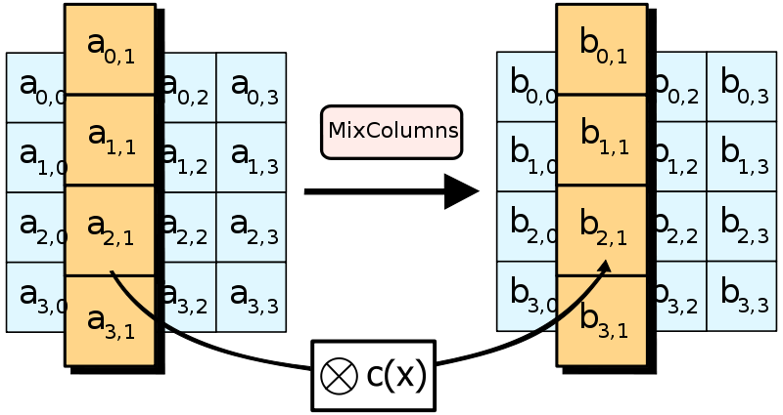
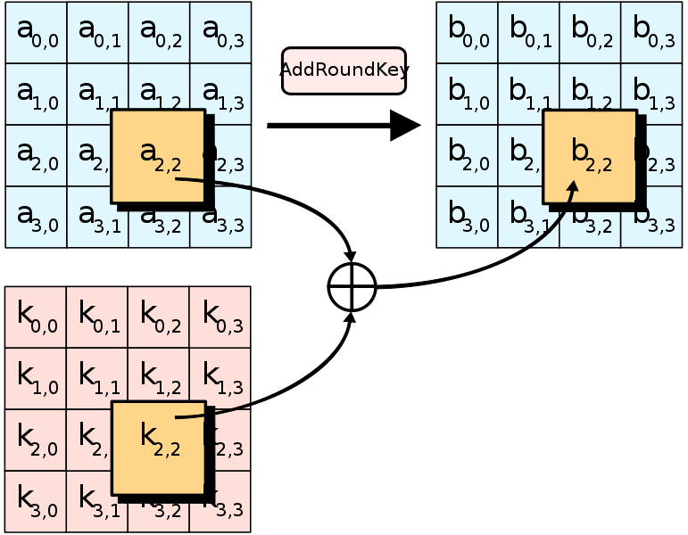
Encryption & Decryption Rounds
05/02/2011
Sub Bytes & Inv Sub Bytes
-implemented as RAMs
-byte of address produces a data byte
-16 RAMs required per round
AES Enc Round
Sub Bytes
(RAM)
Shift Rows
Mix Cols
Add Round Key
data (128)
data (128)
Shift Rows & Inv Shift Rows
-no logic, only routing
-1 transform per round
Key
key (128)
save (4)
Mix Cols & Inv Mix Cols
-word-wise transformation
-logic varies based on direction:
-Enc requires 3 XORs & 1 Mux
-Dec requires 5 XORs & 1 Mux
-4 transforms per round
AES Dec Round
Add Round Key
Inv Mix Cols
Inv Shift Rows
Inv Sub Bytes
(RAM)
data (128)
data (128)
Add Round Key
-same for Encrypt and Decrypt
-bit-wise add of data and key
-requires 1 XOR
-1 transform per round
Key
key (128)
save (4)
Image Credits – Wikipedia – http://en.wikipedia.org/wiki/Advanced_Encryption_Standard

Slide 20
Verification Design
02/25/2013
Known Answer Test
Stream In
Test Vectors
Simulation
Unit
Checking
Unit
Valid
DUT
Assertions

Slide 21
Verification Design
02/25/2013
Randomized Testing
C-Model
Randomizer
Checking
Unit
Valid
DUT
Assertions

Slide 22
Test Bench Design
02/25/2013
Generic test bench wrapper for all tests.
Use `include “stim.v” for each test
Each stim.v defines the test vectors used for that given test.
A test suite is comprised of multiple stim.v files.
Regressions are run with the test suite.
Test Bench
Initialize default signals
i.e. clocks, resets
Initialize/set environment variables to record simulation data
`include “stim.v”

Slide 23
Conclusions
05/02/2011
Our design focuses on speed rather than energy or size using pipelines.
  27 clock cycles latency per encrypt/decrypt block
    8 to shift data in
    10 to encrypt/decrypt
    1 for cipher output stage
    8 to shift data out
The longest path has one input/output RAM access, 1MUX, and 6XORs.

Slide 24
Questions?
05/02/2011

