Slide 1
An all-Python ecLand–CaMa-Flood chain
eclandpy on the LIAISE domain, 1988–2024, validated against the Fortran ecLand CY50R1 control
• G. Balsamo — ECMWF — September 2026
• with C. Kühnlein (ecland-porting) and N. Wedi (pmap-ifs)
• Land: eclandpy (GT4Py port of ecLand, cy50r1 physics) on one NVIDIA A100
• River: CaMa-Flood-GPU (Kang, Yin & Yamazaki 2026, PyTorch/Triton)

Slide 2
In one slide
what was done, and what it showed
• 37 years on the 16×23 LIAISE grid: the first multi-point run of this Python core, then routed through CaMa-Flood-GPU
• Surface temperature indistinguishable from Fortran (+0.05 °C, r = 0.99); evaporation 2 % low; runoff 21 % low
• Restart chain reproduces the Fortran restart state after 10 years: soil T within 0.1 K, soil moisture within 1–2 %
• At the 6 GRDC gauges the Python chain edges the Fortran chain: median KGE −0.135 vs −0.155, r 0.45 vs 0.34, 15/25 station-years
• One real physics gap: a regionally coherent deep-soil-moisture divergence that domain means hide
• Per step: Fortran 8.8 ms (4 threads), eclandpy 24 ms on one CPU core, 32 ms on an A100 — 368 columns cannot fill a GPU; the case for the port is at scale

Slide 3
Porting strategy
five principles
Reuse, don't re-derive eclandpy drives the Fortran-twin-validated GT4Py kernels of ecland_porting (C. Kühnlein) unmodified through their own offline driver; eclandpy's own code is the I/O layer, the adapter, and what the port lacks.
Close the cy48r1→cy50r1 gap surgically Diffing two clean Fortran checkouts across every module on the real execution path found that most cy50r1 physics was already in the 'cy48r1' port; three genuine gaps were ported (RTF2 freezing curve, snow-cover fraction, vegetation tables) and the seven experimental hydrology flags kept off on both sides — a plain cy50r1 vs plain cy50r1 comparison.
Validate on points before grids PLUMBER2: 42 then all 170 flux-tower sites, scored against FLUXNET; Qle/Qh match Fortran within noise, NEE is the known weaker variable. Only then the first multi-point run ever attempted with this core — the LIAISE grid — and its 5-day check against Fortran.
Build what the offline driver lacks A restart chain (ecland_porting has none), diagnostic recorders, lat/lon on outputs so Python files are drop-ins for the Fortran-schema tools, and a coupling layer (eclandpy.cmfgpu) that mirrors cnt41s.F90's hand-over: −(Qs+Qsb), the weights, the advance loop.
Keep the reference run as the arbiter Every step is checked against the Fortran control: initial state, budgets, restart state, annual diagnostics, gauge skill. Where the Python chain is better or worse, we say so with the number.

Slide 4
Architecture
same structure as the Fortran, different packaging
ecLand Fortran vendors CaMa-Flood (src/surf/cmflood) and carries the coupling in cnt41s.F90 — one executable
eclandpy drives ecland_porting's GT4Py kernels unmodified; adds I/O, adapter, Phase 4a flags, a restart chain
eclandpy.cmfgpu the coupling layer only — −(Qs+Qsb) hand-over, inpmat→npz weights, regional subset, chained driver, discharge — CLIs, domain-agnostic
CaMa-Flood-GPU stays an external package: its torch/triton stack cannot share a process with gt4py 1.1.7 / numpy<2
liaise-ecland is configuration — which parameters.nc, mapping, gauges — the way namelist/input_cmf configures LECMF1WAY

Slide 5
Environments and lessons learned
• GPU needs its own environment: cupy-cuda12x 13.6 (14.x forces numpy≥2), nanobind 1.9.2, gcc 11 as nvcc host (nvcc rejects >11), CUDA 12.6, LD_LIBRARY_PATH for GLIBCXX_3.4.26, GT4PY_EXTRA_COMPILE_ARGS unset, ≥64 GB for the nvcc compile of the largest stencil, SLURM qos ng.
• gt4py compiles stencils lazily and re-reads their source from disk: editing model source under a live run recompiles and crashes it (cost us a 20-hour and a 2-hour run). Never touch the source tree while a job runs.
• stencil_validation went public during this work: the pmap-ifs shim eclandpy used lacked freeze() and get_stencil_id; the real package rejects the registry re-registration Phase 4a relied on and re-registers per instantiation. All three now handled; both backends pass single- and multi-driver tests.
• Sign conventions cost real effort: Qsb is a negative soil-column loss, so total runoff is −(Qs+Qsb); Qs−Qsb double-counts surface runoff and passed every plausibility check until compared with Fortran discharge.
• Benchmark on one code version: the CPU and GPU runs straddled the ecland-porting main merge, which made the CPU path 4× faster, and the first performance comparison credited that to the GPU. Re-timed on the current code: 24 ms/step on one core, 32 ms on an A100, 8.8 ms for Fortran on four threads.
• Output files inherit HDF5's one-record-per-chunk default; time-chunking the writers (as ecLand's own offline driver now does) makes point-site files 5× smaller and time-series reads 45× faster at no change in values.

Slide 6
Land surface vs the Fortran control
domain means over 235 land points, 37 years, identical forcing
 | eclandpy (GPU) | Fortran | bias | r
Precipitation, mm/yr | 812.7 | 812.7 | +0.0 | 1.000
Evapotranspiration, mm/yr | -654.5 | -668.3 | +13.8 | 0.955
Total runoff −(Qs+Qsb), mm/yr | 160.8 | 203.4 | -42.6 | 0.848
Surface T (AvgSurfT vs T2m), °C | 12.61 | 12.56 | +0.05 | 0.988
Root-zone soil moisture, kg/m² | 410.8 | 445.3 | -34.6 | 0.711
• Runoff and root-zone deficits are one signal: water stays in the deep soil rather than leaving the column
• Fortran's o_wat does not close its own budget (−60 to −70 mm/yr), so part of the runoff gap may be diagnostic

Slide 7
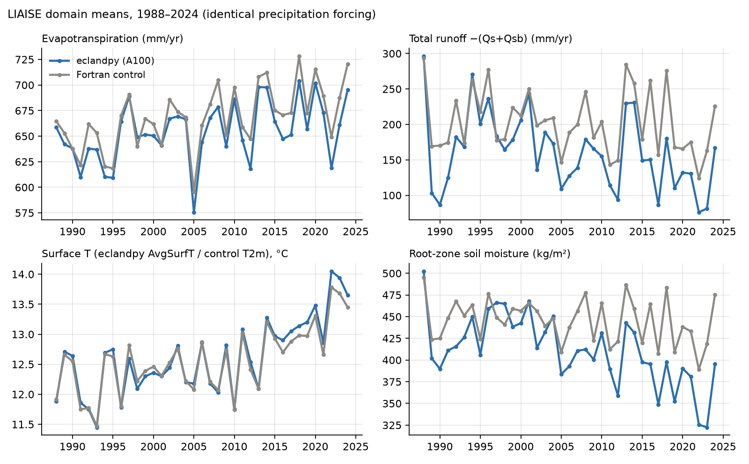
Annual series, 1988–2024

Slide 8
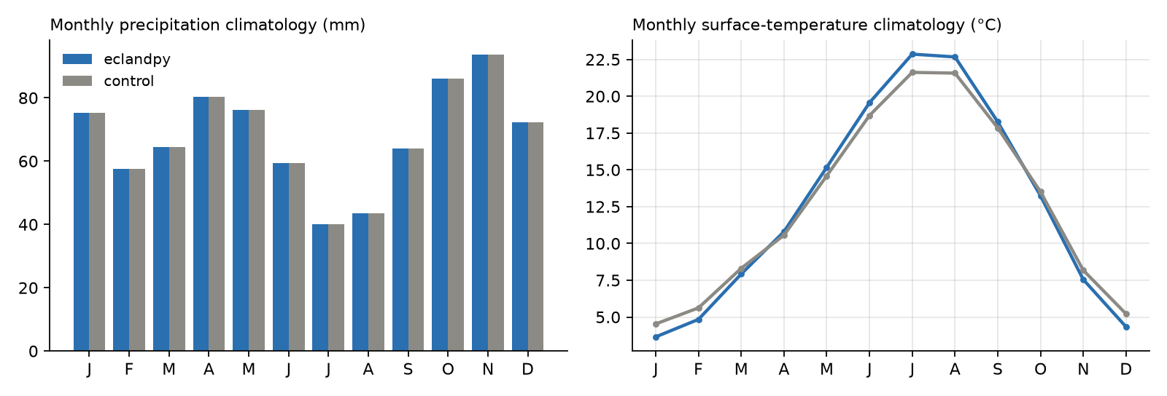
Seasonal cycle
the larger temperature amplitude is skin (AvgSurfT) vs 2 m — eclandpy has no T2m diagnostic

Slide 9
The restart chain, checked against the Fortran restart
state at 1998-01-01 after ten chained years
• Identical to Fortran at 1988 t=0 — the surfinit conversion is exact
• AvgSurfT 276.96 vs 277.02 K; soil temperature within 0.1 K in all four layers
• Soil moisture within 1–2 % (domain mean) in all four layers; one clean timestep across the 1997→1998 boundary
• Small real differences: SWE 0.83 vs 0.56, canopy water 0.22 vs 0.14 kg/m²
• Deep layer (1.9 m): 35 of 235 cells differ by >100 kg/m² — drier on the Duero plateau, wetter on the coasts; signs balance, so means hide it

Slide 10
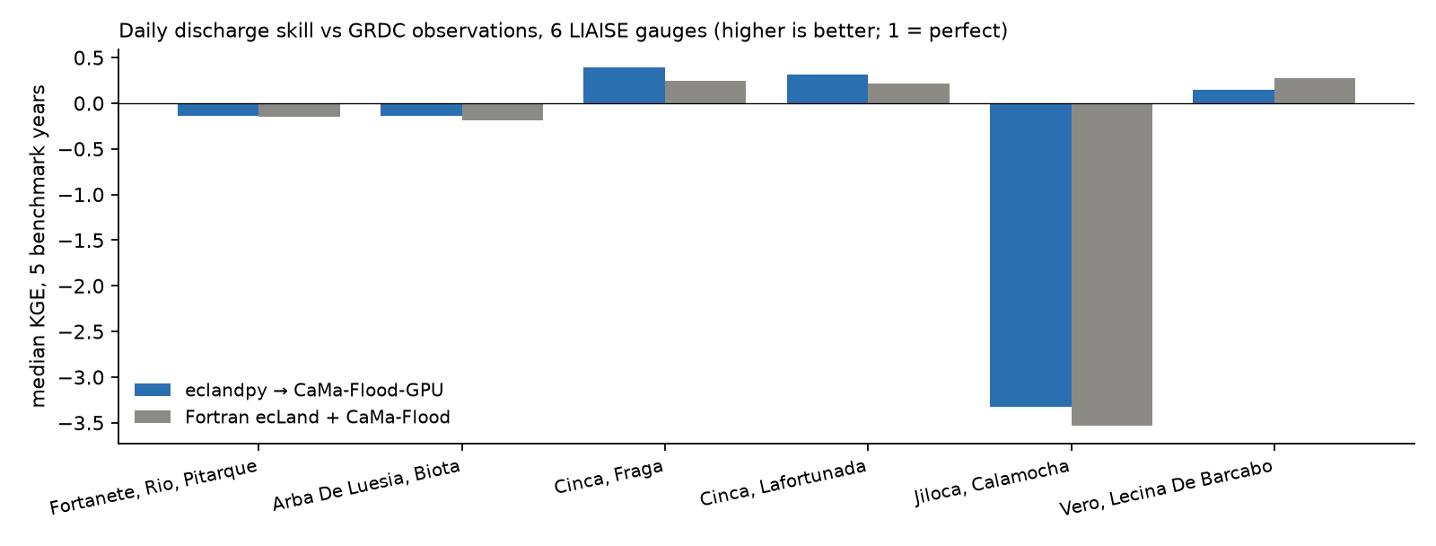
River discharge vs GRDC observations
6 LIAISE gauges, 5 benchmark years, 25 station-years
 | eclandpy → CaMa-Flood-GPU | Fortran chain
median KGE | -0.135 | -0.155
median NSE | -1.003 | -1.181
median correlation r | 0.451 | 0.342
median PBIAS, % | -42.4 | -35.5
station-years won on KGE | 15 of 25 | 10 of 25

Slide 11
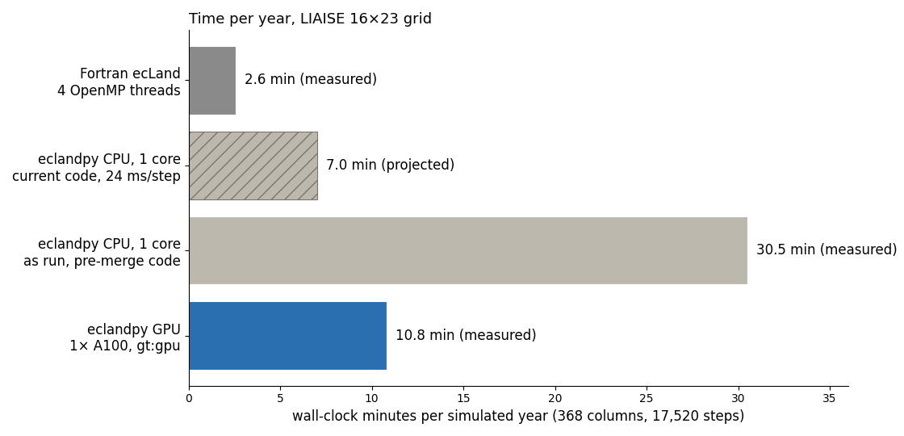
Performance
per simulated year, 368-column LIAISE grid
configuration | per step | per year | 37 years
Fortran ecLand CY50R1, 4 OpenMP threads | 8.8 ms | 2.6 min | 1 h 35 m (measured)
eclandpy gt:cpu_kfirst, 1 core — current code | 24 ms | ≈7 min | ≈4.3 h (projected)
eclandpy gt:cpu_kfirst, 1 core — as run (pre-merge code) | 104 ms | 30.5 min | 13.7 h for 27 yr (measured)
eclandpy gt:gpu, 1× A100 (physics / with recorders) | 32 / 37 ms | 10.8 min | 6.7 h (measured)
• The archived CPU run predates C. Kühnlein's main merge (4× faster CPU path); the earlier "2.9× GPU speed-up" compared across code versions and was wrong
• Per-step cost at 368 columns is kernel-launch latency; CaMa-Flood-GPU's own benchmarks run at 17,675×N columns — the case for the port is at scale

Slide 12
Known gaps and next steps
• Deep-layer (1.9 m) soil moisture diverges regionally after ~2 years — eclandpy drier on the Duero plateau, wetter on the Mediterranean and Cantabrian coasts; 35 of 235 cells by >100 kg/m². The runoff and root-zone offsets follow from it. Next: locate when and where it develops in the L4 time series.
• No T2m/D2m diagnostic in eclandpy (surfpp_ctl_mod's per-tile 2 m scheme is unported); AvgSurfT stands in, which also explains the larger seasonal amplitude in the climatology.
• Two Fortran coupling switches are unported and off in the reference: LWEVAP (lake-tile potential evaporation extracted from floodplain storage — CaMa-Flood-GPU has no evaporation sink) and LROSPLIT (surface/sub-surface passed separately — equivalent while LGDWDLY is off).
• The land-ice tile is dead code in the port (InputBinder hardcodes pcil = 0), harmless on LIAISE; NEE remains the weakest PLUMBER2 variable.
• Performance case must be made at scale: at 368 columns per-step cost is launch latency; CaMa-Flood-GPU's own benchmarks run at 17,675×N columns. Batching the 170 PLUMBER2 sites into one domain is the natural test.

Slide 13
Reproduce it
four commands, two environments
• liaise-ecland/eclandpy_bridge/README.md — prepare inputs → land run (CPU or A100) → routing chain → dashboard
• eclandpy/README.md 'CaMa-Flood-GPU coupling' — the eclandpy.cmfgpu CLIs and the GPU environment
• Dashboards: sites.ecmwf.int/pad/liaise/eclandpy/ (beside /control/), sites.ecmwf.int/pad/plumber2/dashboards/
• github.com/gpbalsamo/eclandpy — the land model + eclandpy.cmfgpu coupling layer (this work: 4e35128 and later)
• github.com/gpbalsamo/liaise-ecland — LIAISE configuration, Fortran control, eclandpy_bridge/ (93fae86 and later), the archived CaMa-Flood-GPU drivers
• github.com/gpbalsamo/ecland-porting, branch cy50r1 — the three cy50r1 physics ports on top of C. Kühnlein's main (merged 29e6152)
• github.com/Kshy0/CaMa-Flood-GPU + Kshy0/hydroforge — the routing model, unmodified
• github.com/stubbiali/stencil-validation (public since 2026-09-14) — the stencil framework at ecland-porting's pinned commit

