Slide 1


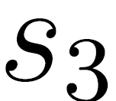
HELLO
WHAT’S
UP?

Slide 2
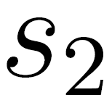
HELLO
WHAT’S
UP?

Slide 3
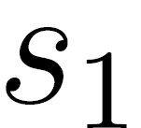
HELLO
WHAT’S
UP?

Slide 4
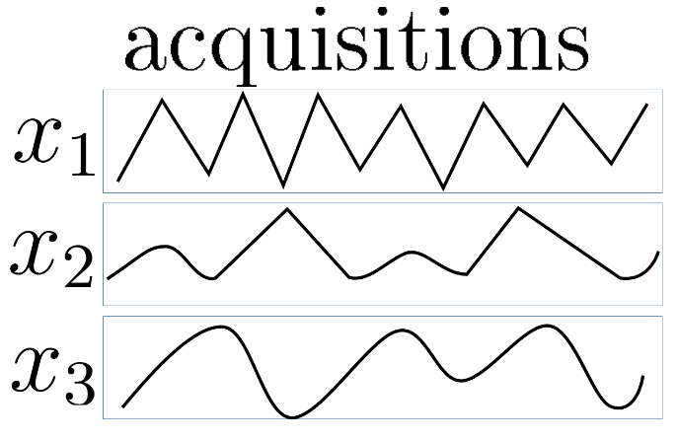

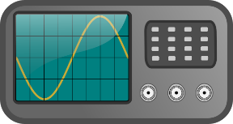
HELLO
WHAT’S
UP?

Slide 5
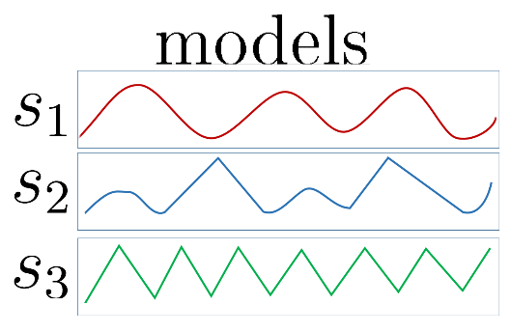
HELLO
WHAT’S
UP?

Slide 6
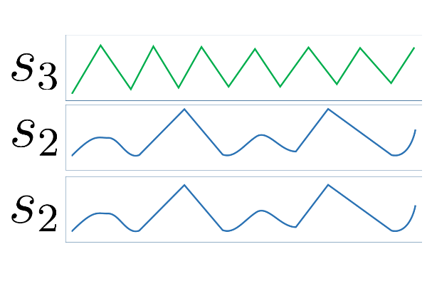
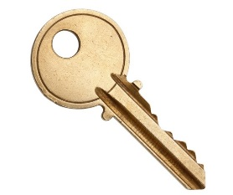
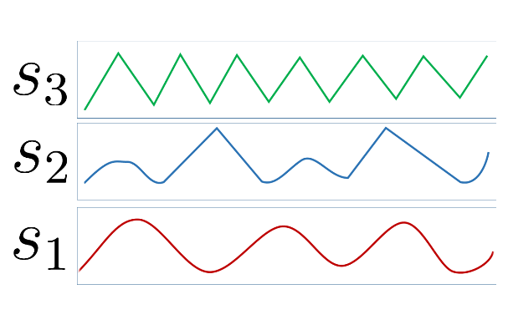
HELLO
WHAT’S
UP?
HELLO
WHAT’S
UP?
Key Hypothesis
HELLO
WHAT’S
UP?

Slide 7


HELLO
WHAT’S
UP?
Comparison
HELLO
WHAT’S
UP?
Key Hypothesis
HELLO
WHAT’S
UP?

Slide 8
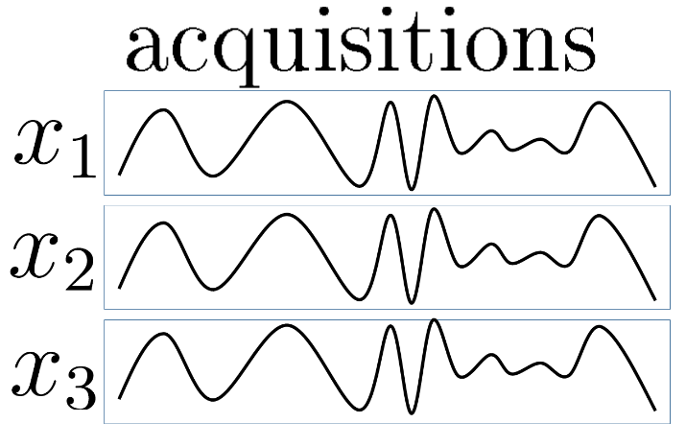
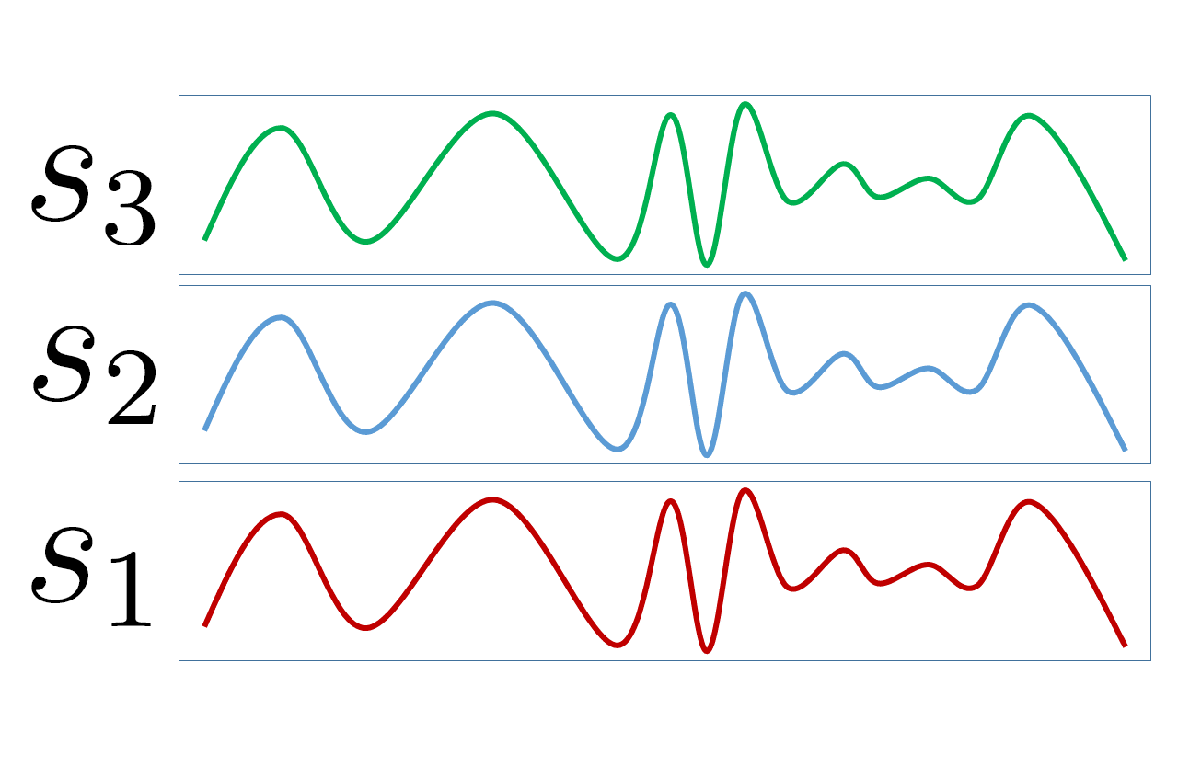
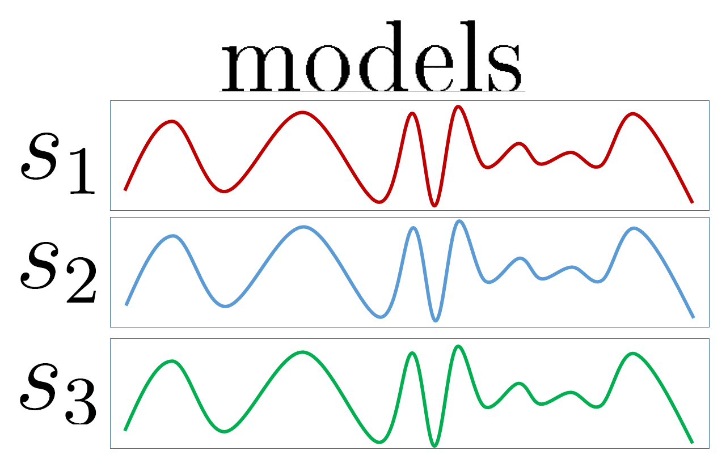
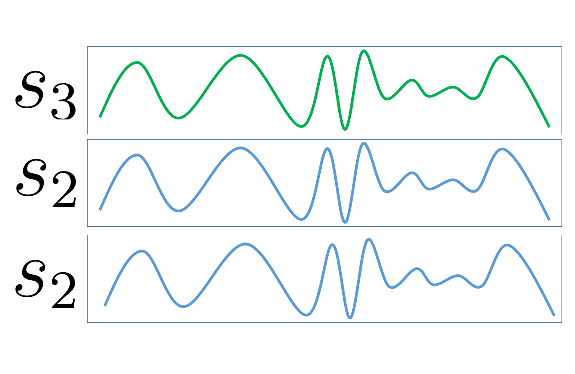
HELLO
WHAT’S
UP?
Comparison
HELLO
WHAT’S
UP?
Key Hypothesis
HELLO
WHAT’S
UP?

