Slide 1
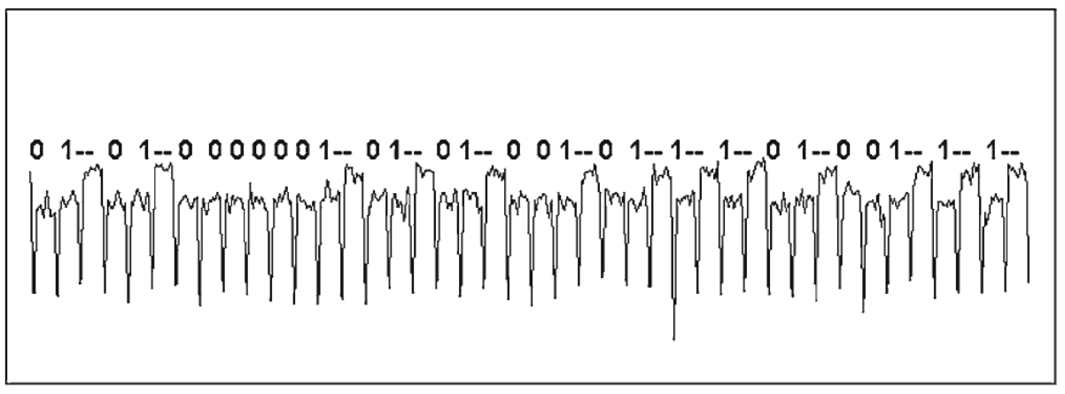


Power consumption
Sound
RSA
Source - Paul Kocher et al. “Introduction to differential power analysis”.
MESSAGE
SIGNATURE
INTERMEDIATE COMPUTATIONS
Time
Electromagnetic irradiation

Slide 2
Power consumption
Sound
PLAINTEXT
CIPHERTEXT
INTERMEDIATE COMPUTATIONS
Time
Electromagnetic irradiation

Slide 3
ENCRYPTION
PLAINTEXT
CIPHERTEXT

