Slide 1


Classifier
x

Slide 2
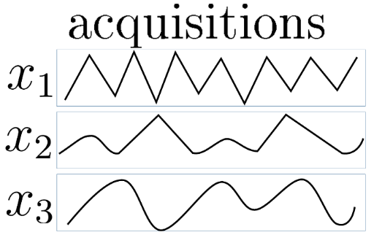
Classifier

Slide 3
Classifier
S₃
RECOMBINATION
Classifier
S₂
Classifier
S₁

Slide 4
Classifier

