Slide 1
Workout Helper
Emma Capirchio

Slide 2
Team Members
Just me!
Emma

Slide 3
Overview of my project
My project was based on an idea from my friend Nick, who goes to the gym almost daily.
It allows him, as the admin, to add workouts to different users and see all the users in the database.
It allows users to track steps and calories and see the workouts assigned to them as well as all the workouts in the database.

Slide 4
Timeline
The first week, I planned out the project with figma and came up with a color scheme.
The second week, I forgot to submit the status.
The third week, I worked on the prototype and the login/register pages.
The fourth week, I set up my database, worked on the user homepage, and finished the login and register pages.
The fifth week, I finished the user homepage.
The sixth week, I connected to the database.
The seventh week, I allowed the admin to add workouts to a user.
The eighth week, I fixed the layout of pages.
The last couple weeks, I spent on cleanup and adding missing components.

Slide 5
Database Organization
I have 3 databases: user_stats, users, workouts.
user_stats includes UserStatID, UserID, WorkoutID, Date, Duration, steps, calories, and step_goal. users includes UserID, UName, PW, Email, and created_at. workouts includes WorkoutID, WorkoutName, and Descript.
Everything is tied through user_stats. With users being connected through UserID and workouts being connected through WorkoutID.

Slide 6
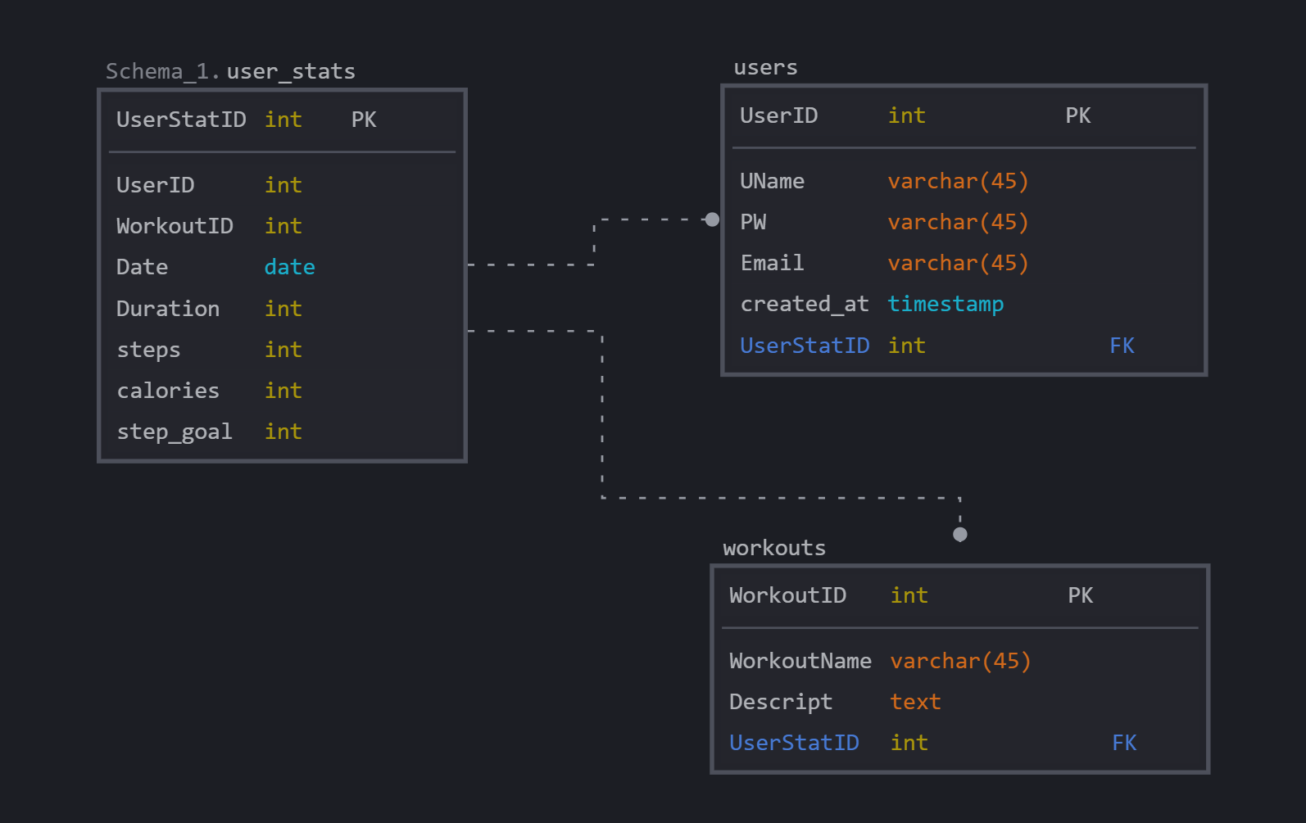
Database Design

Slide 7
Obstacles
I mostly had errors with the database and connecting to MySQL.
I also had trouble finding the time to work on this project.

Slide 8
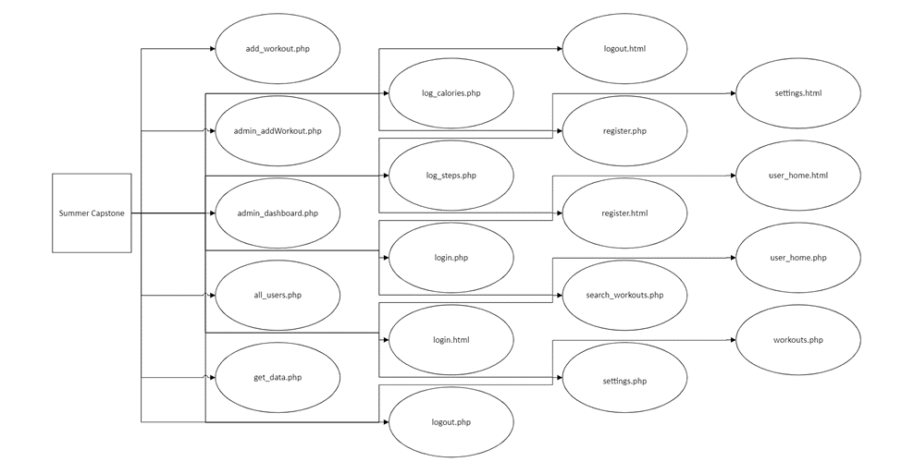
Technical Design
My technical design was a bit strange because I didn’t have any organization between my files.

Slide 9
Summary
This project is a simple workout helper app. You can see workouts and track steps and calories.
I had trouble with connecting to the database, MySQL, and finding time to work on the project.
If I had a chance to redo it or add to it, I would probably put it into an emulator.

Slide 10
Questions?

