Slide 1
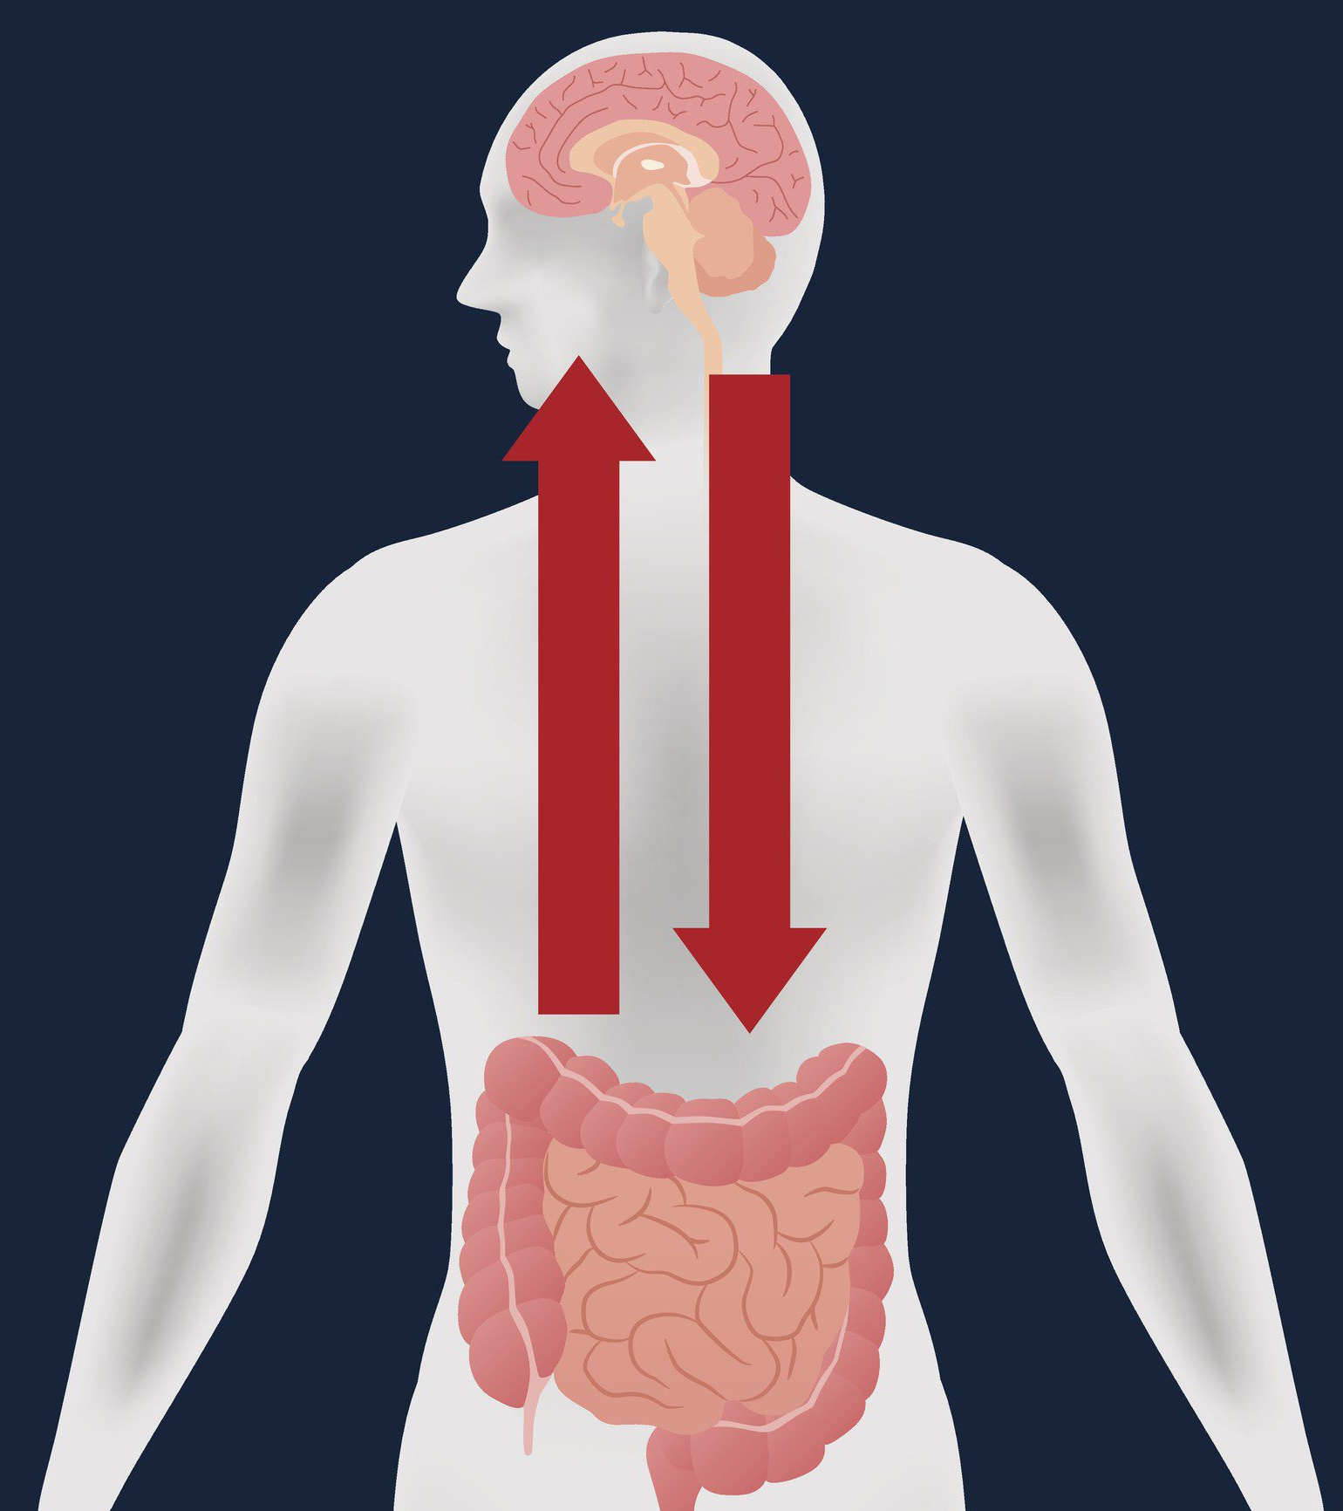
An Investigation of the Human Gut Microbiome’s Influence on Tryptophan Metabolism in ADHD
Capstone Presentation
BIOI 4970
Emma Carlson

Slide 2
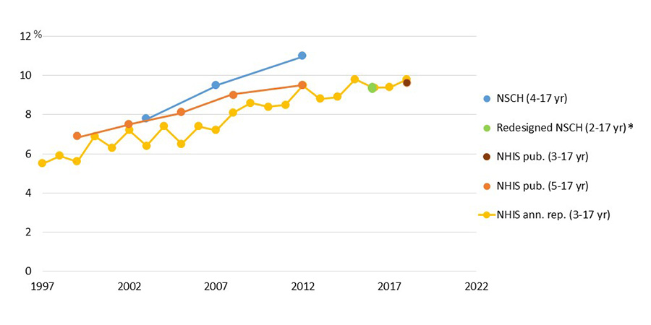
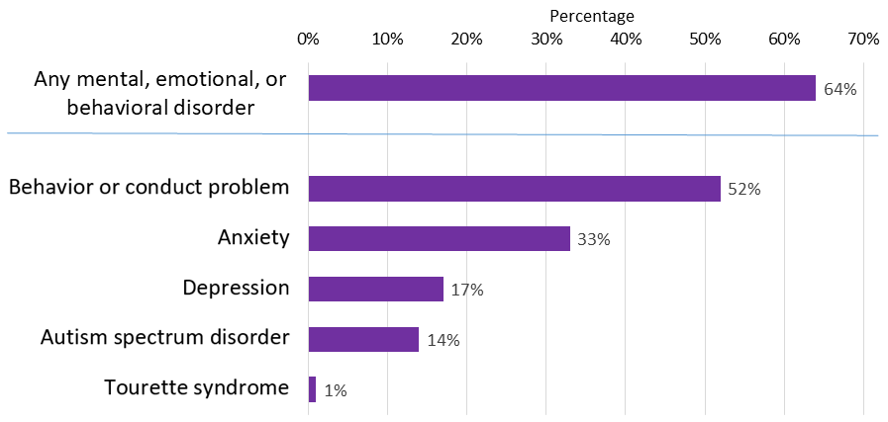
Attention Deficit Disorder with Hyperactivity (ADHD)
Most prevalent neurodevelopment disorder
11% in children^{[9]}
15.1% males, 6.7% females^{[9]}
4.4% in adults^{[9]}
5.4% males, 3.2% females^{[9]}
Approximately 1/3rd of children diagnosed with ADHD have significant symptoms as adults^{[8]}
CDC, ADHD diagnosis throughout the years: Estimates from published nationally representative survey data [9]
CDC, Percent of children with ADHD who had at least one other disorder [9]

Slide 3
Attention Deficit Disorder with Hyperactivity (ADHD)
ADHD predominantly hyperactive-impulsive presentation
ADHD combined presentation
ADHD predominantly inattentive presentation

Slide 4
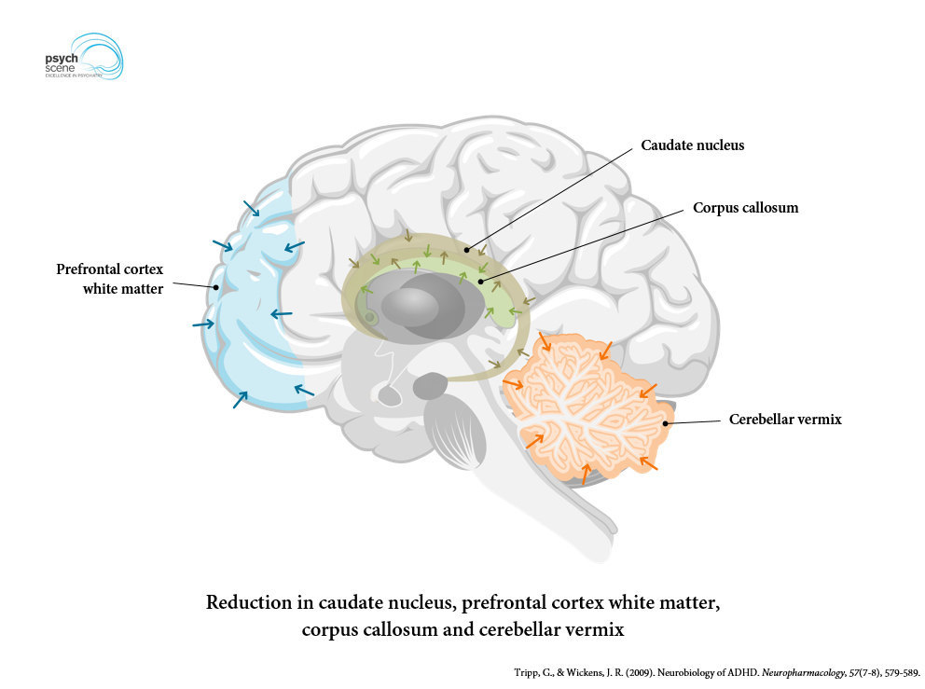
ADHD and Tryptophan Metabolism
Studies have shown that chronically low serotonin levels are implicated in ADHD
25% reduction in binding capacity of serotonin transporter in ADHD patients
Serotonin deficiency results in impulsive and hyperactive behavior
SSRIs have been shown to be clinically-effective in treating ADHD
People with ADHD have more dopamine receptors
Low serotonin levels can result in dopamine overproduction

Slide 5
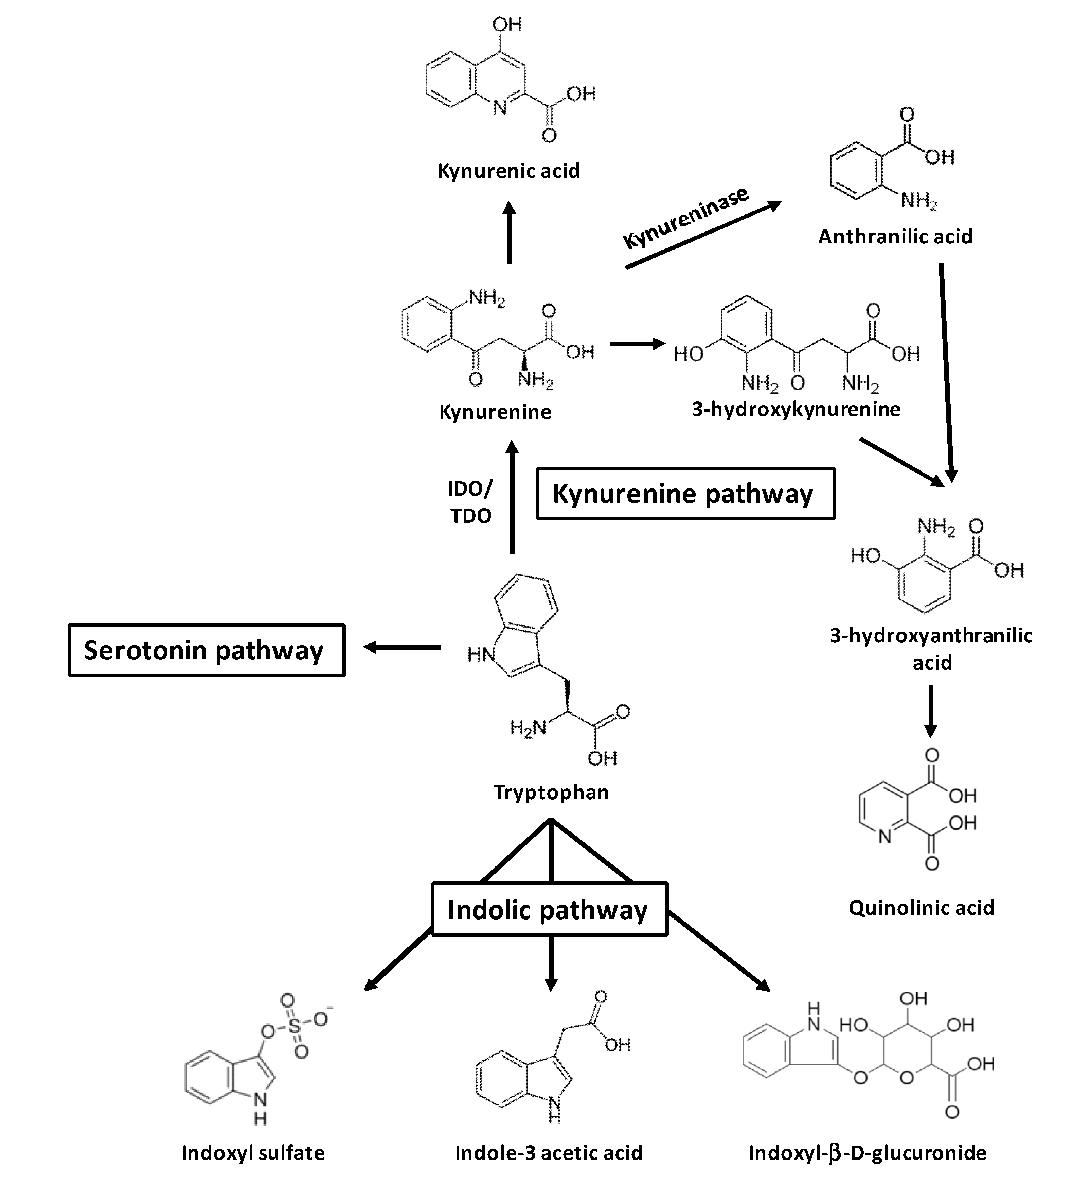
Tryptophan Metabolism and Gut Microbiome
Indole
Metabolites can directly influence tryptophan metabolism
Serotonin
Some commensal bacteria can promote serotonin synthesis
Kynurenine
controlled by immune responsive enzymes
microbes can initiate tryptophan metabolism by activating Toll-like receptors

Slide 6
Motivation/Hypothesis
Determine metabolites, microbes, and reactions that are potentially altered in an individual with an ADHD phenotype
Via gene-disease associations
Via analysis of microbiome samples
Via existing literature

Slide 7



Project ID: PRJEB11419
188 Valid Runs for ADHD
1,390 Valid Runs for Health
128 Filtered Runs for ADHD
990 Filtered Runs for Health
29 Filtered Runs for ADHD (single phenotype)
99 Filtered Runs for ADHD (multiple phenotypes)
990 Filtered Runs for Health
Selection Criteria
BMI: 18.5-30
Age: 20-69
1,250+ sequenced reads
QC status: good run
ADHD
343 species
113 genus
Health
354 species
99 genus
Random Sampling
Differentially abundant
< 0.05 p-value
76 species
29 genus
< 0.01 p-value
54 species
22 genus

Slide 8


Child attention deficit disorder, C0004269
Cognition Disorders, C0009241
Attention Deficit Disorder, C0041671
Attention Deficit and Disruptive Behavior Disorders, C0236964
Attention-Deficit/Hyperactivity Disorder Predominantly Inattentive Type, C0339002
Adult attention deficit hyperactivity disorder, C0865424
Attention deficit hyperactivity disorder, C1263846
ATTENTION DEFICIT-HYPERACTIVITY DISORDERSUSCEPTIBILITY TO7, C2751802
Attention deficit hyperactivity disorder: combined type, C2945552
Undifferentiated attention deficit disorder, C3665679
Attention Deficit Hyperactivity, C3844818
1,640 gene-disease associations
Literature Review
9 genes in Tryptophan Metabolism Pathway
KYNU
TDO2
ACAT1
CAT
MAOA
DDC
ALDH2
ASMT
TPH2

Slide 9
Qiime2: Alpha-diversity, Beta-diversity, Differential Abundance Testing
ADHD – single phenotype
4 Trials
ADHD – multiple phenotypes
4 Trials
Health
4 Trials
Health + ADHD (single phenotype) + ADHD (multiple phenotypes)
10 Trials

Slide 10
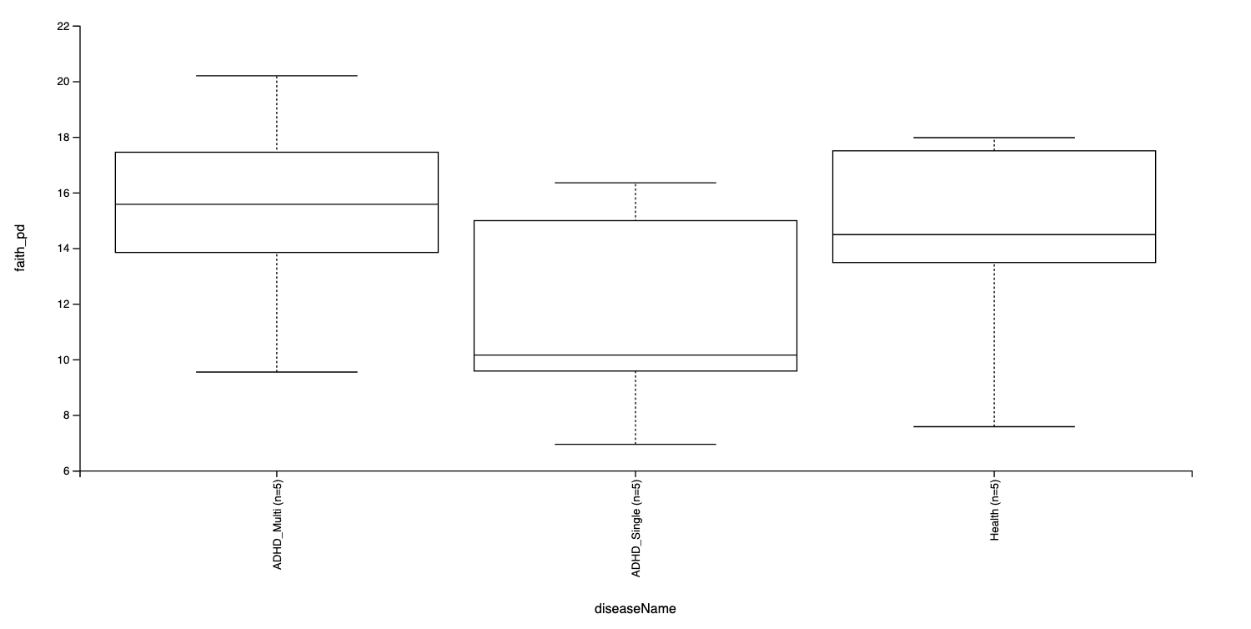
No differences between samples in terms of Shannon H diversity by phenotype
All p-values are greater than 0.05

Slide 11
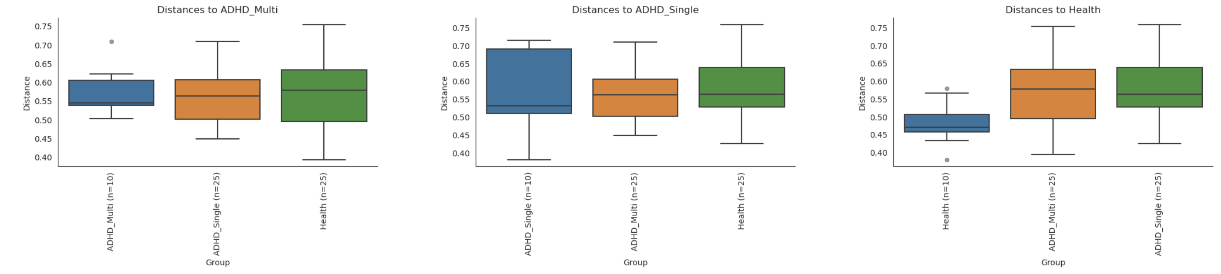
No differences between samples by phenotype via PERMANOVA test
All p-values and q-values are greater than 0.05

Slide 12
Analysis of Compositions of Microbiomes (ANCOM)
ADHD – single phenotype
No significant features found – All Trials
ADHD – multiple phenotypes
No significant features found – All Trials
Health
No significant features found – All Trials
Health + ADHD (single phenotype) + ADHD (multiple phenotypes)
3/10 Trials has significant features

Slide 13
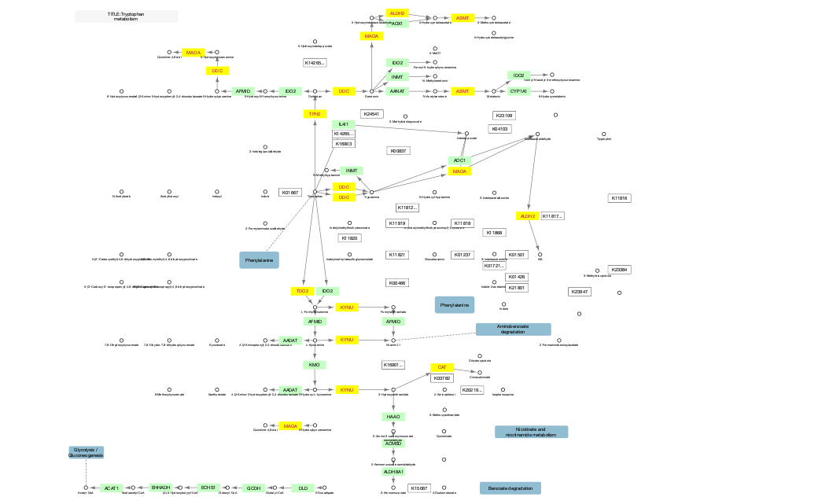
Genes
aldehyde dehydrogenase 2 family member (ALDH2)
acetylserotonin O-methyltransferase (ASMT)
catalase (CAT)
dopa decarboxylase (DDC)
kynureninase (KYNU)*
monoamine oxidase A (MAOA)
tryptophan hydroxylase 2 (TPH2)

Slide 14
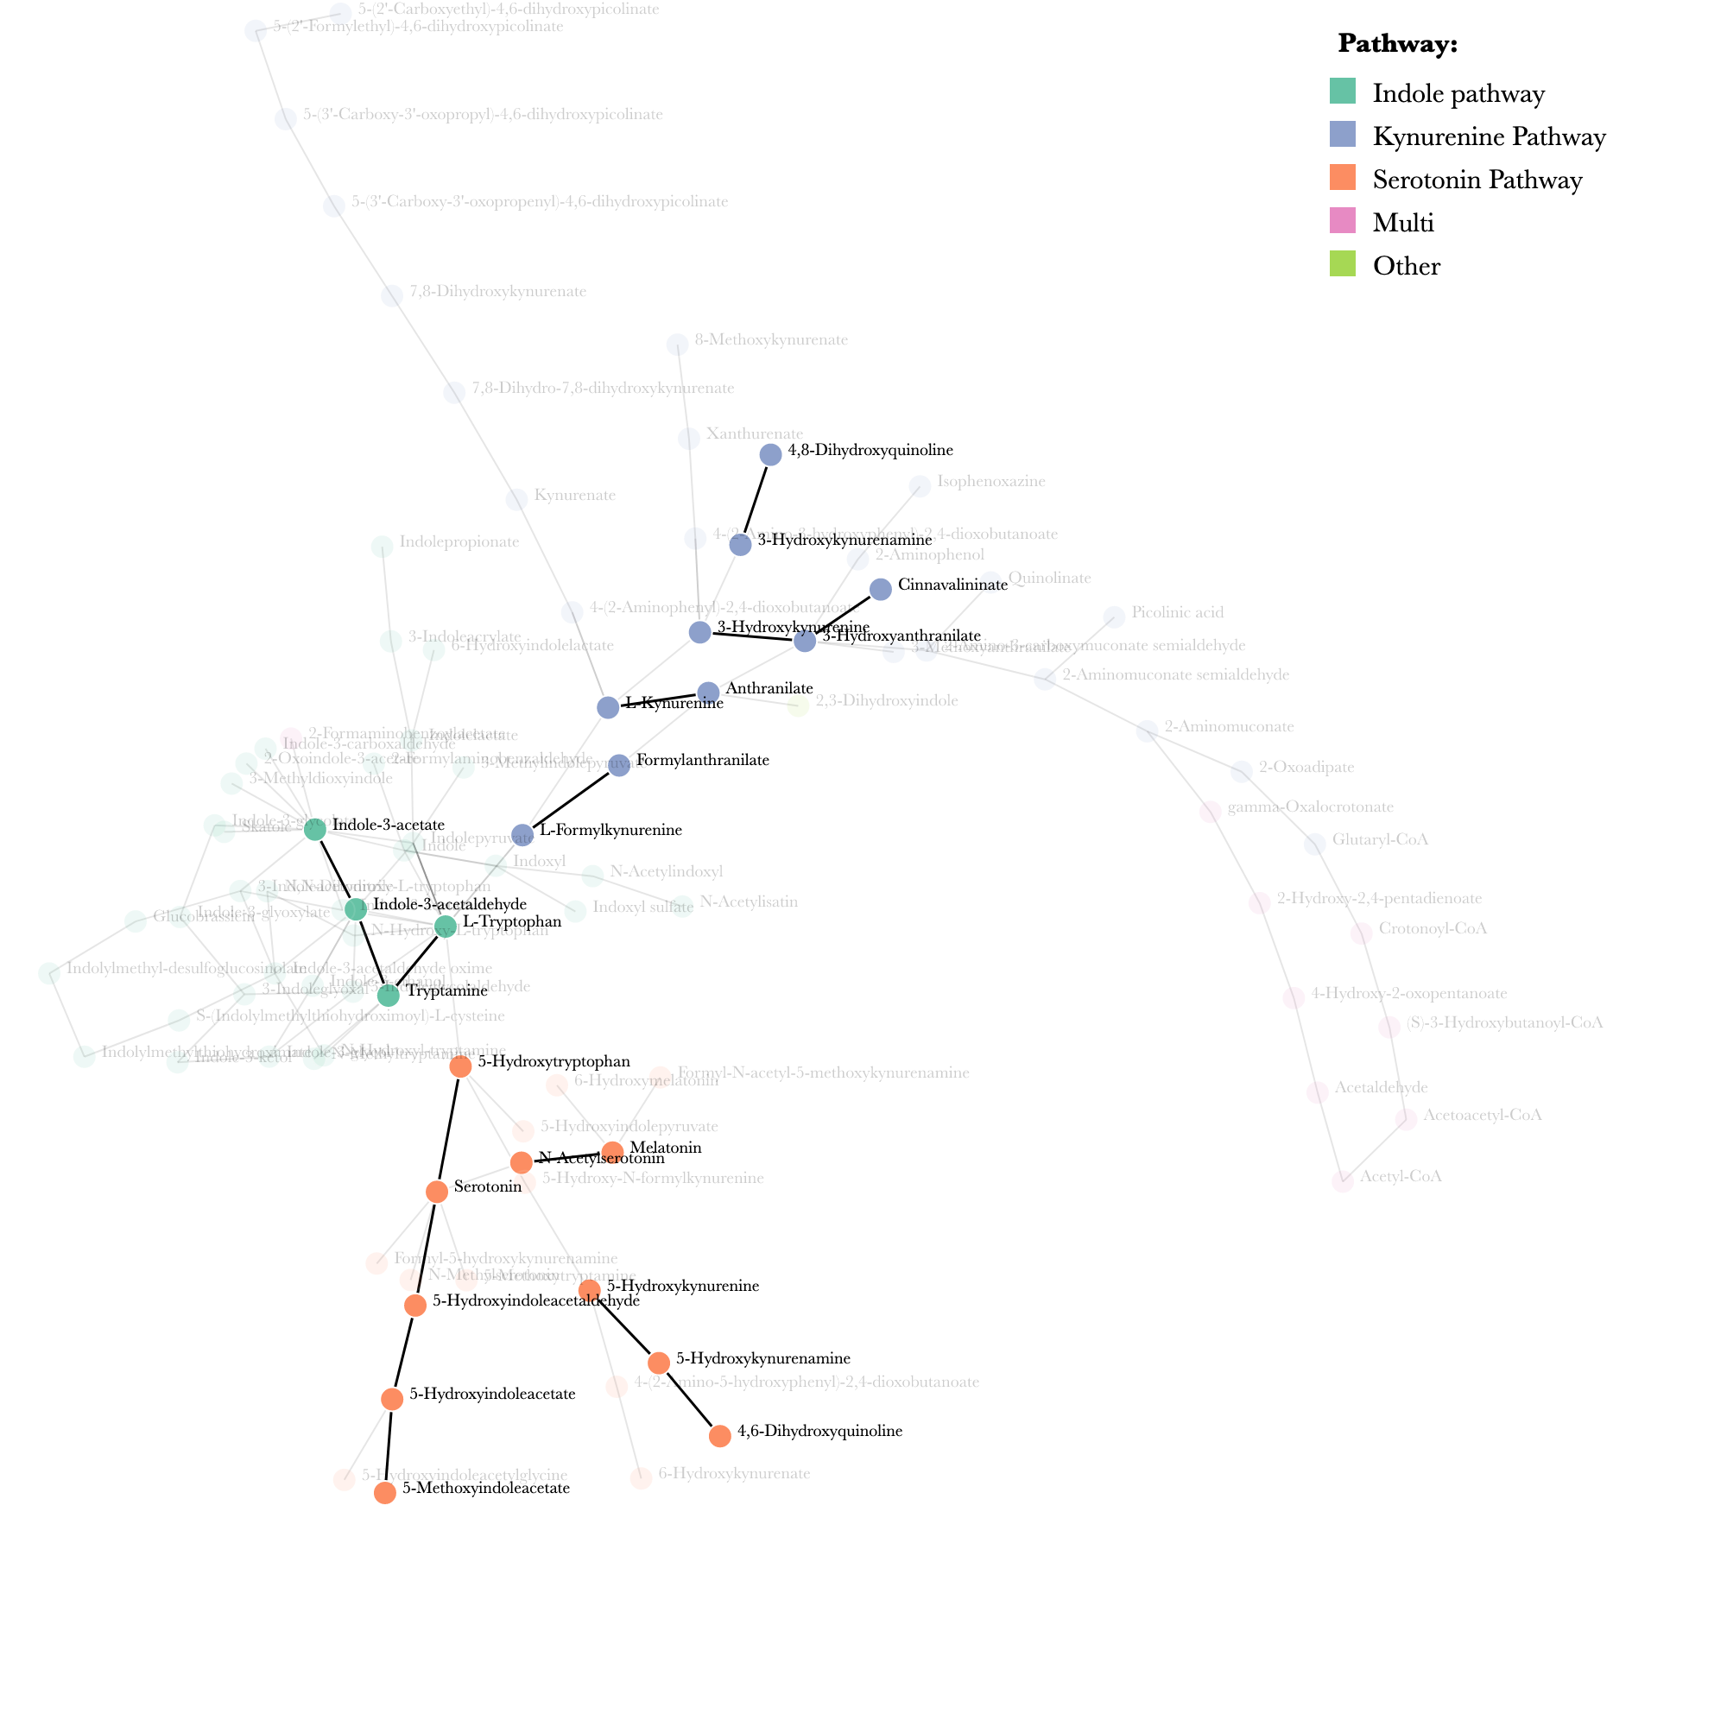
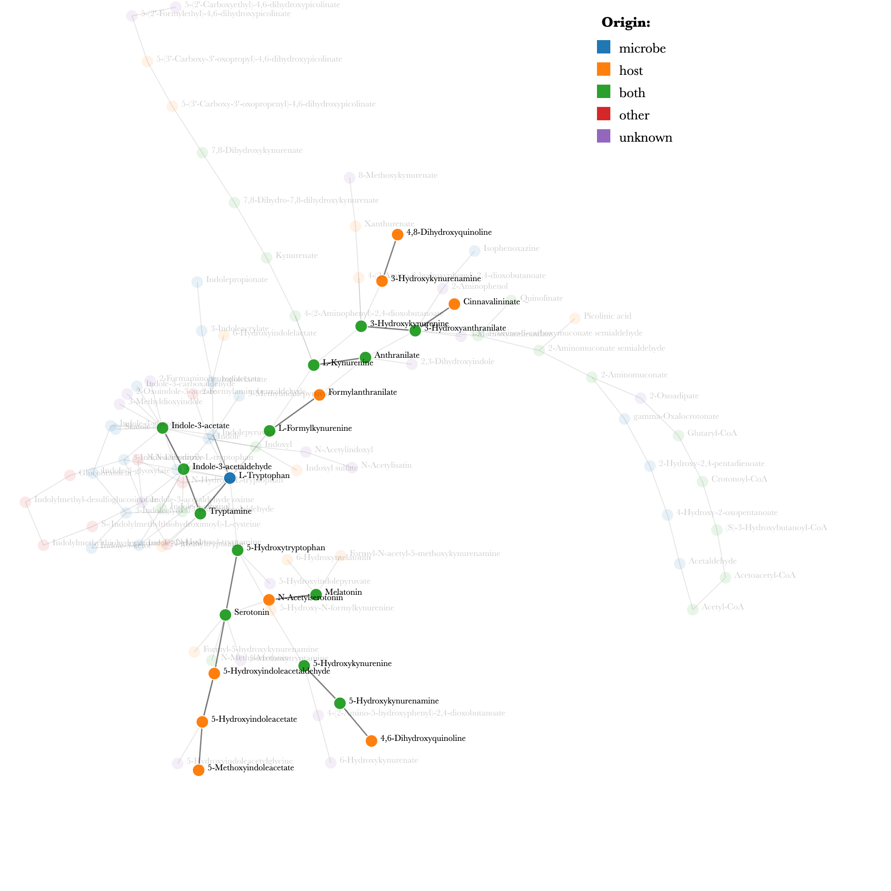
Tryptophan Metabolism Networks

Slide 15
Tryptophan Metabolism Networks
ALDH2
Serotonin Pathway: 5-Hydroxyindoleacetaldehyde, 5-Hydroxyindoleacetate
Indole Pathway: Indole-3-acetaldehyde, Indole-3-acetate
ASMT
Serotonin Pathway: N-Acetylserotonin, Melatonin
Serotonin Pathway: 5-Hydroxyindoleacetate, 5-Methoxyindoleacetate
CAT
Kynurenine Pathway: 3-Hydroxyanthranilate, Cinnavalininate
DDC
Indole Pathway: L-Tryptophan, Tryptamine
Serotonin Pathway: 5-Hydroxykynurenamine, 5-Hydroxykynurenine
Serotonin Pathway: 5-Hydroxy-L-tryptophan, Serotonin
KYNU
Kynurenine pathway: L-Formylkynurenine, Formylanthranilate
Kynurenine pathway: L-Kynurenine, Anthranilate
Kynurenine pathway: 3-Hydroxy-L-kynurenine, 3-Hydroxyanthranilate
MAOA
Kynurenine pathway: 3-Hydroxykynurenamine, 4,8-Dihydroxyquinoline
Indole pathway: Tryptamine, Indole-3-acetaldehyde
Serotonin Pathway: 5-Hydroxykynurenamine, 4,6-Dihydroxyquinoline
Serotonin Pathway: Serotonin, 5-Hydroxyindoleacetaldehyde

Slide 16
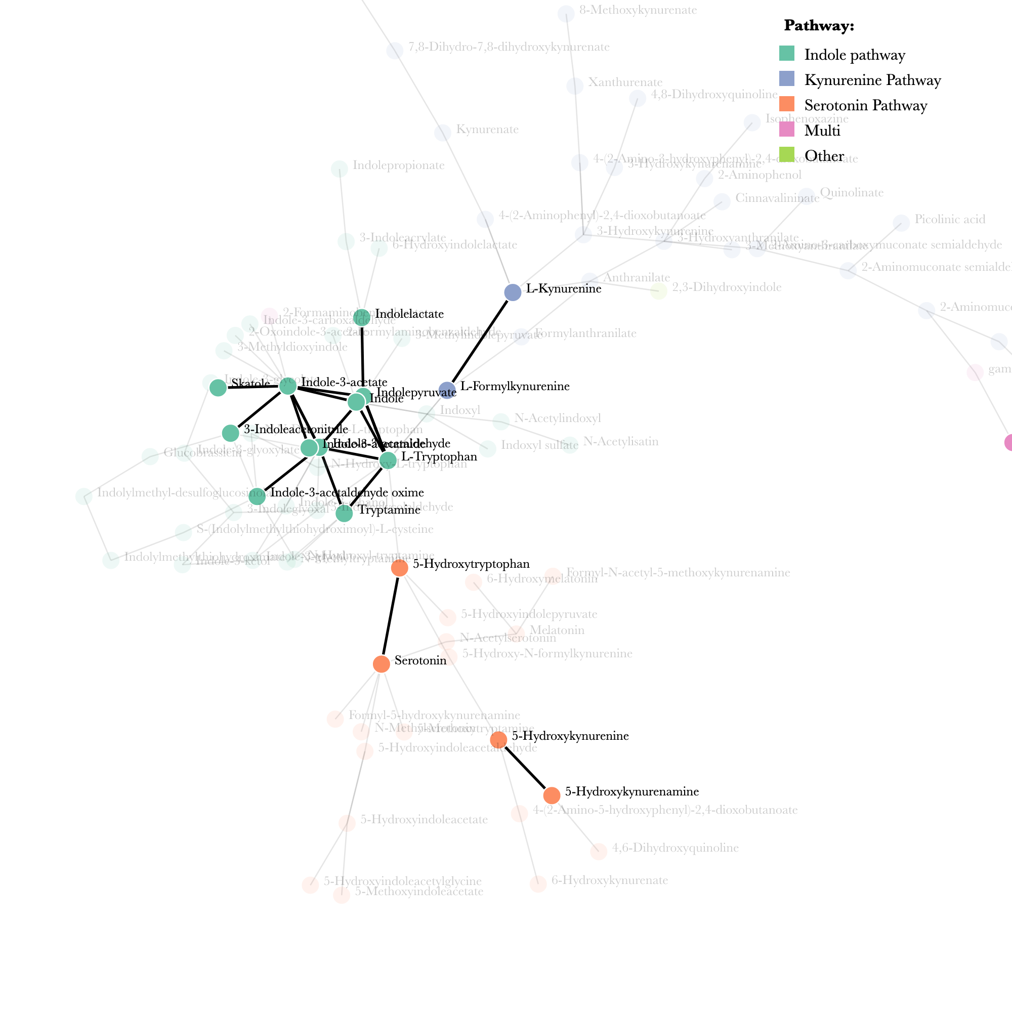
Over-expressed microbes in ADHD
Slackia (Indole, multi)
Holdemania (Indole, multi)
Thermus (Indole, Kynurenine, multi)
Citrobacter (ALL)
Bosea (Indole, Kynurenine, multi)
Dorea (Indole, multi)
Peptococcus (Indole, multi)
Erysipelatoclostridium (Indole, multi)
Holdemanella (Indole, multi)
Parabacteroides (Indole, multi)

Slide 17
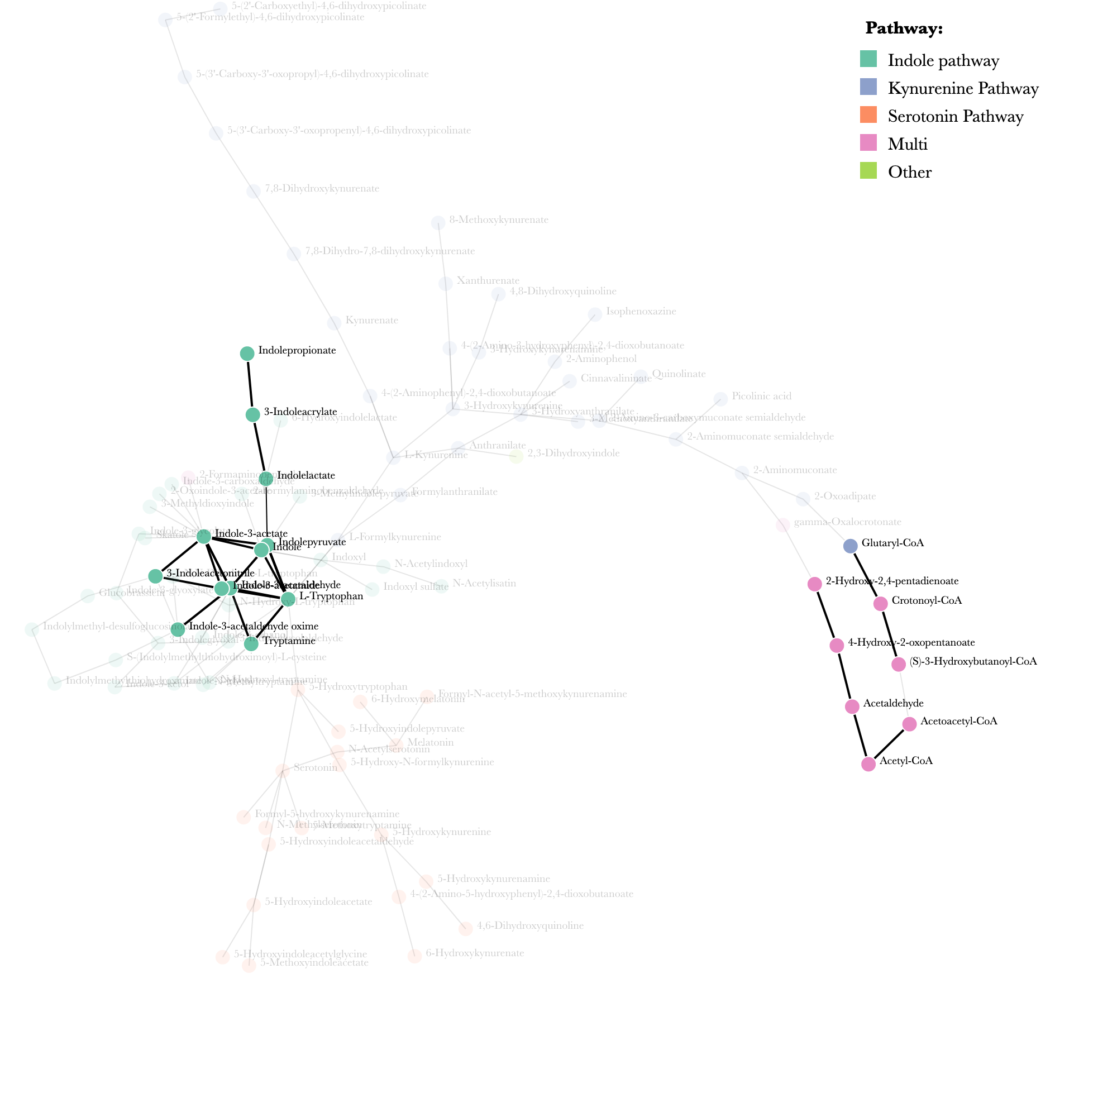
Under-expressed microbes in ADHD
Alistipes (Indole, multi)
Ruminococcus (Indole, Kynurenine, multi)
Dialister (Indole, multi)
Barnesiella (Indole)
Oscillibacter (Indole, multi)
Coprococcus (Indole, multi)
Acidaminococcus (Indole, multi)
Clostridium (Indole, Kynurenine, multi)
Mitsuokella (Indole, multi)
Sporobacter (Indole, multi)
Granulicatella (Indole, multi)
Christensenella (Indole, multi)
Saccharibacillus (Indole, multi)
Odoribacter (Indole, multi)
Butyricimonas (Indole, multi)
Dickeya (Indole, Kynurenine, multi)
Methanomassiliicoccus (Indole, multi)

Slide 18
Literature Review of Genes
MAOA promoter polymorphism are significantly greater in ADHD patients when compared to control patients^{[2]}
Decreased CAT activity is potentially associated with ADHD
Evidence is somewhat inconclusive
Lower CAT activity results in reduced resilience to oxidative stress^{[1]}
DDC and ASMT polymorphic variants increase risk of neuropsychiatric disorders^{[7]}
Included ADHD, autism spectrum disorder, Parkinson's disease, anxiety, schizophrenia

Slide 19
Literature Review of Genes
KYNU produces metabolites with immunomodulatory properties^{[6]}
Important regulator in Kynurenine pathway
Elevated expression may contribute to the pathogenesis of psoriasis
Various TPH2 polymorphisms have an influence on the serotonergic function^{[4]}
Increased risk of mood disorders
Altered response to antidepressant treatment
ALDH2 – Inactive copy decreases risk of Alcohol-Use disorder in males^{[3]}
ADHD prevalence was significantly higher in male alcoholics with inactive copy vs male alcoholics with active copy

Slide 20
Summary
Metabolites found in BOTH KEGG pathway analysis (27) and TrpNet prediction (37)
Melatonin
L-Formylkynurenine
Anthranilate
L-Kynurenine
5-Hydroxykynurenamine
Indole-3-acetaldehyde
Indole-3-acetate
Serotonin
Tryptamine
3-Hydroxyanthranilate
Genes affiliated with ADHD found in Tryptophan Metabolism
aldehyde dehydrogenase 2 family member (ALDH2)
acetylserotonin O-methyltransferase (ASMT)
catalase (CAT)
dopa decarboxylase (DDC)
kynureninase (KYNU)
monoamine oxidase A (MAOA)
tryptophan hydroxylase 2 (TPH2)

Slide 21
Summary
Kynurenine
Thermus
Citrobacter
Bosea
Ruminococcus
Clostridium
Dickeya
Serotonin
Citrobacter
Indole ONLY
Barnesiella
Indole/Multi
Slackia
Holdemania
Thermus
Citrobacter
Bosea
Dorea
Peptococcus
Erysipelatoclostridium
Holdemanella
Parabacteroides
Alistipes
Ruminococcus
Dialister
Oscillibacter
Coprococcus
Acidaminococcus
Clostridium
Mitsuokella
Sporobacter
Granulicatella
Christensenella
Saccharibacillus
Odoribacter
Butyricimonas
Dickeya
Methanomassiliicoccus

Slide 22
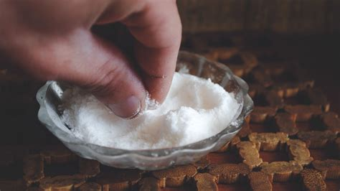
Summary
Kynurenine
Thermus
Citrobacter
Bosea
Ruminococcus
Clostridium
Dickeya
Serotonin
Citrobacter
Indole ONLY
Barnesiella
Indole/Multi
Slackia
Holdemania
Thermus
Citrobacter
Bosea
Dorea
Peptococcus
Erysipelatoclostridium
Holdemanella
Parabacteroides
Alistipes
Ruminococcus
Dialister
Oscillibacter
Coprococcus
Acidaminococcus
Clostridium
Mitsuokella
Sporobacter
Granulicatella
Christensenella
Saccharibacillus
Odoribacter
Butyricimonas
Dickeya
Methanomassiliicoccus

Slide 23
Avenues for future study
Repeat analysis with more robust dataset
Subtype, Severity, Treatment-type, Genetic markers
Explore sex differences
Treatment-naïve vs stimulant treatment vs non-stimulant treatment
Adults with ADHD diagnosed as children versus as adults

Slide 24

Questions?

Slide 25
Sources
[1] A. Naeini, S. Nasim, M. Najafi, M. Ghazvini, and A. Hassanzadeh, “Relationship between antioxidant status and attention deficit hyperactivity disorder among children,” International Journal of Preventive Medicine, vol. 10, no. 1, p. 41, 2019. doi:10.4103/ijpvm.ijpvm_80_18
[2] M. Das et al., “Maoa promoter polymorphism and attention deficit hyperactivity disorder (ADHD) in Indian Children,” American Journal of Medical Genetics Part B: Neuropsychiatric Genetics, vol. 141B, no. 6, pp. 637–642, 2006. doi:10.1002/ajmg.b.30385
[3] M. Itoh et al., “Influence of comorbid psychiatric disorders on the risk of development of alcohol dependence by genetic variations of ALDH2 and ADH1B,” Alcoholism: Clinical and Experimental Research, vol. 44, no. 11, pp. 2275–2282, 2020. doi:10.1111/acer.14450
[4] J. Waider, N. Araragi, L. Gutknecht, and K.-P. Lesch, “Tryptophan hydroxylase-2 (TPH2) in disorders of cognitive control and Emotion Regulation: A perspective,” Psychoneuroendocrinology, vol. 36, no. 3, pp. 393–405, 2011. doi:10.1016/j.psyneuen.2010.12.012
[5] M. Wang et al., “KYNURENINASE contributes to the pathogenesis of psoriasis through pro‐inflammatory effect,” Journal of Cellular Physiology, vol. 237, no. 1, pp. 1044–1056, 2021. doi:10.1002/jcp.30587
[6] P. Chaste et al., “Genetic variations of the melatonin pathway in patients with attention-deficit and hyperactivity disorders,” Journal of Pineal Research, vol. 51, no. 4, pp. 394–399, 2011. doi:10.1111/j.1600-079x.2011.00902.x
[7] P. V. Moskaleva, N. A. Shnayder, and R. F. Nasyrova, “Association of polymorphic variants of DDC (AADC), Aanat and ASMT genes encoding enzymes for melatonin synthesis with the higher risk of neuropsychiatric disorders,” Zhurnal nevrologii i psikhiatrii im. S.S. Korsakova, vol. 121, no. 5, p. 151, 2021. doi:10.17116/jnevro2021121041151
[8] “Attention-deficit/hyperactivity disorder (ADHD),” National Institute of Mental Health, https://www.nimh.nih.gov/health/statistics/attention-deficit-hyperactivity-disorder-adhd (accessed May 11, 2023).
[9] “Data and statistics about ADHD,” Centers for Disease Control and Prevention, https://www.cdc.gov/ncbddd/adhd/data.html (accessed May 11, 2023).
[10] A. Naeini, S. Nasim, M. Najafi, M. Ghazvini, and A. Hassanzadeh, “Relationship between antioxidant status and attention deficit hyperactivity disorder among children,” International Journal of Preventive Medicine, vol. 10, no. 1, p. 41, 2019. doi:10.4103/ijpvm.ijpvm_80_18
[11] T. P. Eicher and M. H. Mohajeri, “Overlapping mechanisms of action of brain-active bacteria and bacterial metabolites in the pathogenesis of common brain diseases,” Nutrients, vol. 14, no. 13, p. 2661, 2022. doi:10.3390/nu14132661
[12] D. Dai et al., “GMREPO V2: A curated human gut microbiome database with special focus on disease markers and cross-dataset comparison,” Nucleic Acids Research, vol. 50, no. D1, 2021. doi:10.1093/nar/gkab1019
[13] D. McDonald et al., “American Gut: An open platform for citizen science microbiome research,” mSystems, vol. 3, no. 3, May 2018. doi:10.1128/msystems.00031-18

