Slide 1

Title: Hotel Reservation Analysis.
Presented by: Edwin Owarume
Date: 10th March, 2024

Slide 2
Outline:
Introduction
Data Sources
Documentation of Cleaning and Manipulation
Summary of Data Analysis
Key Visualizations an Findings
Recommendations

Slide 3
Introduction:
The Bellwood Hotel founded in 1996 is devoted to providing top tier hospitality and comfort to its guests. It boasts of being one of the few 5-star hotels and lodgings within its province.
Business Task: Analyze the Bellwood Hotel data collected from 2017 to 2018 in order to gain insight into the performance rate of the hotel
Problem Statement: How can trends identified from hotel reservations impact the hotel’s operations?

Slide 4
Data Source
The Dataset was provided by the Bellwood Hotel
This data is deemed credible and is not made available to the public.
The dataset contains 12 columns which focus on Booking ID, no of adults, no of children, no of weekend nights, no of week nights, type of meal plan, room type reserved, lead time, arrival date, market segment type, average price per room and booking status.

Slide 5
Cleaning and Manipulation
I downloaded the dataset and stored it with an appropriate file name.
The data contained within was predominantly consistent and as such, much cleaning wasn’t required.
The dataset was then imported into SQL Server Management Studio.

Slide 6
Summary of Data Analysis
Summary analysis was carried out on the dataset and the following metrics were considered:
Total number of reservations in the dataset.
Total reservations and average number of nights spent by guests for each room type.
Most popular meal plans and room types.
The reservations made in the year 2018 and how many reservations per month.
Most common market segment reservation type and which market segments generates the highest average price per room.
The number of adults and children across all reservations.
The comparison between number of reservations on weekends and weekdays.

Slide 7
Summary Continuation
For easy representation of key measurable factors which contribute to the growth of the hotel, I used statements like the ‘WHERE’, ‘GROUP BY’, ‘SELECT’ and ‘LIKE’ statements to filter the dataset.
I also made use of functions such as ‘COUNT’, ‘AVG’ and ‘SUM’ .
I focused mainly on columns containing data related to customer preference such as:
Number of week nights,
Number of weekend nights,
Type of meal plan for each reservation made,
Average price per room,
Room type specified per reservation

Slide 8
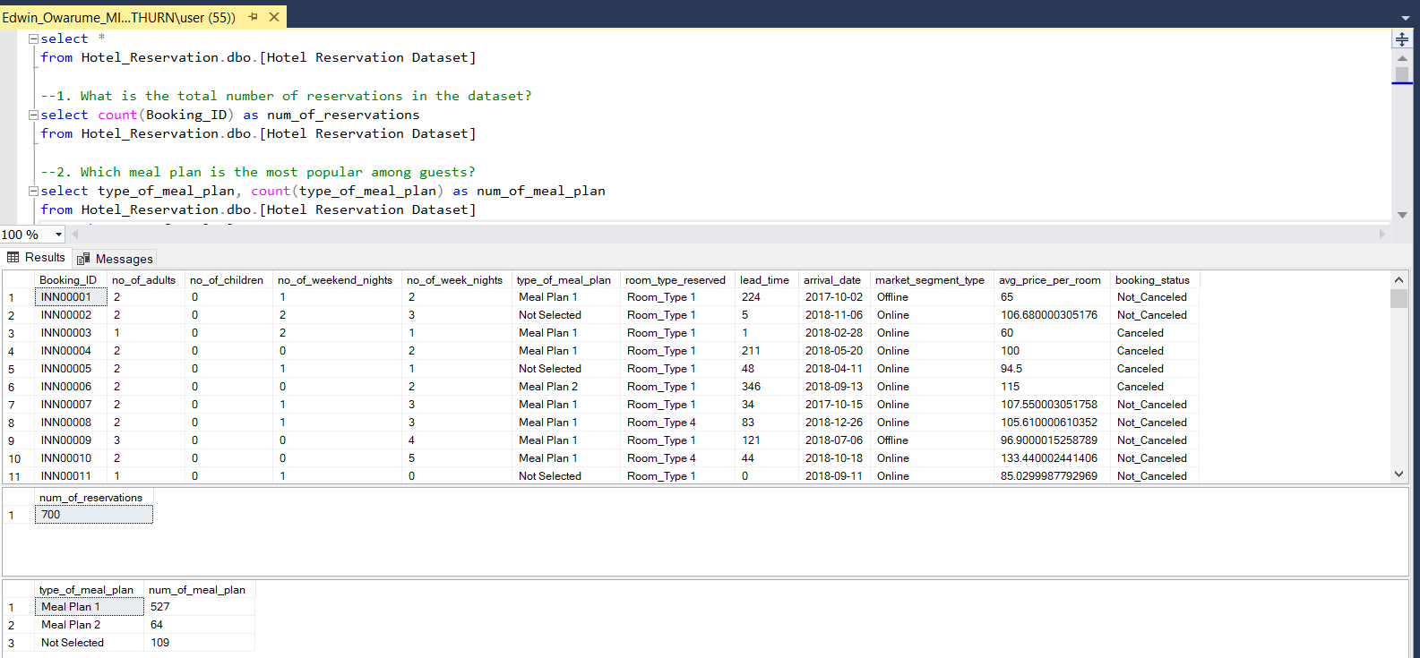
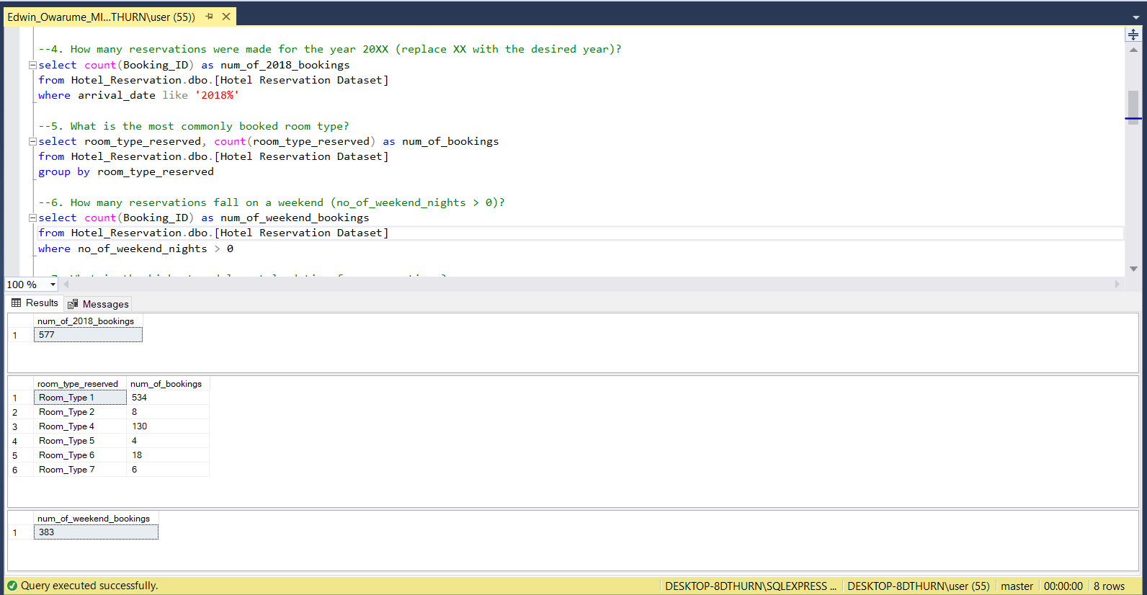
Key Visualizations and Findings
From the query made, I was able to identify:
the total number of reservations made from 2017 to 2018 as 700.
the preferred meal plan as ‘Meal Plan 1’.
This query was able to precisely identify:
the number of bookings in 2018 as 577.
the most popular room type booked as ‘Room Type 1’.
the total number of weekend bookings as 383.

Slide 9
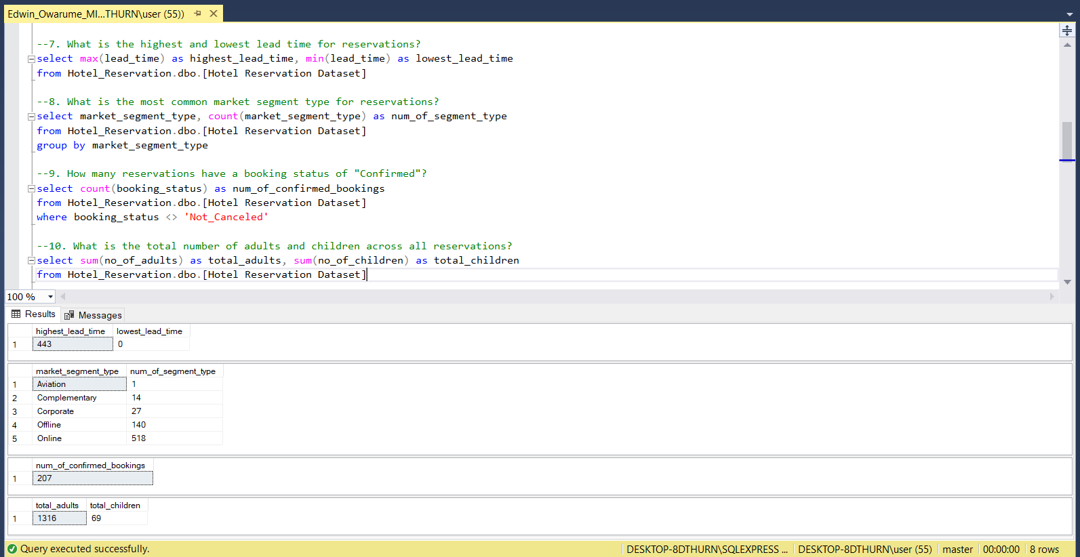
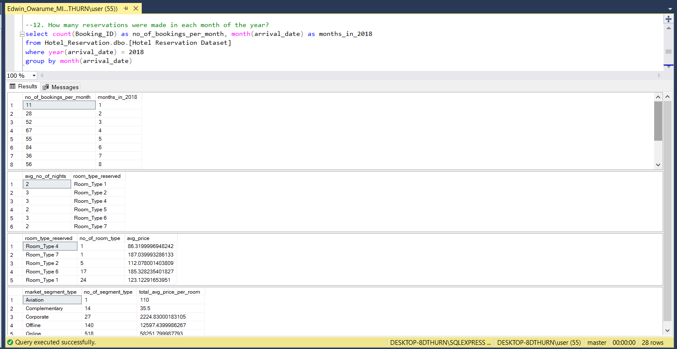
Key Visualizations and Findings continuation
The queries in this section accurately:
show the highest lead time as 443 and lowest as 0.
tell us that the most common market segment type for reservation is online.
identify the number of confirmed bookings as 207(I assumed ‘Not_canceled’ to mean confirmed).
display the total number of adults and children across all bookings.
This section clearly shows:
The number of bookings made in each month in 2018 with June(6) having the highest number of reservations of 84.
The average number of nights spent by guests for each room type with room types 3, 4 and 6 having the highest average.
The most common room type for reservations involving children and the average price for that room type.
The market segment that generates the highest average price per room is ‘online’.

Slide 10
Recommendations:
Identify the reason for meal plan 1 being the customer favorite and improve other meal plans
Gather customer feedback to identify the reasons for canceled reservations and provide countermeasures
Since the most common market segment is online, the hotel management should strive to improve its online presence and reach

