Slide 1

Title: Analysis Report of Agricultural Trends in India Presented by: Edwin Owarume Date: 18th March, 2024.

Slide 2
Outline
Introduction
Data Sources
Summary of Data Analysis
Key Visualizations and Findings
Recommendations

Slide 3
Introduction:
The importance of the Agricultural sector in any nation cannot be overemphasized as it forms the backbone of the importation and exportation products of many countries and as a result, greatly contributes to economic standing of nations as well.
Business Task: Perform an analysis on the agricultural trends of various crops in different states and districts in India from 1966 to 2017.
Problem Statement: Use the agricultural dataset provided to create interactive visualizations that uncover trends, patterns and disparities in agricultural practices which will enable stakeholders to make informed decisions for sustainable farming and resource allocation.

Slide 4
Data Source:
Source
Credibility
Overview
The data was provided to me by Mentorness.
The provided dataset is credible and is publicly accessible.
The dataset comprises of 80 columns which contain data about yield, production and area used for cultivating various crops including rice, maize, groundnut, sorghum, etc. as well as their numerical values across various years, districts and states.

Slide 5
Documentation of Cleaning and Manipulation.
The data was downloaded as a CSV file and saved with an appropriate name.
There were no inconsistencies or blanks within the data set and as such, cleaning was not required.
The data was then loaded into Power BI which was the preferred choice for visualizations.

Slide 6
Summary of Data Analysis
While carrying out this project, I focused on the following metrics:
The total production, yield and area used for the cultivation of rice, maize, minor pulses, fruits and vegetables.
The trends of increment or decrement in production and yield of major crops with respect to the area used for their cultivation from 1966 to 2017.
The disparities among the various states and districts contained within the dataset.
The primary function used during the course of this project was addition.

Slide 7
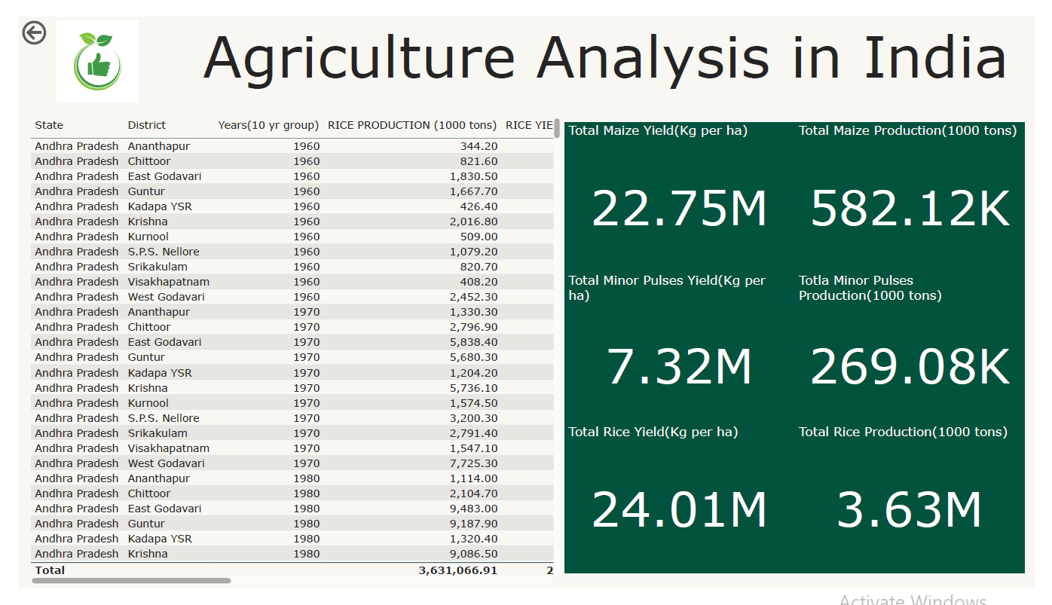
Key Visualizations and Findings

Slide 8
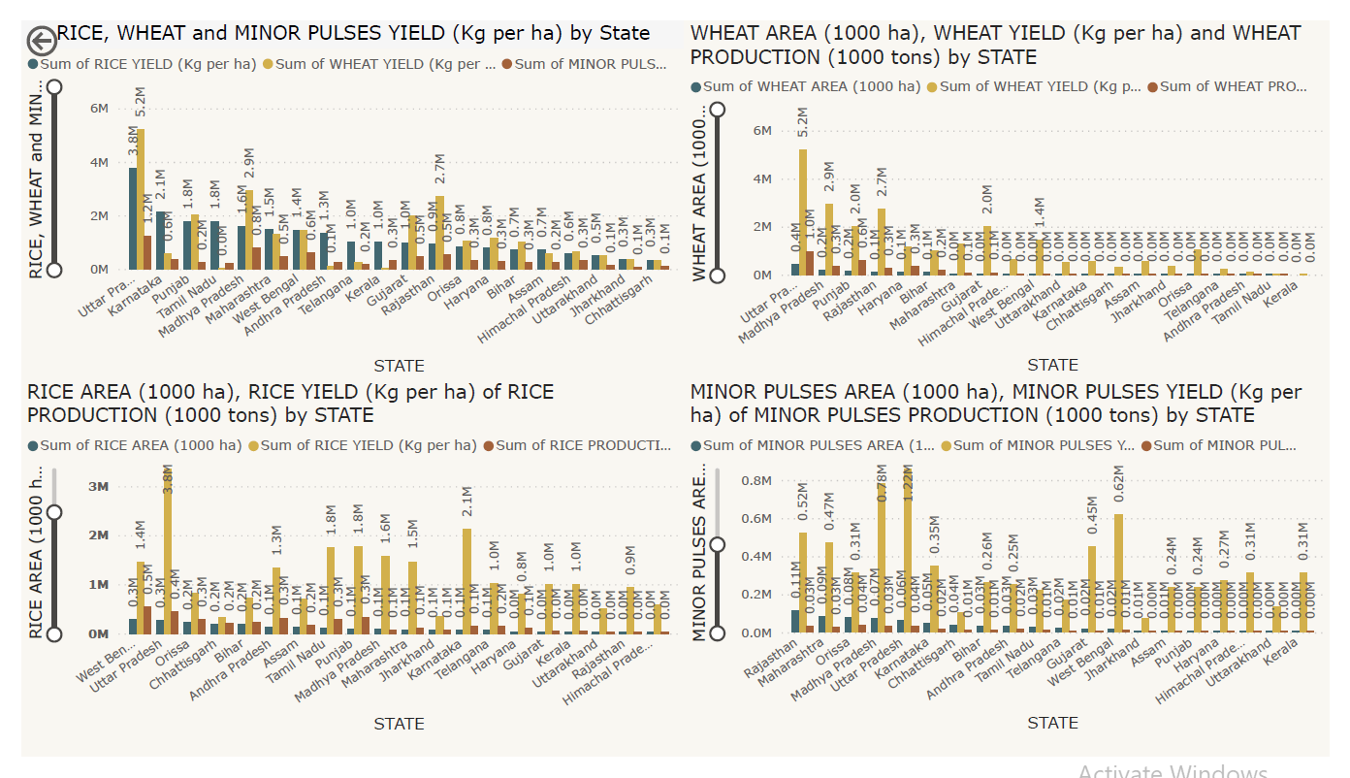
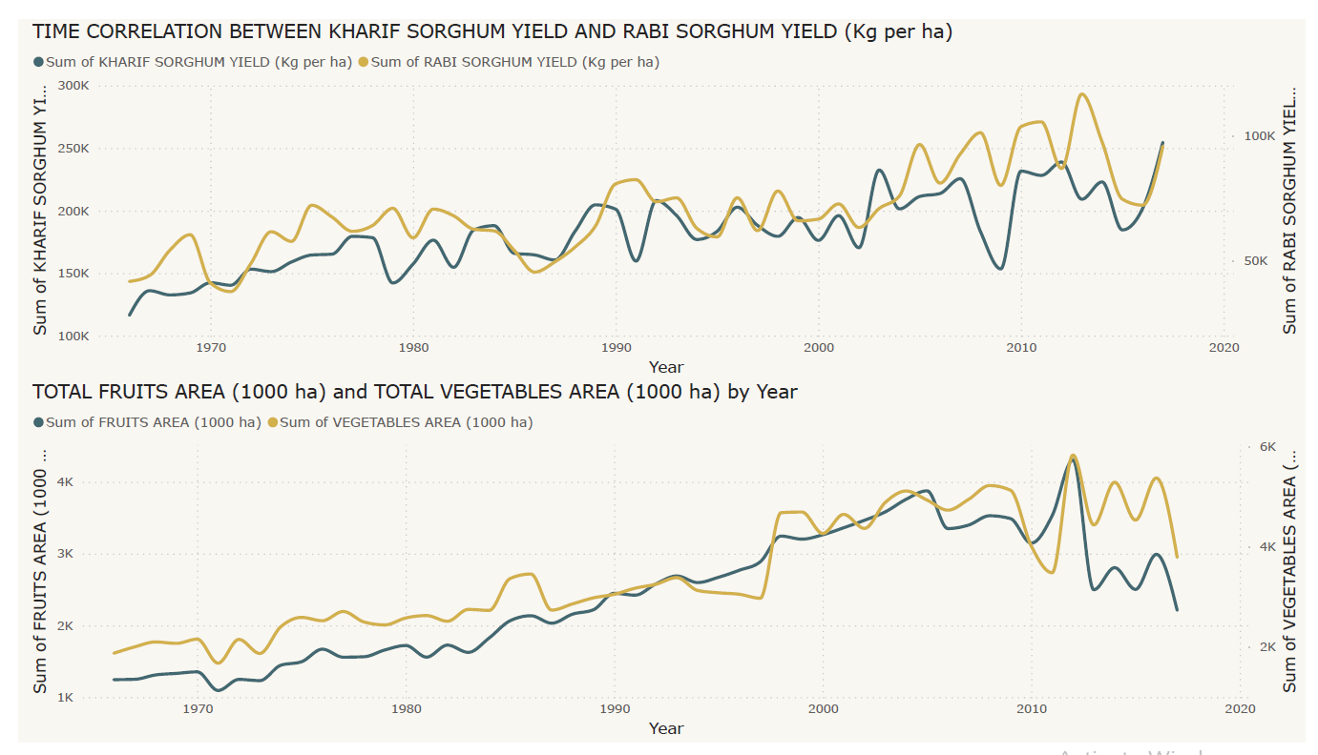
The charts above display the relative areas used for cultivation, yield and production of major crops like rice, wheat and pulses for the various Indian states included within this analysis with Uttar Pradesh having the highest yields in each case.
The charts above are line graphs representing the time-series analysis of Sorghum yields in Kharif and Rabi as well as the time-series analysis of the total area used for cultivation of fruits and vegetables showing a considerable decline in 2012/2013.

Slide 9
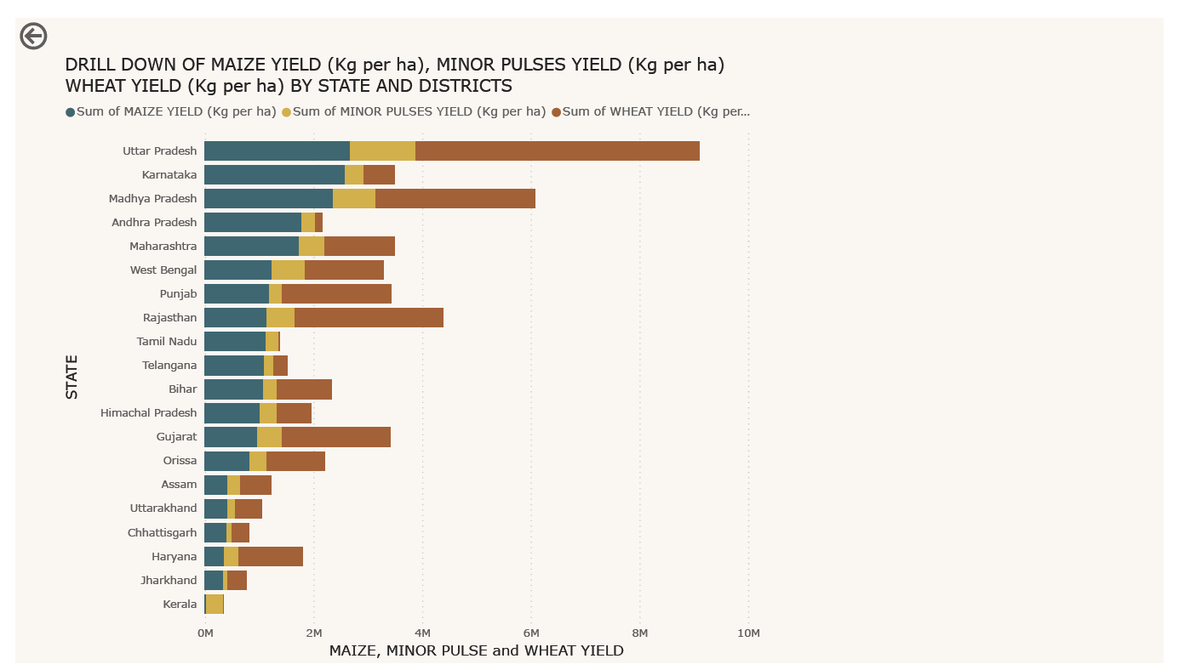
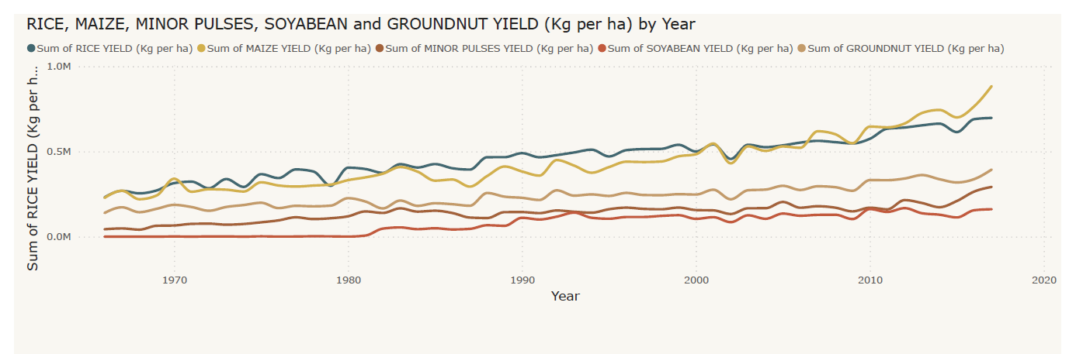
This chart depicts the total yields of maize, pulses and wheat across all states and districts within the states. From this graph, it’s evident that Uttar Pradesh is the leading producer of all three.
Here, I used Power BI to show the disparities among the yields of major crops from 1966 to 2017 with a drill-down of the performances of the different states. This chart shows a steady increase in yields of major crops over the years with maize moving from second most produced to first in 2007.

Slide 10
Seasonal Patterns and External Factors
Seasonal Patterns
Monsoon Season(June to September): This season accounts for the majority of the annual rainfall and is crucial for agriculture as it replenishes the moisture in the soil.
Winter Season(December to February): During this season, Rabi crops are grown(wheat, barley, pulses). The crops grown during this season depend greatly on the water stored during the Monsoon season and irrigation as well.
External Factors
Climate Change: Agricultural practices are highly susceptible to climate variability and change. Erratic climate conditions may lead to crop failures, reduced yields and loss of livelihoods for farmers.
Government Policies: Policies such as subsidies, price and trade regulations greatly affect the cultivation decisions of farmers. These policies could either hinder or aid agricultural development.
Summer Season(March to May): This season offers light showers of rainfall responsible for providing relief from the heat and preparing the soil for the coming Monsoon season.
Land Degradation and Water Scarcity: In order to combat these factors, sustainable land and water management practices are crucial to ensure long-term agricultural productivity.
Post-Monsoon Season(October to November): This season is crucial for harvesting crops which were grown during the Monsoon season such as rice, maize and cotton as it marks the end of the agricultural cycle for those crops.
Pests and Diseases: Outbreaks of pests and diseases are capable of destroying crops and as such, effective pest and diseases management are essential to safeguard agricultural production.

Slide 11
Recommendations
As a stakeholder, one should make proper investments towards pests and diseases management.
Policymakers should always take into account, the most favored crops in the market and strive to make policies which favor their production
Stakeholders should also take note of the various seasonal changes and make informed investments with regards to which crops the current season favors.

