Slide 1
Eduardo Carrascosa

Slide 2
Business Rules
Each course must be taught by only one professor but a professor may teach more than one course
Each course must only use one book
Each course must have an assigned classroom
Assumed that Instructors have NETID’s
Added a Grade attribute
Added an ISBN attribute
Courses include 2018 and 2019 courses both in progress and completed

Slide 3
Converting First Normal form (1nf) to Second Normal Form (2NF)
Full Dependency
NetID | Student Name | Major | Grad Date | Course Number | Course Name | Credit Hours | Classroom | ISBN | Book Name | Publisher | Instructors ID | Instructors Name | Instructors Office | Grade
Partial dependency
Partial dependency
NetID | Course Number | Grade
NetID, Course# → Grade (3NF)
Course# → CourseName, CreditHours, Classroom, ISBN, BookName, Publisher, InstructorsName, InstructorsOffice (2NF)
Course Number | Course Name | Credit Hours | Classroom | ISBN | Book Name | Publisher | Instructors ID | Instructors Name | Instructors Office
NetID | Student Name | Major | Grad Date
NetID → StudentName, Major, GradDate (3NF)

Slide 4
Removing Transitive Dependencies
Course Number | Course Name | Credit Hours | Classroom | ISBN | Book Name | Publisher | Instructors ID | Instructors Name | Instructors Office
Transitive dependencies
Course Number | Course Name | Credit Hours | Classroom | ISBN | Instructors ID
COURSE (3NF)
Instructors ID | Instructors Name | Instructors Classroom
INSTRUCTOR (3NF)
ISBN | Book Name | Publisher
BOOK (3NF)

Slide 5
RELATIONS IN 3NF
Course Number | Course Name | Credit Hours | Classroom | ISBN | Instructors ID
COURSE (3NF)
GRADE (3NF)
NetID | Course Number | Grade
ISBN | Book Name | Publisher
BOOK (3NF)
Instructors ID | Instructors Name | Instructors Office
INSTRUCTOR (3NF)
NetID | Student Name | Major | Grad Date
STUDENT (3NF)

Slide 6
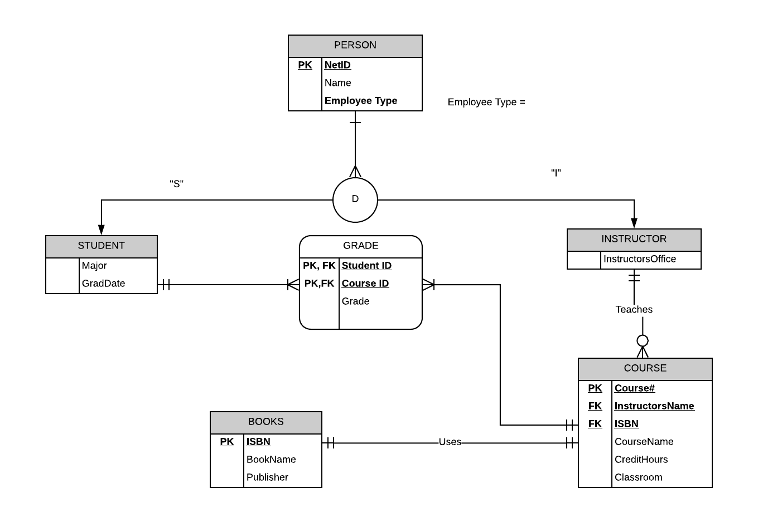
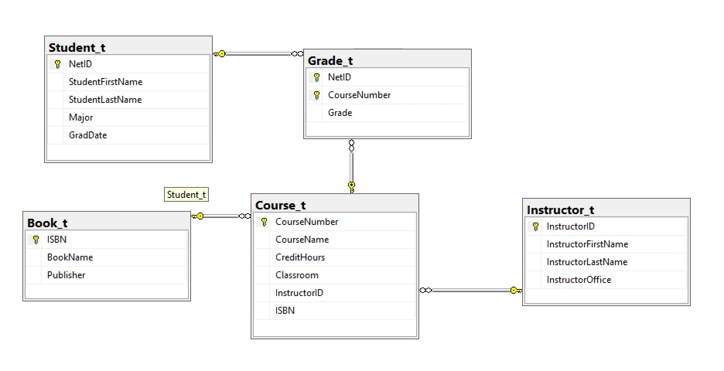
Relational Diagram

Slide 7
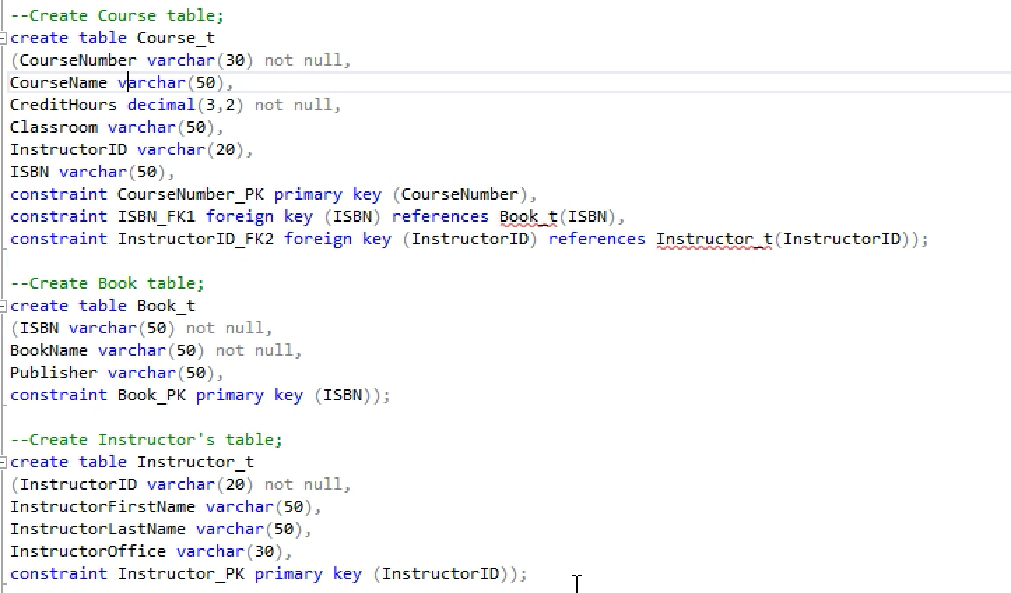
Physical Design (SCHEMA PART I)

Slide 8
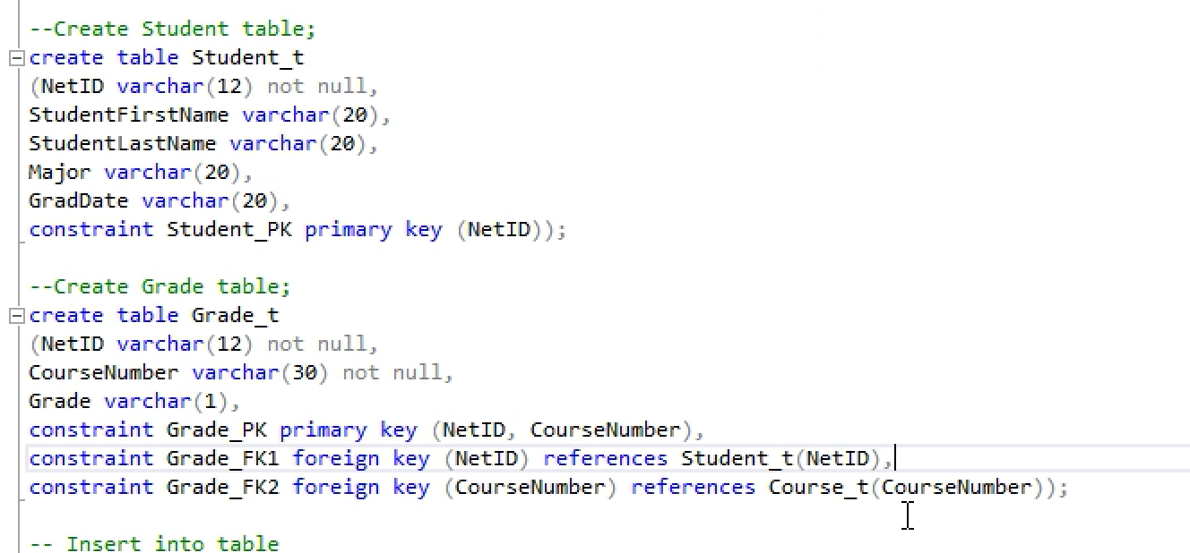
Physical Design (SCHEMA PART II)

Slide 9
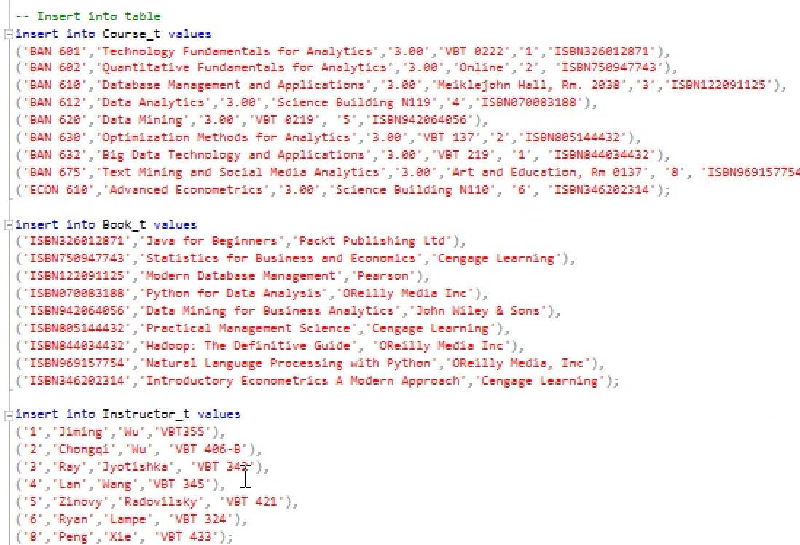
Content (part one)

Slide 10
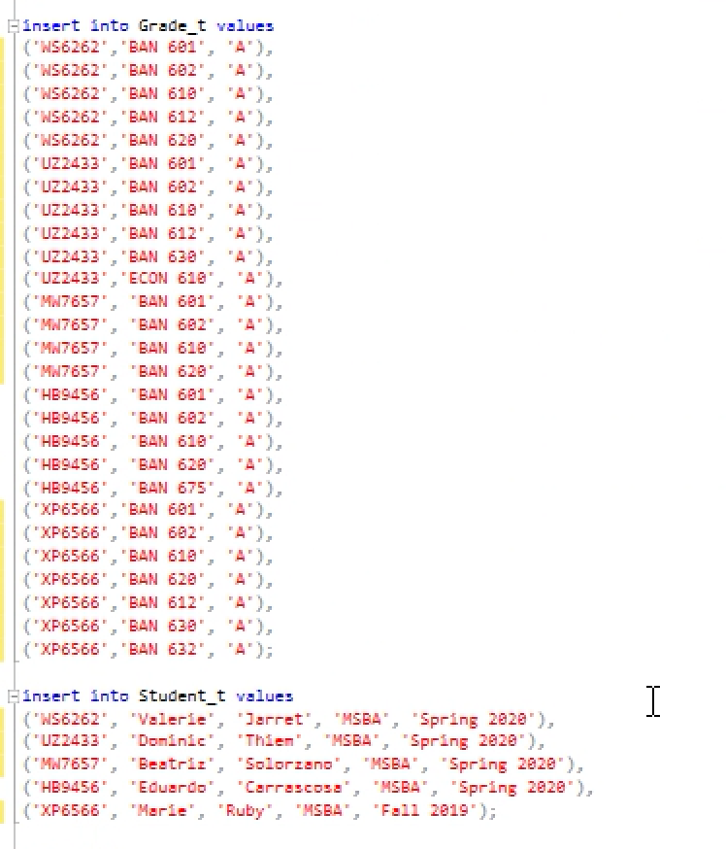
Content (part two)

Slide 11
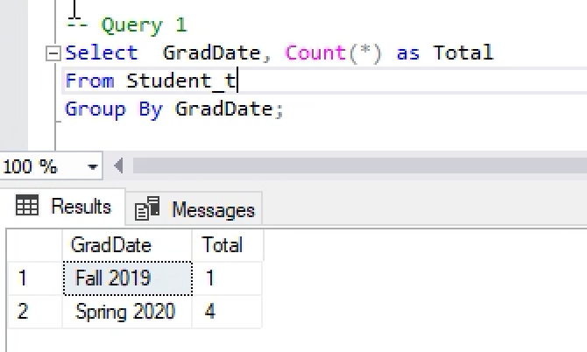
Query1:Count the number of students who are graduating in the same semester

Slide 12
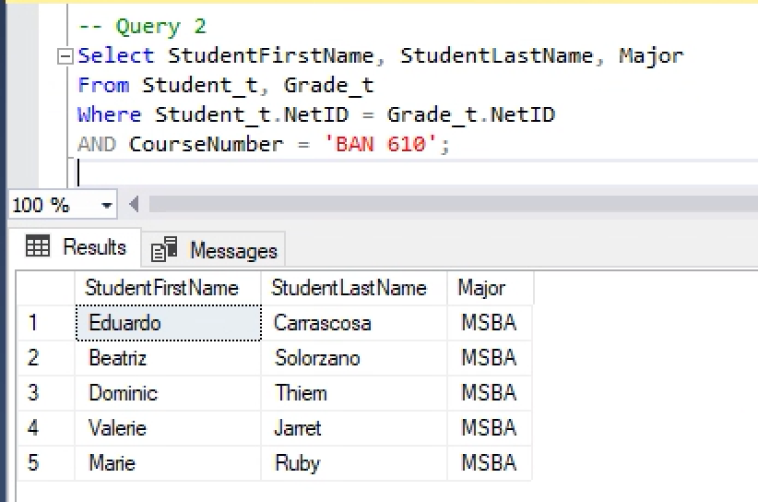
Query 2: Display the students name and major who have taken BAN 610

Slide 13
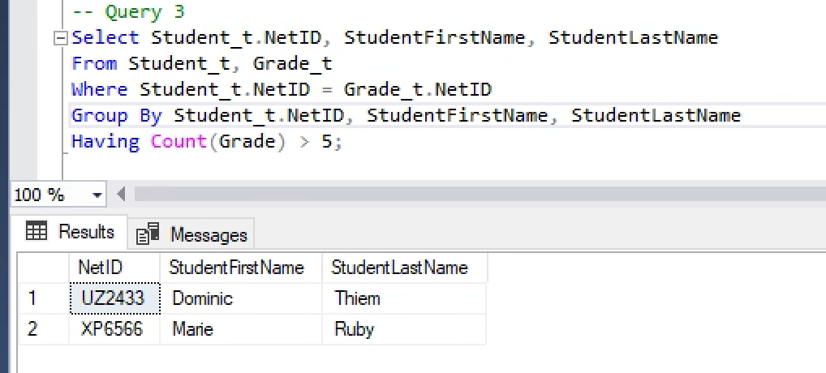
Query 3: Display the NetID and student name of the students who have taken more than 5 courses

Slide 14
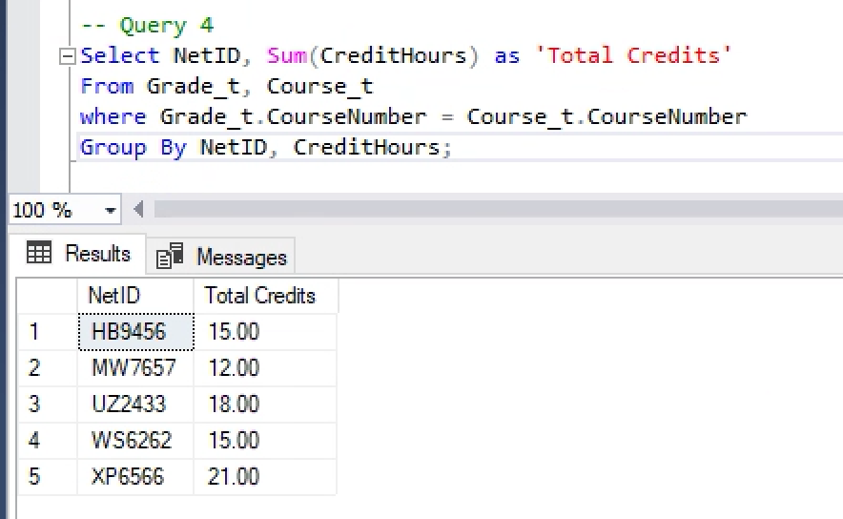
Query 4: Display the NetID and the total credit hours taken by each student in 2018

Slide 15
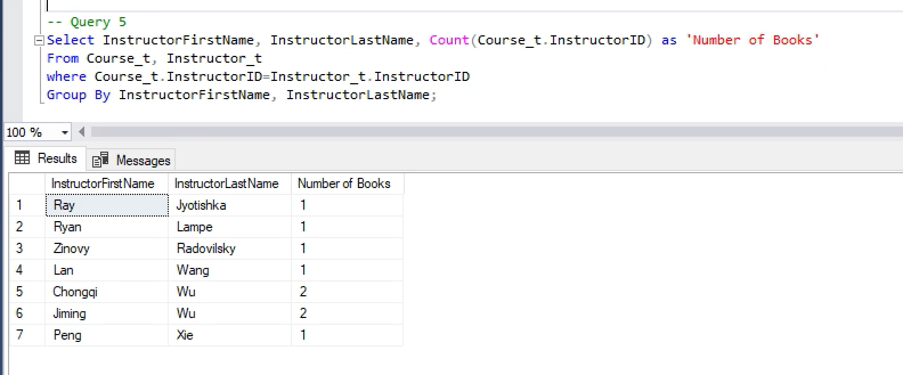
Query 5: Display the instructors name and the number of course books prescribed by each instructor

