Slide 1
Natural Language Processing
Prof. Prashant Rai
VP - Data Science, Pull Logic
pkrai.iitk@wilp.bits-pilani.ac.in

Slide 2
Session 1
These slides are prepared by the instructor, with grateful acknowledgement of James Allen and many others who made their course materials freely available online.

Slide 3
Session Content
Objective of course
What will we learn in this course?
Text books and Reference books
Evaluation Plan
What is Natural Language Processing?
Application areas of Natural Language Processing
Introduction to Natural Language Processing

Slide 4

Objective of course
To Identify and recall fundamental concepts and techniques in Natural Language Processing (NLP).
To Explain the computational properties of natural languages and articulate the algorithms commonly utilized for processing linguistic information.
To Apply basic mathematical models and methods in NLP applications to solve problems and perform tasks.
To Examine research and development efforts in Natural Language Processing to discern trends, challenges, and opportunities.
20
BITS Pilani, Pilani Campus
Notes:
The core objective of a Natural Language Processing (NLP) course is to teach you how to make computers understand and generate human language.

Slide 5
What you will learn in this course
Vector Semantics
Word Embedding
Language Modelling
N-gram language modeling
Neural Language Models
Introduction to LLM and Prompt Engineering
Part-of-Speech Tagging
Parsing
Encoder-Decoder Models, Attention and Contextual Embedding's, BERT
Word sense disambiguation
Semantic web ontology and knowledge Graphs
Retrieval Augmented Generation (RAG)
Notes:
Word Embedding (Ex:"King" is to "Queen" as "Man" is to "Woman")-Word2Vec model
Vector semantics is the study of meaning of words as vector, Count based- TF-IDF,
N-gram is a sequence of N words. Easy to understand, but Doesn’t capture long-term context (only looks at recent words)
LLM is type of neural network model trained on vast amounts of text data to understand and generate human-like language.
Neural Language Models (NLMs) are a modern approach to predicting and generating text using neural networks, particularly deep learning
BERT (Bidirectional Encoder Representations from Transformers)- 2018
Encoder-compress its information into a fixed-length vector called the context vector. Decoder:To generate the output sequence, one element at a time.
Word Sense Disambiguation: correct meaning (sense) of a word in a given context.
Knowledge Graph- consists of Node, Edge and Labels
RAG enables LLMs to access and incorporate information from external knowledge sources in real-time to generate more accurate, relevant, and contextually appropriate responses

Slide 6
Text books and Reference books
T1 | Jurafsky and Martin, SPEECH and LANGUAGE PROCESSING: An Introduction to Natural Language Processing, Computational Linguistics, and Speech Recognition, McGraw Hill
T2 | Manning and Schütze, Foundations of Statistical Natural Language Processing, MIT Press. Cambridge, MA
R1 | Allen James, Natural Language Understanding
R2 | Neural Machine Translation by Philipp Koehn
R3 | Semantic Web Primer (Information Systems) By Antoniou, Grigoris; Van Harmelen, Frank

Slide 7
Evaluation Plan
Name | Weight
Quiz (best 2 out of 3) | 10%
Assignment 1 and 2 | 20%
Mid-term Exam | 30%
End Semester Exam | 40%

Slide 8
What is Natural Language Processing?
Analyze, understand and generate human languages just like humans do.
To explain linguistic theories, to use the theories to build systems that can be of social use..
Started off as a branch of Artificial Intelligence..
Borrows from Linguistics, Psycholinguistics, Cognitive Science & Statistics.
Make computers learn our language rather than we learn theirs.
Notes:
field of Artificial Intelligence (AI) that focuses enabling computers to understand, interpret, generate, and interact using human language

Slide 9
Why Study NLP?
A hallmark of human intelligence.
Text is the largest repository of human knowledge and is growing quickly.
emails, news articles, web pages, IM, scientific articles, insurance claims, customer complaint letters, transcripts of phone calls, technical documents, government documents, patent portfolios, court decisions, contracts, ……
The Natural Language Processing (NLP) Market size to grow from USD 15.7 billion in 2022 to USD 49.4 billion by 2027, at a Compound Annual Growth Rate (CAGR) of 25.7% during the forecast period.
Notes:
Human language is the largest source of complex, unstructured data in the world (emails, social media, articles, customer reviews, legal documents, etc.). Studying NLP equips you with the tools to process this massive data deluge.
NLP is the foundation for Large Language Models (LLMs) like Gemini, ChatGPT, and others. Studying NLP gives you a deep understanding of how these systems are trained, how they work (e.g., using Transformers), and how to fine-tune them. Voice assistants like Siri, Alexa, and Google Assistant rely on NLP for speech recognition (converting voice to text) and natural language understanding (interpreting the intent). Services like Google Translate use advanced NLP models to translate languages accurately while preserving context and meaning.

Slide 10
Why are language technologies needed?
Many companies make a lot of money if they could use computer programmes that understood text or speech.
answering the phone, and replying to a question
understanding the text on a Web page to decide who it might be of interest to
translating a daily newspaper from Japanese to English
understanding text in journals / books and building an expert systems based on that understanding

Slide 11
Dreams or reality??
Will my computer talk to me like another human ??
Will the search engine get me exactly what I am looking for??
Can my PC read the whole newspaper and tell me the important news only..??
Can my palmtop translate what that Japanese lady is telling me.. ??
Ahhh.. Can my PC do my NLP assignments ??
Do you know how our brain processes language ??

Slide 12
Where does it fit in the CS taxonomy?
Computers
Databases
Artificial Intelligence
Algorithms
Networking
Robotics
Natural Language Processing
Search
Information
Retrieval
Machine
Translation
Language
Analysis
Semantics
Parsing
Notes:
Parsing: syntactic analysis, is the process of analyzing a string of symbols
Semantics: study of meaning in language

Slide 13
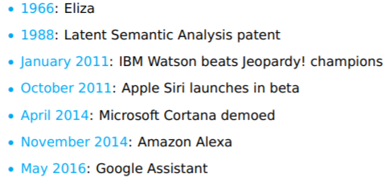
Brief history of NLP
2020 – Conversational Agents
Notes:
Eliza: One of the first NLP chatbots, mimicked a therapist. It simulated human conversation, specifically a Rogerian psychotherapist, using simple pattern matching and substitution rules,

Slide 14
Introduction to Natural Language Processing
The Study of Language.
Applications of Natural Language Understanding.
Evaluating Language Understanding Systems.
The Different Levels of Language Analysis.
Representations and Understanding.
The Organization of Natural Language Processing Systems.
Notes:
Study of language: How do words form phrases and sentences? What constrains the possible meanings for a sentence?

Slide 15
The study of language
Discipline | Typical Problems | Tools
Linguists | How do words form phrases and sentences? What constrains the possible meanings for a sentence? | Intuitions about well-formedness and meaning; mathematical models of structure and meaning
Psycholinguists | How do people identify the structure of sentences? How are word and text meanings identified? | Experimental techniques based on measuring human performance; statistical analysis of observations
Philosophers | What is meaning, and how do words and sentences acquire it? How do words identify objects in the world? | Natural language argumentation using intuition about counter-examples; mathematical models (for example, logic and model theory)
Computational Linguists | How is the structure of sentences identified? How can knowledge and reasoning be modeled? How can language be used to accomplish specific tasks? | Algorithms, data structures; formal models of representation and reasoning; AI techniques (search and representation methods)

Slide 16
Dave: Open the pod bay doors, HAL.
HAL: I am sorry, Dave. I am afraid I can’t do that.
Dave: What’s the problem.
HAL: I think you know what the problem is just as well as I do.
Dave: I don’t know what you’re talking about.
HAL: I know that you and Frank were planning to disconnect
me, and I’m afraid that’s something I cannot allow to happen.
General speech and language understanding and generation capabilities
Politeness: emotional intelligence
Self-awareness: a model of self, including goals and plans
Belief ascription: modeling others; reasoning about their
goals and plans

Slide 17
Hal: I can tell from the tone of your voice, Dave, that you’re upset.
Why don’t you take a stress pill and get some rest.
[Dave has just drawn another sketch of Dr. Hunter].
HAL: Can you hold it a bit closer?
[Dave does so].
HAL: That’s Dr. Hunter, isn’t it?
Dave: Yes.
Recognition of emotion from speech
Vision capability including visual recognition of emotions and faces
Also: situational ambiguity

Slide 18
To attain the levels of performance we attribute to HAL, we need to be able to define, model, acquire and
manipulate
Knowledge of the world and of agents in it,
Text meaning,
Intention

Slide 19
NLP Applications
Question answering
Who is the first Taiwanese president?
Text Categorization/Routing
e.g., customer e-mails.
Text Mining
Find everything that can be done with NLP
Machine (Assisted) Translation
Language Teaching/Learning
Usage checking
Spelling correction
Is that just dictionary lookup?

Slide 20
Application areas
Text-to-Speech & Speech recognition
Healthcare
Natural Language Dialogue Interfaces to Databases
Information Retrieval
Information Extraction (http://nlp.stanford.edu:8080/ner/process)
Document Classification
Document Image Analysis
Automatic Summarization (https://quillbot.com/summarize)
Text Proof-reading – Spelling & Grammar_
Machine Translation_
Fake News and Cyberbullying Detection
Monitoring Social Media Using NLP
Plagiarism detection
Look-ahead typing / Word prediction_
Question Answering System (http://start.csail.mit.edu/index.php)
Sentiment Analysis (https://komprehend.io/sentiment-analysis)

Slide 21
NLP Tools
Some commercial tools
IBM Watson | A pioneer AI platform for businesses
Google Cloud NLP API | Google technology applied to NLP
Amazon Comprehend | An AWS service to get insights from text
Open Source Tools
Stanford Core NLP is a popular Java library built and maintained by Stanford University.
SpaCy - One of the newest open-source Natural Language Processing with Python libraries
Gensim is a highly specialized Python library that largely deals with topic modeling tasks using algorithms like Latent Dirichlet Allocation (LDA)
Natural Language Toolkit (NLTK) is the most popular Python library
Generative Pre-trained Transformer (GPT) is an autoregressive language model released recently by Open AI, pre-trained on (billions of parameters). It is autocompleting program and is used mainly for predicting text
AllenNLP: Powerful tool for prototyping with good text processing capabilities. Automates some of the tasks which are essential for almost every deep learning model. It provides a lot of modules like Seq2VecEncoder, Seq2SeqEncoder.
Berkeley Neural Parser (Python). It is a high-accuracy parser with models for 11 languages. It cracks the syntactic structure of sentences into nested sub phrases. This tool enables the easy extraction of information from syntactic constructs

Slide 22
NLTK installation
The Natural Language Toolkit (NLTK) is a platform used for building programs for text analysis.
Open Anaconda terminal, run
pip install nltk.
Anaconda and Jupiter are best and popular data science tools
In Jupyter, the console commands can be executed by the ‘!’ sign before the command within the cell.
! pip install nltk
NLTK book
NLTK discussion forum
https://www.nltk.org/install.html

Slide 23
NLTK Demo

Slide 24
Pre-processing text data
Cleaning (or pre-processing) the data typically consists of a number of steps:
Lowercasing
Remove punctuation("hello!" → "hello")
Tokenization ("I love NLP" → ["I", "love", "NLP"])
Remove stop words ("the dog is sleeping" → "dog sleeping")
Lemmatize/Stem("running", "runs", "ran" → "run")
Text Normalization ("u" → "you", "colour" → "color")
Vectorization (Converts text into numbers (e.g., using TF-IDF or Word2Vec) )

Slide 25

Why is NLP Big Deal
L = Words + rules + exceptions..
Ambiguity at all levels..
We speak different languages..
And language is a cultural entity..
So they are not equivalent..
Highly systematic but also complex..
Keeps changing.. New words, New rules and New exceptions..
Source : Electronic texts / Printed texts / Acoustic Speech Signal.. they are noisy..
Language looks obvious to us.. But it is a Big Deal ☺!

Slide 26
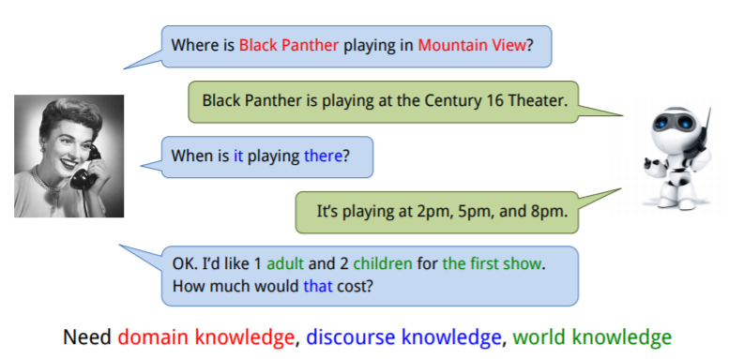
Why is NLP difficult?

Slide 27
Types of Ambiguities
Structural Ambiguities
Namrata thinks she understands me.
She thinks Namrata understands me.
Visiting relatives can be nuisance. (two meanings)
Grammatical Ambiguities
I (feminine or masculine) go.
Can- Noun = container, Can – Modal(auxiliary verb),
Can-verb = to can means to pack etc
Lexical Ambiguities:
Polysemy Ex: "understand" (I get it)
Homonymy Ex: Bank= river, financial bank
Notes:
The challenges we face stem from the highly ambiguous nature of natural language. As an English speaker you effortlessly understand a sentence like "Flying planes can be dangerous". Yet this sentence presents difficulties to a software program that lacks both your knowledge of the world and your experience with linguistic structures. Is the more plausible interpretation that the pilot is at risk, or that the danger is to people on the ground? Should "can" be analyzed as a verb or as a noun? Which of the many possible meanings of "plane" is relevant? Depending on context, "plane" could refer to, among other things, an airplane, a geometric object, or a woodworking tool. How much and what sort of context needs to be brought to bear on these questions in order to adequately disambiguate the sentence?
Polysemy: Verbs with three levels of meanings
1) Literary, 2) Abstract, 3) Frozen
Ex: The man drank the apple juice (Literary)
The car drank gasoline (Abstract)
The idea drank the heart (Frozen)
Homonymy : Category same still different meaning

Slide 28
Different Levels of Language Analysis
Discourse
Pragmatic
Semantic
Syntactic
Lexical
Morphological
Notes:
Morphological Knowledge : Concerns how words are constructed from basic meaning units called morphemes.A morpheme is the primitive unit of meaning in a language (Ex: “friendly” is derived from the meaning of noun “friend” and suffix “-ly”, which transforms noun into adjective)
Lexical Knowledge :Concerns with listing of words and categorizing themEx:friendful or beautyship is incorrect lexically.But friendship and beautiful is correct
Syntactic Knowledge :Concerns how words can be put together to form correct sentences and determines what structural role each word plays in the sentence and what phrases are subpart of other phrases Ex: “Large have green ideas nose” is lexically correct but syntactically incorrect.
Semantic Knowledge :Concerns what words mean and how these meanings – combine in sentences to form sentence meanings.This is the study of context-independent meaning.Ex: “Green ideas have large noses” is syntactically correct but semantically incorrect.
Pragmatic Knowledge :Concerns how sentences are used in different situations how use affects the interpretation of sentence
“She cuts banana with a pen” is semantically correct but pragmatically incorrect as it has no useful meaning.
Discourse Knowledge :Concerns how the immediately preceding sentences affect the interpretation of next sentence
Ex: Chetana is a student of VIT college. She is also teacher at Cummins College of Engineering for Women.

Slide 29
Levels of language understanding
Morphological Knowledge : Concerns how words are constructed from basic meaning units called morphemes. A morpheme is the primitive unit of meaning in a language (Ex: “friendly” is derived from the meaning of noun “friend” and suffix “-ly”, which transforms noun into adjective)
Lexical Knowledge :Concerns with listing of words and categorizing them Ex:friendful or beautyship is incorrect lexically. But friendship and beautiful is correct
Syntactic Knowledge :Concerns how words can be put together to form correct sentences and determines what structural role each word plays in the sentence and what phrases are subpart of other phrases Ex: “Large have green ideas nose” is lexically correct but syntactically incorrect.

Slide 30
Levels of language understanding
Semantic Knowledge :Concerns what words mean and how these meanings – combine in sentences to form sentence meanings. This is the study of context-independent meaning. Ex: “Green ideas have large noses” is syntactically correct but semantically incorrect.
Pragmatic Knowledge :Concerns how sentences are used in different situations how use affects the interpretation of sentence
“She cuts banana with a pen” is semantically correct but pragmatically incorrect as it has no useful meaning.
Discourse Knowledge :Concerns how the immediately preceding sentences affect the interpretation of next sentence
Ex: John went to the restaurant. He left a big tip.

Slide 31
Context Free Grammar
S → NP VP (A sentence is a noun phrase + verb phrase)
NP → Det N (Noun phrase is determiner + noun)
VP → V NP (Verb phrase is verb + noun phrase)
Det → 'the'
N → 'dog' | 'cat'
V → 'chased' | 'saw'
With this grammar, we can generate:
The dog chased the cat
A Context-Free Grammar G is formally defined as a 4-tuple: G = (V, T, R, S)
CFG Help machines understand or generate syntactically correct text
Notes:
"Context-free" means each rule applies independently of surrounding symbols.
A Sentence (S) is made up of a Noun Phrase (NP) followed by a Verb Phrase (VP). Noun Phrase (NP) consists of a Determiner (Det) followed by a Noun.

Slide 32
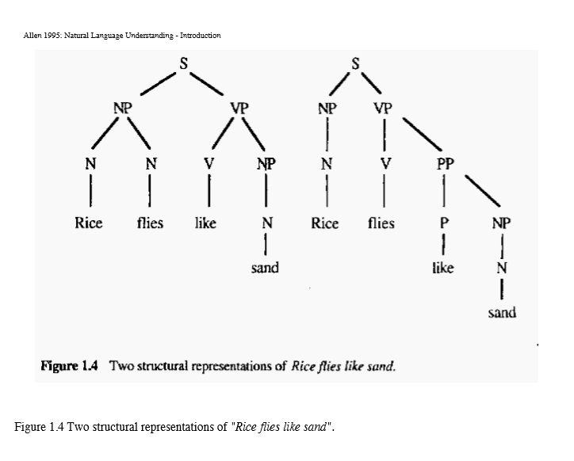
Representations and Understanding
CFG Rules
S -> NP VP
NP -> N N
NP -> N
VP -> V NP
VP -> V PP
PP -> P NP
Lexicon
Rice : N
Flies : N, V
Like : V, P
Sand : N
NP – Noun Phrases
VP – Verb Phrases
PP – Prepositional Phrases

Slide 33
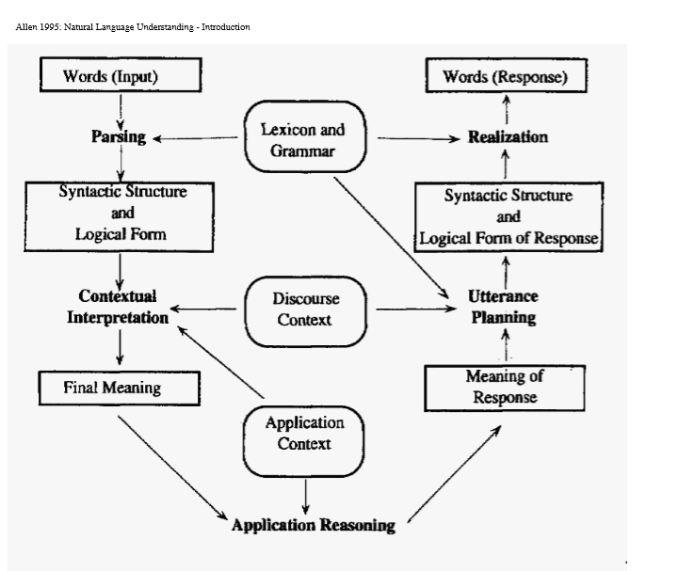
The Organization of Natural Language Processing Systems
Natural Language Understanding
Natural Language Generation
Encoding
Decoding
Notes:
1. Words (Input)The process begins with the raw sequence of words or tokens received from the user.
2. ParsingThis step analyzes the syntactic structure of the input (how the words are grammatically related). It relies heavily on the Lexicon and Grammar (the rules of the language).
3. Syntactic Structure and Logical FormThe result is a formal, unambiguous representation of the sentence's structure and its literal meaning (e.g., using a form of predicate logic or a semantic network).
4. Contextual InterpretationThis is the crucial step of disambiguation. It combines the literal Logical Form with the current Discourse Context (what was previously said) and Application Context (knowledge about the domain) to resolve ambiguities (like pronoun references or word sense).
5. Final MeaningThe final, unambiguous, context-aware meaning of the input utterance. This is the ultimate encoded representation that the system will act upon. 1. Meaning of ResponseThe intended, conceptual message to be conveyed, as determined by the Application Reasoning module.
2. Utterance PlanningThis stage decides how to phrase the response. It involves choosing the appropriate tone, level of detail, and high-level sentence structure based on the Discourse Context. The output is the Syntactic Structure and Logical Form of Response.
3. RealizationThis is the final stage of generation, where the abstract structure and logical form are translated into actual words. This step uses the Lexicon and Grammar to ensure the generated sentence is grammatically correct and uses appropriate vocabulary.
4. Words (Response)The final, coherent text output that is delivered to the user.

Slide 34
Evaluating Language Understanding Systems
What metrics to use?
How to deal with complex outputs like translations?
Are the human judgments measuring something real? reliable?
Is the sample of texts sufﬁciently representative?
How reliable or certain are the results?

Slide 35
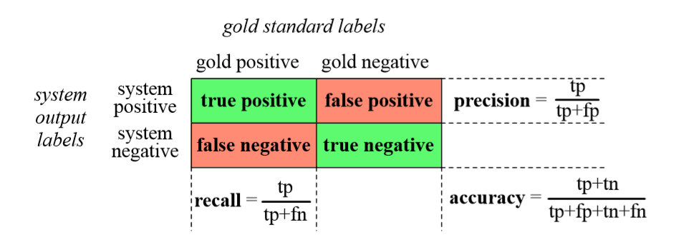
Contingency Table

Slide 36
Contingency Table
 | Predicted: SetAlarm | Predicted: PlayMusic | Predicted: GetWeather | Total Actual
Actual: SetAlarm | 30 (TP) | 2 (FN) | 0 (FN) | 32
Actual: PlayMusic | 5 (FP) | 48 (TP) | 1 (FN) | 54
Actual: GetWeather | 0 (FP) | 1 (FP) | 13 (TP) | 14
Total Predicted | 35 | 51 | 14 | 100
Accuracy= (30+48+13)/100=0.91
Precision ( SetAlarm)=30/(30+5)=0.857
Recall ( SetAlarm)=30/(30+2)= 0.937
Notes:
Why TN isn't used: In a multi-class setup, we don't define a single "True Negative" for the whole system. Instead, the correct prediction of any class other than the one we are focusing on acts as a TN when you treat the problem as binary. Since the goal is overall correctness, we simply sum all the individual, successful class predictions (TPs).

Slide 37
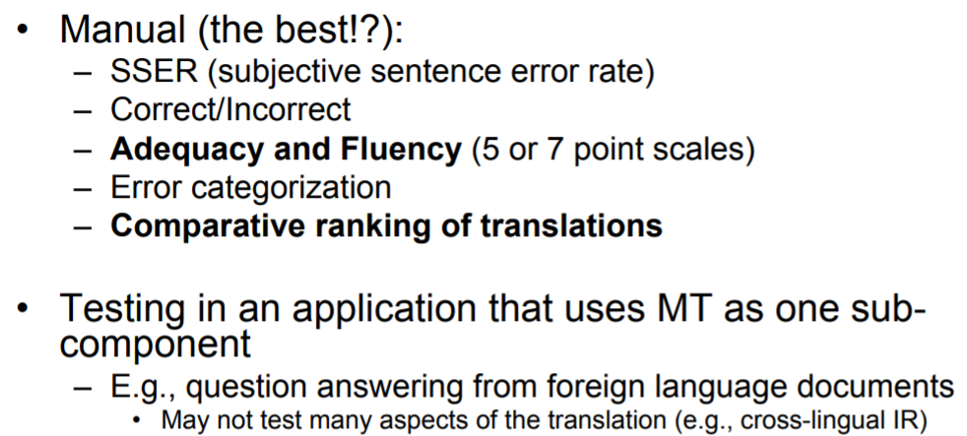
Some other evaluation measures
Notes:
MT: Machine Translation

Slide 38
Words of Wisdom … Wisdom is not in words; Wisdom is meaning within words - KAHLIL GIBRAN

Slide 39
Good References
https://emerj.com/partner-content/nlp-current-applications-and-future-possibilities/
https://venturebeat.com/2019/04/05/why-nlp-will-be-big-in-2019/
https://www.nltk.org/book/
https://www.coursera.org/learn/python-text-mining/home/week/1
https://openai.com/api/
https://analyticssteps.com/blogs/top-nlp-tools
https://web.stanford.edu/~jurafsky/NLPCourseraSlides.html
https://www.cstr.ed.ac.uk/emasters/course/natural_lang.html
https://web.stanford.edu/class/cs224u/2016/materials/cs224u-2016-intro.pdf
https://www.mygreatlearning.com/blog/trending-natural-language-processing-applications/

