Slide 1
Simulating string profiles by solving the wave equation
Emanuel Casiano-Diaz
Computational Physics
Prof. Adrian Del Maestro

Slide 2
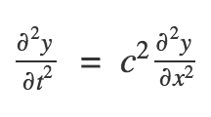
The Wave Equation
Second order partial order derivative
Central equation of motion of wavelike phenomena
For example: Electromagnetic waves, waves on a lake surface, etc…
But does it govern string motion too? The answer is yes!

Slide 3
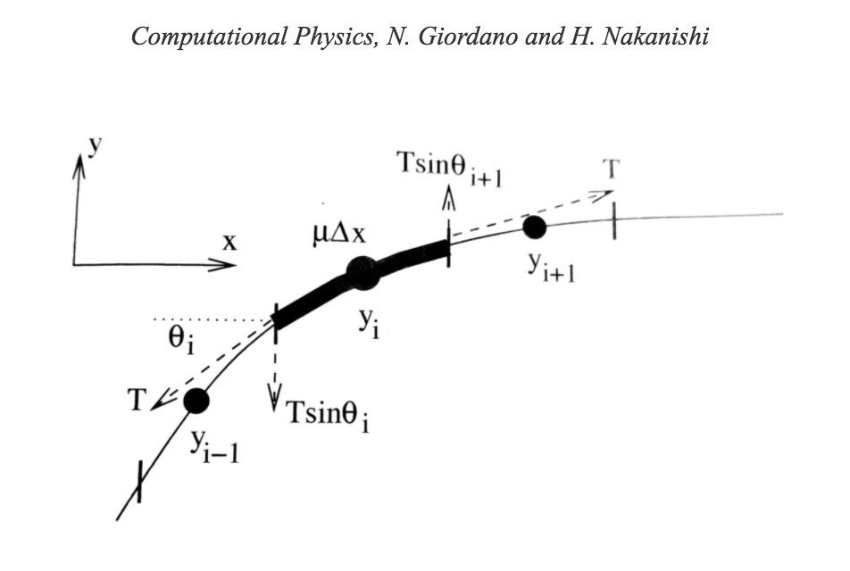

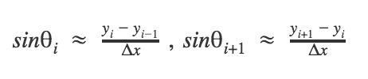
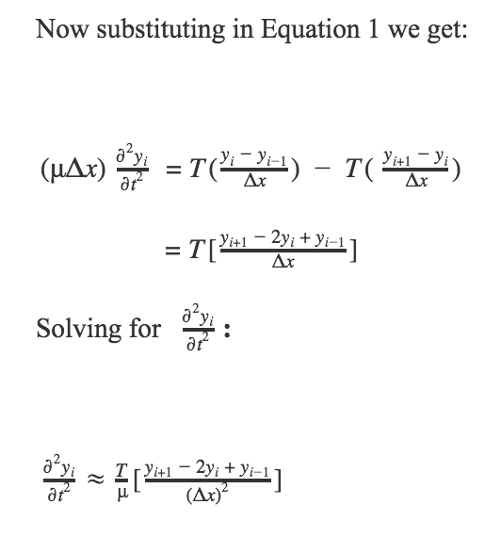
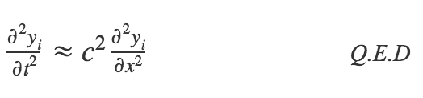
Proof
Assume small angles and vertical displacements

Slide 4
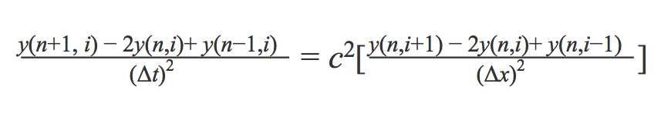
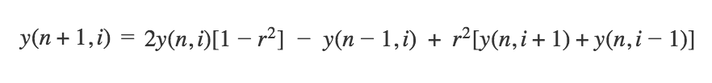
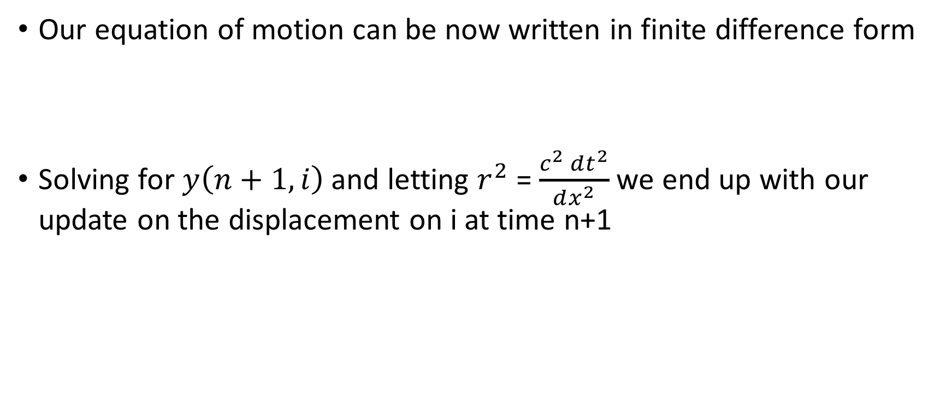
The update
Our equation of motion can be now written in finite difference form
Solving for $y\left(n+1,i\right)$ and letting $r^{2}$ = $\frac{c^{2} dt^{2}}{dx^{2}}$ we end up with our update on the displacement on i at time n+1
Notice that we only need to store three arrays of values, previous, current and next

Slide 5
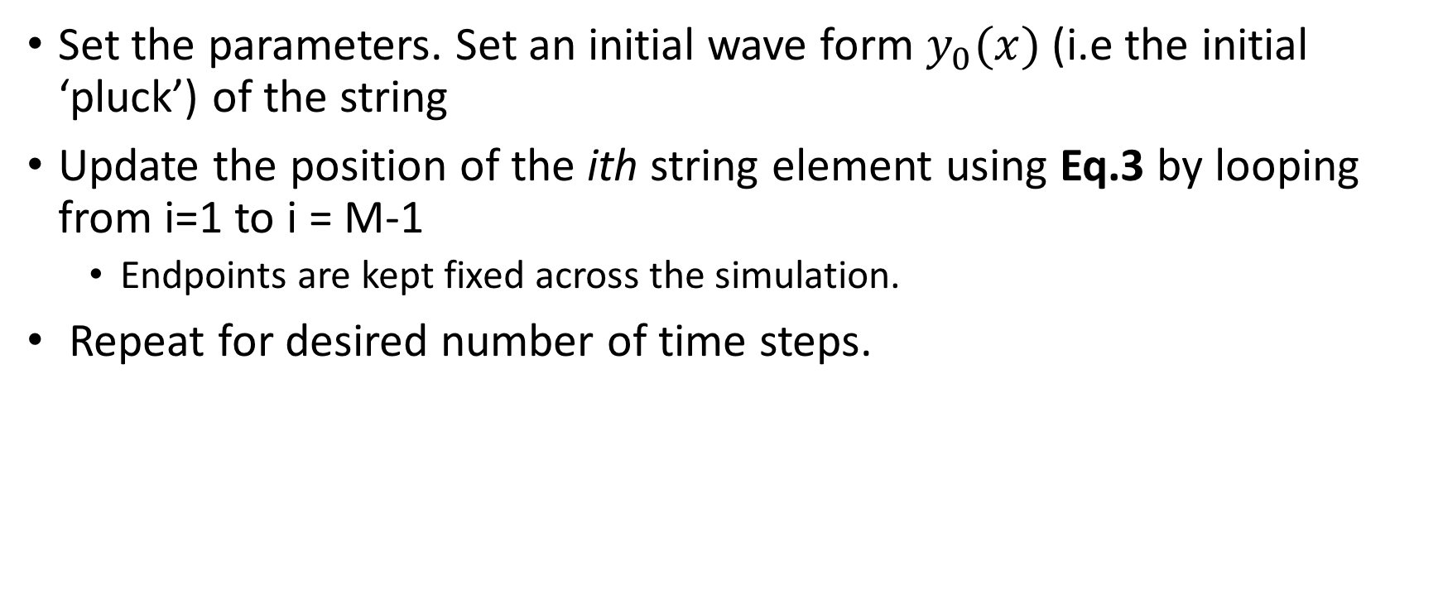
Algorithm
Set the parameters. Set an initial wave form $y_{0}(x)$ (i.e the initial ‘pluck’) of the string
Update the position of the ith string element using Eq.3 by looping from i=1 to i = M-1
Endpoints are kept fixed across the simulation.
Repeat for desired number of time steps.

Slide 6
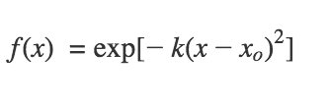
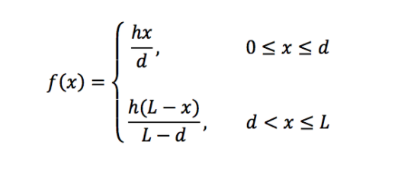
Gaussian and Guitar Plucks
For a gaussian pluck, assume the initial string profile is
To simulate the pluck of a guitar, we will initialize the string profile as

Slide 7
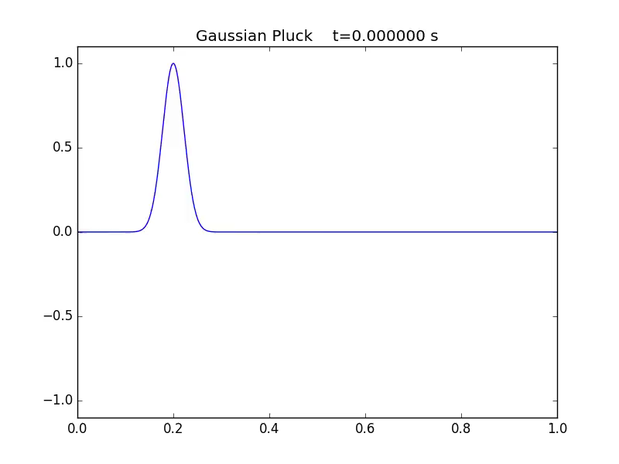
Gaussian Pluck

Slide 8
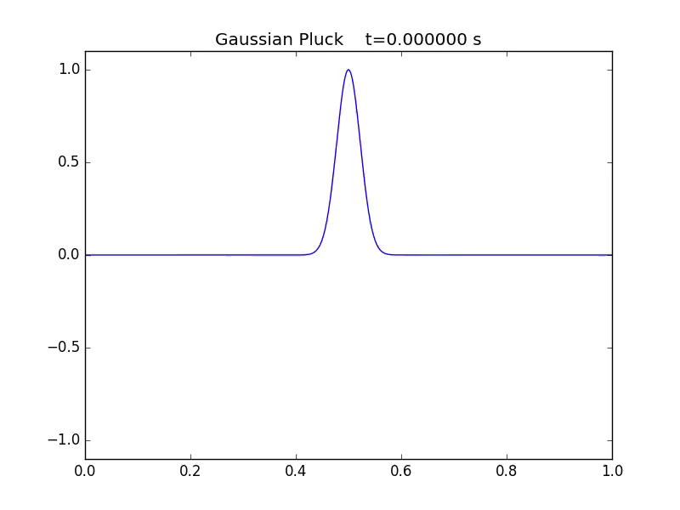
Gaussian Profile (Pluck at the middle)

Slide 9
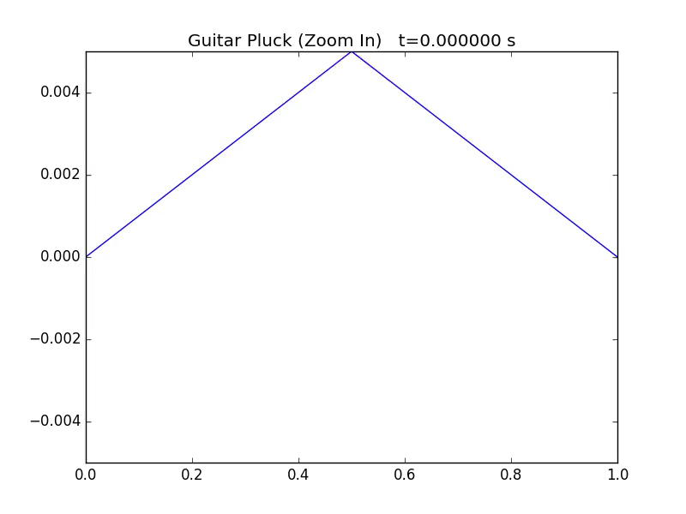
Guitar Pluck (Pluck at the middle)

Slide 10
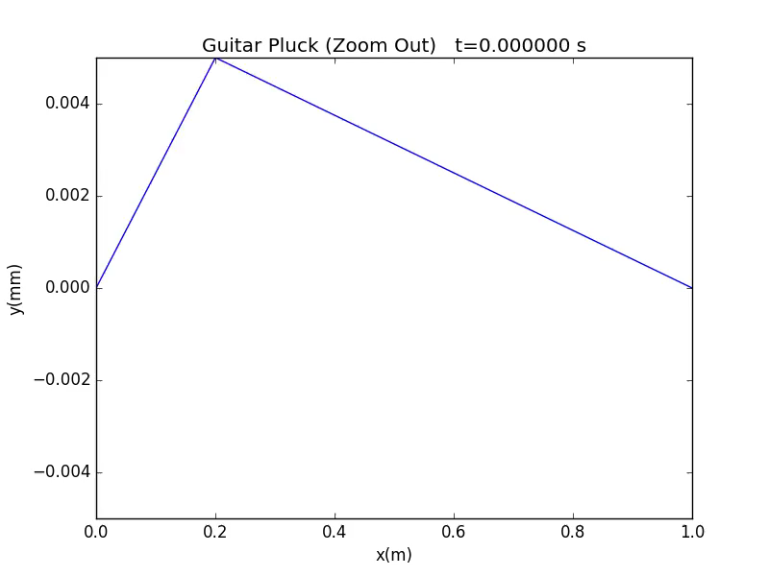
Guitar Pluck

Slide 11
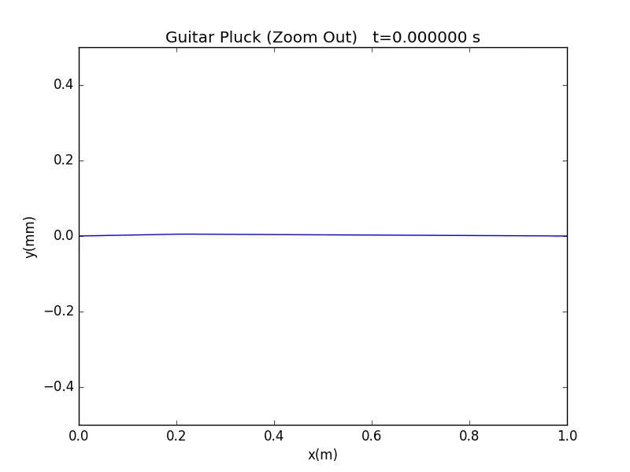
Guitar Pluck (Zoom Out)

Slide 12
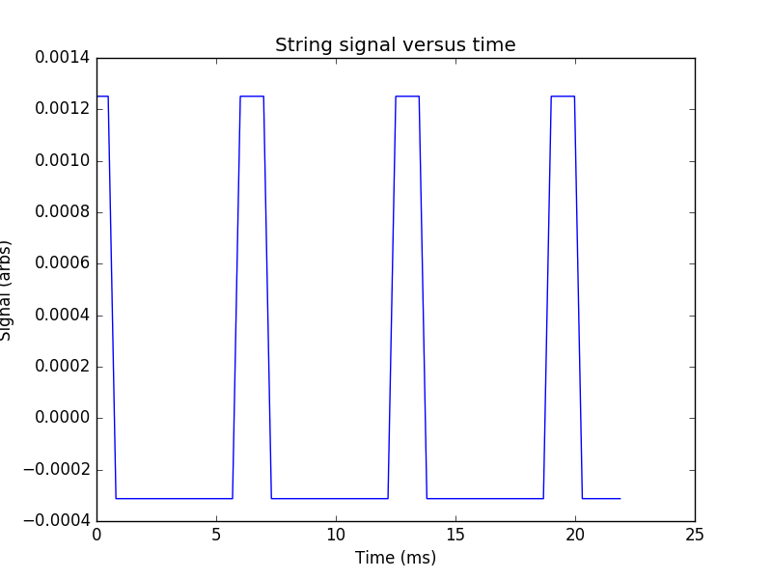
The signal
Now that we have our string profiles, we can analyze the displacement of a single point across time.
We can analyze sound properties of the string by computing the power spectrum of this signal

Slide 13
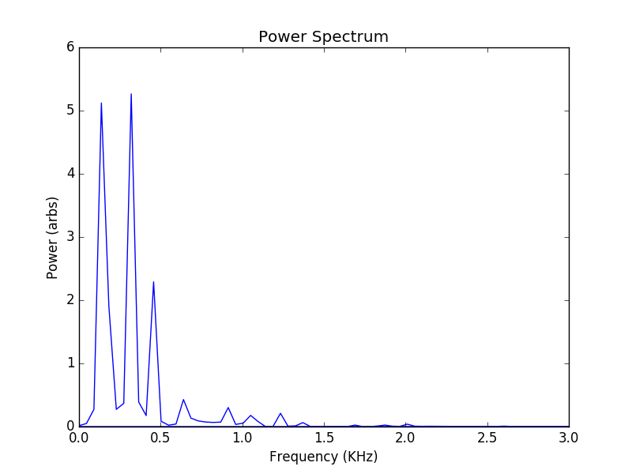
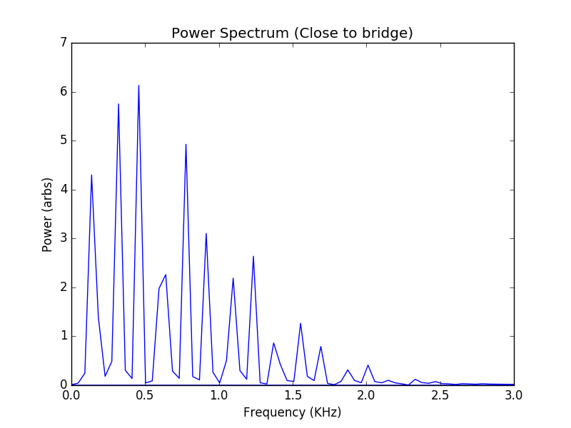
Power Spectra
These peaks represent the harmonics of the string

Slide 14
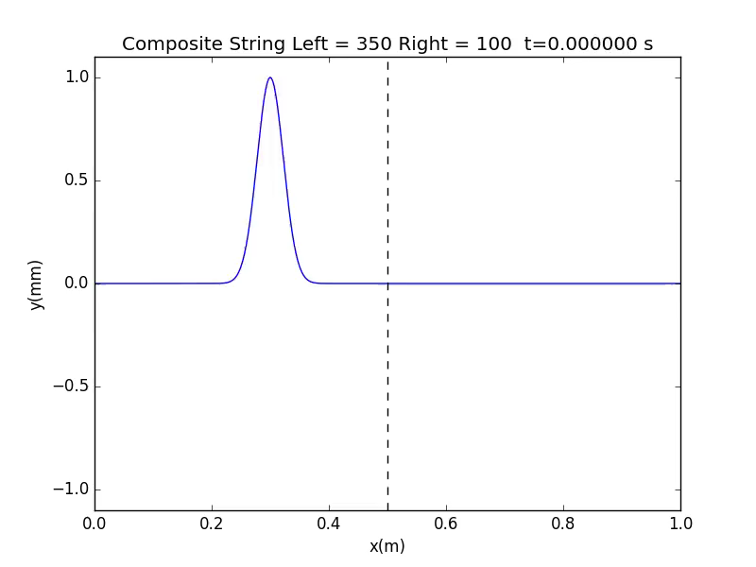
The composite strings
Wave propagates at a certain speed in some spatial region of the spring and with a different speed in other regions
Equivalent to EM Waves going through media with different index of refraction

Slide 15
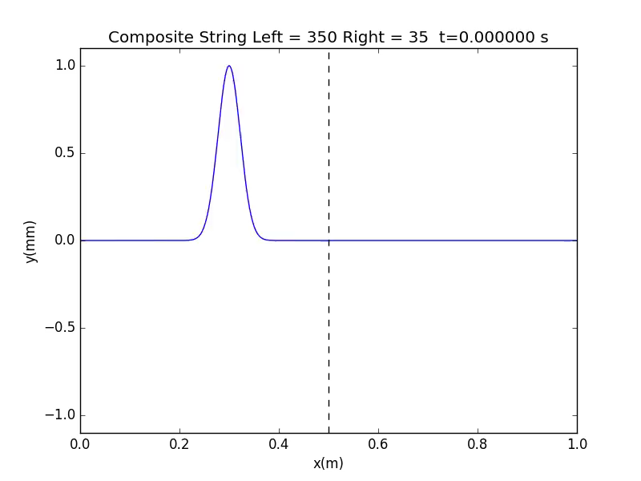
Now let’s make the right side have even larger mass per unit length …

