Slide 1
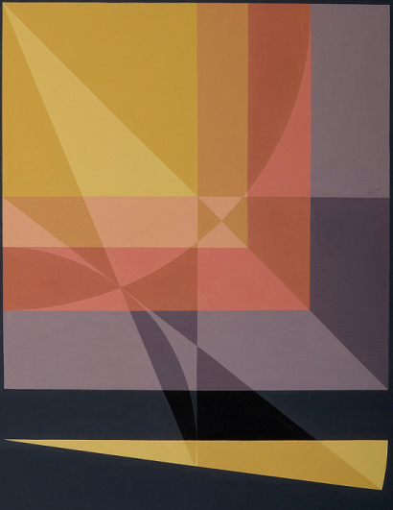
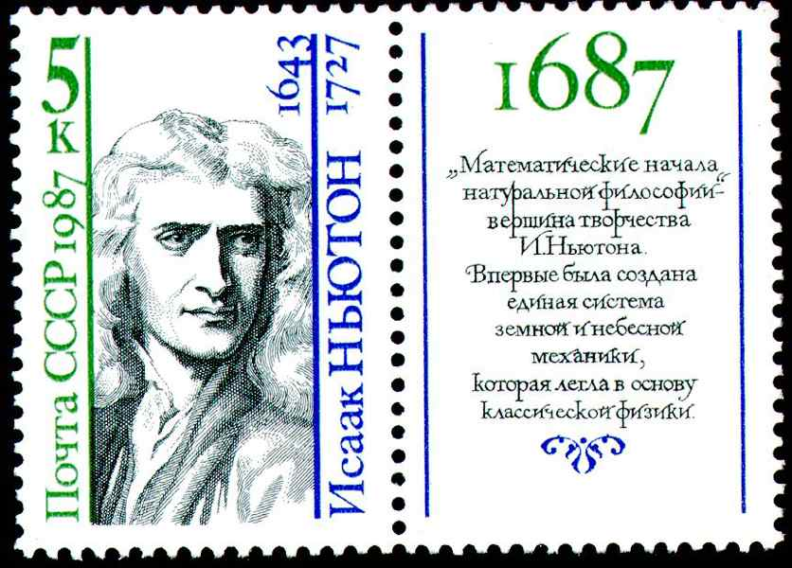
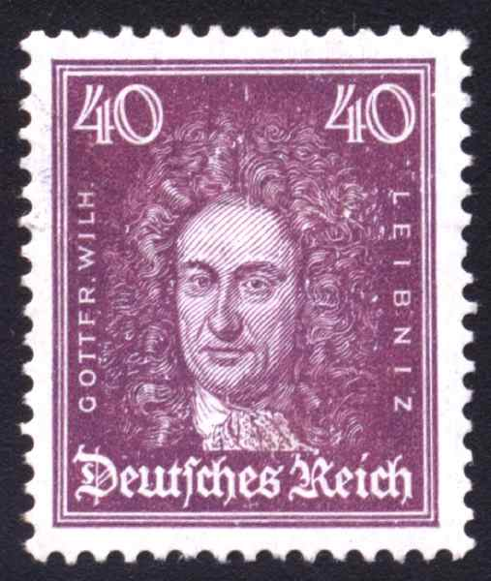
Differential Calculus:
From Practice
To Theory
Eugene Boman
Pennsylvania State University
Robert Rogers
State University of New York
Isaac Newton
Gottfried Leibniz

Slide 3
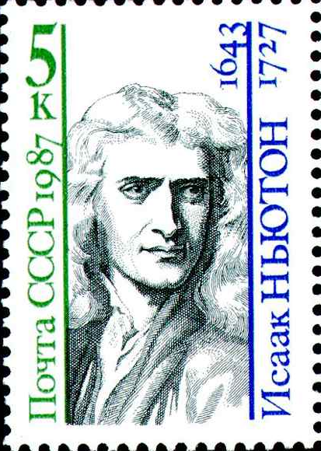
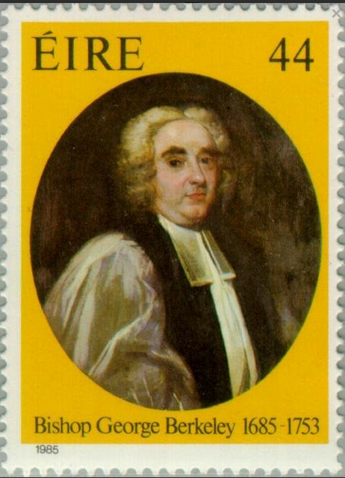
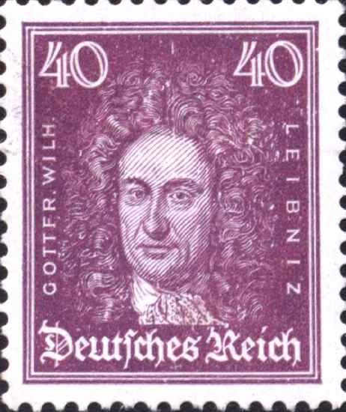
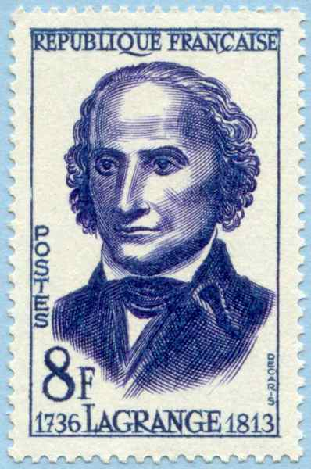
Differential Calculus
From Practice to Theory
Eugene Boman
The Pennsylvania State University
Robert Rogers
The State University of New York

Slide 4
Differential Calculus:
From Practice to Theory
Eugene Boman
Robert Rogers
The Pennsylvania State University
The State University of New York

Slide 5
Differential Calculus:
From Practice to Theory
Eugene Boman
Robert Rogers
The Pennsylvania State University
The State University of New York
Newton
Berkeley
Leibniz
Lagrange

Slide 6
