Slide 1

Intelligent Credit Card
Fraud Detection System
A Cost-Sensitive AI Approach to
Minimizing Financial Risk
Ernesto C. Baldono Jr.

Slide 2


The High Cost of Invisible Fraud
The Imbalance:
Fraud is rare (0.17%) but expensive.
The “Accuracy Trap”:
A standard system can have 99.8% accuracy and still catch ZERO fraud.
FALSE ALARM
MISSED
FRAUD
The Financial Reality:
Cost of Missed Fraud:
~$122 (Direct Loss)
Cost of False Alarm:
~$2 (Admin Cost)

Slide 3
Beyond Accuracy: Cost-Sensitive
Objective: Maximize Net Savings
Logistic Regression
Random Forest
The Engine:
Tested 4 Algorithms
(Logistic Regression vs. Random Forest vs. XGBoost vs. Neural Network (MLP)
vs
XGBoost
Neural Network
Privacy-First:
Utilized anonymized PCA data to detect behavioral anomalies rather than relying on Personally Identifiable Information
BEST MODEL

Slide 4
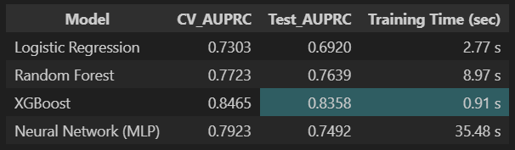
Benchmarking Performance:
The “Algorithm Battle”
The Baseline: Logistic Regression provided a fast reference point but struggled to capture complex, non-linear fraud patterns.
The “Deep Learning” Tradeoff: The Neural Network (MLP) showed promise but required significantly higher training time for only marginal gains.
The Ensemble: Random Forest and XGBoost dominated the leaderboard, proving that “ensemble” methods (combining multiple decisions) are superior for tabular financial data.

Slide 5
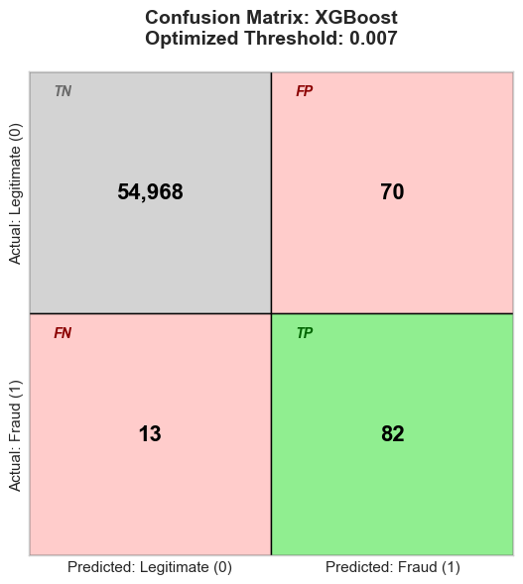
Winning Architecture: XGBoost
Key Metrics:
Recall (Fraud Caught): 86.32%
(The priority metric).
AUPRC Score: 0.8358
(High reliability on rare events).
Inference Speed: 0.91 sec
(Real-time ready).

Slide 6
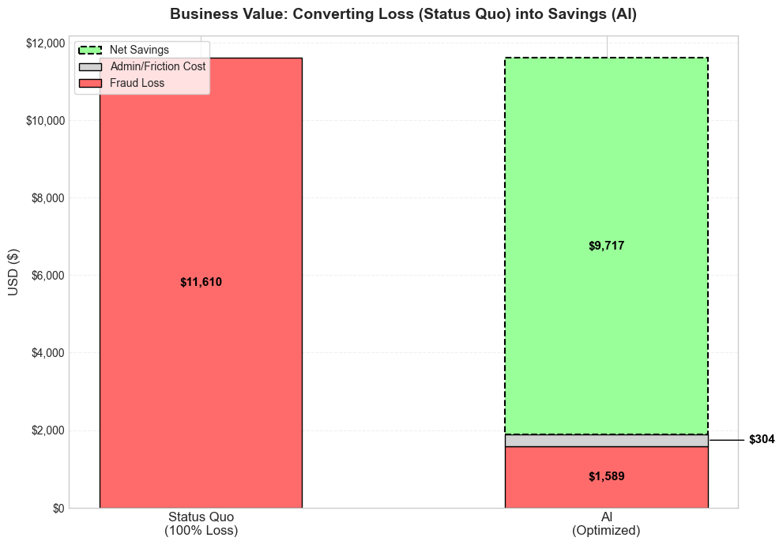
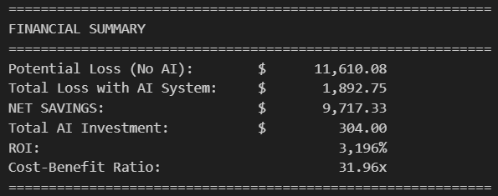
Turning Potential Loss into Savings
Green Bar: $9,717.33 saved!
ROI: 3,196% on operational spend.
Cost-Benefit Ratio: 31.96x
(For every $1 spent, we save $31.96.)

Slide 7
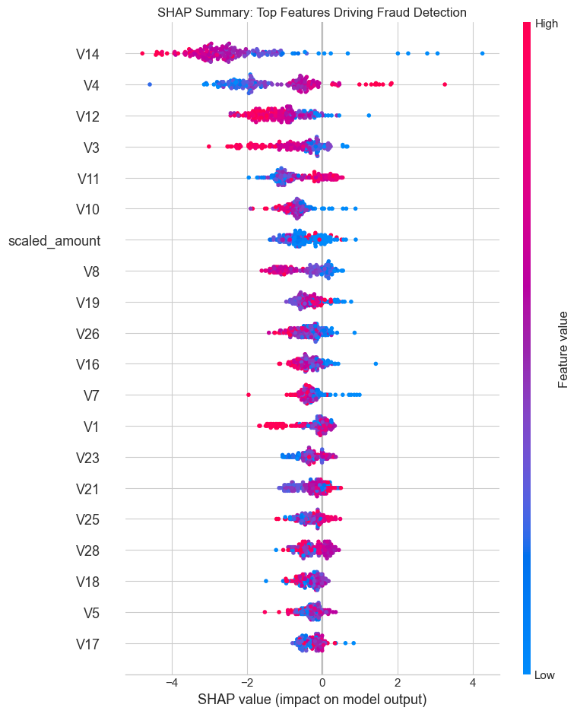
No “Black Boxes”: Explaining the Decisions
Audit:
Verified that the model uses behavior (V1-V28), and not just wealth (scaled_amount).
Compliance:
Fully interpretable decisions for regulatory audits.

Slide 8
Production-Ready Architecture
Reproducibility: Pipeline includes Scalers, Thresholds, and Metadata.
Latency: Optimized for sub-second decision making.
Robustness: Fail-safe data loading and error handling.
Raw Transactions
Preprocessor (Scaler)
AI Model
Decision (Block/Allow)

Slide 9
SUMMARY & RECOMMENDATION
Problem Solved: Addressed the $122 (missed fraud) vs $2 (admin) cost imbalance.
Value Delivered: Estimated Net Savings of $9,717.33.
Risk Managed: Audited for bias and stability.
Recommendation: Proceed to Pilot Deployment.

