Slide 1
Dr. Emily Christina Murphy (she/her)
Assistant Professor, Digital Humanities
Faculty of Creative and Critical Studies
PI, ReMedia Infrastructure
emily.murphy@ubc.ca
Dr. Electra Eleftheriadou, PhD, ACC (she/her) Educational Consultant for Inclusion Centre for Teaching and Learning
electra.eleftheriadou@ubc.ca
Contract Grading
And Student- Focused Assessment
Slide Design: Kai Hagen ReMedia Design Consultant, Bachelor of Media Studies

Slide 2
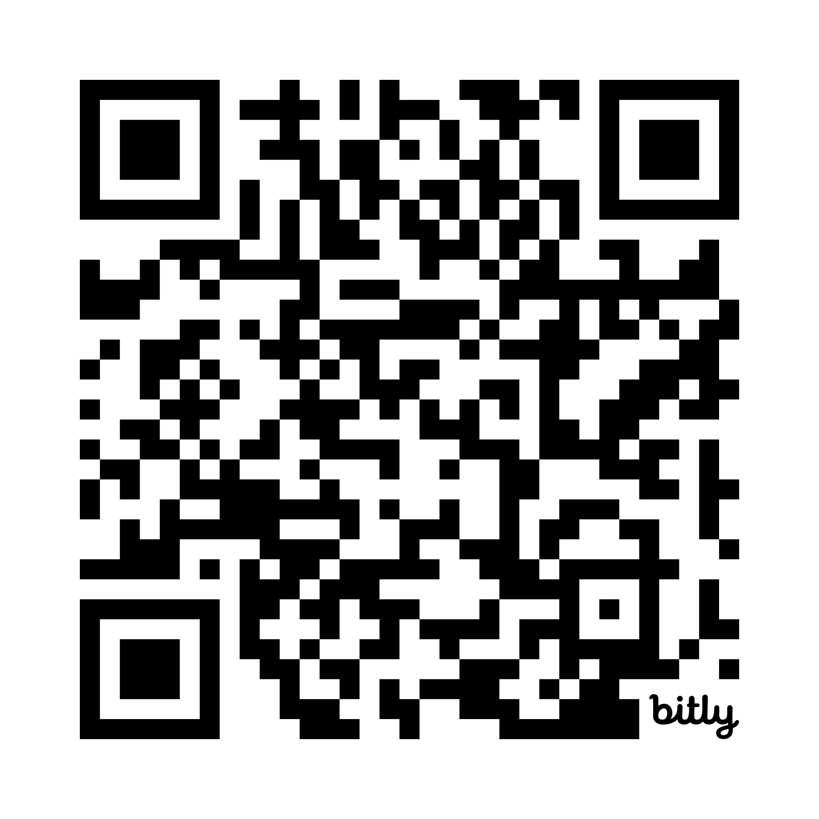
Link: https://bit.ly/4nbyApP

Slide 3



Contract Grading Definitions
Worksheet Part I: Commitments and Values, Assessment Philosophy, Obstacles
Guided Activity: Transform a conventional syllabus
Worksheet Part I: Learning Outcomes, Activities and Assignments

Slide 4
Contract Grading: an evaluation approach that stages a negotiation between instructor and students mediated through a ‘contract’ in which students choose which grade they will work towards within a range of options presented to them

Slide 5
Assumptions:
Students complete all work to a passable level, and revise if assignments are not passable
Usually higher grades entail more labour or volume on the part of students
A grade has neutral value OR
Grades interfere with learning

Slide 6

The advantage of contract grading is that you, the student, decide how much work you wish to do this semester; if you complete that work on time and satisfactorily, you will receive the grade for which you contracted. This means planning ahead, thinking about all of your obligations and responsibilities this semester and also determining what grade you want or need in this course.… I respect the student who only needs a C, who has other obligations that preclude doing all of the requirements to earn an A in the course, and who contracts for the C and carries out the contract perfectly. (This is another one of those major life skills: taking responsibility for your own workflow.) - Cathy Davidson

Slide 7
Contract Grading vs. Progressive Rubrics (and other student-focused approaches to teaching and assessment) Similar - focus on abilities rather than shortcomings - flexibility for student choice and aptitudes - opportunities for student reflection and agency within the course Different - balance of volume of work and quality of work - mandatory front-ended emphasis on student agency - move away from grades as strictly tied to value (but could go further…) - usually, no percentage weighting of assignment and all assignments must be completed to pass the course More about grading alternatives: https://krieger.jhu.edu/writing-program/writing-toolkit/concepts-and-practices/alternatives-to-grading/ More about progressive rubrics: https://bccampus.ca/event/flo-lab-progressive-rubrics-using-ai-to-drive-student-growth/

Slide 8
Contract Grading vs. Ungrading Similar - focus on abilities rather than shortcomings - flexibility for student choice and aptitudes - opportunities for student reflection and agency within the course - focus on process rather than product - recognize that grades interfere with learning Different - retaining graded assessment structures More about ungrading: Blum and Kohn, Ungrading: Why Rating Students Undermines Learning (and What to Do Instead). https://utpdistribution.com/9781949199826/ungrading/

Slide 9
Types of Contract Grading Aggregate Model Project-Based Model

Slide 10
Aggregate Model

Slide 11
Ryan Cordell’s Text Technologies class: To contract for an “A” in this course, you agree to: - Earn “Satisfactory” on all class preparation assignments save two. - Miss no more than two classes. - Take no more than one information overload day during the semester. - Exceed expectations regarding in-class device according to the policies outlined in the device use rubric. - Write at least nine “Satisfactory” lab reports over the course of the semester. As specified in the assignment, lab reports are due within one week of the pertinent laboratory activity. - Complete two “Satisfactory” Unessays on a schedule you will specify in your contract and present the strongest in class on December 4. https://f19tot.ryancordell.org/assignments/

Slide 12
Project-Based Model

Slide 13
Intellectual problem:
Scope is not simply size or volume. It is also complexity. How can contract grading teach scope with a large, core project?

Slide 14
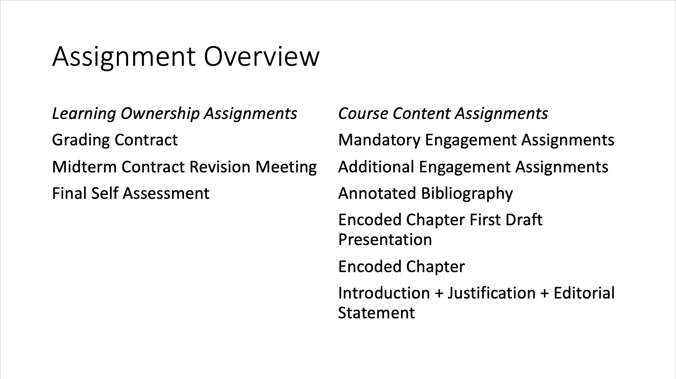

Slide 16
Variations and related approaches
Labour only (Asao B. Inoue)
“Specifications grading” (Linda Nilson): Students can make choices that support their production of rigorous work; contract negotiated weights for different assignment “bundles”
Preserved evaluation (J. Danielewicz and P. Elbow, and many others): All students start with a B (for example) if they complete the assignments, and may improve that grade based on the quality of the work
Ungrading: Grades interfere with learning and grades-based assessments should be radically divorced from student learning (Susan D. Blum, Alfie Kohn, and Jessie Stommel)

Slide 17
Contexts:
Technical writing;
Elementary, secondary, and postsecondary writing instruction;
Digital humanities pedagogy
Computer Science, Statistics, and UX/digital design courses
Social Work
Psychology and other experimental science fields

Slide 18
Benefits: - Made previous improvements to the course much more legible; - Students produced exemplary work; - Reduced my grading time (or at least felt like it did); - Challenged me to think carefully and clearly about concepts like scope, which are especially important in project-based and non-written work; - Made me a much more intellectually generous instructor.

Slide 19
Limitations/Things that need work: - I chose to retain an aspect of evaluation; - About the same number of students failed the course, but the course median was higher; - Easy for students to move down a grade, but not to move up a grade; - Labour still conforms to structures of inequality.

Slide 20
Worksheet: PART I

Slide 21
Activity: Transforming a Sample Syllabus from Conventional, Criteria-Based Grading to Contract Grading

Slide 22
Sample Course: ENGL/DIHU 155 - 1st year literature and composition class with a focus on culture and technology - Primarily non-majors - Learning outcomes are standardized across all ENGL15X classes to conform to 1st year English requirement

Slide 23
Course-Specific Learning Outcomes - Examine media objects and technology from a humanities perspective; - Understand important aspects of the history of technology and media; - Examine the rhetorical, structural, or semiotic strategies of different media forms to construct audience and usership; - Create simple media objects that make argumentative claims about social, political, or artistic domains.

Slide 24
Learning Outcomes, 15X requirements (1 of 3) Examine literary texts from a critical perspective - identify and discuss various fictional, poetic, and dramatic genres or literary genres in born-digital media (i.e. framed narrative, soliloquy, short story, novel, comedy, hypertext, narrative games, etc.); - analyze literary devices, such as speaker, imagery, rhyme scheme, alliteration, metaphor, etc.; - examine authorial and rhetorical strategies in creating literary and cultural texts; - when applicable, identify literary periods, general historical context, links to real-world issues, and theoretical frameworks as those relate to the text(s); and - analyze relationships and patterns within and among texts

Slide 25
Learning Outcomes, 15X requirements (2 of 3) Group Work and Oral Skills - Work effectively in groups; - identify and verbalize key ideas from readings in small group discussion settings; - synthesize multiple viewpoints; - present group conclusions to class.

Slide 26
Learning Outcomes, 15X requirements (3 of 3) Writing and Research - employ university-level prose, including appropriate critical terminology; - develop an argument with a thesis or controlling idea, using accurate, relevant, and sufficient supporting material for a scholarly audience and purpose; - demonstrate research abilities through proficient use of library resources (i.e. completing interlibrary loan requests, use of the UBC online catalogue and scholarly databases); - integrate secondary material, including quotations, paraphrases, and summary, purposefully and effectively, providing authority and context; - document sources fully and ethically (i.e., in adherence to the university’s policy on academic integrity) according to the current MLA style guide (and, when deemed applicable by instructors, the current APA documentation system), informed by Indigenous Style (e.g., as per Gregory Younging’s Elements of Indigenous style: a guide for writing by and about Indigenous Peoples or a similar guide); and - employ a university-level writing process, including revision and editing.

Slide 27
Current Assignments 0% Writing Diagnostic (mandatory, no grade) 10% Syllabus Quiz 10% Participation Grades + Quizzes 20% Analytic Writing Assignment (600-800 words) 20% Essay (1000 words) 20% Wikipedia Final Project 20% Final Exam (1200 words) - non-negotiable requirements for ENGL15X classes: 3000-3500 words of writing, writing diagnostic, final exam worth at least 20% of grade

Slide 28
Challenge: Retain required Learning Outcomes while implementing Minimum Viable Requirements approach to Contract Grading

Slide 29
Assignments that have to stay 0% Writing Diagnostic (mandatory, no grade) 20% Final Exam (1200 words) *The final exam is required by my department to be worth at least 20% of the grade for first-year classes. However, percentage grades tend not to work in contract grading. One way to solve this problem is to make the final exam one of five major components that students have to pass in order to pass the course.

Slide 30
New Assignment Ideas ideas from aggregate model - participation points - writing reflections - number of peer reviews ideas from project-based model - scale of Wikipedia article wild cards - manifesto assignments (credit to Laura Hartmann-Villalta) - student-led assignments

Slide 31
Worksheet: PART II

Slide 32



THANK YOU

