Slide 1
World Happiness Report
🌎+😊
By: Ayman Ahmed and Mohammed Iqbal

Slide 2
Goal
World Happiness Report 2021
Countries Happiness, GDP, social support, life expectancy, freedom, generosity and corruption
Is it possible to classify how happy people are within a country
Average Happiness = 5.53
Randomly selected countries from data to be training set and test set

Slide 3
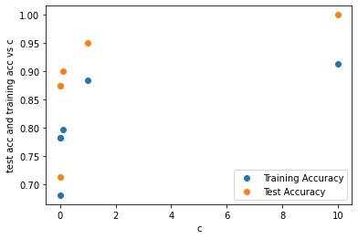
Logistic Regression with Ridge Regularization
Training Accuracy: 100%
Testing Accuracy: 91%
C = 10
Minimal bias
Varying levels of variance (no more than (∓5)
Little overfitted

Slide 4
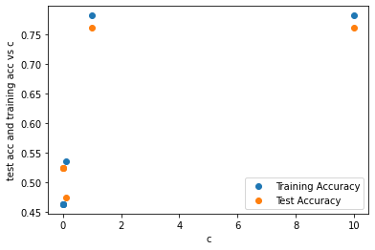
Logistic Regression with Lasso Regularization
Training Accuracy w/ Polynomial Transformation: 76.25%
Testing Accuracy w/ Polynomial Transformation: 78.2%
C = 1 and 10
Bias
Minimal variance (∓2)
Underfitted

Slide 5
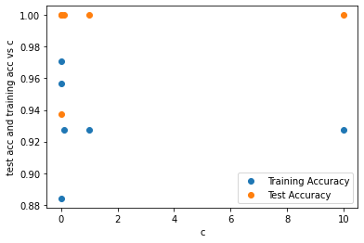
Logistic Regression with Polynomial Transformation
Training Accuracy w/ Polynomial Transformation: 100%
Testing Accuracy w/ Polynomial Transformation: 97.1%
C = .001
Minimal bias
Varying levels of variance (no more than (∓5)
Little overfitted
Best results of the three

Slide 6
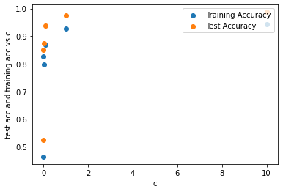
Support Vector Machines Linear Kernel
Training Accuracy w/ Linear: 98.7%
Testing Accuracy w/ Linear: 94.2%
C= 10
Minimal bias
Minimal variance
Best results of the three

Slide 7
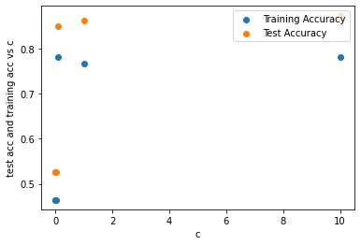
Support Vector Machines Polynomial
Training Accuracy: 87.5%
Testing Accuracy: 78.2%
C= 10
Minimal bias
Varying levels of variance
Overfitted

Slide 8
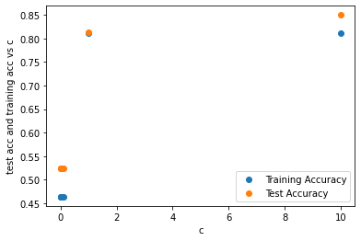
Support Vector Machines RBF
Training Accuracy w/ RBF: 85%
Testing Accuracy w/ RBF: 81.1%
C= 10
Minimal bias
Varying levels of variance)
Very little overfitting

Slide 9
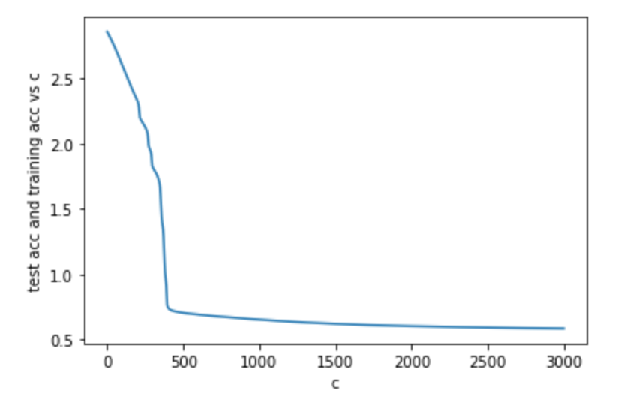
Neural Networks
Prediction Accuracy: 51.6%
By default neural networks performed normally, but not above / below average
Very overfitted in comparison
Using Sigmoid Function

Slide 10
Neural Networks with Ridge Regularization
Prediction Accuracy: 76.3%
By adding a ridge regularization and testing out different values for alpha, lambda, and hidden layers, we got the best model.

Slide 11
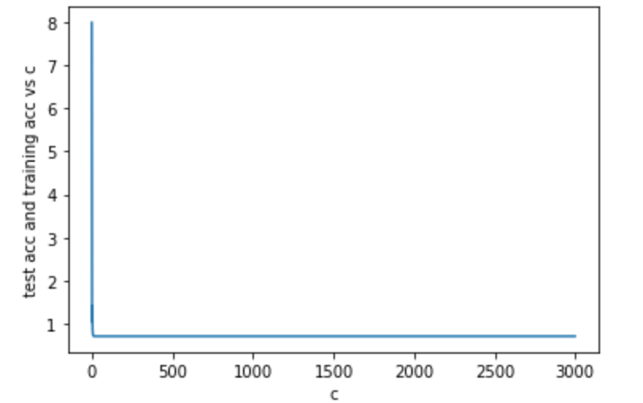
Neural Networks with reLU Transformation
Prediction Accuracy: 36.6%
By adding the reLU transformation, accuracy dropped sharply

Slide 12
Conclusion
Based off the results it seems that ridge regularization with neural networks provided the best results.

