Slide 1
Intro to GridDyn
Philip Top
Lawrence Livermore National Laboratory
top1@llnl.gov

Slide 2
Outline
Part 1
  Inspiration
  Origins
  History
  Philosophy
  Vision
Part 2
  Structure
  Capabilities
  Code

Slide 3

Inspiration
FY13-15 Modeling and Simulation LLNL internal R&D
  The goal was to explore the coupling between transmission and distribution systems
Grid Dynamics

Slide 4
Requirements for Transmission software
Work with HPC and elsewhere
Give easy access to manipulate solvers and solution methodology
Include variety of model details
Be able to couple with other software modeling platforms
Serve as an experimental platform for scalable high performance grid modeling methods development

Slide 5
Identified Gaps
No open research code written in compiled language that provided the necessary flexibility for conducting computational experiments and included sufficient details of system dynamics.
Did not provide flexibility of using a variable time step solver
Many open power systems programs construct an impedance matrix, implying all loads and gens must fit within that parameterization at least in any given timestep

Slide 6
Decision
After looking at all available options and much internal discussion a decision was made to develop a new positive sequence transmission simulation tool in Early 2013.

Slide 7
Philosophy and design goals
Well structured, well written code
Cross Platform (OS and scale)
Written with Modern language, using modern techniques and libraries
Include support for a wide range of power system features: limits, adjustable controls, deadbands, protection, breakers, relays, sensors, etc.
Modular and replaceable
  Models are independent of the solvers
  Models do not need to know the internal structures of other models (defined by interface and function)
  Solution technique is not fixed by the models
Inputs formats are flexible and not tied to the model layout
Built for flexibility
Built to interact with other simulation tools

Slide 8
Vision
GridDyn as the software package of choice for research institutions and utilities for exploring novel simulation and solver techniques for the grid, performing non-traditional simulations, and as a building block for enabling power grid R&D
  Flexible
  Easy to expand
  Moderately easy to use
  Open Source
  Cross Platform
  Scalable from laptops to HPC systems
A proving ground to test new methods and techniques that can be later adapted and migrated to commercial tools
A Training platform for enhancing the education of future power engineers

Slide 9


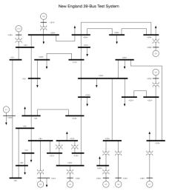
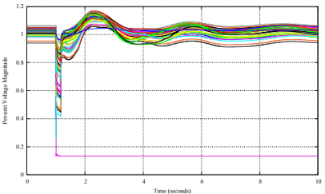
GridDyn - LLNL’s Power Transmission System Simulator
Open, multi-platform, multi-scale (in time and space), multi-mode power system simulation platform
Built from the ground up to be compatible with both HPC and standalone systems
Designed for model and solver flexibility as well as coupling with other simulators
Solver Technology
Simulation
Power Flow
Full
Dynamics
Coupling to Other Platforms
Contingency
Distribution Simulation
Regulation
FSKIT
Communication Simulation
Optimization
FMI
Other External Simulators
Models
Input
XML
Generators & Loads
Output
Buses & Lines
Cdf, raw, epc, m, etc
Others

Slide 10

Visualize
GridDynMain, GridDynServer, TestCore
FMU Library
FMI models
Extra Models
File Input
.XML
.RAW
.CDF
.m
-others
Numeric
Solvers
-Internal
Object API
Models
Bookkeeping
Solver interface
IO
GridDynOpt
Additional models,
Bookkeeping
API’s for optimization
Numeric
Optimizers
-CPLEX
-CLP
-CBC
-IPOPT
-Others?

Slide 11
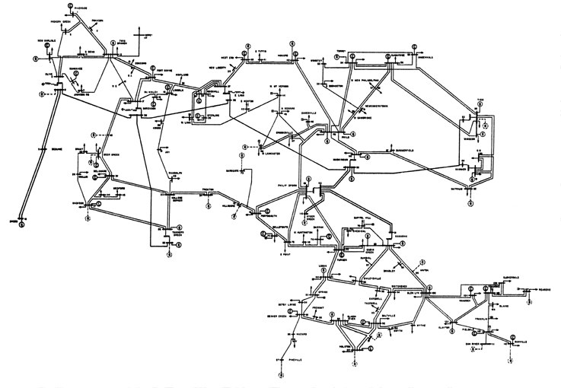
What can it do?
Positive Sequence power flow
  Full AC power flow
  Numerous approximations
    DC
    Decoupled
    Linear
    Simplified
    Small angle

Slide 12
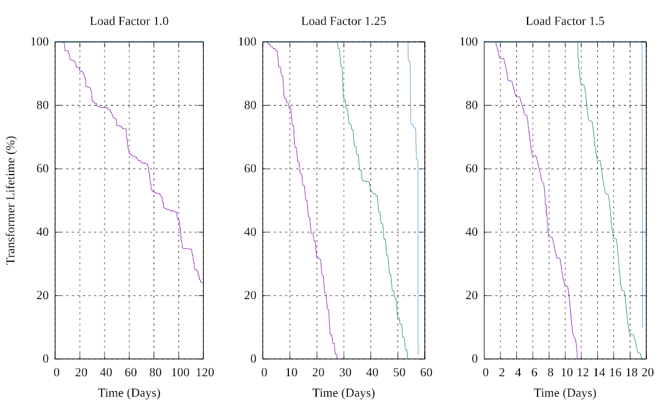
What can it do?
Event Driven Power Flow
  Perform an iterated power flow over time with periodic updates or driven by system events

Slide 13
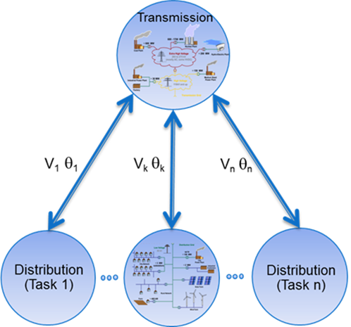
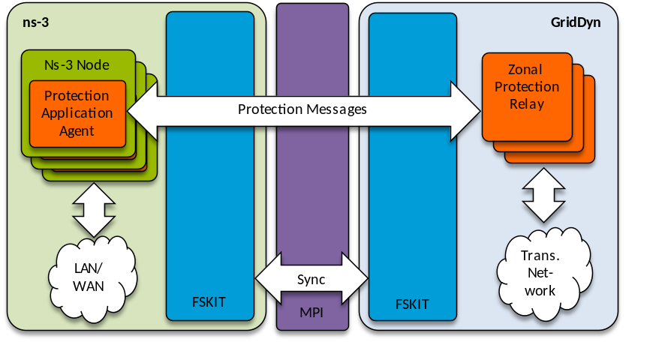
What can it do?
In coordination with FSKIT* and Pargrid*, couple with Distribution systems and communication systems
* Open source release is in process

Slide 14
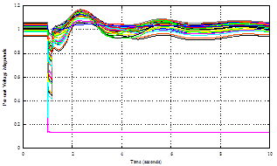
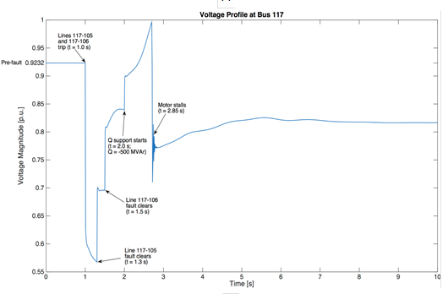
What can it do?
Dynamic Simulation
  Evolve system over time using DAE equations
  Similar approximations available as in power flow

Slide 15
Code
Written in C++ making heavy use of C++11
  Will utilize C++14 standard soon
  Object oriented design
Project managed in CMAKE (tested on Windows, linux, mingw, and macs)
Minimum Compilers
  MSVC 14 (Visual studio 2015)
  GCC 4.9
  Intel 16
  Clang 3.4 (3.5 for openMP)
External Libraries
  Boost 1.49+ (though some planned features may require 1.61+)
  Sundials 2.6.2+ (Kinsol, IDA, though possible uses for other libraries)
  SuiteSparse (KLU through sundials)
Some documentation in code for Doxygen

Slide 16
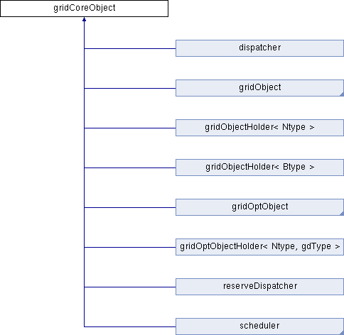
Code: gridCoreObject
Base class for most objects related to the grid

Slide 17
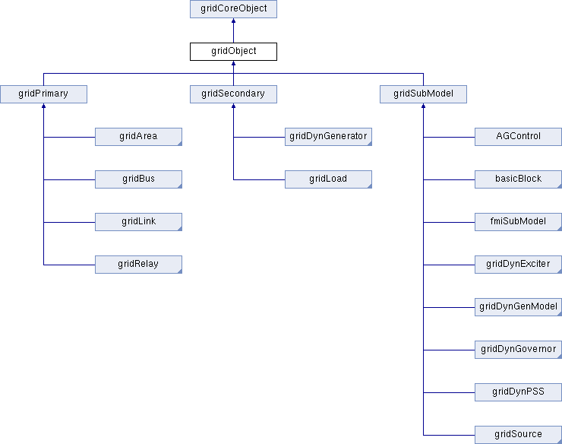
Code: GridObject

Slide 18
Ongoing work
Ongoing work is currently supported by applications using GridDyn including:
  Contingency analysis
  FMU interface
  Co-simulation with communications and Distribution models
  Wide Area Controls
  Visualization

