Slide 1
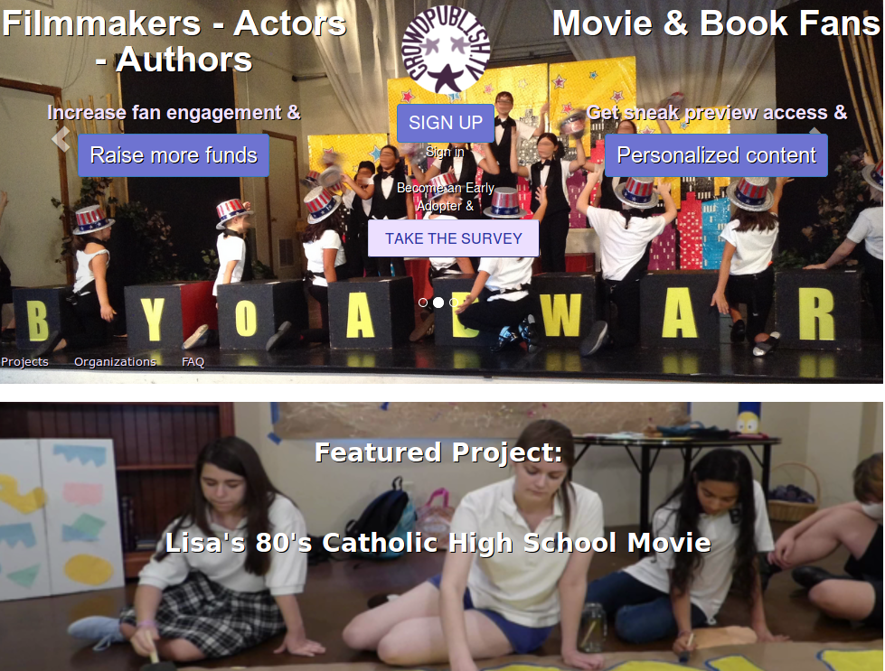

CrowdFunding
CrowdEngagement
For INDIE ACTORS
Notes:
CrowdPublish.TV - where actors empower themselves by selling themselves directly to their fans

Slide 2
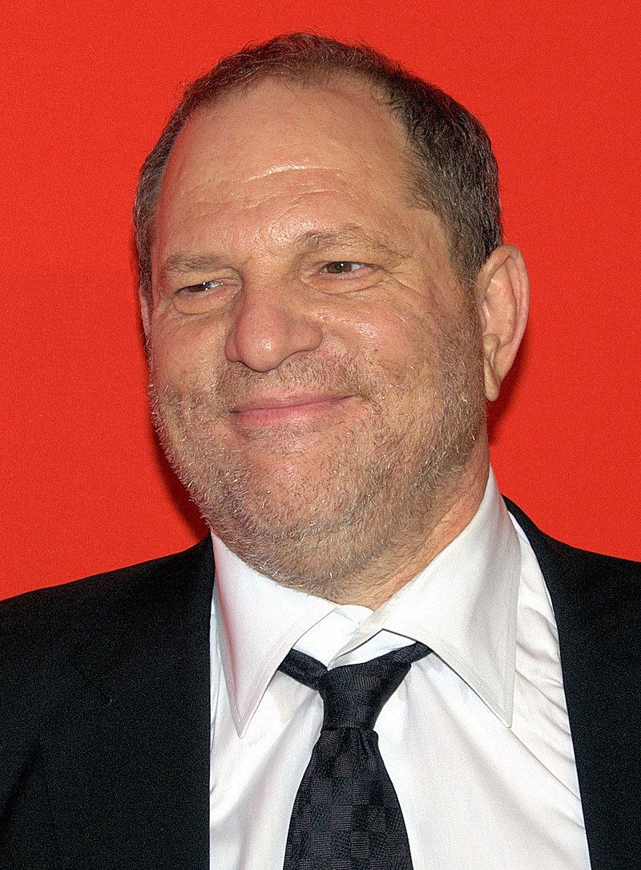
Dependent on producers
Missing $ opportunities
Marketing-time consuming
Harvey Weinstein
Problem
By David Shankbone [CC BY 3.0], via Wikimedia Commons
Notes:
Actors don’t make themselves famous. They wait to be “discovered” by someone else who controls money.
Fans wait for content from actors. During their off-season, actors miss out on using their brand to earn more $ because fans don’t have the opportunity to purchase directly from actors
Marketing is time consuming – Organizations & clubs can help market actors to their members but they need incentive
Everyone has a Harvey Weinstein in their life.

Slide 3
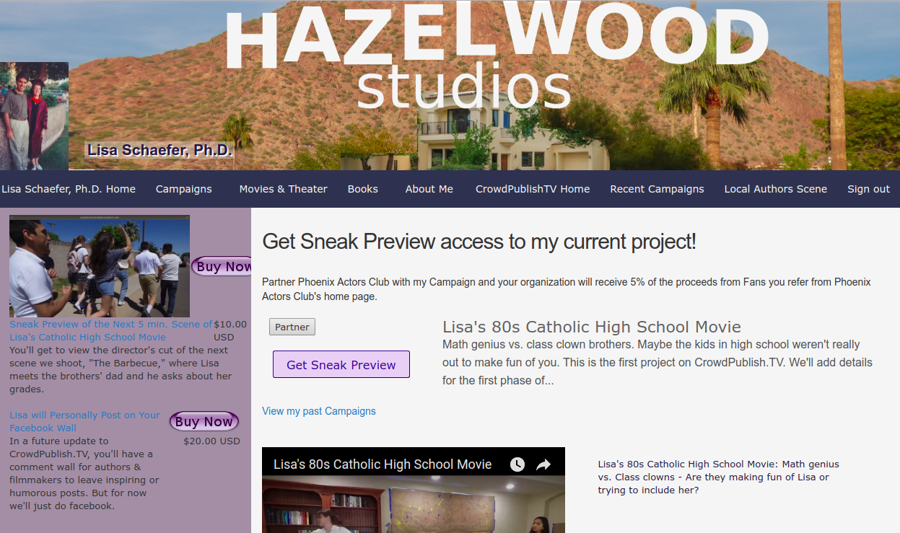
Solution: give actors POWER
Notes:
Really, this is about Power. And $ is power.
On CrowdPublish.TV Actors get their own web page. Here they control their Brand.
It functions like their own website, but if they want to make changes They don’t need to get someone else to do it.
With CrowdPublish.TV actors Earn $ from fans for engaging w/them-no middleperson
Here Actors have the option to Reward organizations for doing the marketing for them

Slide 4
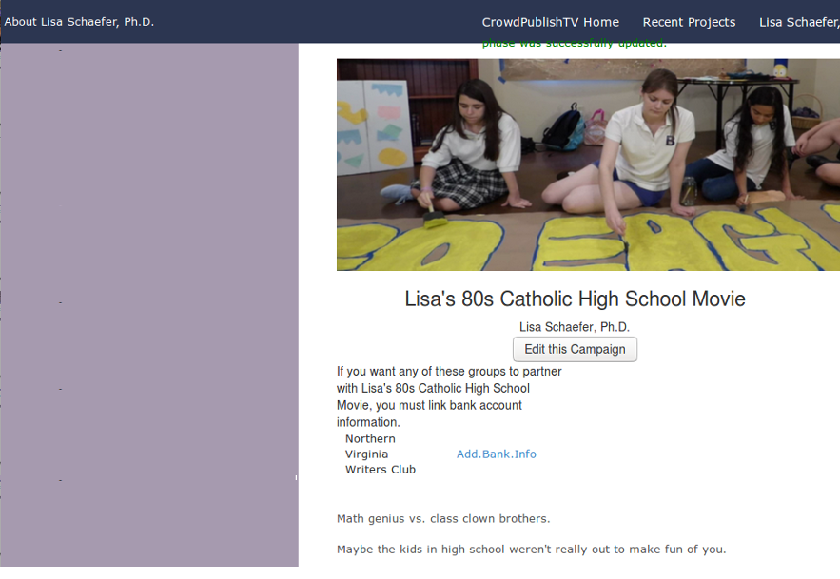

Product – Campaign
Notes:
After creating their CrowdPublish.TV profile, actors
post a campaign. And their campaign gets a page like this one.

Slide 5
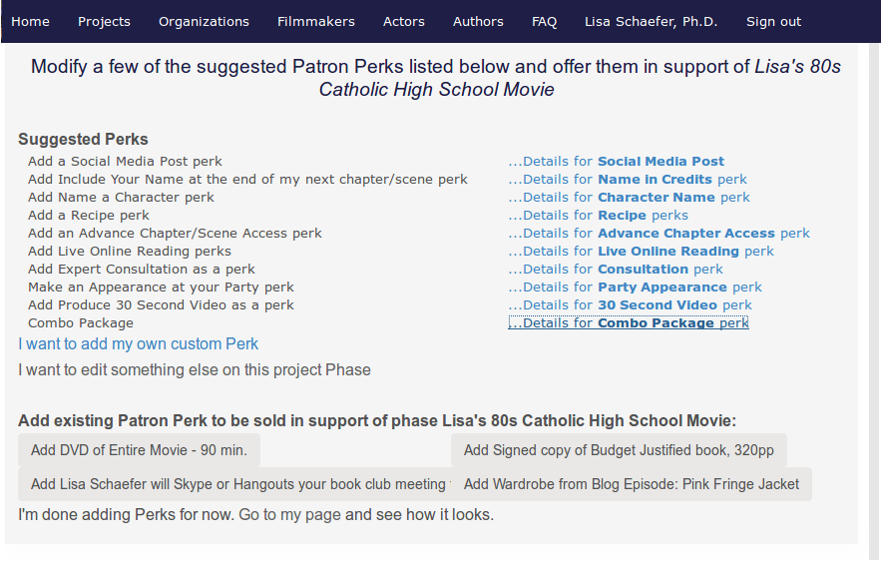
Product – offer perks
Notes:
Then actors create Perks, or semi-tangible merchandise. We provide a list to pick from, such as
News about what happened behind the scenes or
Play a game of 6 Degrees of Bacon on your FB wall or
Skype into your movie night
And a bunch of other fun items to sell. Basically fans pay actors to inform their friends about their brand and engage with them so their friends will also support the actor’s work.
These Perks get posted on the Campaign sidebar. They’re also on the Actor sidebar so fans can easily find what’s being offered.

Slide 6
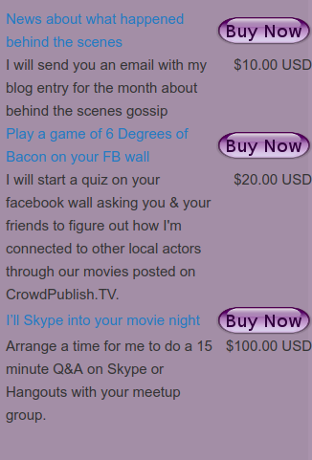
Product – Campaign
Notes:
Let’s say you were cast in Lisa’s 80s Catholic High School Movie. You create a campaign.
And maybe you went to Catholic school. Or maybe you went to a regular school and you want to help them with a fundraiser. You ask the school to Partner with your campaign.
Then the school sends a link to all their alumni. For an incentive to advertise your campaign, they get 5% of all purchases that they refer.

Slide 7
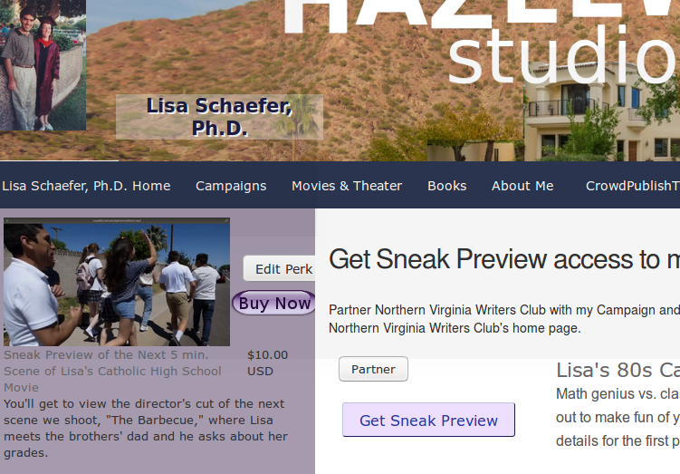
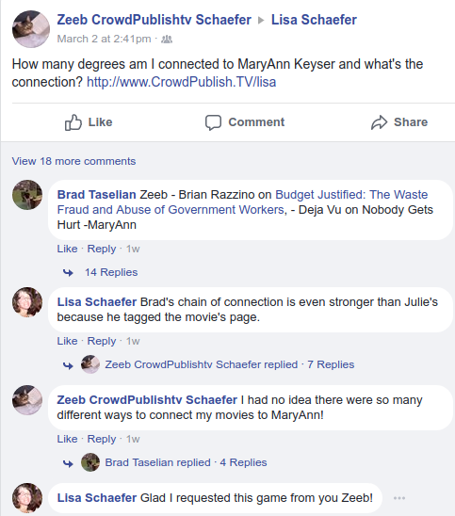
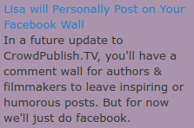
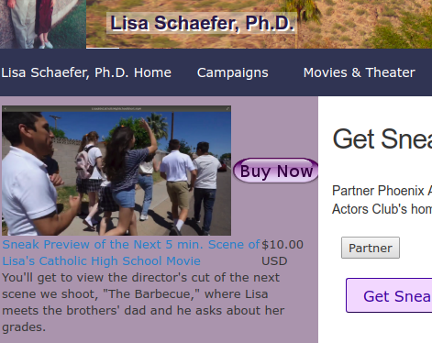
Product – fans purchase
Notes:
P

Slide 8
Market Validation
$51.4 billion
2013
$6 billion
2017
$5.5 billion
2015
Donation & reward crowdfunding
Premium digital content
TV & Movie merchandizing
Notes:
I don’t expect CrowdPublish.TV to usurp the entire market for any of these three markets, however these numbers show that there is a big demand for
Crowdfunding
Premium digital content and
Entertainment merchandising
Kickstarter, indiegogo, patreon have shown that crowdfunding can be successful for filmmakers, though they have no data for actors
However Steve Martin is selling online comedy course
William Shatner sold kidney stone

Slide 9
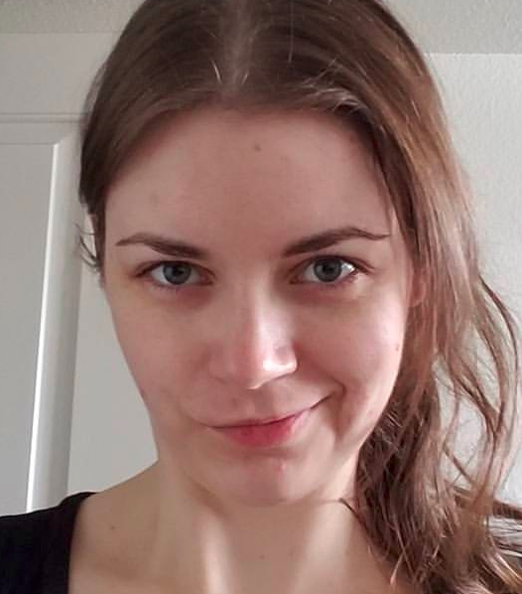
Market - 1st Customer
MaryAnn Keyser
Notes:
MaryAnn is the Lead Actor in the fabulous movie Lisa’s 80s Catholic High School Movie. She has a degree in film from ASU
MaryAnn is in her mid 20’s and has a day job. She’s involved in the local theater scene, so she works with other actors, who know other actors, who know other actors. She has a great work ethic and takes initiative when it comes to helping a movie to happen.
She’s never done a crowdfunding campaign before, so she’s stumbling around a bit while I work with her to find out how she uses CrowdPublish.TV and recruits fans.
Once we get past that, she’ll add her colleagues to the pages for the movies & theater productions she’s been in so her colleagues can run their own campaigns.

Slide 10
Business Model
We take 5% commission from actors’ sales on the site.
Notes:
CrowdPublish.TV gets 5% of all transactions.
We have lots of ideas for premium features in the future, which we’ll roll out one at a time based on user feedback.
A few ideas include:
Being featured in sidebars, home page
Managing email notifications
Analytics
Personal Domain name + redirect
Actors:
Get featured in sidebars, home page
Maintaining fan email notifications
Statistics/analytics
Domain name + redirect
Event rsvps
Premium membership
Fans:
Premium content
Subscriptions to authors
Featured reviews
Membership discounts.

Slide 11



Roadmap
Sharing features
Higher profile users
Quantitative analysis
Qualitative analysis
Blast
Colleagues & organizations
Early
Adopters
Notes:
We’re starting by working with Early Adopters.
Based on what we learn from that process we’re doing a high-level qualitative analysis to find out how to make the site easier to use
Then we’ll get the Early Adopters’ colleagues involved. Once we have more users, we can use data to find out which features are more popular and decide how to enhance those features.
At that point the site will be ready for the wider population of actors and fans, so we’ll announce the site to larger actor and movie fan organizations and meetups.
When we have a base of Little Red Hen users-those who jump on the bandwagon because they want a share of what everyone else is getting -
we’ll implement New features to encourage more sharing and improve user satisfaction. We’ll use that success to attract higher profile actors that have large followings. And by ‘large’ I mean start with D-listers and the staff of C-listers.
Maybe Oprah some day but that’s too far ahead to plan for

Slide 12






Competition

Slide 13

 | Kick starter | Go Fund Me | Indie Gogo | Patreon | Only Fans | Face book
Marketing Assist | creator handbook | campaign tips | list of PR firms, campaign guide | none | none | paid ads, sharing | 5% Referral for actors’ approved organizations
Culture | invention | phil-anthropy | invention & creativity | creativity | porn | conversation | Engage with fans & their friends
Community | tech | general public | artists | artists | actors | friends | Connected Actors & Fans
Product | gadgets | donation | tech, film, equity | art & media | hidden content | donation | Engagement, merchandise
Notes:
CrowdPublish.TV is similar in function to other crowdfunding platforms, but the intended community & culture is different.
With CrowdPublish.TV Fans pay YOU to share your work with their friends
You’re Connected to your acting colleagues via movie pages so your colleagues’ fans can also discover you
The reason I bothered including OnlyFans in this list is that it was mentioned by a Venture Devils colleague. I didn’t look at it in depth because I don’t need to analyze how much of it isn’t porn when all the first items I saw were porn. That’s enough info.\
CrowdPublish.TV is the opposite of porn, the solution to the Harvey Weinstein problem. It’s for fans to engage with actors’ brain, not purchase them as objects. It’s so actors like control access to fans so they don’t ever have to resort to porn. So MaryAnn never has to rely on a Harvey Weinstein. She can rely on her fans and herself.

Slide 14
Summary
Crowdfunding = Power
Fans <3 engagement
Connections
Notes:
With tech enabling more microbusiness transactions, the market is ripe for actors to be supported by their fans.
Crowdfunding is a growing trend and can give actors more power over their brand along with the ability to grow a career not completely dependent on producers or bad influences.
There is demand for content and engagement with actors.
Actors can run crowdfunding campaigns on other platforms, but they would not have the support of the connections to their actor colleagues or organizations.

Slide 15

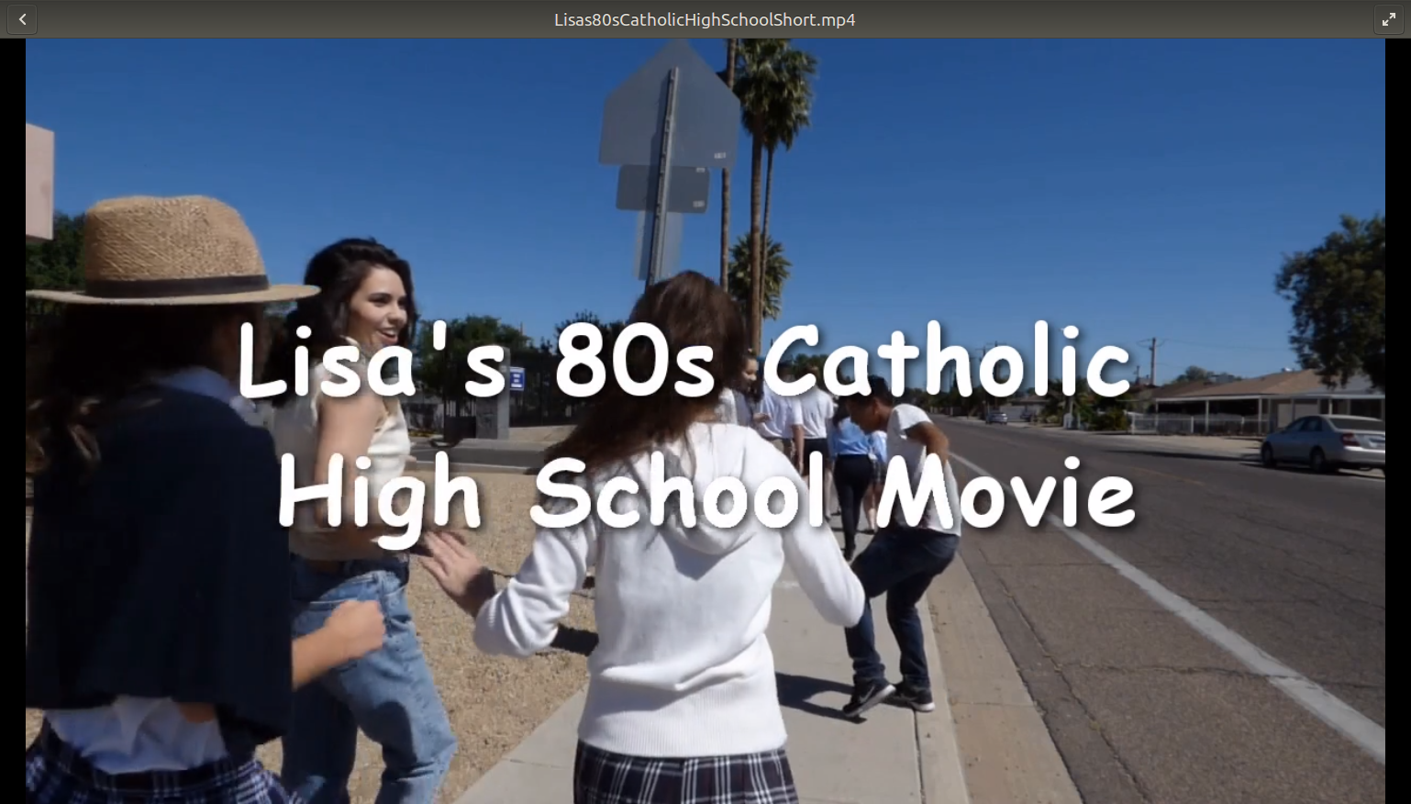

Notes:
I’m Lisa Schaefer, author, filmmaker, founder and software engineer of CrowdPublish.TV.

