Slide 1
PageRank
Ji Suk Kim
Yonghong Liu
Qinghong Zeng
Zhichen Zhang

Slide 2

What is PageRank?
PageRank is an algorithm that ranks the “importance” of a webpage using links
Used for search engines such as Google, Yahoo, etc.
First algorithm used in Google search engines
Notes:
Quantity and quality
NYTimes vs Random blogger

Slide 3

Motivation
To visualize the relations among websites.
To evaluate the importance of a website.
Notes:
So for our project, we have 2 goals: to visualize the relations amongst the websites and to evaluate the importance of a website

Slide 4
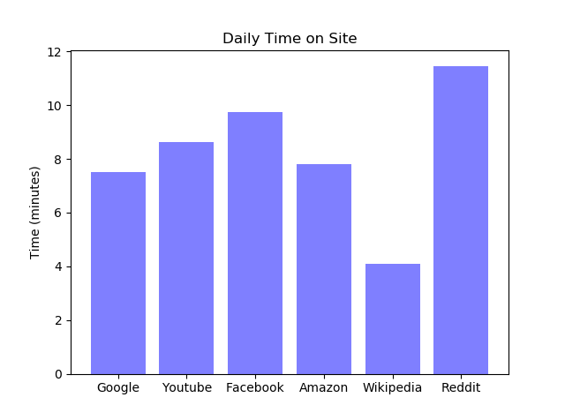
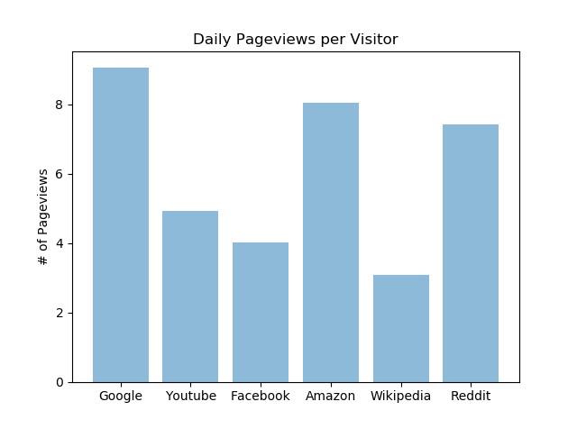
Potential factors that affect page ranking
Notes:
In recent years, many search engines use a variety of factors to determine page ranking, which pagerank still plays an important role in. But we thought it would be interesting to explore some other factors that search engines use to determine page ranking, so we have graphs of the daily time on site and daily pageviews per visitor of the top 6 most popular websites. If these 2 factors were the only factors in play, it looks like Reddit should come out on top in terms of page ranking, but as we’ll see on another chart, reddit is far less often linked to compared ot the likes of youtube and facebook

Slide 5
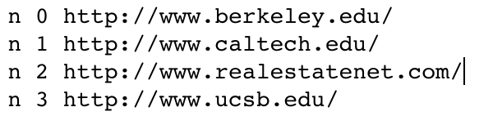

Dataset: Links about California
Contains 9000+ links (.txt)
<n,index,link>
We will analyze domain occurrence on this
16000+ relations of these links (.txt)
<e,index, source_link,target_link>
We will implement Pagerank based on their relations

Slide 6
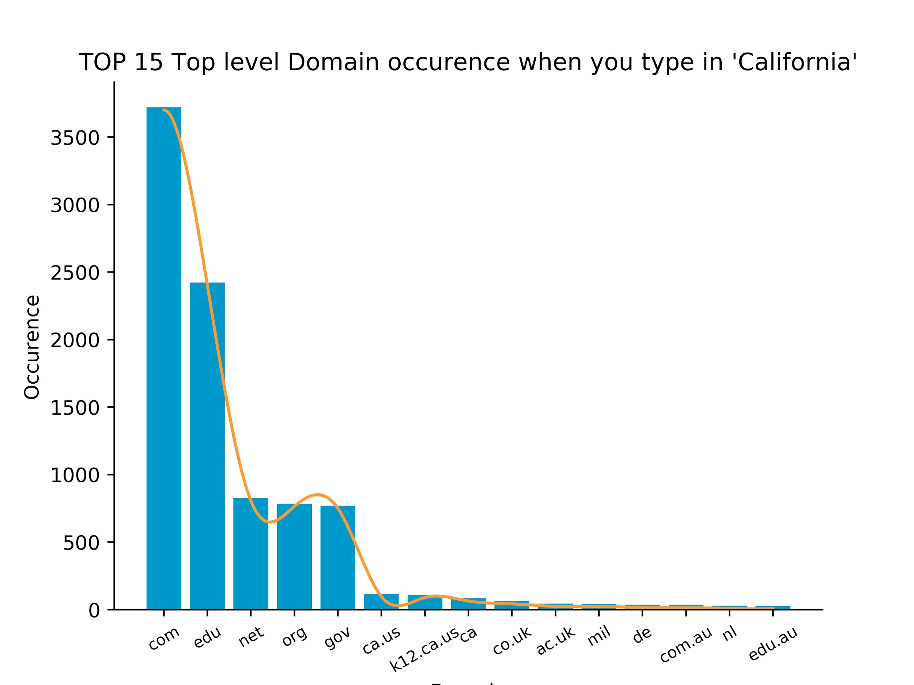
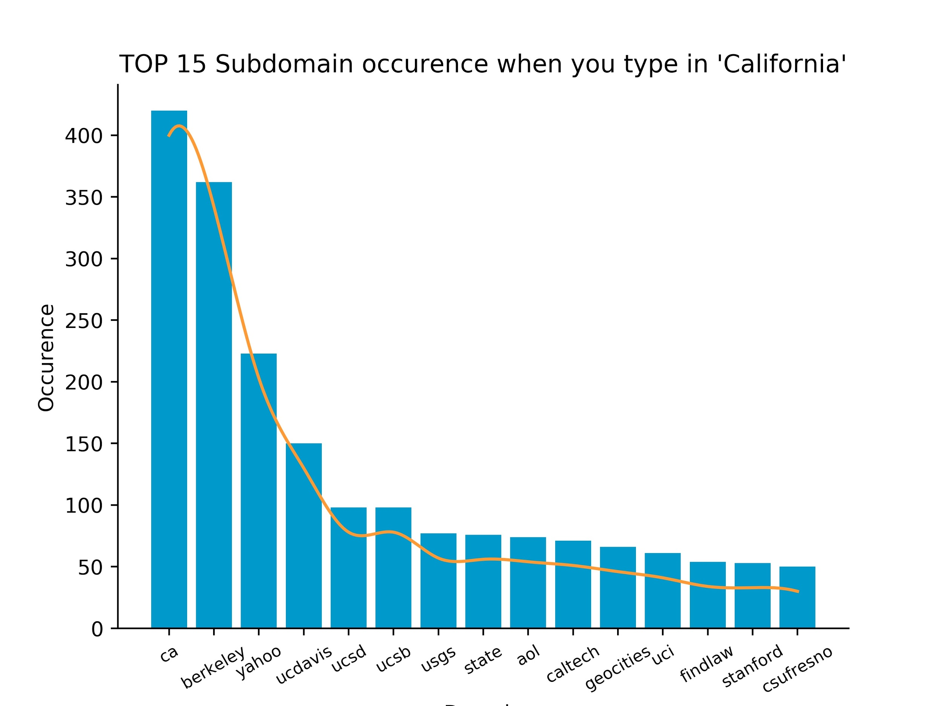
What happens when you search ‘California’

Slide 7
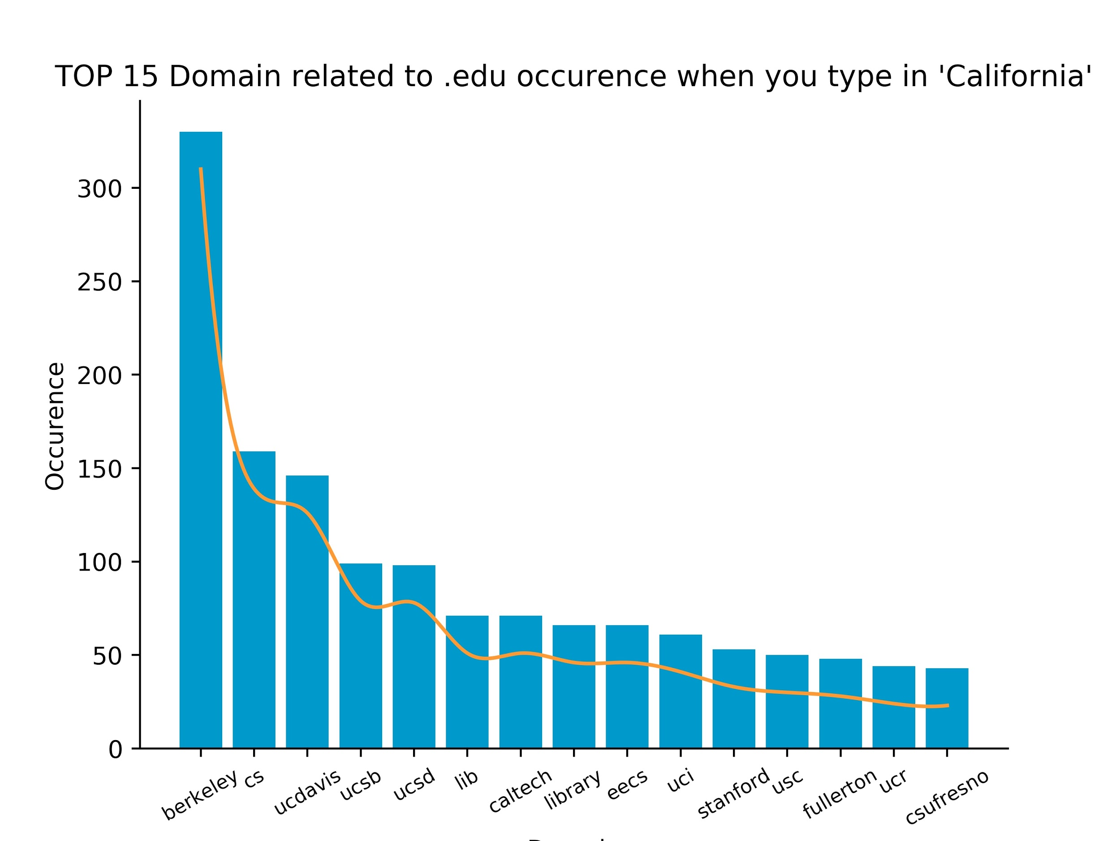
What happens when you search ‘California’ (Cont)
Here I am !
But histogram cannot give us relations among websites.

Slide 8
Furthermore, what if we want to visualize the top 100 instead, or even top 1000? How do we visualize a huge dataset?

Slide 9
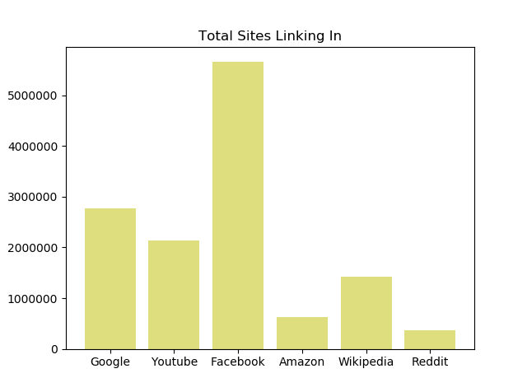
PageRank here to help!
The rank value (dot) indicates an importance of a particular page.
A hyperlink to a page (edges) counts as a vote of support.
Sources → Targets (linking to).

Slide 10
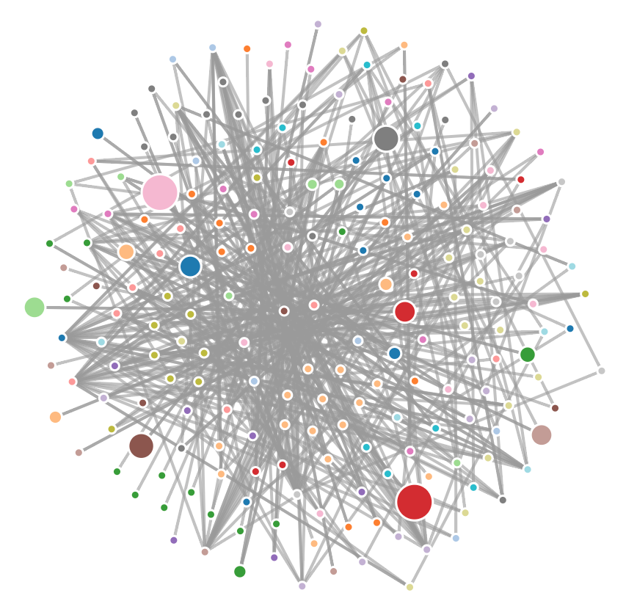
PageRank Visualization with top 200 websites.
One “Big” Website!

Slide 11
Works Cited
https://en.wikipedia.org/wiki/PageRank
https://www.alexa.com/topsites/countries/US
http://www.cs.cornell.edu/courses/cs685/2002fa/data/gr0.California

