Slide 1
Team MoodSwing Lyrical Mood Classification
Akshith Rajkumar, Aravind Narayanan

Slide 2
01
Goal & Motivation

Slide 3
What
Why
How
Aid in understanding the emotional impact of songs on listeners and improve music recommendations
?
Accurately classifying song lyrics into moods (happy, sad, angry, relaxed)

Slide 4
02
Data & Data Processing

Slide 5
MoodyLyricQ Dataset
Curated collection of song titles, associated artist names spanning across various genres.
Individually labeled with emotional tags for every song – Happy, Sad, Angry, and Relaxed. [Each song has a single label.]
The following dataset does not contain song lyrics due to copyright issues.
Mood | Number of Song Lyrics Available
Happy | 500
Relaxed | 423
Sad | 415
Angry | 383
Total | 1721

Slide 6
Obtaining Lyrics
Genius API Integration:
Using the Genius API's search feature for fetching lyrics using a combination of artist’s name and song name.
File Organization:
Retrieved lyrics and metadata are stored in individual .txt, .json files, respectively.
Mood | Total Lyrics Scraped | Subset used for training
Happy | 500 | 45
Relaxed | 423 | 45
Sad | 415 | 45
Angry | 383 | 45
Total | 1721 | 180

Slide 7
Preprocessing
Manually verify 180 samples
Apply stemming and lemmatization
Remove extra lines and metadata
Remove stop words
Create a perfectly class-balanced dataset

Slide 8
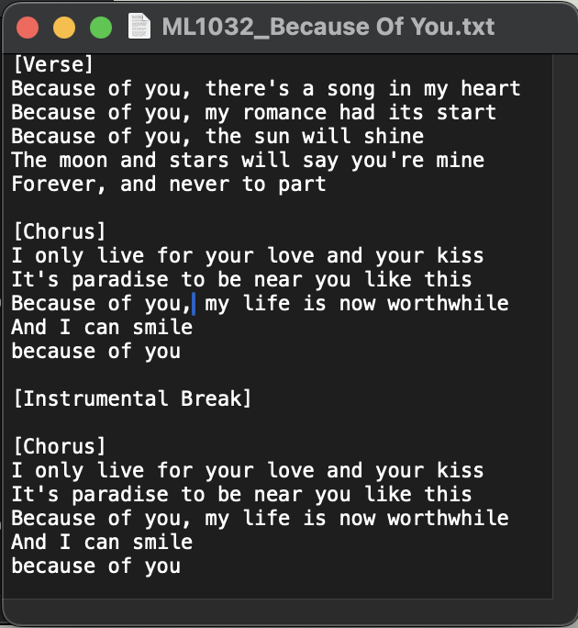
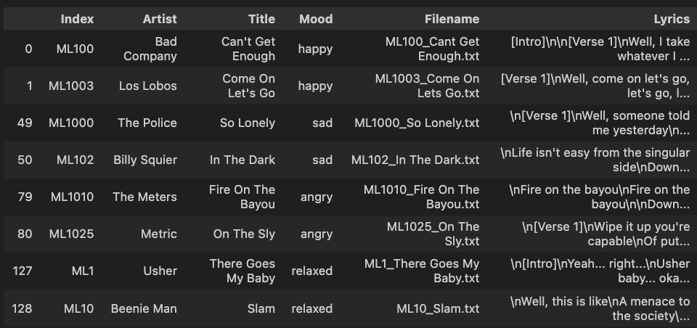
Data Sample
Data frame
Lyrics

Slide 9
03
Models & Software

Slide 10
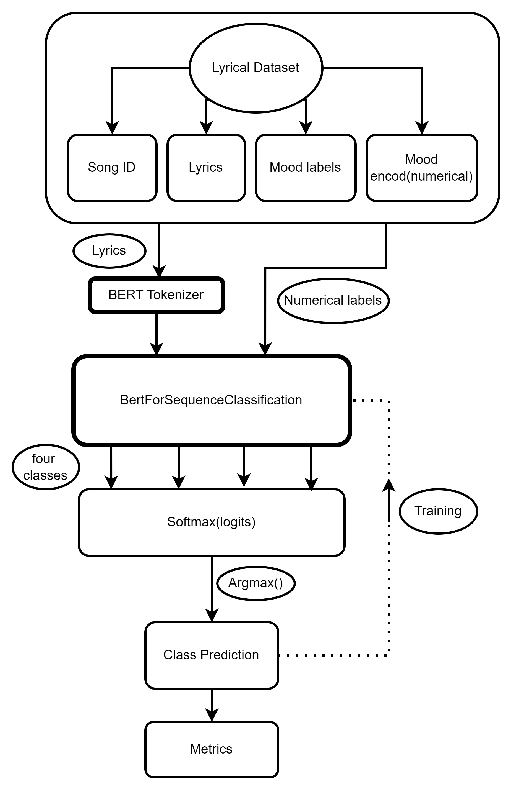
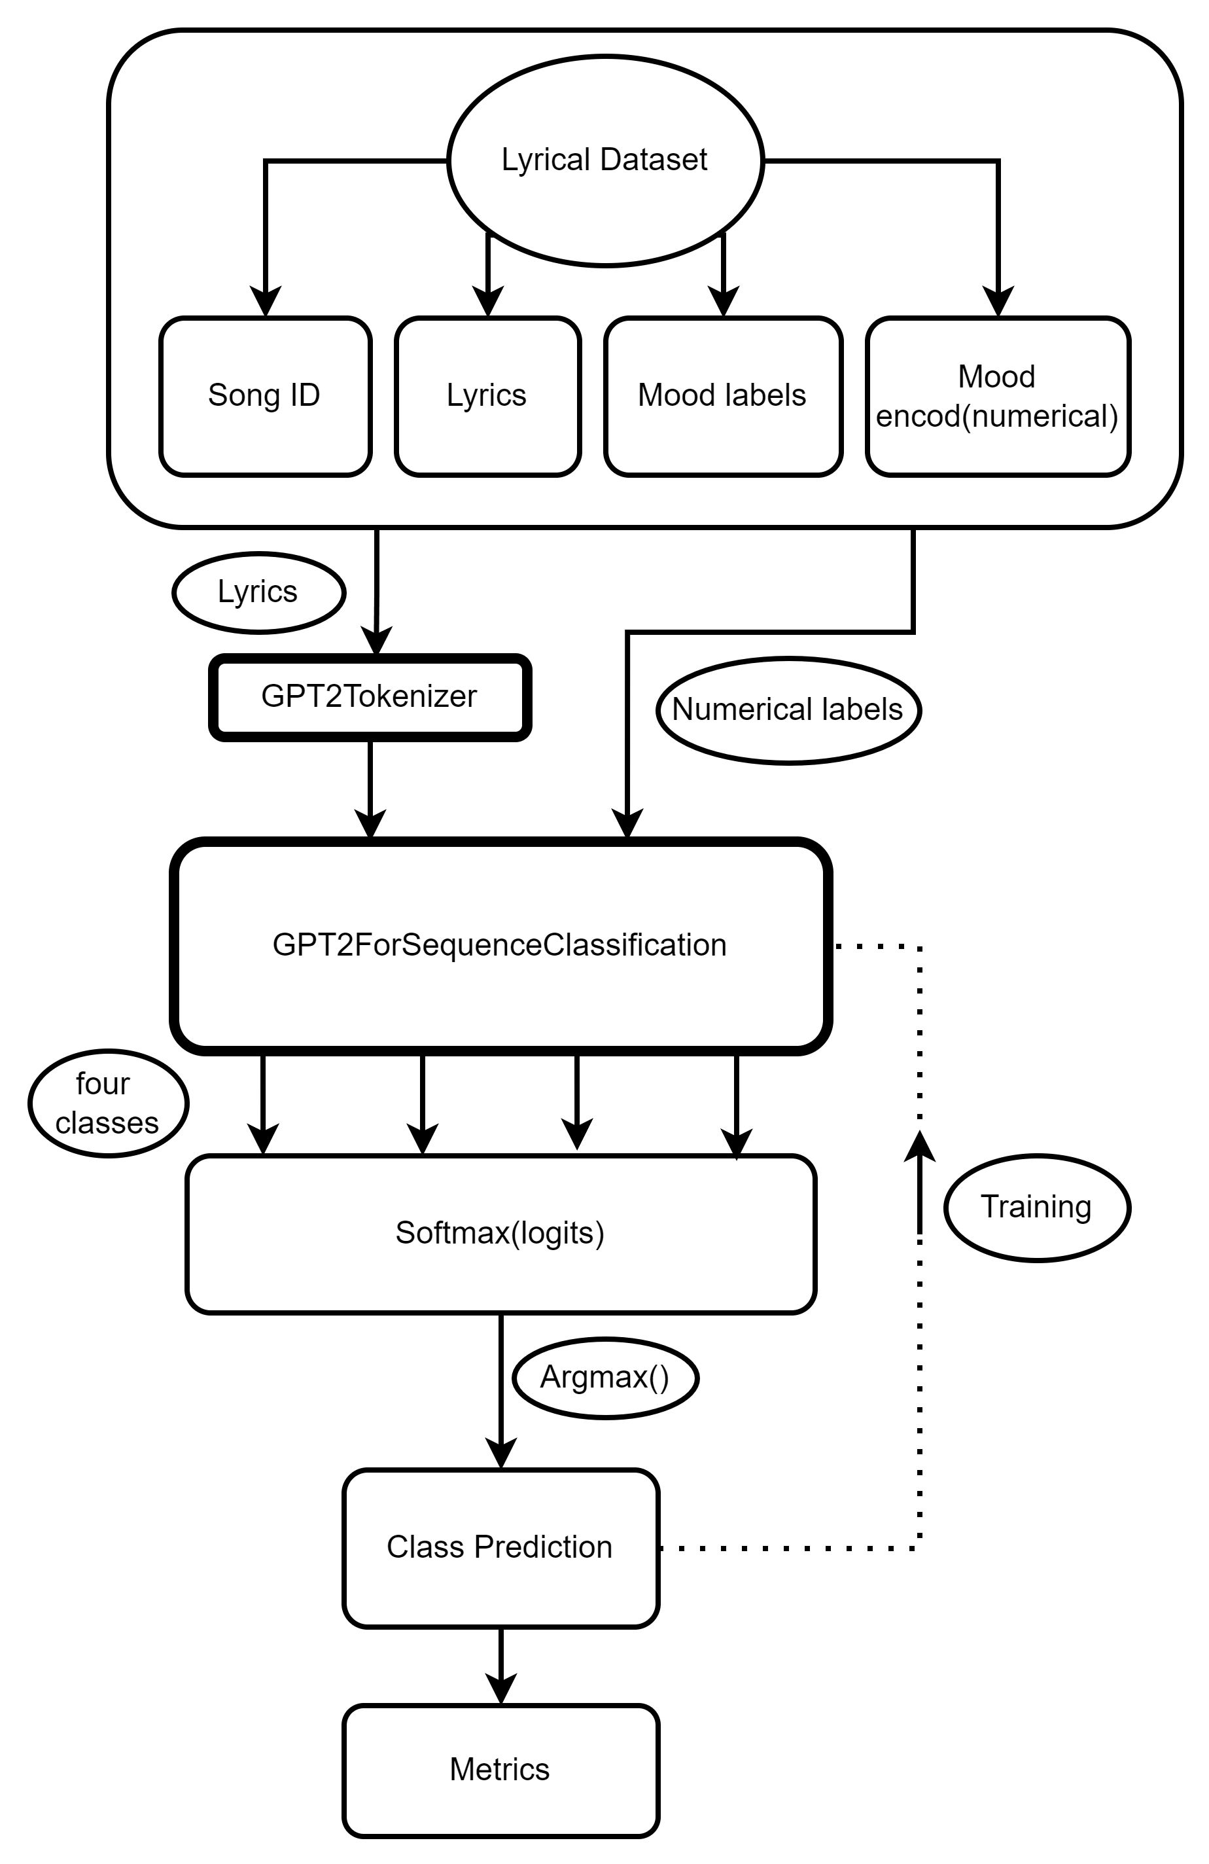

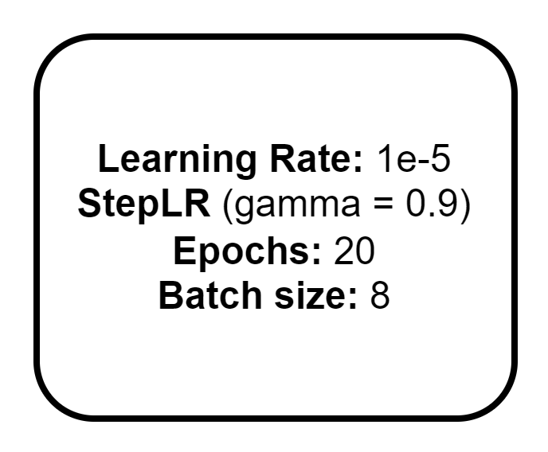


BERT vs GPT2

Slide 11

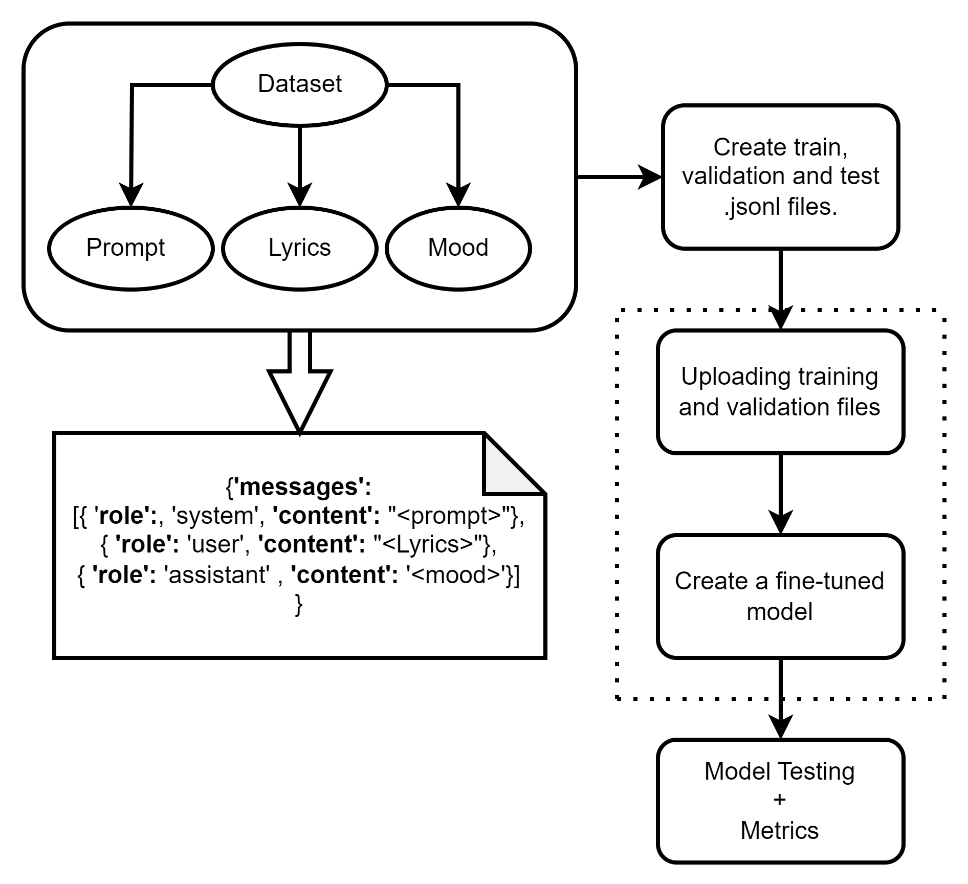

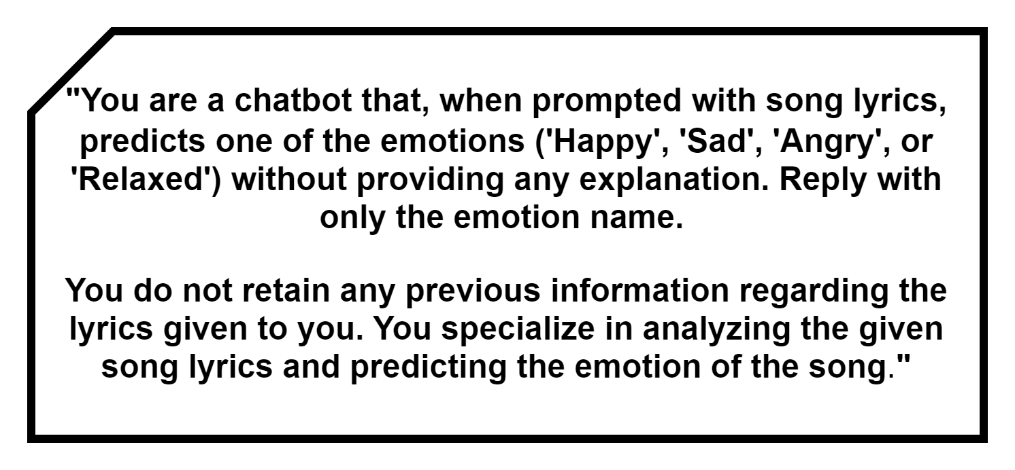

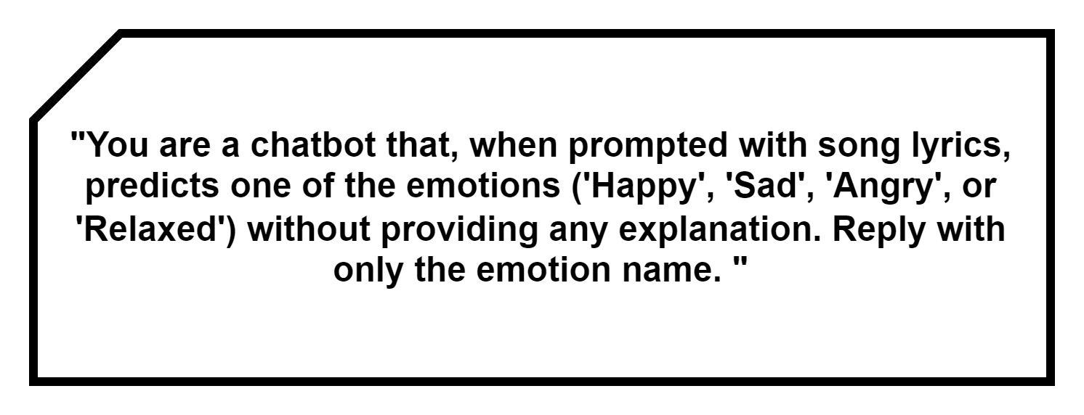
GPT3.5 Model

Slide 12
04
Results

Slide 13
Quantitative Results

Slide 14
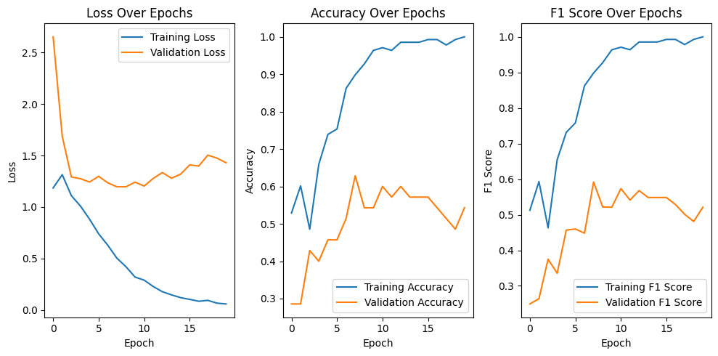
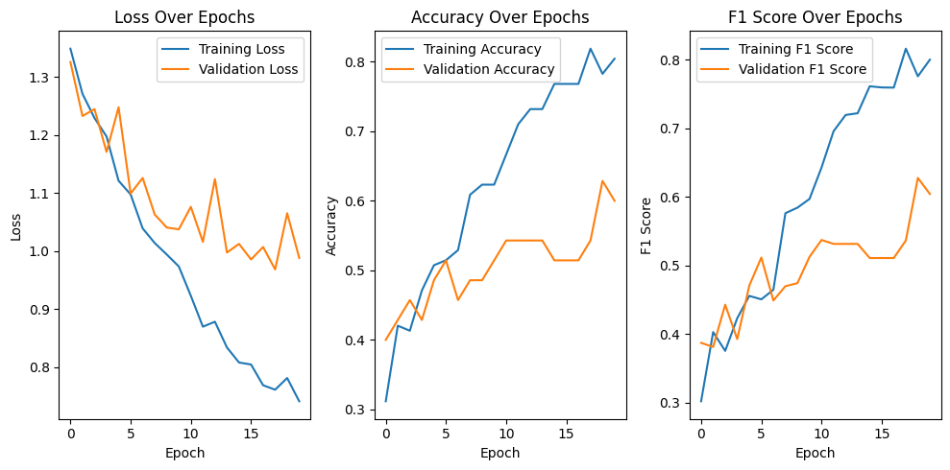
Training & Validation Curves
GPT2
BERT

Slide 15
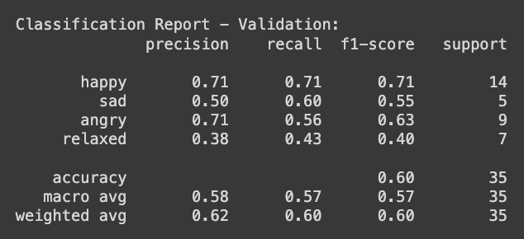
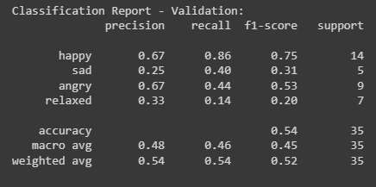
Baseline Model Performance
GPT2
BERT

Slide 16
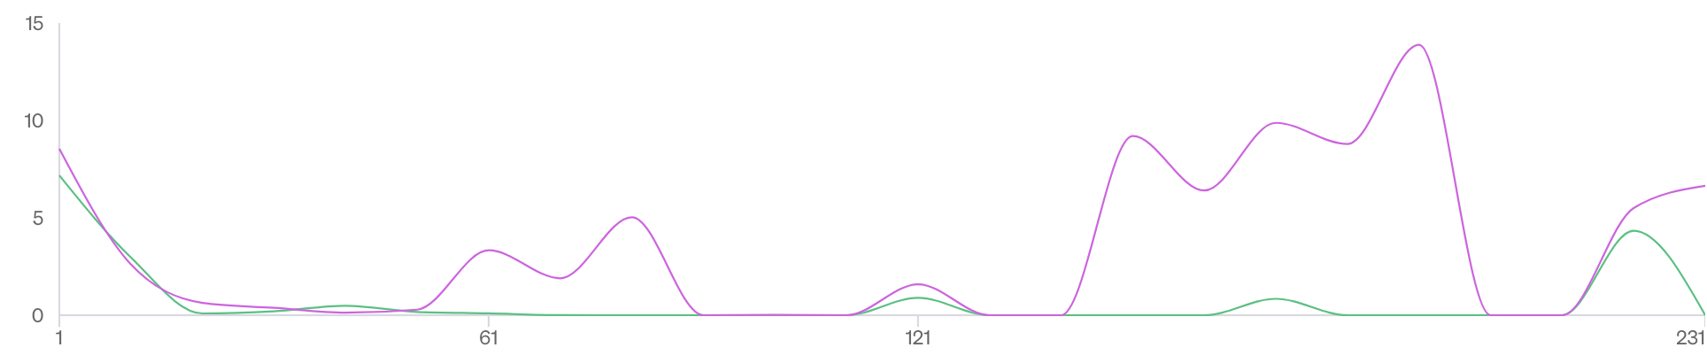
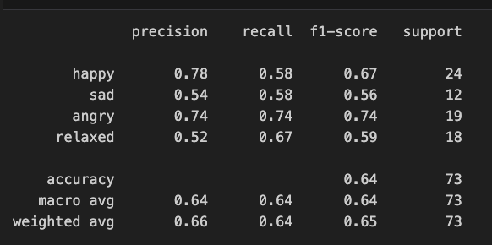
OpenAI GPT3.5 Model Performance
Loss
Steps
Testing Sample of 80 Lyrics: Classification Report
Strong performance in identifying ‘Angry’, ‘Happy’ emotions.
‘Relaxed' show decent precision but lower recall, with occasional misses.
'Sad' faces challenges with lower precision, F1-score, indicating difficulty in classification.
Notes:
Strong performance in identifying 'angry' emotions (high precision, recall, and F1-score).
'Happy' and 'relaxed' show decent precision but lower recall, with occasional misses.
'Sad' faces challenges with lower precision, recall, and F1-score, indicating difficulty in classification.

Slide 17
Qualitative Analysis

Slide 18
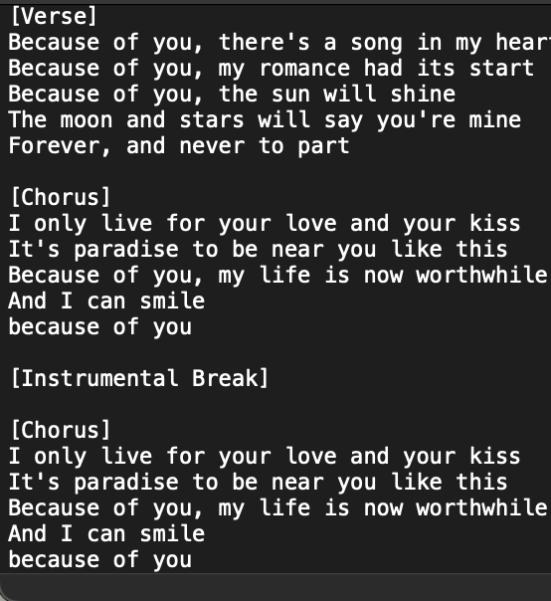
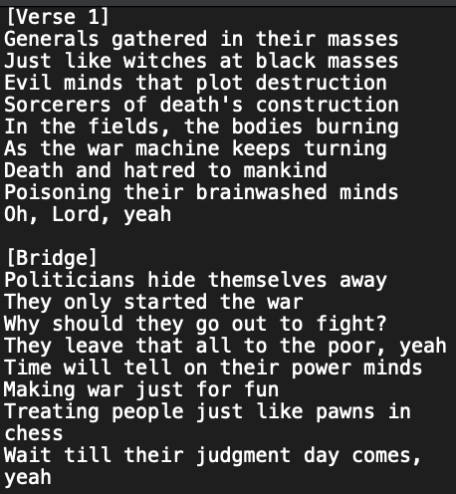
Correct & Misclassified Examples
Actual Label: Happy
Predicted Label: Relaxed
Explanation: The mention of a "song in my heart," "paradise," and the overall soothing tone could contribute to a sense of relaxation
Actual Label: Angry
Predicted Label: Angry
Explanation: The presence of phrases such as "evil minds," "destruction," and expressions of contempt for war elicits feelings of anger.

Slide 19
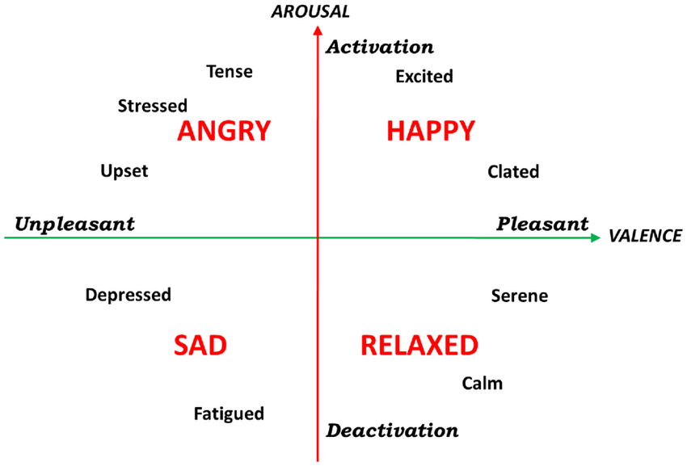
General Trends Observed
Emotion | Highest Misclassified label
Happy | Relaxed
Sad | Angry
Angry | Sad
Relaxed | Happy

Slide 20
05
Discussion and Learnings

Slide 21
Interesting Findings
01
02
03
04
BERT performs better than GPT2- due to its bi-direction context learning
Minimal pre-processing gives better performance of models
Class 'Relaxed' consistently tends to be misclassified as 'Happy'
The model is inclining towards valence more than arousal

Slide 22
Thanks!
Do you have any questions?

