Slide 1

FEBRUARY 2026
Midterm Review
ECE312

Slide 2
Exam Details
This is a WRITTEN exam, so please bring pencils/erasers
The exam is open note/book, but closed laptop/calculator/electronics
There are some multiple choice questions, and some free response questions
Free response questions are mostly about writing code
We will most likely be curving the exam, depending on the overall class performance
A list of C standard library functions that you can use in your free response questions will be provided.

Slide 3
Free Response Tips
Make a quick general plan for your solution, then start writing
As you write, you will think of things to change. Allow yourself space to change your solution as you go.
Think about edge cases!!!
If you can only think of a partial solution, something is better than nothing. Write as much as you can!
We will likely be lenient with some C syntax (e.g., no semicolons after every line, a missing set of brackets) if we can understand what your intent was, but try your best to write compile-able code.
Believe in yourself! You are smarter than you think.

Slide 4
What You Should Study
Pointers (double/triple pointers, pointer arithmetic, etc.)
Strings
Variable Declarations (types, visibility, etc.)
Code Image (stack and heap, how are they different? Where do global/constant variables go?)
Malloc and free (how to use, memory leaks, use-after-free, etc.)
Structs (how to declare/define, how to access elements, struct size, etc.)
Time complexity
Recursion (we will talk about it in class today)
Search algorithms (linear search, binary search)
Sorting algorithms

Slide 5
What You Don’t Have to Study
Linux commands/compiler commands
Git and Github stuff
How to use Valgrind/AddressSanitizer (though you should be familiar with heap usage errors in general, we will not test on how to specifically use these tools or read the output)
Makefile (VERY useful skill, but it won’t be on the midterm)

Slide 6
Review: Free Response
Write code that can keep track of books in a library. Each Book struct should record book title, author, and whether the book is checked out. A Library should contain all Book structs, as well as a total count of all books.
Define the Book struct, and write a function that can create a Book given a title and author. Define the Library struct, and write a function that can add a Book to the Library. Finally, write a function that will sort Books in the Library by author name.

Slide 7
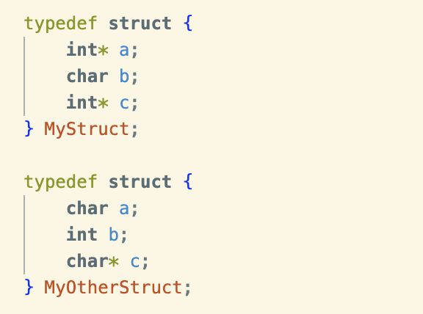
Review: Size of Structs
What is the size of MyStruct? What is the size of MyOtherStruct?

Slide 8
Review: Size of Structs
2 rules for calculating the size of structs:
All elements should land on an address divisible by their size
The entire struct size should be divisible by the size of the biggest element

Slide 9
Review: Size of Structs
char b must have enough space that int* c lands on an address divisible by 8. char b must therefore be 8 bytes, and the total size is 24 bytes
char* c is 8 bytes, so char a and int b must together make a multiple of 8 bytes. int b is 4 bytes, so char a must be a multiple of 4 bytes. Therefore, char a is 4 bytes, int b is 4 bytes, and char* c is 8 bytes. Total size is 16 bytes

Slide 10
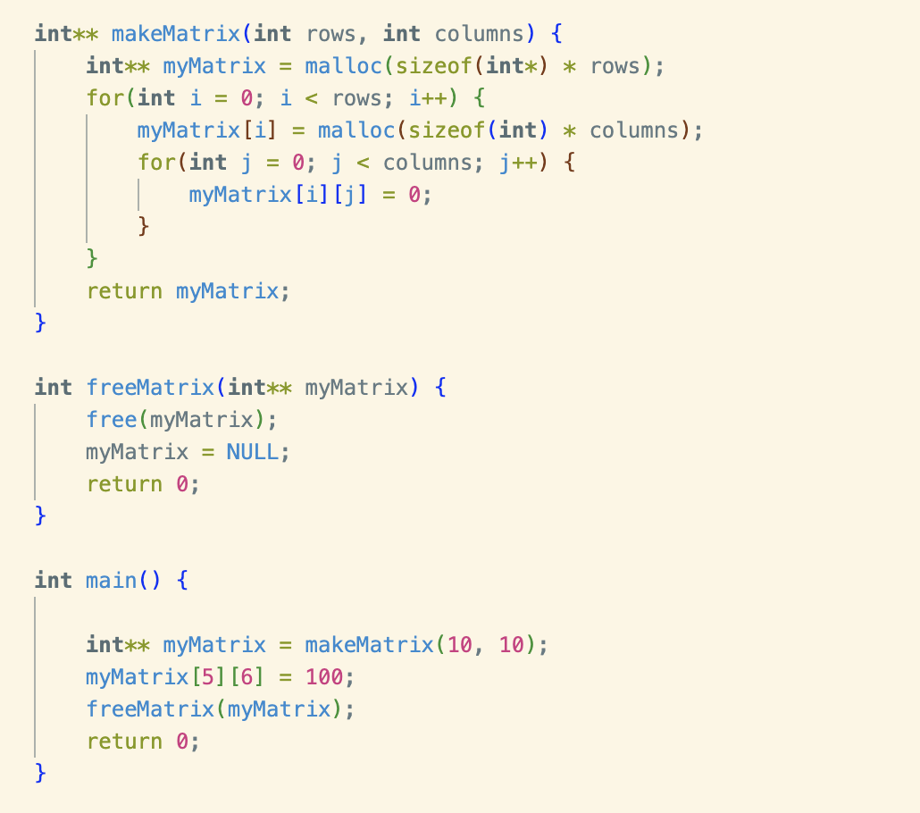
Review: Malloc and Free
What is wrong with the following code? Is anything wrong?

Slide 11
Review: Malloc and Free
Our free() function only frees the top-most malloc in the matrix. All of the malloc’ed arrays inside the loop are now leaked memory because we never freed them.

Slide 12
Review: Stack and Heap
How are the stack and heap different?

Slide 13
Review: Stack and Heap
Stack:
Memory is contiguous
Memory cannot be un-assigned/reused
Addresses DECREASE as stack size increases

Slide 14
Review: Stack and Heap
Heap:
Memory addresses of elements are determined by the allocator and are not necessarily related in any way
Memory must be explicitly allocated by the programmer using malloc()
Memory CAN be un-assigned/reused if free() or realloc() is called
Addresses HAVE NO PREDETERMINED PATTERN as heap size increases.

Slide 15
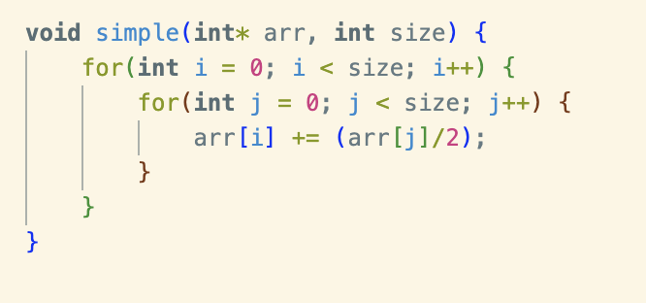
Review: Time Complexity
What is the time complexity of the code?

Slide 16
Review: Time Complexity
The outer loop iterates through the entire array. The inner loop also iterates through the entire array. Therefore, this time complexity is O(n^2)

Slide 17
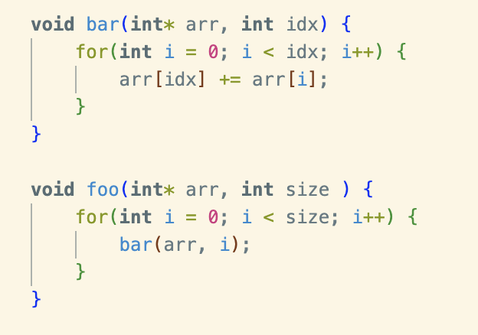
Review: Time Complexity
What is the time complexity of the code?

Slide 18
Review: Time Complexity
The loop in foo() iterates size times. It calls bar() each time, passing the current index i. Inside bar(), the loop iterates ”idx” times.
The total number of times “arr[idx] += arr[i]” is run is 0 + 1 +…+ (size-2) times, or 1 + (size * size/2) times. Therefore, the complexity is O(n^2) (or O(n^2/2+1) if you want to be precise

